Slide 1
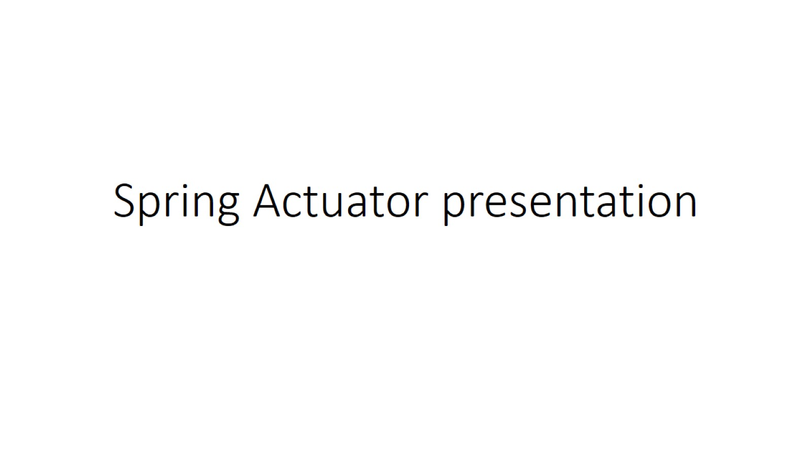
Spring Actuator presentation

Slide 2
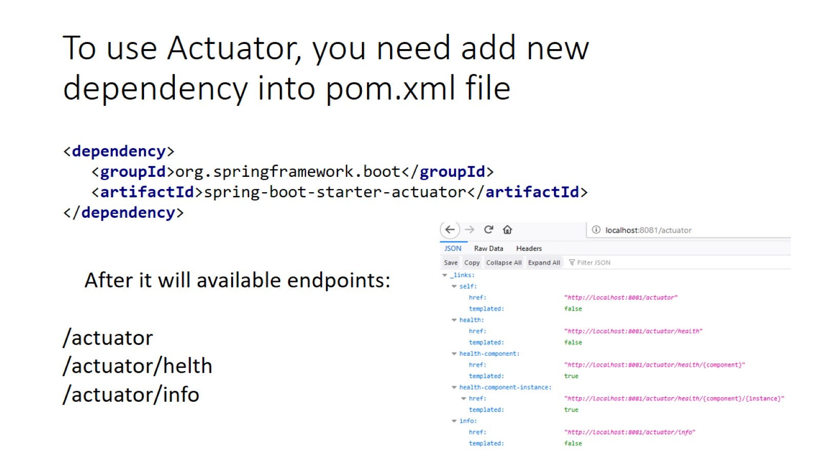
To use Actuator, you need add new dependency into pom.xml file

Slide 3
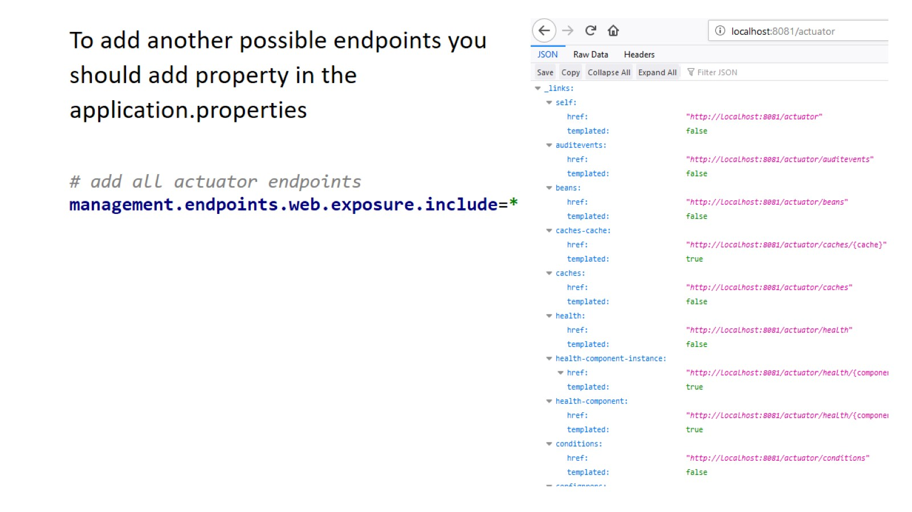

Slide 4
