Slide 1

RINGATLAN

Slide 2
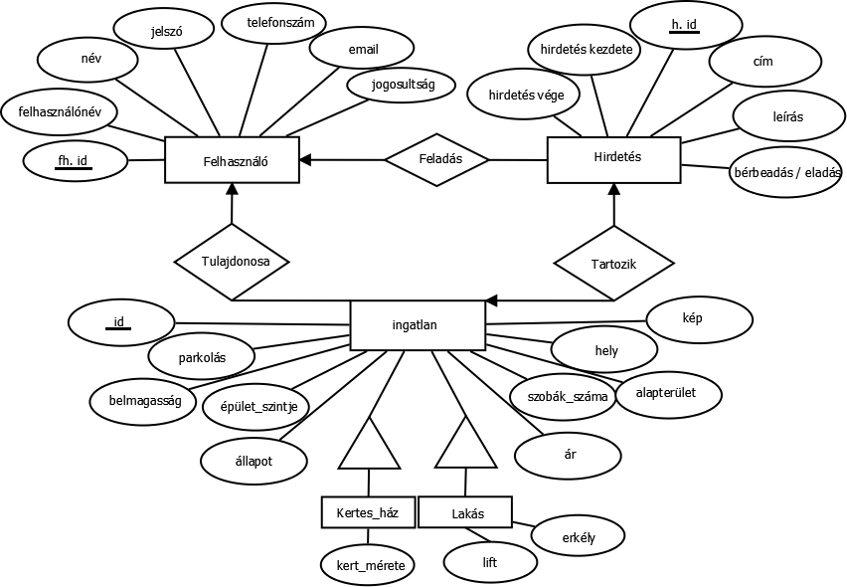
E-K Diagram

Slide 3
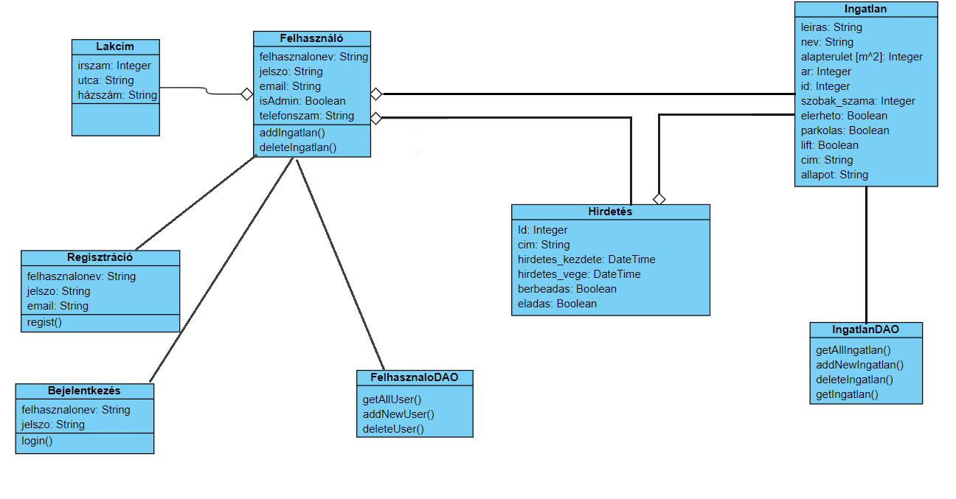
Class Diagram

Slide 4
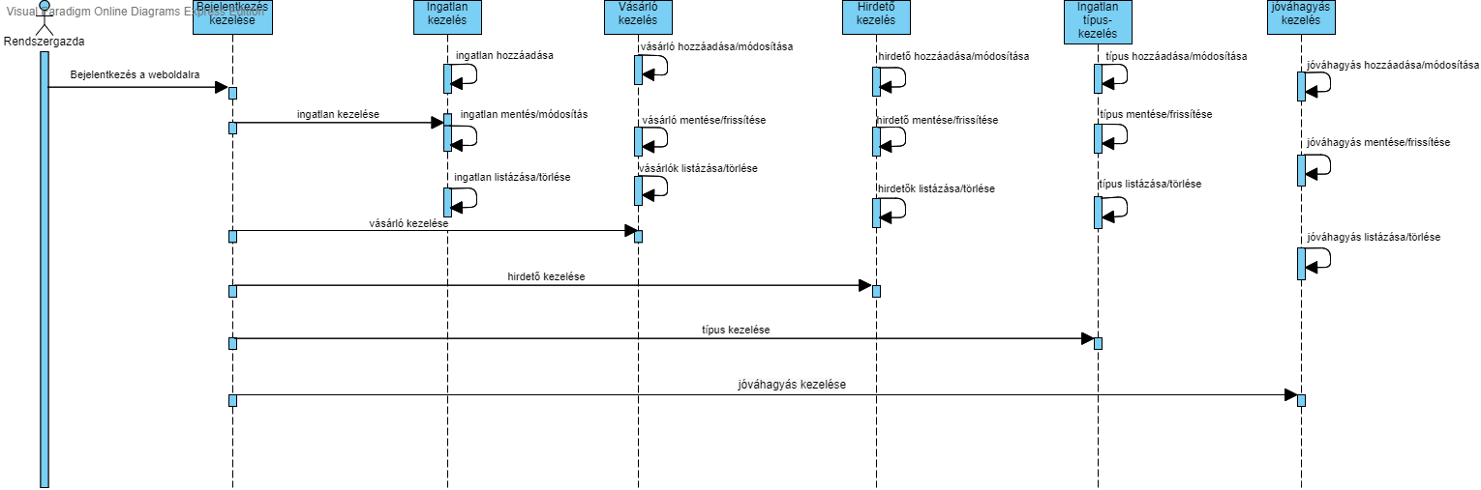
Sequence Diagram

Slide 5
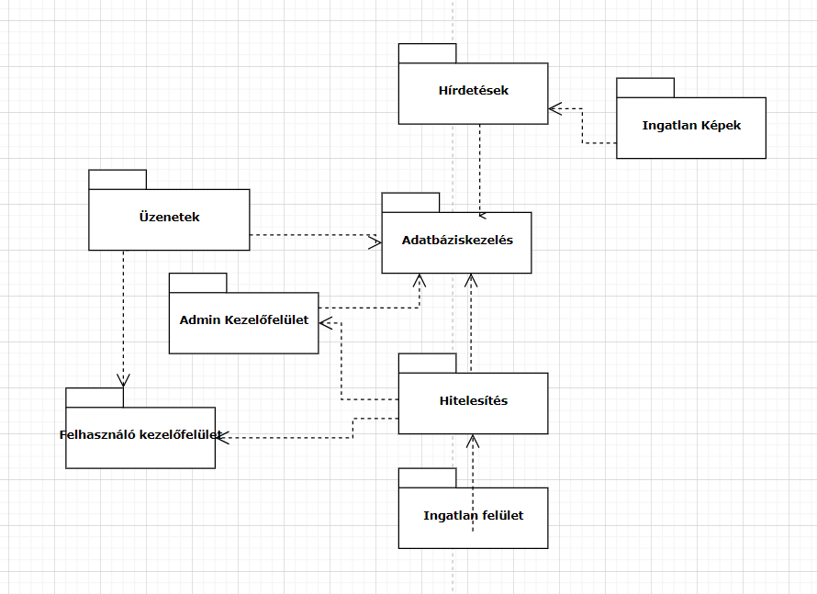
Package Diagram

Slide 6
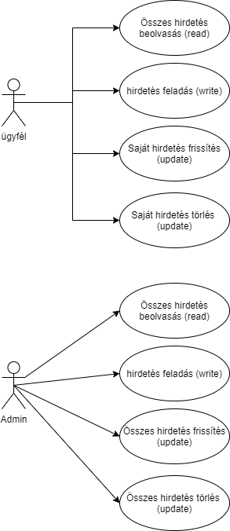
UseCAse Diagram

