Slide 1
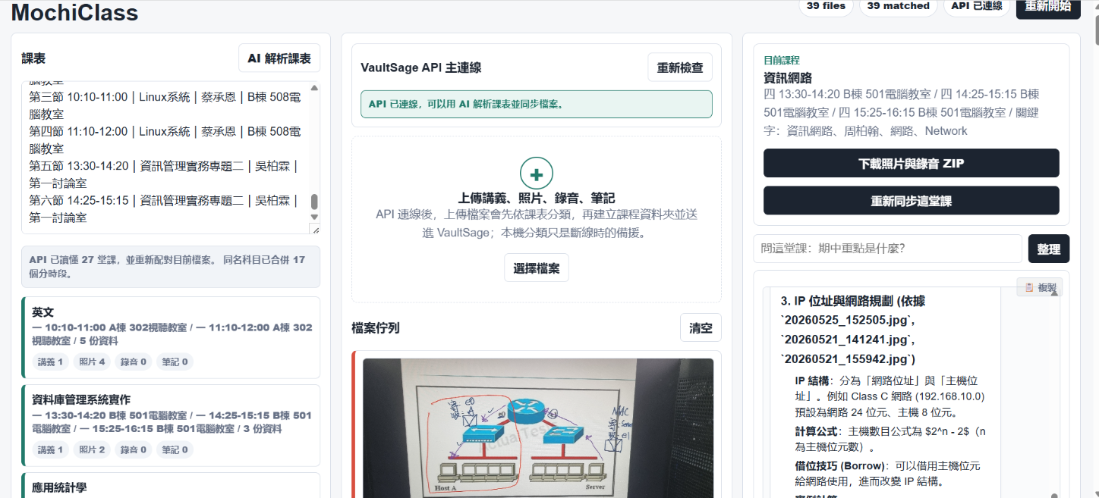
MochiClass
Schedule-driven intelligent class file manager
Turn scattered lecture photos, PDFs, recordings, and timetable text into course-based study context with VaultSage API.
API-first
Privacy-aware
AI timetable parsing + Q&A
Local browser storage first
Live demo: https://vm0u832-mochiclass.hf.space/
MochiClass | VaultSage API Submission
01

Slide 2
PROBLEM
Students collect everything, but context disappears.
A normal week produces many files, but most tools organize by filename, not by class moment.
Lecture photos
Handouts
Recordings
Whiteboards and slides are captured quickly, often with random camera names.
PDFs are useful, but disconnected from the actual class session.
Audio contains context, but is hard to search during review.
The missing layer is not another notebook. It is course-aware file management.
MochiClass | VaultSage API Submission
02

Slide 3
SOLUTION
MochiClass uses the timetable as the organizing interface.
Users type or paste a timetable, upload real files, then click a course to see the related material.
1
Parse timetable
2
Upload files
3
Match by context
4
Ask & export
VaultSage API reads messy text and structures courses.
PDF, images, audio, and notes enter a processing queue.
Time, OCR, transcript, and keywords map files to courses.
Course Q&A and one-click ZIP download.
MochiClass | VaultSage API Submission
03

Slide 4
VAULTSAGE API
The API is the intelligence layer, not just a chat box.
MochiClass uses VaultSage for AI parsing, file sync, retrieval-grounded Q&A, and course-aware answers.
Browser app
MochiClass backend
VaultSage API
Course answer
Timetable, uploads, local state
API key, OCR, speech fallback
Directories, files, chat, retrieval
Grounded summary by class
Timetable parsing: unstructured text → structured course sessions
Course Q&A: OCR/transcripts + VaultSage retrieval context
MochiClass | VaultSage API Submission
04

Slide 5
PRODUCT PROOF
The interface is built around a student’s real workflow.
A course click reveals related handouts, photos, recordings, and an answer box above the fold.
Course-first navigation
Timetable as file manager.
Visible progress
Progress and counts by course.
Exportable evidence
Course media ZIP export.
MochiClass | VaultSage API Submission
05

Slide 6
DEMO FLOW
A judge can test it in under three minutes.
The demo uses real files, not filename tricks, and supports Chinese / English / Korean UI labels.
01
Paste timetable
AI Parse converts schedule text into course blocks.
02
Upload files
Lecture PDFs, photos, recordings enter the queue.
03
Watch matching
OCR/transcripts and timestamps assign files to courses.
04
Ask a question
VaultSage API answers with course-specific context.
05
Download ZIP
Course media can be exported for submission or review.
MochiClass | VaultSage API Submission
06

Slide 7
DIFFERENTIATION
MochiClass focuses on file management before note generation.
It complements AI notebooks by solving the messy input layer: what belongs to which class?
Capability
Generic AI notebook
MochiClass
Input model
Upload documents
Timetable + documents + photos + recordings
Organization
Notebook folders
Automatic course matching by class session
Student workflow
Ask about a corpus
Click a class, then ask about that class
Output
Generated notes
Course file hub, Q&A, preview, ZIP export
MochiClass | VaultSage API Submission
07

Slide 8
PRIVACY & DEPLOYMENT
The default state lives in the user’s browser.
Course data is not centralized in a custom database; API calls happen when AI features need context.
localStorage
IndexedDB
VaultSage API
Timetable, course selection, match state, chat history, language setting.
Uploaded file blobs such as photos, PDFs, and recordings remain in the browser.
Used for AI parsing, file sync, retrieval, and answer generation.
Deployment target: Hugging Face Spaces with backend environment variable for the API key.
MochiClass | VaultSage API Submission
08

Slide 9
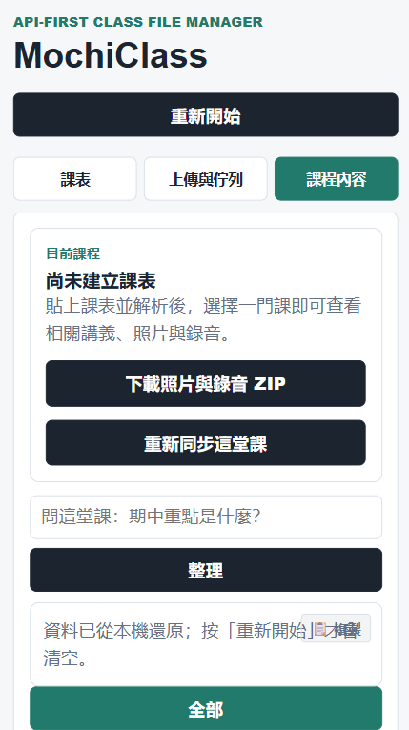
ROADMAP
The prototype is already usable; the next step is reliability at scale.
The current build supports responsive layout, sample files, OCR, audio summaries, and API-grounded Q&A.
Near term
Clearer processing states, stronger OCR queue feedback, and safer cache reset.
Middle term
Better multilingual OCR tuning and per-course search filters.
Long term
Shared class spaces, exportable study packets, and teacher-provided course packs.
MochiClass | VaultSage API Submission
09

Slide 10
MochiClass
A timetable-driven AI file manager for student class materials.
Why it matters
Makes messy student files searchable by course context.
Test URL
https://vm0u832-mochiclass.hf.space/
Uses VaultSage API for timetable understanding and grounded Q&A.
Keeps the main state in the browser for privacy-aware testing.
GitHub: add repository link in the submission form
10

