Slide 1
Next Hikes IT Solutions
Vincy Mehta
User Analytics in the Telecommunication Industry

Slide 2
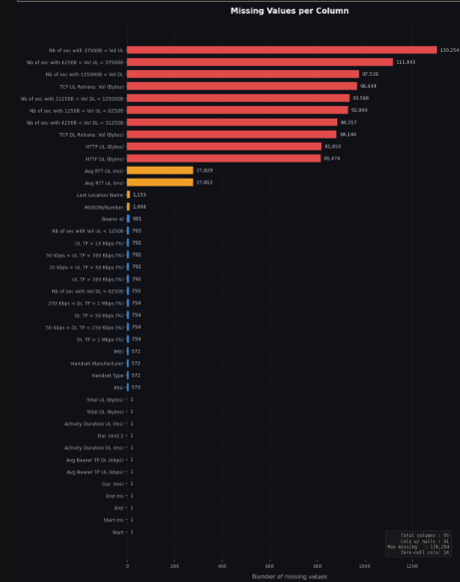
Here are the key insights from the chart, which shows how much data is missing in your dataset
The biggest issue is with network volume and speed metrics: The top red bars show that columns related to upload/download volumes (like Nb of sec with 37500B < Vol UL) and TCP/HTTP data have the highest amount of missing information, peaking at over 130,000 missing values.
Network delay metrics are moderately missing: The two yellow bars (Avg RTT DL and Avg RTT UL) are both missing around 27,000 values.
User and device identifiers are mostly intact: Columns like MSISDN/Number, Bearer Id, Handset Manufacturer, and IMSI (shown in blue) are missing very little data (mostly under 1,500 values).
Basic connection data is nearly perfect: The bottom columns (like Start, End, and Total UL/DL (Bytes)) are only missing 1 value each, meaning this foundational data is almost fully complete.

Slide 3
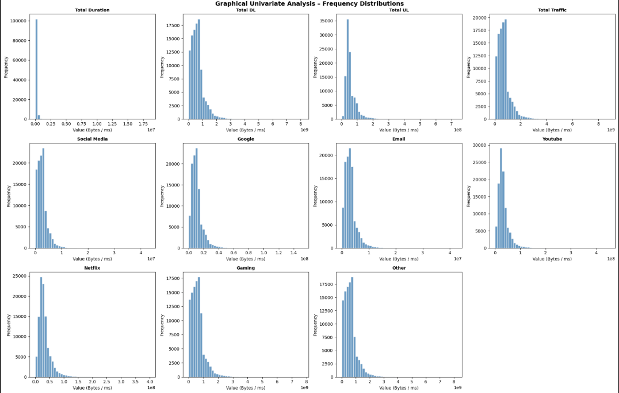
Insights
Content consumption is dominated by media-heavy apps. The data traffic scale for Netflix and Gaming is multi-fold higher than Email or Social Media.
Apps like Social Media and Google have a massive frequency (very tall bars on the left), meaning users open them constantly throughout the day, but they don't consume huge amounts of bytes per session.
The extremely sharp spike in Total Duration near zero proves that your network experiences millions of micro-transactions—users checking notifications for just a few seconds and disconnecting.
Ensure your network switchboards can handle millions of simultaneous connection requests without dropping signal, rather than worrying about long-lasting continuous sessions.

Slide 4
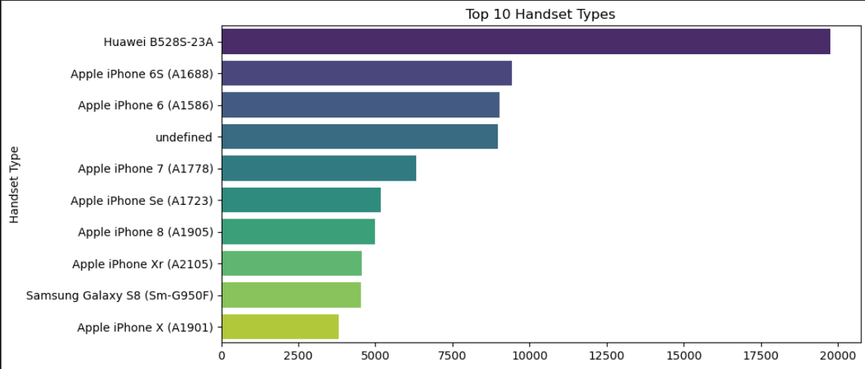
Insights
The 1 device by a huge margin is the Huawei B528S-23A, which is actually a 4G home router/gateway, not a smartphone.
This shows that a significant portion of your high-volume users are using fixed wireless internet for their homes or offices rather than just mobile data on the go. You should design specific "Home Wi-Fi" unlimited data plans to target this massive segment.
Looking at smartphones alone, Apple absolutely dominates your network. Out of the top 10 positions, 7 belong to various iPhone models (iPhone 6S, 6, 7, SE, 8, XR, X).
Your user base has a high concentration of premium, tech-savvy, or affluent users. You can partner with premium brands for marketing, and prioritize making sure your mobile app and network configurations are perfectly optimized for iOS devices.
Interestingly, older models like the iPhone 6S and iPhone 6 are much higher on the list than newer ones like the iPhone X or XR.

Slide 5
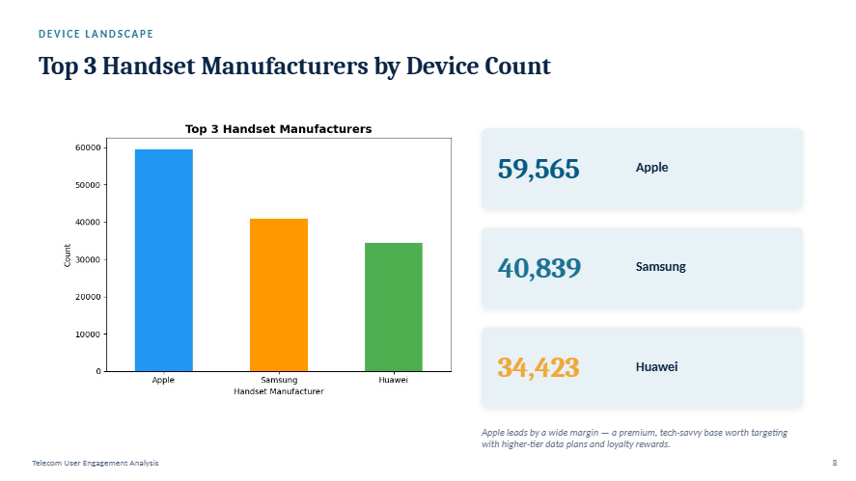

Slide 6
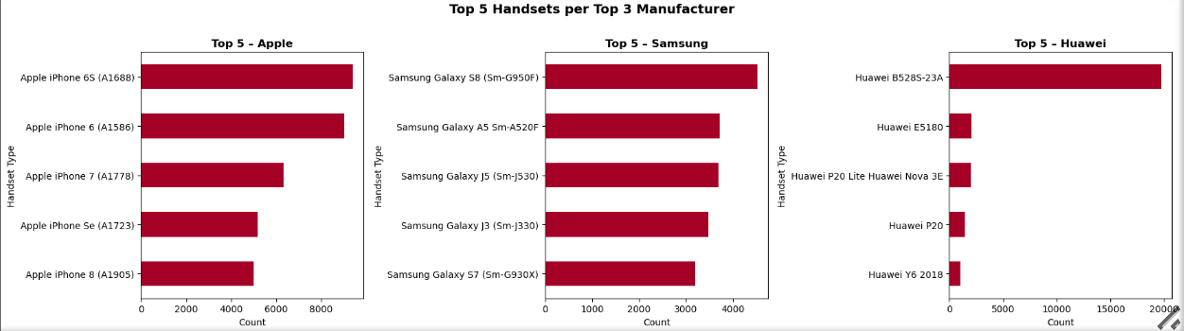
Insights
For both Apple and Samsung, the top charts are heavily populated by older legacy devices (iPhone 6S, iPhone 6, Samsung Galaxy S8, Galaxy S7, Galaxy A5).
the Huawei chart is overwhelmingly dominated by a single device—the Huawei B528S-23A (a home Wi-Fi router)—while its smartphones (like the P20 and Y6) have tiny counts. In contrast, Apple and Samsung have a very healthy, evenly distributed spread across multiple smartphone models (like iPhone 6S/6 and Galaxy S8/A5).

Slide 7
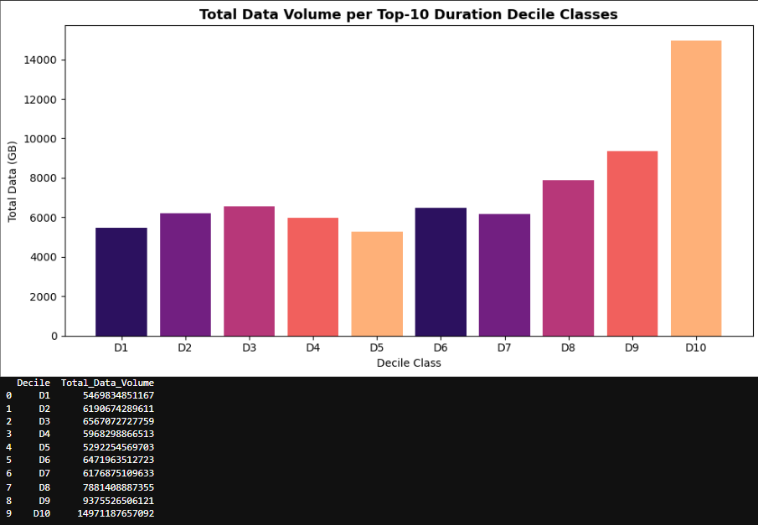
Insights
Decile Class D10 (the top 10% of users who stay connected the longest) consumes an astronomical amount of data—nearly 15,000 GB. This is more than double the consumption of most individual lower deciles (D1 to D7).
These are your most valuable power-users—likely watching continuous video streaming, downloading massive files, or gaming for hours. You must introduce specialized premium "unlimited duration/data" loyalty tiers to prevent this high-revenue cohort from churning to competitors.
Even the users who spend the least amount of time on the network (D1) still consume a very significant baseline volume of data (around 5,400 GB). From D1 to D7, data volume remains relatively stable between 5,000 GB and 6,500 GB.
There is a distinct "hockey-stick" growth curve starting from D8 (around 7,800 GB) which jumps up sharply through D9 (around 9,300 GB) and peaks drastically at D10.

Slide 8
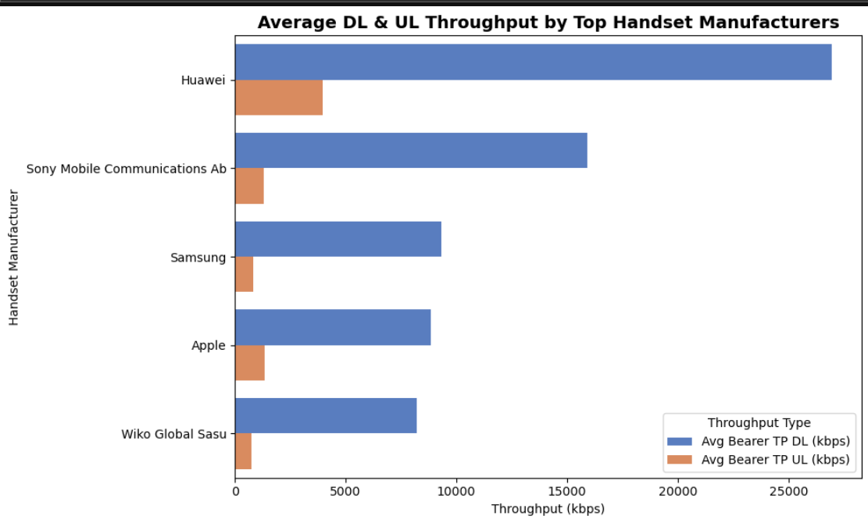
Insights
Huawei dominates network performance: Huawei devices deliver significantly faster internet speeds than any other manufacturer on the list. Its average download speed (DL) is roughly three times faster than market leaders like Samsung and Apple.
The download vs. upload gap is massive: For every brand, downloading data (streaming, browsing, pulling files) is exponentially faster than uploading data (posting videos, sending files).
Sony outperforms the biggest giants: While Samsung and Apple dominate global market share, Sony devices actually outperform them in data speeds, taking a clear second place on this chart.
Apple and Samsung are neck-and-neck: The two biggest smartphone brands deliver nearly identical download and upload performance on this network, meaning they offer a very similar user experience regarding internet speed.
Wiko lags behind: Wiko devices have the lowest performance on the chart, meaning their users experience the slowest download and upload speeds.

Slide 9
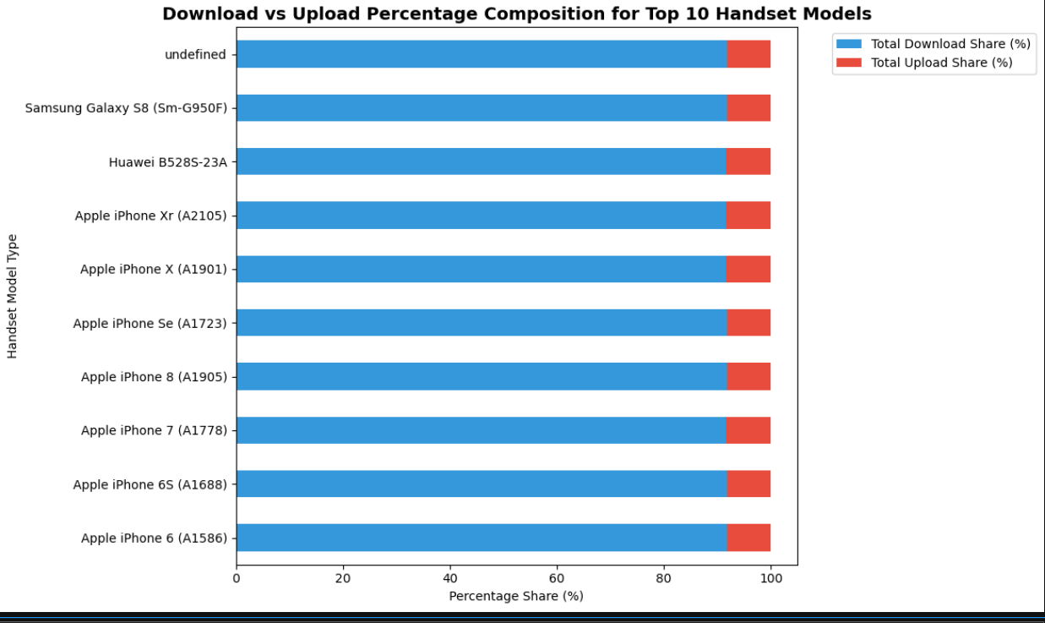
Insights
Identical user behaviour across all devices: Regardless of the smartphone brand or model (whether an older iPhone 6 or a Samsung Galaxy S8), the ratio of download data to upload data remains completely identical.
Downloads heavily dominate network traffic: For every single device listed, downloading traffic makes up roughly 92% of their total data usage.
Upload usage is universally low: Uploading traffic accounts for a tiny fraction—only about 8% of total data usage across all models.

Slide 10
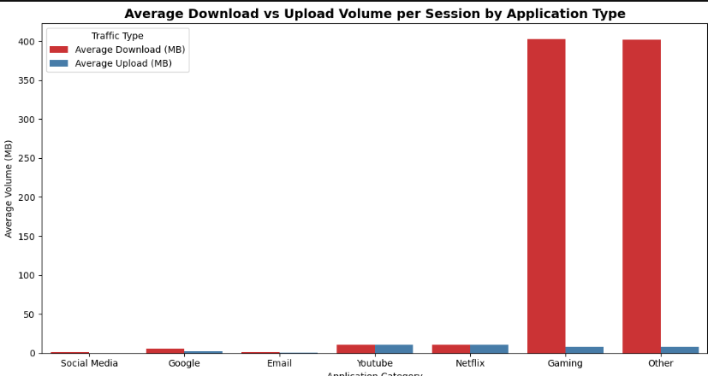
Insights
Gaming consumes massive download data: Gaming is the clear outlier. When users open a gaming session, they download an immense amount of data—over 400 MB per session on average. This is vastly higher than common data-heavy apps like YouTube or Netflix.
Most standard apps have low data footprints per session: Social Media, Google, Email, YouTube, and Netflix all use surprisingly low data volumes per individual session (under 15 MB).
Upload requirements are minimal everywhere: Across all applications, upload needs remain very low. Even for Gaming, which has massive download demands, the upload volume stays under 10 MB per session.
The "Other" category is a heavy data driver: Just like gaming, the "Other" category consumes over 400 MB of download data per session.

Slide 11
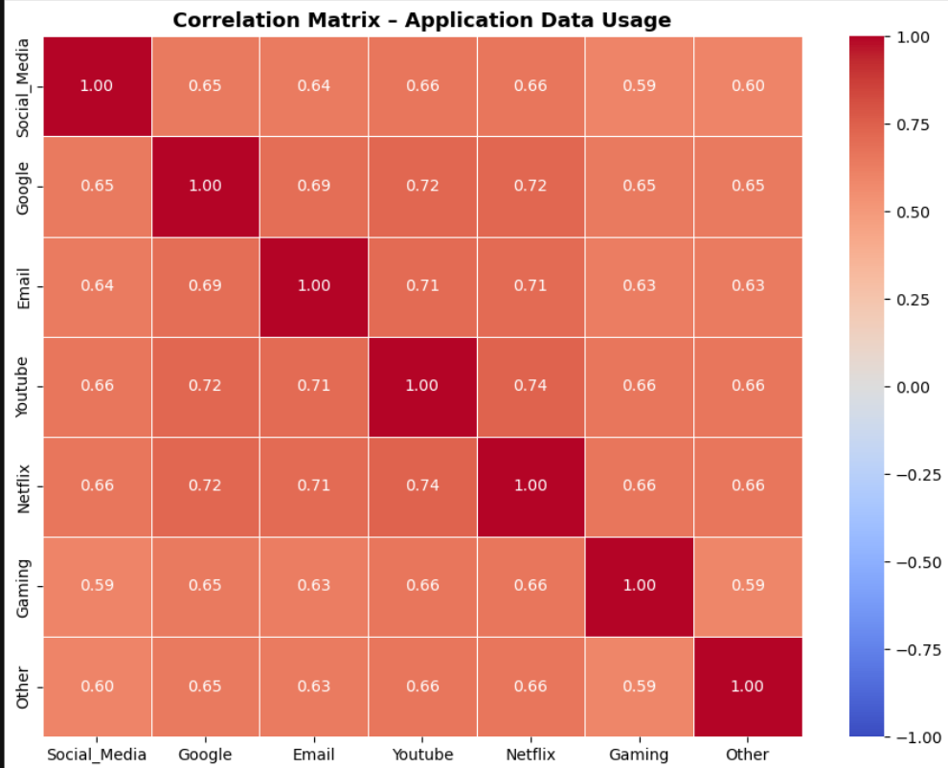
Insights
The highest correlation value is between YouTube and Netflix (0.74).
This shows that users who consume a lot of video data on YouTube are highly likely to do the same on Netflix. The business should introduce a combined "Streaming/Entertainment Pass" that offers discounted or high-speed data specifically bundled for both YouTube and Netflix together.
Google shows consistently strong positive correlations across all other apps—such as with YouTube (0.72), Netflix (0.72), and Email (0.69).
All correlation values in the matrix are moderately high and positive (ranging roughly from 0.59 to 0.74). There are zero negative or weak correlations.

Slide 12
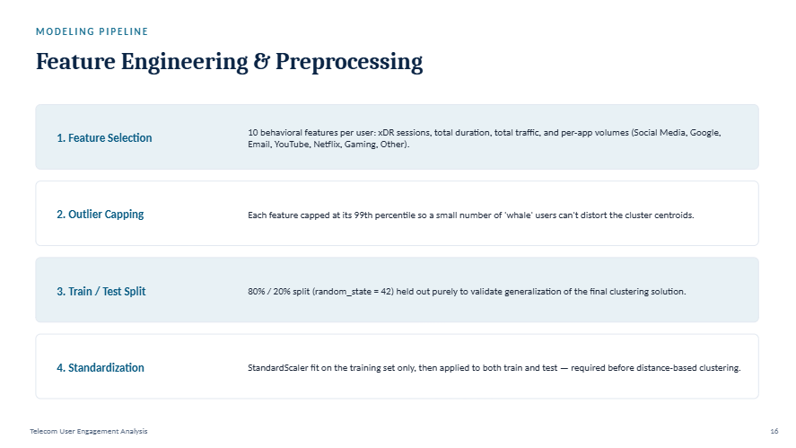

Slide 13
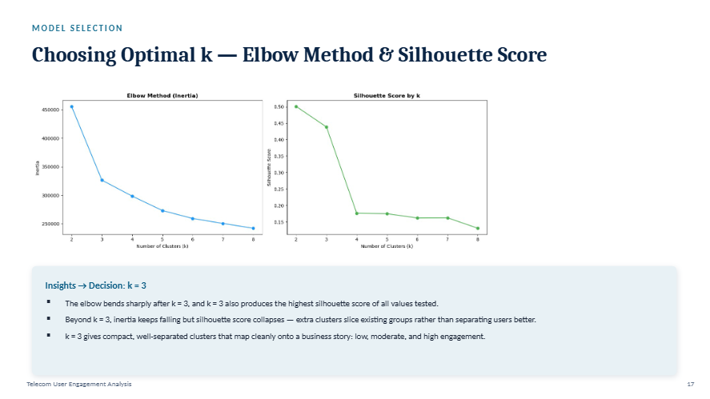

Slide 14
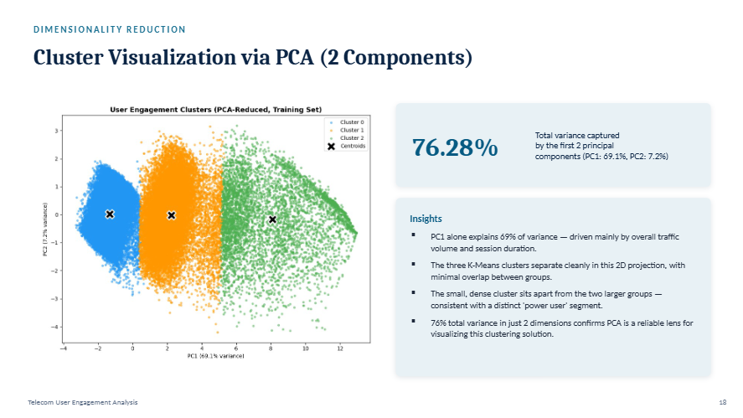

Slide 15
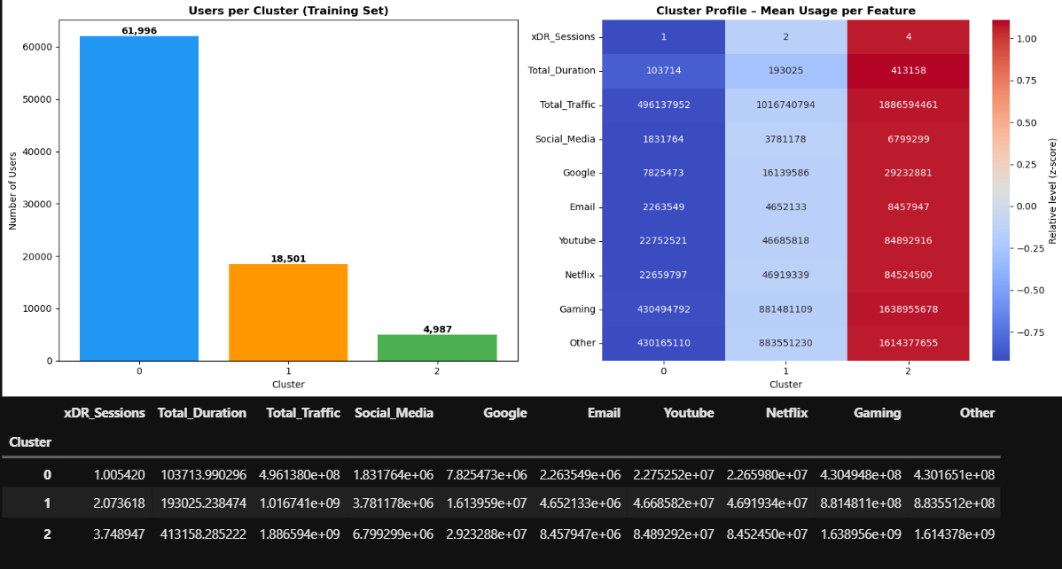
Insights
Cluster 0 — the largest group: below-average sessions, duration, and traffic across every app. These are light / occasional users.
Cluster 1 — moderate, fairly balanced usage across all apps; the "average" subscriber.
Cluster 2 — the smallest group but with by far the highest total traffic, session count, and duration, especially on YouTube, Netflix, and Gaming. These are the network's power users / heavy streamers.
Business takeaway: Cluster 2 users generate a disproportionate share of network load and revenue potential — worth targeting with premium data bundles or streaming passes — while Cluster 0 is the biggest re-engagement opportunity.

Slide 16
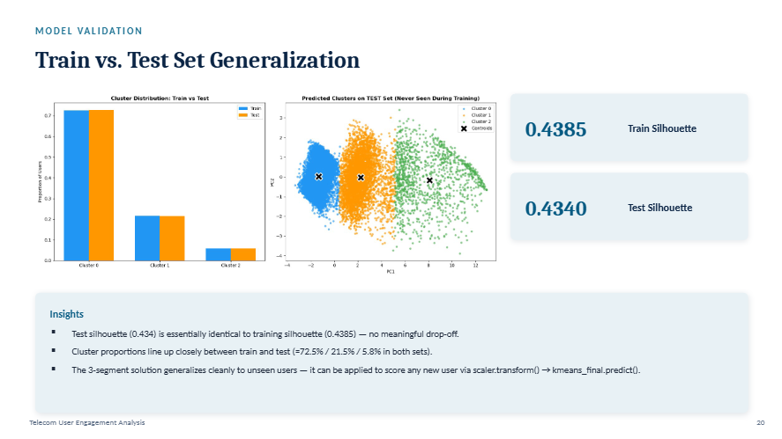

Slide 17
Conclusion
Target Home Routers & iPhones
Fixed-wireless routers (Huawei B528S-23A) drive the highest individual volumes.
Apple iPhones dominate smartphone traffic.
Launch "Home Wi-Fi" plans and prioritize iOS network optimization.
Monetize Power Users (Cluster 2)
The top 10% of users (Decile D10) consume a massive share of data.
Heavy traffic is driven mostly by Gaming, YouTube, and Netflix.
Introduce premium data tiers and bundled streaming passes.
Support Micro-Sessions & Heavy Downloads
Traffic consists of millions of rapid, ultra-short sessions.
Downloads account for 92% of total network traffic.
Upgrade switchboards for rapid connection requests and high downstream bandwidth.
Deploy Validated Model
Network volume columns contain missing metrics, but core connection data is fully complete.
The 3-segment clustering model generalizes perfectly to unseen data.
Deploy the pipeline to automatically score new users for targeted marketing.

Slide 18
Thank You

