Slide 1
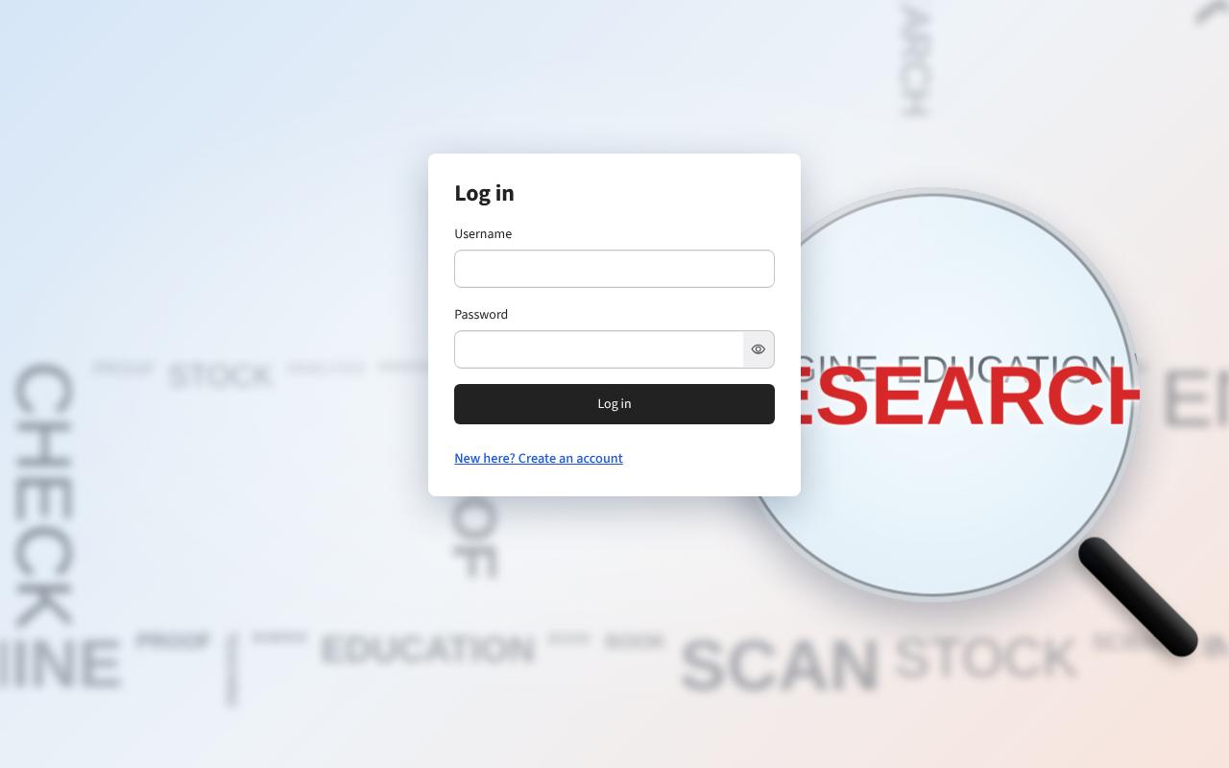
Equity Research News Tool
Reads the latest news on a company or topic and writes an analyst-style summary.
LangChain · Streamlit · NewsAPI · Groq

Slide 2
What this presentation covers
01
Problem and goal
Why the tool exists and what it produces
02
Design and technology
Flow, stack, LangChain, NewsAPI and the LLM
03
The app
Interface, login, security, caching and history
04
Quality
Problems solved, testing and limits
05
What comes next
Future scope and wrap-up

Slide 3
Analysts spend hours reading news
The problem
The goal
An equity analyst follows many companies. The news on each one is spread over many sites, so reading it all takes hours before any real analysis starts.
Type a company, index or topic. Get one structured summary in seconds, built from the latest articles.
Less reading. Faster first view. The analyst still checks the sources.

Slide 4




One query, four sections of output
Overview
Key takeaways
Sentiment
Risks to watch
A 2-3 sentence summary of the overall news.
4 to 6 short bullets with the most important facts.
Bullish, Bearish or Neutral, with a one-line reason.
2 to 4 short bullets on what could go wrong.

Slide 5
Built in six phases
1 Environment setup
2 LangChain configuration
3 Streamlit interface
Install the libraries and get the API keys.
Set up the LLM, the prompt template and the chain.
Build app.py with a search box and a summary area.
4 Enhancing the tool
5 Testing and validation
6 Documentation
Add NewsAPI so the summary uses real articles.
Check that it runs and that summaries are relevant.
write the README, list requirements.

Slide 6
From a query to a summary in five steps
1
2
3
4
5
Log in
Search
Fetch
Summarize
Read & save
Each user has a private account and history.
Type a company, index or topic in the chat box.
NewsAPI returns the 10 most relevant English articles.
Titles and descriptions go into one prompt. The LLM writes the summary.
The answer appears in chat, is saved to history and can be downloaded.

Slide 7
Built with free, open tools
Streamlit
Chat interface, sidebar and downloads
LangChain
Prompt template and the chain that calls the LLM
Groq LLM
Free default model. Gemini and OpenAI also work
NewsAPI
Latest English articles for any query
python-dotenv
API keys live in .env, never in the code
PBKDF2
Salted password hashing, lockout after 5 tries

Slide 8


LangChain: a prompt plus an LLM
PromptTemplate
You are an AI assistant helping
an equity research analyst.
### Overview
### Key Takeaways
### Sentiment
### Risks & Things to Watch
Query: {query}
Summaries: {summaries}
Fills the {query} and {summaries} slots in one fixed prompt.
Chain wrapper
Joins prompt and LLM, then exposes a simple .run() call.
Temperature 0.2
Keeps answers steady and close to the articles.

Slide 9
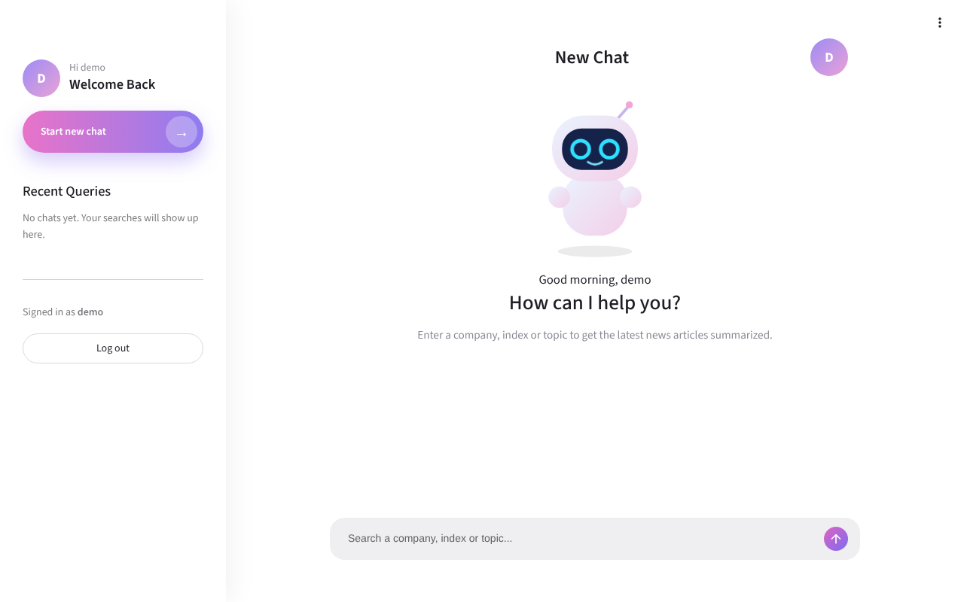


A chat interface, not a form
Chat bubbles
Questions as grey bubbles, answers as plain text.
Live loading steps
Shows fetching the news, then summarizing the articles.
Sidebar
New chat, recent queries and log out in one place.

Slide 10



Login and sign up
Simple sign up
Username of 3-20 letters, numbers or _. Password of 8+ characters.
Salted hashes
Passwords are never stored, only PBKDF2 hashes.
Optional invite code
Set SIGNUP_CODE so only invited people can join.

Slide 11
Caching and friendly errors
Invalid API key
1 hour
Tells you which key to check in .env.
The same query is not fetched or summarized again for an hour. This protects the free NewsAPI limit of 100 requests a day.
Rate limit reached
Asks you to wait and try again.
No internet or no articles
Explains the cause in one short line.

Slide 12
History and downloads
Saved per user
Recent queries
Every search is saved in data/chats and survives a page refresh.
The sidebar lists the latest 30 chats. One click reopens a chat.
Clear all history
Download .md or .txt
One button removes the saved chats of the logged-in user.
The file includes the summary and the list of source articles.

Slide 13
Thank you

