Slide 1

Hospital Management System
By
Siddhardha Chedella
Vineetha Mallu
Gnana Kumari Yadlapati
Priyanka Kuncham

Slide 2
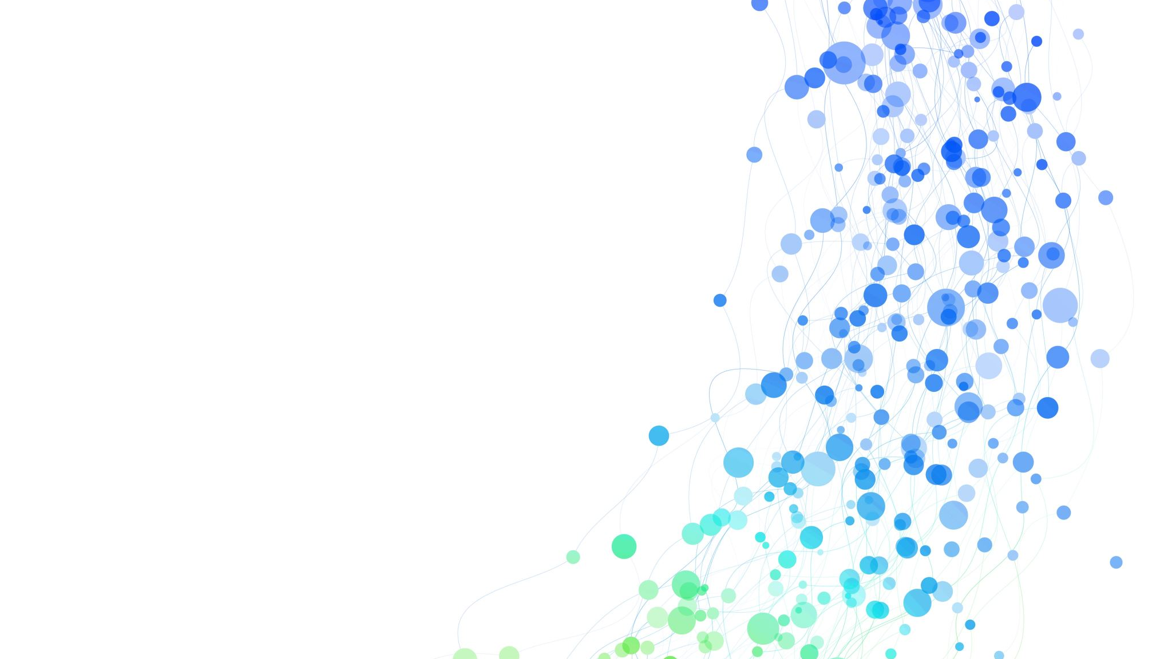
Introduction
Hospitals interact with a lot of people in a day and there are various activities involved in day-to-day operations of hospitals.
A Hospital Management System (HMS) is a software solution designed to streamline and optimize all aspects of a hospital's operations. It acts as a central hub for managing patient data, administrative tasks, and clinical activities.

Slide 3

Aim
Develop a modern, web-based hospital management system that offers a user-friendly interface.
Interaction between patients, doctors, staff are managed and administrated by Administrator.
It is used to manage the following information. Patient information, Doctor Availability and Staff information, scheduling an appointment for patient and etc.

Slide 4
Technologies Used:
Frontend : React.js
Backend : Node.js, Express
Database : MySQL

Slide 5

React JS
React.js is a JavaScript library used for building user interfaces, particularly for web applications.
It allows developers to create interactive, dynamic UIs efficiently by breaking down the interface into reusable components.
React.js also has a vibrant ecosystem with a wide range of tools, libraries, and community support, making it an excellent choice for developing modern web applications.
Additionally, React.js promotes a declarative approach to building UIs, where developers describe what the UI should look like

Slide 6

Java script
JavaScript is the core programming language used in React.js for creating dynamic and interactive user interfaces.
JavaScript handles user interactions and events within React components
JavaScript is used to fetch data from external sources such as APIs.
JavaScript is essential in React.js for creating dynamic, data-driven user interfaces and handling user interactions effectively.

Slide 7

Node JS
Node.js plays a crucial role in React applications by serving as the runtime environment for running server-side code and building a backend for React applications.
Node.js enables server-side rendering of React components, allowing the application to generate HTML on the server before sending it to the client.
Node.js provides a runtime environment for running development servers, facilitating hot reloading and fast iteration during React application development.

Slide 8

My Sql
MySQL holds significant importance in the field of Database Management Systems (DBMS) due to its reliability, performance, scalability, and cost-effectiveness.
MySQL offers a stable and efficient platform for managing data, making it a trusted choice for powering mission-critical applications and websites.
Its compatibility with various operating systems and programming languages, combined with extensive community support, further enhances its appeal.

Slide 9
Tables in the database
Doctor
Name | Email | Specialization | Gender
Name | Email | Address | Gender | Password
Patient
Name | Email | Phone Number | Password
Admin
Name | Email | Gender | Phone Number
Staff

Slide 10
Appointment
Start Time | End Time | Status | ID | Date
Schedule
Start Time | End Time | Day | ID | Breaks
Medical History
Surgeries | Medications | Date/time | ID

Slide 11
