Slide 1
ANSIBLE AND AWS INTEGRATION
SOFTWARES USED:
ANSIBLE & AWS
The aim was to provision an AWS instance in AWS Cloud and to Install Tomcat server in it.
Later Rundeck/Jenkins will use that VM to give out the results to the client.

Slide 2
REQUIREMENTS:
VM 1 (Local VM for Ansible 10.0.12.100:8080)
  Configuration Details:
    Ubuntu (x86_64)
    4GB RAM
    10GB HDD
Provision an EC2 Instance in cloud using ansible
Install Tomcat Server on the cloud Instance.
Accomplishments:
Completed provisioning an instance in the AWS cloud. The part where we stuck is to access the created instance and install the tomcat server.

Slide 3
Important Steps and Pre-requisites:
Ansible (Latest Version)
Open-ssh Server
Install Boto plug-in for AWS
An AWS account
ssh configuration (private and public key pairs)
Provision an Instance using ansible, access and install Tomcat in that Instance

Slide 4
SINGLE-NODE HADOOP INSTALLATION
Requirements:
    Ubuntu 10.04LTS (ansible controller node)
    Ubuntu 10.04LTS (ansible host node for hadoop installation)
Playbook
Ansible host node
Ansible controller node
Ubuntu 14.04 LTS
10.0.12.55 IP
Ubuntu 14.04 LTS
10.0.12.54 IP

Slide 5
Requirements for VM1 (10.0.12.55)
    Ansible 2.2
    SSH connection to VM2 (/etc/ansible/hosts)
Requirements for VM2(10.0.12.54)
    Java Version 1.7
    Hadoop Version 2.4
    SSH configuration
    (Above softwares are installed on VM2 using playbook)

Slide 6
Accomplishments
Playbooks are written for each step of hadoop installation in controller node 10.0.12.55
  Installation of Java
  Creating Hadoop group and adding hduser
  SSH configuration
  Installation of Hadoop
  Setup configuration files(bashrc,hadoop-env.sh,core-site.xml,mapred-site.xml.template,hdfs-site.xml)
Sucessfully executed playbooks for hadoop group creation,adding hduser,ssh configuration, installation of hadoop and configuration setup files on 10.0.12.54

Slide 7
Challenges
Installation of java(full ip access)
Command execution like hadoop namenode format and start-all.sh

Slide 8
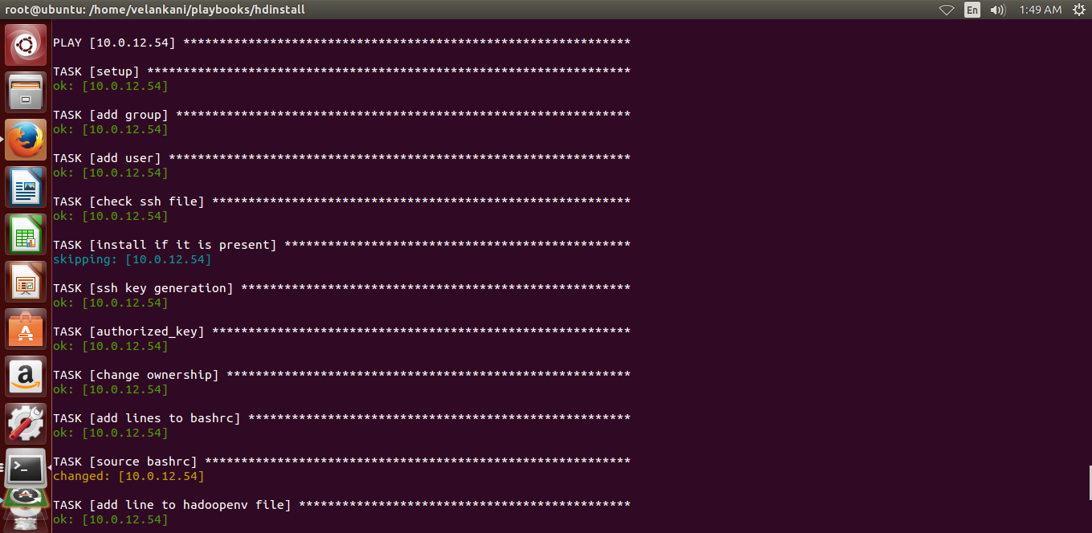
Execution of playbook
ansible-playbook hdinstall.yml

Slide 9
