Slide 1
Jeopardy

Slide 2
Description
Just like Jeopardy gameshow
5 categories, each with 3 questions worth $100,$200,$300 respectively
When a question is clicked, a window appears with 4 multiple-choice answers randomly selected from the correct answers to the other questions
The user’s score is displayed in a separate window, and is increased or decreased every time a question is answered

Slide 3
Demonstration

Slide 4
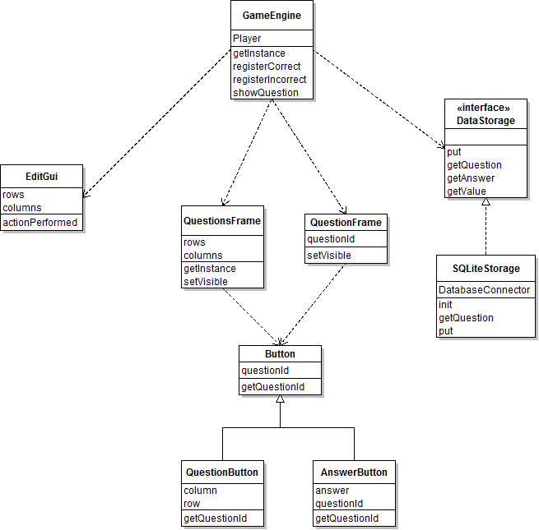
UML

Slide 5
Polymorphism
AnswerButton and QuestionButton both extend Button, which provides the getQuestionId method that ties the button to its respective question
answer1.getQuestionId();

Slide 6
Special Features
The questions are stored in a SQLite Database

Slide 7
Known Bugs
I put in the rows and columns for each question into the database backwards, so in this specific set of questions, the rows and columns are switched in the database
This isn’t really a bug because it doesn’t make the program malfunction

Slide 8
Third Party Libraries
Swing – Java SE library for creating GUIs
SQLite – provided by sqlite.org to interface between Java programs and SQLite databases

Slide 9
Questions

Slide 10
Conclusion
Pretty easy
It got kind of boring playing it over and over and over again to test it out
I think that the project is of a good quality for a class project, if it were a product I would be marketing I would want to refine it more
I didn’t learn anything new, I just reapplied knowledge from previous programs that I have written

