Slide 1
Migration
Penobscot Estuary Community Modeling Workshop
ABM Draft Bioaccumulation Function
August 6th, 2025
Drafted By: Vanessa Quintana

Slide 2
Relevant Background Information
Term | Definition
Landward Migration | Movement of fish from marine or estuarine zones upstream into freshwater, typically during spawning migrations.
Seaward Migration | Movement of fish from freshwater or estuarine habitats toward the ocean, often seen in juvenile or post-spawning individuals.
Homing | The ability of fish to return to their natal habitat, guided by environmental cues like salinity, temperature, or chemical signals.

Slide 3
Model Objectives
Purpose: Simulate how fish migrate under flow resistance by calculating swimming effort, difficulty, and energy cost.
Objectives:
Simulate migration movement under varying flow conditions
Calculate swimming speed based on fish energy and water velocity, capturing how fish respond to hydrodynamic resistance.
Quantify energetic difficulty of movement
Use a velocity-based difficulty factor to scale the energetic cost of upstream swimming based on local flow and fish traits.
Track movement and energy depletion
Determine fish position and energy loss at each time step, revealing where and when movement becomes inefficient or unsustainable.
Notes:
Reduce energy cost during high-flow events
Calculate effective swimming speed based on fish energy and water velocity, capturing how fish respond to hydrodynamic resistance.
Allow recovery during periods of physiological stress
Use a normalized velocity-based difficulty factor to scale the energetic cost of upstream swimming based on local flow and fish traits.
Track when and where resting occurs
Determine fish position updates and energy loss at each time step, revealing where and when movement becomes inefficient or unsustainable.

Slide 4
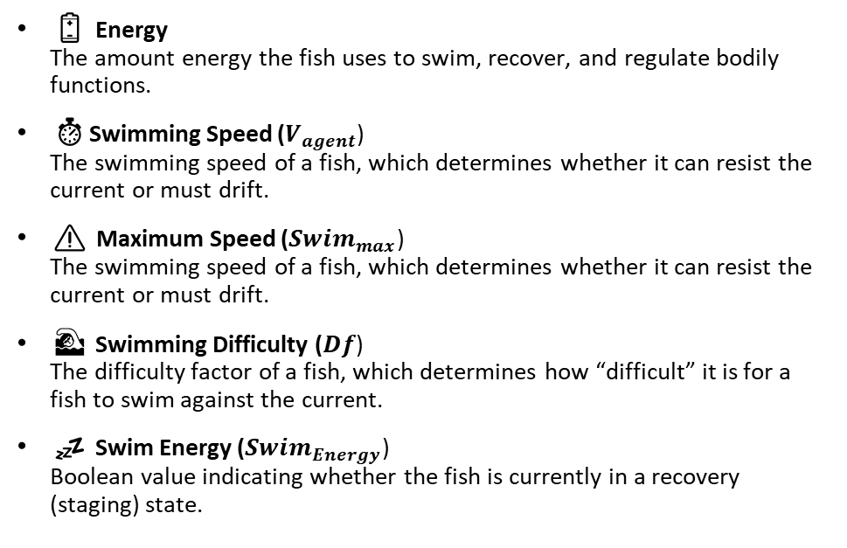
Key Variables for the Model
🌍 Environmental Variables
🐟 Individual (Fish) Variables
🌀 Velocity (u)
The along-channel flow velocity in a patch, influencing whether fish swim or drift.
🛑 Patch Difficulty (Patch-Df)
The difficulty factor of a patch, which records the highest difficulty experienced in the patch over time.
🐟 Fish (Fish)
The cumulative number of fish using one location.
⏳ Time Spent (Time)
The cumulative time fish spend resting in one location.
🔋 Energy
The amount energy the fish uses to swim, recover, and regulate bodily functions.
⏱️Swimming Speed ($V_{agent}$)
The swimming speed of a fish, which determines whether it can resist the current or must drift.
⚠️ Maximum Speed (${Swim}_{max}$)
The swimming speed of a fish, which determines whether it can resist the current or must drift.
🏊 Swimming Difficulty ($Df$)
The difficulty factor of a fish, which determines how “difficult” it is for a fish to swim against the current.
💤 Swim Energy (${Swim}_{Energy}$)
Boolean value indicating whether the fish is currently in a recovery (staging) state.
Notes:
The along-channel flow velocity in a patch, influencing whether fish swim or drift.

Slide 5



Swimming Becomes More or Less Difficult as Fish Move Through Changing Flow Conditions
Swimming Speed
$$V_{agent}$$
Current Velocity
Velocity Direction × Magnitude = Difficulty Factor (Df)
Highest difficulty:
→ Strongest velocity in the opposite direction of fish movement
Lowest difficulty:
→ Weak or assisting flow in the same direction as fish movement
Legend
Seaward Direction (-)
Landward Direction (+)
Notes:
If |Vpatch|>Vagent|𝑉𝑝𝑎𝑡𝑐ℎ|>𝑉𝑎𝑔𝑒𝑛𝑡 and Vagent≤Speedmin

Slide 6




Fish adjust their speed to overcome opposing currents, constrained by maximum velocity and rate of change.
Swimming Against the Flow
Y
Y
Ecological Implication
$${Swim}_{max}$$
As flow strengthens, fish increase speed to counter resistance, constrained by their max swimming rate and how fast they can accelerate.
X
X
|Current Velocity|
Increases
$V_{agent}$ Increases
Y
Y
As flow weakens, fish reduce speed to conserve energy unless overcoming velocity is needed for continued migration.
$${Swim}_{max}$$
X
X
Desired$Speed$
|Current Velocity|
Decreases
$V_{agent}$ Increases
$$Swimming Speed$$

Slide 7


Fish use favorable currents to move faster with less effort, without being limited by their maximum swimming speed.
Swimming with the Flow
Y
Y
Ecological Implication
$${Swim}_{max}$$
When flow aids migration, fish swim more efficiently but still face constraints from max speed and acceleration.
X
X
|Current Velocity|
Increases
$V_{agent}$ Increases
Y
Y
As favorable flow lessens, fish boost effort to maintain progress, using more energy if currents slow too much.
$${Swim}_{max}$$
Desired Swimming Velocity
X
X
Swimming Velocity
|Current Velocity|
Decreases
$V_{agent}$ Decreases
Current Velocity

Slide 8
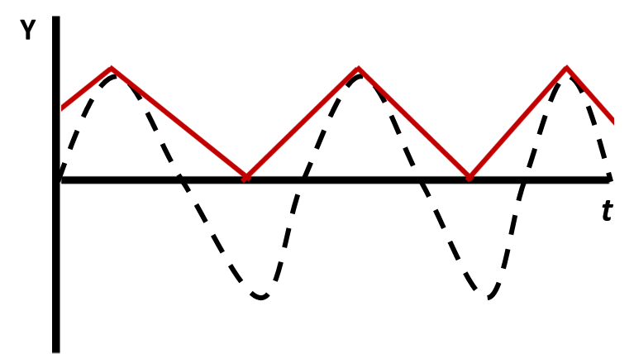
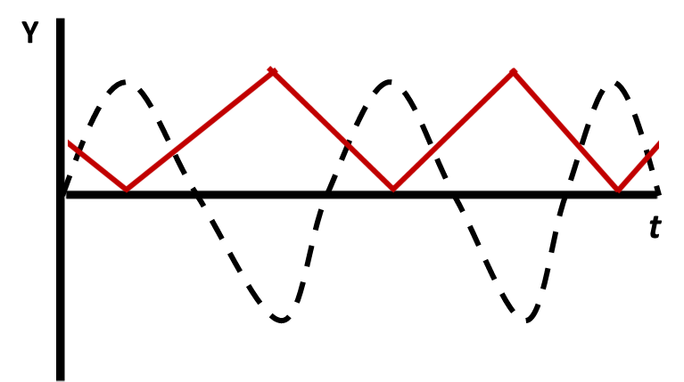
Fish Calculate Swimming Difficulty Factor
Max Difficulty: Peak Landward Flow
Max Difficulty: Peak Seaward Flow
Difficulty Factor (Df)
Velocity (u)
Y
Fish swim against seaward flow (– velocity).
Df increases with stronger seaward flow (more resistance).
When flow turns landward (+ velocity), Df decreases (less resistance).
Fish swim against landward flow (+ velocity).
Df increases with stronger landward flow (more resistance).
When flow is seaward (- velocity), Df decreases (less resistance).
Landward Migration
Seaward Migration
X
(+) Velocities are in the Landward direction
(-) Velocities are in the Seaward direction
Notes:
If |Vpatch|>Vagent|𝑉𝑝𝑎𝑡𝑐ℎ|>𝑉𝑎𝑔𝑒𝑛𝑡 and Vagent≤Speedmin

Slide 9
More difficult conditions require more energy to swim, making resistance a key driver of energy use.
Calculating Energy Use
Y
Y
Ecological Implication
Greater difficulty forces fish to use more energy to maintain movement or balance.
X
X
Difficulty Increases
Energy Use Increases
Y
Y
As stress or resistance declines, fish reduce energy use, allowing recovery and longer endurance.
X
X
Stress Decreases
Energy Use Decreases

Slide 10
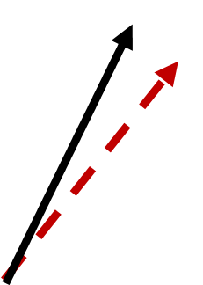

Fish use favorable landward currents to boost forward movement, increasing their swimming speed with the flow.
=
Current Velocity
Swimming Speed
$$V_{agent}$$
Seaward Direction (-)
Landward Direction (+)
Time: 1
Fish: 1
Each patch tracks how many fish visit and how long they stay.
Current Velocity
Notes:
If |Vpatch|>Vagent|𝑉𝑝𝑎𝑡𝑐ℎ|>𝑉𝑎𝑔𝑒𝑛𝑡 and Vagent≤Speedmin

Slide 11


Reduced resistance during favorable flow conditions leads to lower swimming difficulty and improved migration efficiency.
=
Swimming Speed
Current Velocity
Swimming Difficulty
$$V_{agent}$$
Seaward Direction (-)
Landward Direction (+)
Time: 1
Fish: 1
Df: 1
Each patch also tracks the highest difficulty experienced in one location.
Current Velocity
Notes:
If |Vpatch|>Vagent|𝑉𝑝𝑎𝑡𝑐ℎ|>𝑉𝑎𝑔𝑒𝑛𝑡 and Vagent≤Speedmin

Slide 12
Lower swimming difficulty reduces energy expenditure, making favorable currents energetically beneficial.
=
Swimming Speed
Current Velocity
Swimming Difficulty
Energy Use
Energy Levels
$$V_{agent}$$
Seaward Direction (-)
Landward Direction (+)
Time: 1
Fish: 1
Df: 1
Current Velocity
Notes:
If |Vpatch|>Vagent|𝑉𝑝𝑎𝑡𝑐ℎ|>𝑉𝑎𝑔𝑒𝑛𝑡 and Vagent≤Speedmin

Slide 13
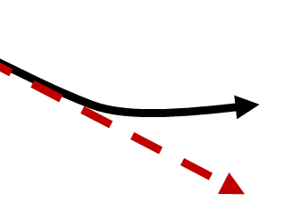
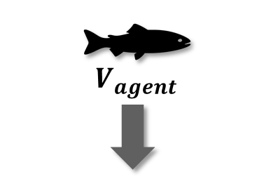

Fish decrease their swimming speed when supportive currents weaken, compensating to maintain migration progress.
=
Current Velocity
Swimming Speed
Difficulty = 1
$$V_{agent}$$
Seaward Direction (-)
Landward Direction (+)
Time: 1
Time: 1
Fish: 1
Fish: 1
Df: 1
Current Velocity
Notes:
If |Vpatch|>Vagent|𝑉𝑝𝑎𝑡𝑐ℎ|>𝑉𝑎𝑔𝑒𝑛𝑡 and Vagent≤Speedmin

Slide 14

Reduced flow support raises swimming difficulty, especially when fish must rely more on their own effort.
=
Swimming Speed
Current Velocity
Swimming Difficulty
Difficulty = 1
$$V_{agent}$$
Seaward Direction (-)
Landward Direction (+)
Time: 1
Time: 1
Fish: 1
Fish: 1
Df: 1
Df: 8
Current Velocity
Notes:
If |Vpatch|>Vagent|𝑉𝑝𝑎𝑡𝑐ℎ|>𝑉𝑎𝑔𝑒𝑛𝑡 and Vagent≤Speedmin

Slide 15

As difficulty rises, energy demand increases, reducing migration efficiency.
=
Swimming Speed
Current Velocity
Swimming Difficulty
Energy Use
Energy Levels
Difficulty = 1
$$V_{agent}$$
Seaward Direction (-)
Landward Direction (+)
Time: 1
Time: 1
Fish: 1
Fish: 1
Df: 1
Df: 8
Current Velocity
Notes:
If |Vpatch|>Vagent|𝑉𝑝𝑎𝑡𝑐ℎ|>𝑉𝑎𝑔𝑒𝑛𝑡 and Vagent≤Speedmin

Slide 16

Opposing currents raise resistance, forcing fish to work harder to maintain progress during migration.
=
Current Velocity
Swimming Speed
Difficulty = 1
Difficulty = 8
$$V_{agent}$$
Seaward Direction (-)
Landward Direction (+)
Time: 1
Time: 1
Time: 1
Fish: 1
Fish: 1
Fish: 1
Df: 1
Df: 8
Current Velocity
Notes:
If |Vpatch|>Vagent|𝑉𝑝𝑎𝑡𝑐ℎ|>𝑉𝑎𝑔𝑒𝑛𝑡 and Vagent≤Speedmin

Slide 17

Greater swimming resistance under opposing flow raises difficulty, especially in regions where current direction conflicts with migration movement.
=
Swimming Speed
Current Velocity
Swimming Difficulty
Difficulty = 1
Difficulty = 8
$$V_{agent}$$
Seaward Direction (-)
Landward Direction (+)
Time: 1
Time: 1
Time: 1
Fish: 1
Fish: 1
Fish: 1
Df: 1
Df: 8
Df: 8
Current Velocity
Notes:
If |Vpatch|>Vagent|𝑉𝑝𝑎𝑡𝑐ℎ|>𝑉𝑎𝑔𝑒𝑛𝑡 and Vagent≤Speedmin

Slide 18

Energetically costly regions emerge when high swimming difficulty drives up energy use, reducing available energy for continued migration.
=
Swimming Speed
Current Velocity
Swimming Difficulty
Energy Use
Energy Levels
Difficulty = 1
Difficulty = 8
$$V_{agent}$$
Seaward Direction (-)
Landward Direction (+)
Time: 1
Time: 1
Time: 1
Fish: 1
Fish: 1
Fish: 1
Df: 1
Df: 8
Df: 8
Current Velocity
Notes:
If |Vpatch|>Vagent|𝑉𝑝𝑎𝑡𝑐ℎ|>𝑉𝑎𝑔𝑒𝑛𝑡 and Vagent≤Speedmin

Slide 19

Fish dynamically adjust swimming speed based on current direction and migration direction.
Difficulty = 1
Difficulty = 8
Difficulty = 8
Seaward Direction (-)
=
Landward Direction (+)
Time: 1
Time: 1
Current Velocity
Swimming Speed
Time: 1
Fish: 1
Fish: 1
Fish: 1
Df: 1
Df: 8
Df: 8
$$V_{agent}$$
Time: 1
Fish: 1
Current Velocity
Notes:
If |Vpatch|>Vagent|𝑉𝑝𝑎𝑡𝑐ℎ|>𝑉𝑎𝑔𝑒𝑛𝑡 and Vagent≤Speedmin

Slide 20

Swimming becomes more difficult when fish can no longer rely on the current to support migration movement.
Difficulty = 1
Difficulty = 8
Difficulty = 8
Seaward Direction (-)
=
Landward Direction (+)
Swimming Speed
Time: 1
Time: 1
Swimming Difficulty
Time: 1
Fish: 1
Fish: 1
Current Velocity
Fish: 1
Df: 1
Df: 8
Df: 1
$$V_{agent}$$
Time: 1
Fish: 1
Df: 1
Current Velocity
Notes:
If |Vpatch|>Vagent|𝑉𝑝𝑎𝑡𝑐ℎ|>𝑉𝑎𝑔𝑒𝑛𝑡 and Vagent≤Speedmin

Slide 21
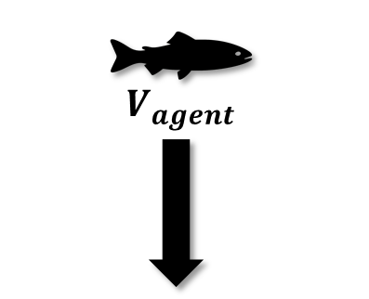


Reduced flow support raises swimming effort and energy use, even when fish move in the same direction as the current.
Difficulty = 1
Difficulty = 8
Difficulty = 8
Seaward Direction (-)
=
Swimming Speed
Landward Direction (+)
Time: 1
Swimming Difficulty
Energy Use
Energy Levels
Time: 1
Fish: 1
Current Velocity
Fish: 1
Df: 1
Df: 1
$$V_{agent}$$
Time: 1
Fish: 1
Df: 1
Current Velocity
Notes:
If |Vpatch|>Vagent|𝑉𝑝𝑎𝑡𝑐ℎ|>𝑉𝑎𝑔𝑒𝑛𝑡 and Vagent≤Speedmin

Slide 22
Individual-Specific Traits
Trait Type | Generalization
Energy | Internal reserves used for movement and recovery.
Swimming Speed | How fast a fish can move and if they can overcome current velocity.
Maximum Speed | The upper limit of a fish’s swimming ability, constrained by size, age, and species.
Swimming Energy | Energy cost of swimming, scaled by flow difficulty and swimming resistance.
Individual traits like size, age, and species influence a fish’s swimming capacity, energy use, and ability to navigate changing flow conditions.

Slide 23
Outputs of Interest
Type | Variable | What It Tells Us
Temporal | Energy | Measures total energy use over time, reflecting migration effort and recovery needs.
 | Swimming Difficulty | Tracks difficulty from swimming against or with the current, influencing energy expenditure.
Spatial | Patch-Difficulty | Maps areas with highest swimming difficulty and periods where fish struggle to migrate.
 | Time | Shows where fish spend the most time, which may indicate resting zones or movement delays.
 | Fish | Visualizes fish distribution by location, helping assess habitat use and crowding.
Model outputs identify where and when swimming becomes most difficult, highlighting zones of high energy demand during fish migration.

Slide 24
Discussion Prompts
Accuracy & Realism
Do the swimming patterns and difficulty levels reflect your understanding of how fish move with or against the current?
Does it make sense that fish would adjust speed based on current direction and strength?
Missing Variables, Traits, or Parameters
Are there other traits (like homing, spawning condition, or feeding behavior) that could influence swimming behavior?
Are there environmental drivers (e.g., lunar phase, temperature, salinity) missing that could affect swimming difficulty or route selection?
Outputs of Interest
Which outputs would help us understand where or when fish struggle most during migration?
Are time-based outputs (e.g., time spent in high-difficulty zones) or spatial outputs (e.g., maps of swimming effort or resistance) more useful for understanding migration efficiency?

Slide 25
Fish can increase swimming speed to maximum levels as long as there is energy available, but higher difficulty leads to more energy expended
Y
Y
X
X
Difficulty Increases
Energy Increases

Slide 26
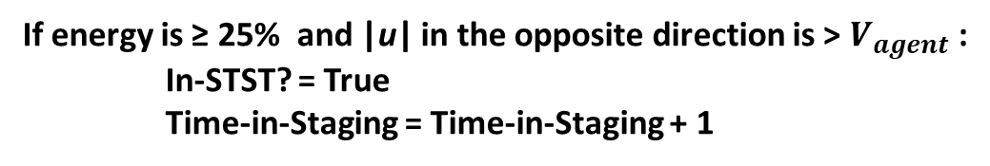


3. Fish Determine if Resting is Needed
Legend
Current Velocity (u)
Energy Level
Swimming Velocity ($V_{agent}$)
🔋
Swimming Speed
Stress Level
🧠
$$V_{agent}$$
Current Velocity
If energy is ≥ 25% and |u| in the opposite direction is > $V_{agent}$:
In-STST? = True
Time-in-Staging = Time-in-Staging + 1
If energy is ≤ 25% or stress > 50%:
Staging? = True
Time-in-STST = Time-in-STST + 1
Notes:
If |Vpatch|>Vagent|𝑉𝑝𝑎𝑡𝑐ℎ|>𝑉𝑎𝑔𝑒𝑛𝑡 and Vagent≤Speedmin

Slide 27



4. Fish Move to Conserve Energy
Sufficient Energy
Low Energy
🔋
Low Stress
High Stress
🧠
🧠
⚠️
Selective Tidal Stream Transport (STST)
Staging
Fish attempt to remain in place, move lower in the water column, and drift passively with the current to conserve energy use.
Fish identify and move to the most energy-efficient neighboring patches to rest
where:
|u| < $V_{agent}$

Slide 28
5. Track the Location where Fish are Resting
Legend
Current Velocity
Swimming Velocity
If STST? = True:
STST-in-Patch = STST-in-Patch + 1
STST-time = STST-time + 1
If Staging? = True:
Staging-in-Patch = Staging-in-Patch + 1
Staging-time = Staging-time + 1
Notes:
If |Vpatch|>Vagent|𝑉𝑝𝑎𝑡𝑐ℎ|>𝑉𝑎𝑔𝑒𝑛𝑡 and Vagent≤Speedmin

Slide 29


6. Check for Better Conditions
Fish remain in STST until swimming difficulty is 10%
Fish remain Staging until stress is <= 10% and Energy >= 75%
Why it Matters:
Highlights areas where fish expend the most energy just to regulate salinity.
Helps detect environmental stress zones.
Can be used to guide restoration efforts by identifying energy-intensive “pinch points” during migration.

Slide 30

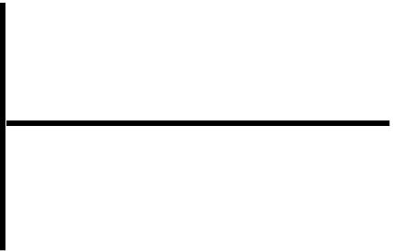
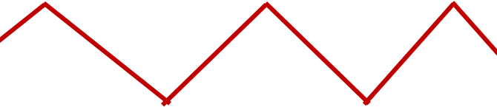
Y
Y
t
t

Slide 31




Slide 32
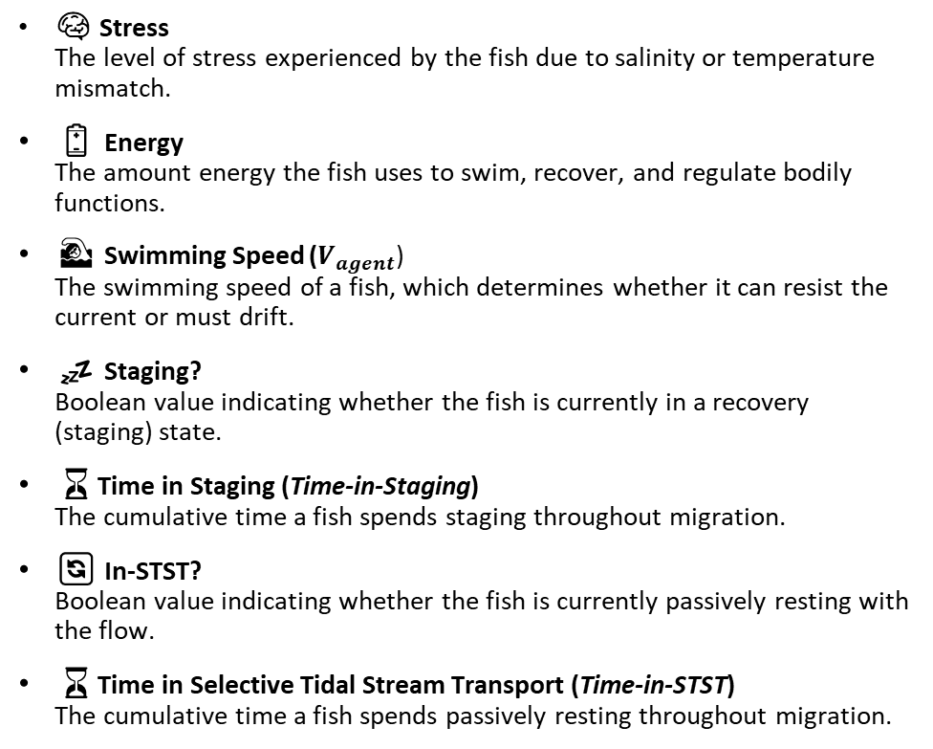
Key Variables for the Model
🌍 Environmental Variables
🐟 Individual (Fish) Variables
🌀 Velocity (u)
The along-channel flow velocity in a patch, influencing whether fish swim or drift.
🛑 Staging Location (Staging-in-Patch)
The number of agents currently resting (staging) in a patch, useful for identifying recovery zones.
🌊 Selective Tidal Stream Transport Location (STST)
The number of agents currently drifting via STST in a patch, highlighting passive transport zones
⏳ Time Spent Selective Tidal Stream Transport (STST-time)
The cumulative time fish spend resting in one location.
💤 Time Spent Staging (Staging-time)
The cumulative time fish spend staging in one location.
🧠 Stress
The level of stress experienced by the fish due to salinity or temperature mismatch.
🔋 Energy
The amount energy the fish uses to swim, recover, and regulate bodily functions.
🏊 Swimming Speed ($V_{agent}$)
The swimming speed of a fish, which determines whether it can resist the current or must drift.
💤 Staging?
Boolean value indicating whether the fish is currently in a recovery (staging) state.
⏳Time in Staging (Time-in-Staging)
The cumulative time a fish spends staging throughout migration.
🔄 In-STST?
Boolean value indicating whether the fish is currently passively resting with the flow.
⏳Time in Selective Tidal Stream Transport (Time-in-STST)
The cumulative time a fish spends passively resting throughout migration.
Notes:
The along-channel flow velocity in a patch, influencing whether fish swim or drift.

Slide 33
vv
=
Legend
Current Velocity
Swimming Speed
Seaward Direction (-)
Landward Direction (+)
$$V_{agent}$$
Landward Migration
Current Velocity
Notes:
If |Vpatch|>Vagent|𝑉𝑝𝑎𝑡𝑐ℎ|>𝑉𝑎𝑔𝑒𝑛𝑡 and Vagent≤Speedmin

Slide 34
Fish Calculate Swimming Difficulty Factor
Max Difficulty: Peak Landward Flow
Max Difficulty: Peak Seaward Flow
Difficulty Factor (Df)
Velocity (u)
Y
Fish swim against seaward flow (– velocity).
Df increases with stronger seaward flow (more resistance).
When flow turns landward (+ velocity), Df decreases (less resistance).
Fish swim against landward flow (+ velocity).
Df increases with stronger landward flow (more resistance).
When flow is seaward (- velocity), Df decreases (less resistance).
Landward Migration
Seaward Migration
X
(+) Velocities are in the Landward direction
(-) Velocities are in the Seaward direction
Notes:
If |Vpatch|>Vagent|𝑉𝑝𝑎𝑡𝑐ℎ|>𝑉𝑎𝑔𝑒𝑛𝑡 and Vagent≤Speedmin

Slide 35
Fish dynamically adjust swimming speed based on current direction and migration direction.
Difficulty = 1
Difficulty = 8
Difficulty = 8
Seaward Direction (-)
=
Landward Direction (+)
Time: 1
Time: 1
Current Velocity
Swimming Speed
Time: 1
Fish: 1
Fish: 1
Fish: 1
Df: 1
Df: 8
Df: 8
$$V_{agent}$$
Time: 1
Fish: 1
Current Velocity
Notes:
If |Vpatch|>Vagent|𝑉𝑝𝑎𝑡𝑐ℎ|>𝑉𝑎𝑔𝑒𝑛𝑡 and Vagent≤Speedmin

Slide 36
Swimming becomes more difficult when fish can no longer rely on the current to support migration movement.
Difficulty = 1
Difficulty = 8
Difficulty = 8
Seaward Direction (-)
=
Landward Direction (+)
Swimming Speed
Time: 1
Time: 1
Swimming Difficulty
Time: 1
Fish: 1
Fish: 1
Current Velocity
Fish: 1
Df: 1
Df: 8
Df: 1
$$V_{agent}$$
Time: 1
Fish: 1
Df: 1
Current Velocity
Notes:
If |Vpatch|>Vagent|𝑉𝑝𝑎𝑡𝑐ℎ|>𝑉𝑎𝑔𝑒𝑛𝑡 and Vagent≤Speedmin

Slide 37
Reduced flow support raises swimming effort and energy use, even when fish move in the same direction as the current.
Difficulty = 1
Difficulty = 8
Difficulty = 8
Seaward Direction (-)
=
Swimming Speed
Landward Direction (+)
Time: 1
Swimming Difficulty
Energy Use
Energy Levels
Time: 1
Fish: 1
Current Velocity
Fish: 1
Df: 1
Df: 1
$$V_{agent}$$
Time: 1
Fish: 1
Df: 1
Current Velocity
Notes:
If |Vpatch|>Vagent|𝑉𝑝𝑎𝑡𝑐ℎ|>𝑉𝑎𝑔𝑒𝑛𝑡 and Vagent≤Speedmin

