Slide 1
Osmoregulation Function
Penobscot Estuary Community Modeling Workshop
ABM Draft Osmoregulation Function
August 6th, 2025
Drafted By: Vanessa Quintana

Slide 2
Relevant Background Information
Term | Definition
Osmoregulation | How fish keep the right balance of salt and water inside their bodies, even when the water around them changes.
Gills | Organs that allow fish to breathe and also help control the salt and water balance in their bodies.
Chloride Cells | Special cells in the gills that help fish adjust to salty or fresh water by moving salt in or out of their bodies.
Homeostasis | The ability of fish to keep their internal conditions stable and healthy, even when the environment changes.

Slide 3
Model Objectives
Purpose: Simulates stress and energy use as fish adapt to changing salinity.
Objectives:
Quantify Salinity Stress by calculating the difference between environmental salinity and internal salinity.
Regulate Chloride Cell Density to maintain homeostasis by adjusting cell expression in response to stress.
Estimate Energy Costs associated with chloride cell creation, maintenance, and decay to track the metabolic trade-offs of osmoregulation.

Slide 4
Key Variables for the Model
🌍 Environmental Variable
🐟 Individual (Fish) Variables
🧂 Salinity
How salty the surrounding water is
(Affects how much the fish needs to regulate)
⚡ Energy
Available energy for physiological processes
🌊 Salinity Stress
Difference between internal and external salinity
💧 Internal Salinity
The salt level the fish is trying to maintain inside its body
🧫 Chloride Cell Density
Percent of specialized gill cells expressed for salt regulation

Slide 5
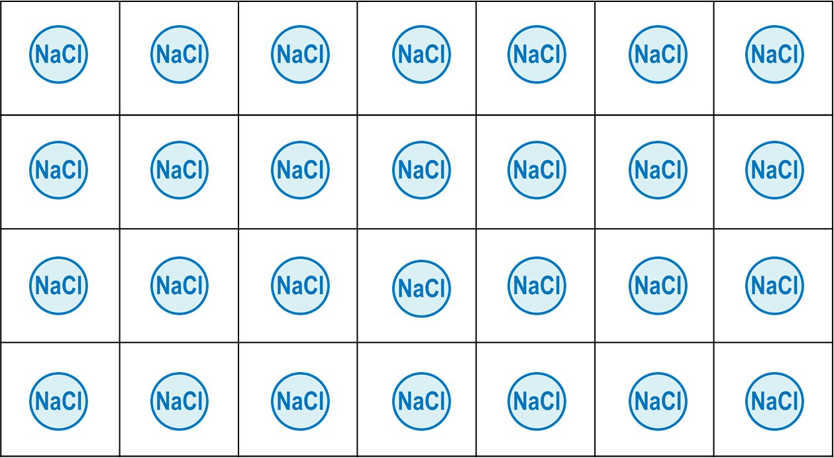

1. Fish Interact with Environmental Salinity
Internal Salinity
Environmental Salinity
Environmental Salinity - Acclimated Salinity = Stress from Salinity

Slide 6
2. Fish Calculate Stress from Salinity
Y
Y
Ecological Implication
Individual osmoregulation processes cannot keep up with maintaining homeostasis of the fish and salinity stress increases.
X
X
Difference Increases
Stress Increases
Dependent on Acclimation Rate
Y
Y
Fish is maintaining homeostasis and salinity stress decreases.
Internal Salinity
Environmental Salinity
X
X
Difference Decreases
Stress Decreases

Slide 7
3. Fish Calculate Chloride Cells Needed
Y
Y
Ecological Implication
Stress initializes the creation of new chloride cells to keep up with osmoregulation and maintain homeostasis, limited by a fish’s cell growth rate.
X
X
Stress Increases
Chloride Cells Increase
Dependent on Growth Rate
Y
Y
Fish can remove excess chloride cells that are not needed to maintain homeostasis.
X
X
Stress Decreases
Chloride Cells Decrease
Dependent on Growth Rate
Chloride Cells
Max Rate of Cell Growth/Decay

Slide 8


4. Fish Calculate Energy Cost to Regulate Cells
Y
Y
%
Current Cells
Creation Energy
X
X
Chloride Cells Increase
Energy Cost is More
Stress initializes the creation of new chloride cells which costs lots of energy
Y
Y
%
Current Cells
Energy to Destroy
X
X
Chloride Cells Decrease
Energy Cost Is less
Fish can remove excess chloride cells that are not needed to maintain homeostasis, but this still uses some energy.

Slide 9
5. Fish Calculate Cell Maintenance Energy
Y
%
Current Cells
Energy Cost of Maintenance
X
Net Energy Cost of Maintenance

Slide 10
6. Fish Calculate Total Energy Balance
Y
Y
Y
X
X
X
Energy Cost of Creation
Energy Cost of Maintenance
Total Energy Cost
Y
Y
Y
X
X
X
Total Energy Cost
Energy Cost of Decay
Energy Cost of Maintenance

Slide 11
Individual-Specific Traits
Trait Type | Generalization | Feedback Prompt
Salinity Acclimation Rate | Higher for larger, older fish; species-dependent | What species or life stages are better at acclimating to salinity changes?
Cell Growth/Decay Rate | Slower in larger, older fish | Are there size thresholds or life stages where this isn’t true?
Creation Energy | Higher for large/old fish or energetically expensive species | What species are more energetically expensive? Is this true for all life stages/ species?
Decay Energy | Lower than creation but still trait-influenced | Is this difference significant enough to model?

Slide 12
Discussion Prompts
Physiology & Assumptions
Do the model’s assumptions about age and size improving salinity acclimation reflect what’s observed in the field?
Is the slower chloride cell growth in older fish an appropriate generalization?
Energy Use & Trade-offs
Are the representations for creating, maintaining, and removing chloride cells realistic?
Should cell decay cost less than creation in all cases, or could there be exceptions (e.g., during stress recovery)?
Would it make sense to include energy thresholds where osmoregulation begins to fail?
Model Simplifications
Are their key physiological processes or variables missing from this version?
Are there feedback loops (e.g., stress reducing energy, which limits regulation) that should be more explicit?
Species-Specific Differences
Are the generalizations of the function consistent across species (e.g., alewife vs. blueback herring)?
Should species have different salinity tolerance windows?

Slide 13
Express Chloride Cells
Environmental Salinity
Environmental Salinity - Acclimated Salinity = Osmotic Stress

Slide 14

Process Flow Diagram
Environmental Salinity
Internal Salinity
Difference between environmental salinity and acclimated-salinity
Osmotic Stress
Difference Decreases
Difference Increases
Stress Decreases
Stress Increases
Chloride Cell Density
Stress Decreases
Stress Increases
Density Decreases
Density Increases
New Chloride Cells
Creation Energy Cost
Maintenance Energy Cost
Energy - Osmoregulation Energy
Energy

Slide 15
Osmotic Stress Creates a Response in the Fish
Increased Stress
Decreased Stress
Environmental Salinity

Slide 16
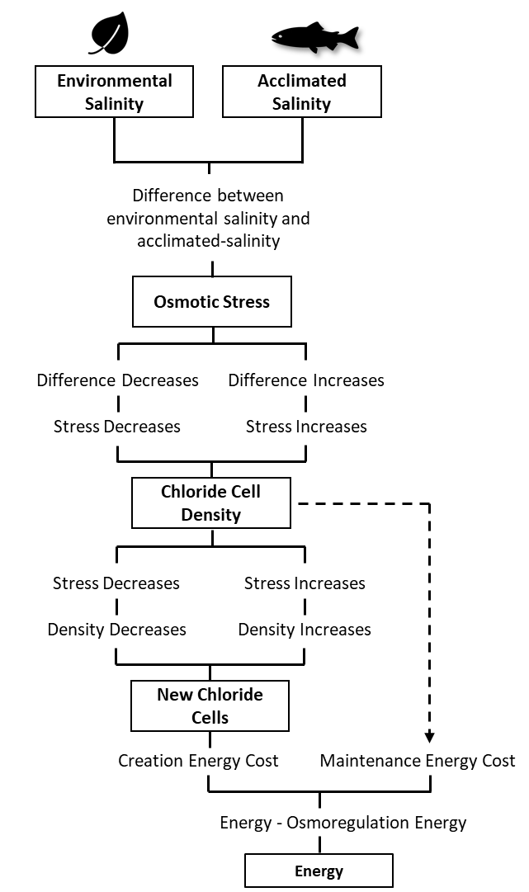

Slide 17
Osmotic Stress
Environmental Salinity
Fish have an internal level of acclimated-salinity
Represents biological ability to manage internal ion-concentrations.
Represents Salinity Concentrations in an Estuary

Slide 18


Environmental Salinity Levels
Fish have an internal level of acclimated-salinity
Fish Interact with Salinity within their Environment

Slide 19
Environmental Salinity Levels
Fish have an internal level of acclimated-salinity
Fish Interact with Salinity within their Environment

Slide 20
Environmental Salinity Levels
Fish have an internal level of acclimated-salinity
Represents biological ability to manage internal ion-concentrations.

Slide 21


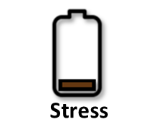
=
External Salinity
Internal Salinity
Salinity Stress
Energy Use
Energy Use
Stress
=
=
External Salinity
Stress
Internal Salinity
Salinity Stress
External Salinity
Internal Salinity
Salinity Stress
=
External Salinity
Internal Salinity
Salinity Stress
=
=
External Salinity
Internal Salinity
Salinity Stress
Energy Use
External Salinity
Internal Salinity
Salinity Stress
Energy Use

Slide 22
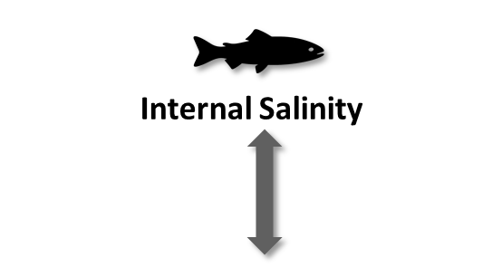
=
External Salinity
Internal Salinity
Salinity Stress
Legend
Internal Salinity
Salinity
Environmental Salinity
Stress from salinity would be greater in transitional zones

Slide 23
=
External Salinity
Internal Salinity
Salinity Stress
Legend
Internal Salinity
Salinity
Environmental Salinity
Stress from salinity would be greater in transitional zones

