Slide 1
Predation Behavior
Penobscot Estuary Community Modeling Workshop
ABM Draft Foraging Function
August 6th, 2025
Drafted By: Vanessa Quintana

Slide 2
Relevant Background Information
Term | Definition
Optimal Foraging Theory | The idea that animals balance energy gain with effort and risk, choosing to forage only when the benefits outweigh the costs.
Suspended Particulate Matter (SPM) | Fine particles in water that reduce visibility and affect predator-prey detection.
Gape Limit | Maximum prey size a predator can consume, based on its own size.
Predator | An agent that detects, selects, and consumes prey to gain energy.
Prey | Agents that avoid predators using fleeing behaviors based on visual detection and social cues.

Slide 3
Model Objectives
Purpose: This module simulates predator-prey interactions between migratory fish species (predators like striped bass and prey like alewife) during migration.
Objectives:
Link predator-prey interactions to environmental conditions
Allow predators and prey to evaluate nearby environmental conditions, and adjust their behaviors accordingly.
Simulate optimal predation behavior
Enable predators to prey on other agents based on the optimal foraging theory, and prey to flee from predators.
Link energy gain and depletion predator-prey behavior
Predators gain energy from consuming prey, while prey lose energy when fleeing.
Notes:
Reduce energy cost during high-flow events
Enable fish to passively drift with the current when swimming is inefficient, conserving energy for critical behaviors like spawning.
Allow recovery during periods of physiological stress
Let fish temporarily stop migrating to restore energy and acclimate to environmental changes such as salinity shifts or elevated flow resistance.
Track when and where resting occurs
Identify the spatial and temporal patterns of resting behaviors, including staging hotspots and zones of selective tidal stream transport, to inform habitat quality assessments.

Slide 4


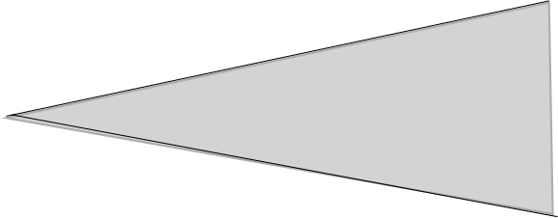
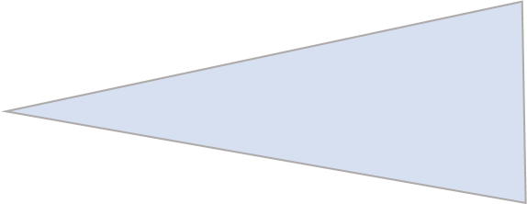
Predator
Prey
Legend
SPM
Agents visually detect other agents based on turbidity, size, and proximity.

Slide 5
Predator
Prey
Legend
SPM
High SPM levels can decrease vision radius and make prey harder to find, and predators harder to recognize

Slide 6
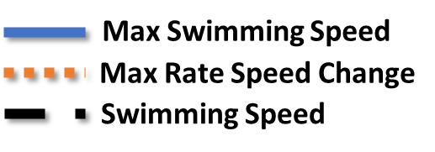
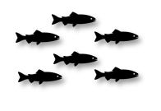
Fleeing and Pursuit Limits
Max Swimming Speed
Max Rate Speed Change
Swimming Speed
Y
$${Swim}_{max}$$
Swimming Speed
t
time
Speed increases from fleeing and pursuit consume energy and are constrained by maximum velocity and rate of change.
Energy-depleted agents cannot flee or pursue.

Slide 7

Predator
Prey
Legend
SPM
Predators calculate the cost of pursuing and consuming prey using the prey’s size, prey density, proximity, and gape limit to define catch effort.

Slide 8
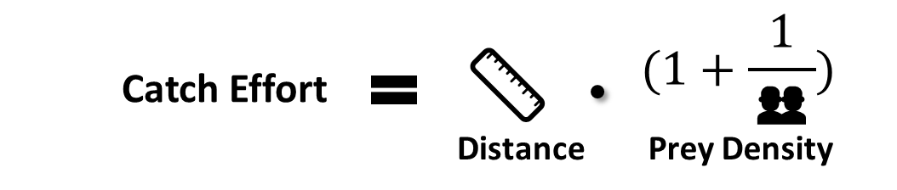
Calculate Catch Effort
🦷
Available prey for consumption is filtered out by an agent’s gape limit.
👥
Higher density of prey decreases the catch effort in predators.
📏
Closer prey require less energy to pursue and capture.

Slide 9
More difficult conditions require more energy to swim, making resistance a key driver of energy use.
Predator Energy Use
Y
Y
Ecological Implication
c
Greater catch effort forces fish to use more energy to successfully capture prey.
t
High Catch Effort
High Energy Use
Y
Y
Lower catch effort requires less energy to successfully capture prey.
Low Catch Effort
t
Low Energy Use

Slide 10
Fleeing predators costs energy, and prey that run out of energy will be easy to catch.
Prey Energy Use
Y
Y
Ecological Implication
Greater fleeing effort forces prey to use more energy to successfully evade predators.
t
High Fleeing Effort
High Energy Use
Y
Y
Lower fleeing effort requires less energy to successfully evade predators.
Low Fleeing Effort
t
Low Energy Use

Slide 11


Optimal Foraging Theory
Y
❌
Prey Size
(Energy Gain: Low)
Net Return: Low
t
High Energy Use
Y
✅
Prey Size
(Energy Gain: High)
Net Return: High
t
Low Energy Use

Slide 12
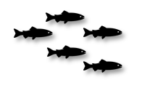
Predator
Prey
Legend
SPM
Eaten: 1
Eaten: 1
Model tracks when and where prey are consumed

Slide 13
Individual-Specific Traits
Trait Type | Generalization
Energy | Determines if predators can pursue or prey can escape.
Hunger Level | Determines if a predator is hungry or not.
Predation Ability | Determines reaction time to prey based on age and experience.
Fleeing Ability | Determines reaction time to predators based on age and experience.
Each fish’s species, size, energy, stress levels, and foraging preferences shape its foraging behavior.

Slide 14
Outputs of Interest
Type | Variable | What It Tells Us
Temporal | Prey Consumed | Tracks when fish are consuming prey.
 | Prey Species | Tracks what type of prey fish are consuming.
Spatial | Predation Events | Areas where predation is concentrated.
 | Escape Events | Areas where predation is constantly avoided successfully.
These outputs help identify risky locations, critical survival zones, and habitat impacting predation behaviors.

Slide 15
Discussion Prompts
Accuracy & Realism
Do predators always prioritize predation during migration, or are there situations when they are more likely to ignore nearby prey?
Does limiting predator pursuit by gape size, hunger levels, or energy availability reflect real-world behavior?
Missing Variables, Traits, or Parameters
Are there time-of-day, tidal phase, or species constraints that influence when predation is more likely or more successful?
What environmental (e.g., turbidity, salinity, visibility) or structural barriers (e.g., dams, culverts, entrainment zones) might inhibit predation or fleeing behavior?
Outputs of Interest
Should the model prioritize where predation and escape attempts happen or how often they occur?
Are there ways we could use these outputs to support habitat restoration or passage design?

Slide 16
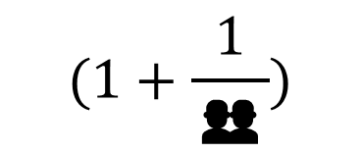
Indifi
$$(1+\frac{1}{\text{👥}})$$
📏
Catch Effort
Distance
Prey Density
Gape limit it proportional to the agent’s size.
Indifi

Slide 17
Catch Effort
Gape Limit is a function of the agent’s size tracking ability for fish to consume prey at different sizes
Density is a function of the agent’s school size
Proximity is the distance from an agent
Predators calculate the cost of pursuing and consuming prey using the prey’s size, prey density, proximity, and gape limit.

Slide 18



Pursuit by Predators
Fleeing by Prey
Energy Levels
Energy Use
Energy Gain
High Energy
Energy Levels
Energy Use
Low Energy
Pursuit of prey costs energy, but predators will gain energy with a successful catch
Fleeing predators costs energy, and prey that run out of energy will be easy to catch.

