Slide 1
Resting Behavior
Penobscot Estuary Community Modeling Workshop
ABM Draft Bioaccumulation Function
August 6th, 2025
Drafted By: Vanessa Quintana

Slide 2
Relevant Background Information
Term | Definition
Selective Tidal Stream Transport (STST) | A strategy where fish conserve energy by drifting with favorable tidal currents, usually by positioning themselves in slower or deeper water during migration.
Staging | A behavior where fish temporarily stop migrating to recover from low energy or high stress, often staying in one area until conditions improve.
Stress | The strain a fish feels when something in the environment changes (like temperature, or salinity) that makes it harder for them to stay healthy.

Slide 3
Model Objectives
Purpose: Simulate energy-conserving strategies fish use during migration
Objectives:
Reduce energy cost during high-flow events
Enable fish to passively rest when swimming is inefficient, conserving energy for critical behaviors like migration and spawning.
Allow recovery during periods of physiological stress
Let fish temporarily stop migrating to restore energy and acclimate to environmental changes such as salinity shifts or elevated flow resistance.
Track when and where resting occurs
Identify the spatial and temporal patterns of resting behaviors, including staging hotspots and zones of selective tidal stream transport, to inform habitat quality assessments.
Notes:
Reduce energy cost during high-flow events
Enable fish to passively drift with the current when swimming is inefficient, conserving energy for critical behaviors like spawning.
Allow recovery during periods of physiological stress
Let fish temporarily stop migrating to restore energy and acclimate to environmental changes such as salinity shifts or elevated flow resistance.
Track when and where resting occurs
Identify the spatial and temporal patterns of resting behaviors, including staging hotspots and zones of selective tidal stream transport, to inform habitat quality assessments.

Slide 4
Conditions that Trigger Resting
Condition | Result | Mechanism
Current velocity > swimming speed | Passive resting | Selective Tidal Stream Transport
Energy ≤ 25% | Stop & actively recover | Staging
Stress > 50% | Stop & actively recover | Staging
Fish rest when environmental conditions exceed their ability to swim or cope.

Slide 5

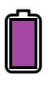





Legend
Stress
Energy
Swimming Speed
Salinity (psu)
Temperature ($C$)
$$V_{agent}$$
Current Velocity ($u$)
u
u
u
u
u
u
u
u
u
u
u
u
u
u
u
u
u
u
u
u
u
u
u
u
u
u
u
u
Environmental Conditions
Fish adjust energy and stress based on current speed, salinity, and temperature.
Notes:
If |Vpatch|>Vagent|𝑉𝑝𝑎𝑡𝑐ℎ|>𝑉𝑎𝑔𝑒𝑛𝑡 and Vagent≤Speedmin

Slide 6
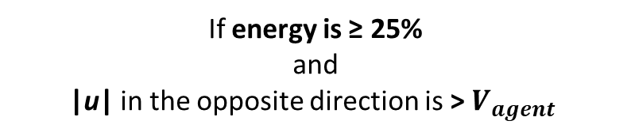

Stress
Energy
Swimming Speed
$$V_{agent}$$
Staging
Selective Tidal Stream Transport (STST)
If energy is ≤ 25% or stress > 50%
If energy is ≥ 25%
and
|u| in the opposite direction is > $V_{agent}$
No Rest Needed
Fish compare their energy, stress, and swimming capacity to the environment to decide whether to pause and recover (staging) or drift passively (STST).
Notes:
If |Vpatch|>Vagent|𝑉𝑝𝑎𝑡𝑐ℎ|>𝑉𝑎𝑔𝑒𝑛𝑡 and Vagent≤Speedmin

Slide 7
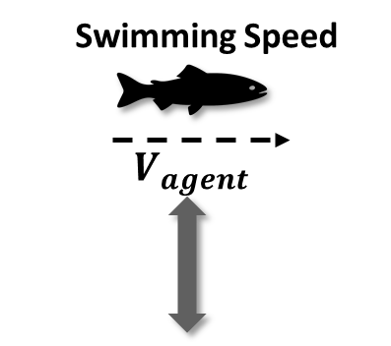

Stress
Energy
Swimming Speed
$$V_{agent}$$
Staging
Selective Tidal Stream Transport (STST)
If energy is ≤ 25% or stress > 50%
If energy is ≥ 25%
and
|u| in the opposite direction is > $V_{agent}$
Staging Needed
Environmental Conditions
When conditions exceed a fish’s limits, it enters staging or STST mode depending on whether it needs to actively recover or passively drift.
Notes:
If |Vpatch|>Vagent|𝑉𝑝𝑎𝑡𝑐ℎ|>𝑉𝑎𝑔𝑒𝑛𝑡 and Vagent≤Speedmin

Slide 8

Stress
Energy
Swimming Speed
$$V_{agent}$$
Staging
Selective Tidal Stream Transport (STST)
If energy is ≤ 25% or stress > 50%
If energy is ≥ 25%
and
|u| in the opposite direction is > $V_{agent}$
STST Needed
Environmental Conditions
Environmental conditions affect how much stress a fish is experiencing and how much energy is available to the fish.
Notes:
If |Vpatch|>Vagent|𝑉𝑝𝑎𝑡𝑐ℎ|>𝑉𝑎𝑔𝑒𝑛𝑡 and Vagent≤Speedmin

Slide 9
Each Patch Tracks if Fish are Resting in that Location
Swimming Speed
$$V_{agent}$$
STST: 0
STST: 0
STST: 1
Staged: 0
Staged: 1
Staged: 0
Environmental Conditions
Resting patterns help identify areas that may limit progress or increase contamination exposure risk.
Notes:
If |Vpatch|>Vagent|𝑉𝑝𝑎𝑡𝑐ℎ|>𝑉𝑎𝑔𝑒𝑛𝑡 and Vagent≤Speedmin

Slide 10


Low Energy
Low Stress
Sufficient Energy
High Stress
Selective Tidal Stream Transport (STST)
Staging
Fish attempt to remain in place, move lower in the water column, and drift passively with the current to conserve energy use.
Fish identify and move to the most energy-efficient neighboring patches to rest
where:
|u| < $V_{agent}$

Slide 11


While in Rest: Fish Check for Better Conditions
Fish remain in STST until |u| in the opposite direction is < $V_{agent}$
Fish remain Staging until Stress is <= 10% and Energy >= 75%
Why it Matters:
Identifies critical recovery thresholds for migratory fish behavior.
Pinpoints locations where currents or temperature and salinity fluctuations impose energetic stress.
Supports fisheries management by revealing when and where fish pause most often, and assessing whether these resting zones overlap with areas of high contamination.

Slide 12
Individual-Specific Traits
Trait Type | Generalization
Stress | Sensitivity to salinity and temperature changes.
Energy | Internal reserves used for movement and recovery.
Swimming Speed | How fast a fish can move and if they can overcome current velocity.
Each fish rests differently based on its own energy reserves, swimming speed, and ability to handle stress. These traits shape when, where, and how long it pauses during migration.

Slide 13
Outputs of Interest
Type | Variable | What It Tells Us
Temporal | STST? | When fish switch into passive drift due to unfavorable flow conditions.
 | Staging? | When fish stop active migration to recover from low energy or high stress.
 | Time-in-STST | Cumulative time fish spend utilizing STST throughout migration.
 | Time-in-Staging | Cumulative time fish spend staging throughout migration.
Spatial | STST-in-Patch | Where in the environment fish most frequently rely on STST behavior.
 | Staging-in-Patch | Where fish most often stop to recover based on flow and stress conditions.
 | STST-time | Which locations accumulate the most total time in passive drift.
 | Staging-time | Which locations accumulate the most total time spent resting or recovering.
Identifies where and when resting occurs during migration.

Slide 14
Discussion Prompts
Accuracy & Realism
Do the triggers for STST or Staging (e.g., high current velocity, low energy, high stress) feel biologically reasonable?
Does it make sense that fish might rest more in certain areas or times due to hydrodynamics, salinity stress, or thermal stress?
Outputs of Interest
Which outputs are most useful for identifying critical habitat or management actions (e.g., resting hotspot maps, resting duration, overlap of these spots with contamination)?
Is it more helpful to track where fish rest or how long they remain in those states?

