Slide 1
Resting
Penobscot Estuary Community Modeling Workshop
ABM Draft Bioaccumulation Function
August 6th, 2025
Drafted By: Vanessa Quintana

Slide 2
Relevant Background Information
Term | Definition
Selective Tidal Stream Transport (STST) | Harmful substances (like mercury and methylmercury) that can be found in the environment and affect fish health.
Staging | Tiny floating particles in the water that can carry pollution and be absorbed through skin and gills exposure.
Stress | The strain a fish feels when something in the environment changes (like temperature, or salinity) that makes it harder for them to stay healthy.

Slide 3
Model Objectives
Purpose: Simulate energy-conserving strategies fish use during migration
Objectives:
Reduce energy cost during high-flow events
Enable fish to passively rest when swimming is inefficient, conserving energy for critical behaviors like migration and spawning.
Allow recovery during periods of physiological stress
Let fish temporarily stop migrating to restore energy and acclimate to environmental changes such as salinity shifts or elevated flow resistance.
Track when and where resting occurs
Identify the spatial and temporal patterns of resting behaviors, including staging hotspots and zones of selective tidal stream transport, to inform habitat quality assessments.
Notes:
Reduce energy cost during high-flow events
Enable fish to passively drift with the current when swimming is inefficient, conserving energy for critical behaviors like spawning.
Allow recovery during periods of physiological stress
Let fish temporarily stop migrating to restore energy and acclimate to environmental changes such as salinity shifts or elevated flow resistance.
Track when and where resting occurs
Identify the spatial and temporal patterns of resting behaviors, including staging hotspots and zones of selective tidal stream transport, to inform habitat quality assessments.

Slide 4
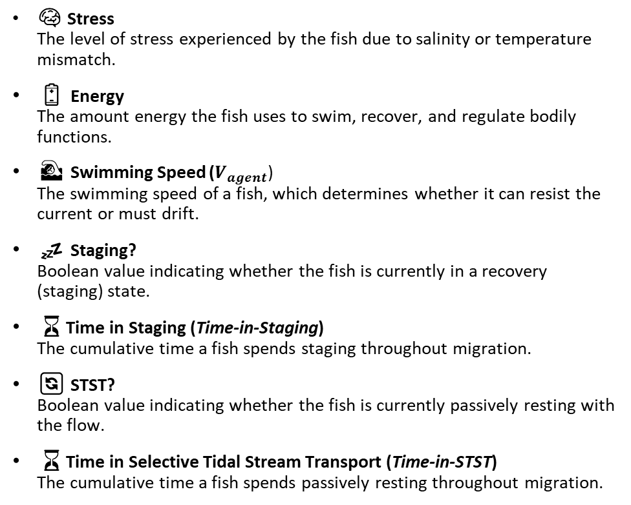
Key Variables for the Model
🌍 Environmental Variables
🐟 Individual (Fish) Variables
🌀 Velocity (u)
The along-channel flow velocity in a patch, influencing whether fish swim or drift.
🛑 Staging Location (Staging-in-Patch)
The number of agents currently resting (staging) in a patch, useful for identifying recovery zones.
🌊 Selective Tidal Stream Transport Location (STST-in-Patch)
The number of agents currently drifting via STST in a patch, highlighting passive transport zones
⏳ Time Spent Selective Tidal Stream Transport (STST-time)
The cumulative time fish spend resting in one location.
💤 Time Spent Staging (Staging-time)
The cumulative time fish spend staging in one location.
🧠 Stress
The level of stress experienced by the fish due to salinity or temperature mismatch.
🔋 Energy
The amount energy the fish uses to swim, recover, and regulate bodily functions.
🏊 Swimming Speed ($V_{agent}$)
The swimming speed of a fish, which determines whether it can resist the current or must drift.
💤 Staging?
Boolean value indicating whether the fish is currently in a recovery (staging) state.
⏳Time in Staging (Time-in-Staging)
The cumulative time a fish spends staging throughout migration.
🔄 STST?
Boolean value indicating whether the fish is currently passively resting with the flow.
⏳Time in Selective Tidal Stream Transport (Time-in-STST)
The cumulative time a fish spends passively resting throughout migration.
Notes:
The along-channel flow velocity in a patch, influencing whether fish swim or drift.

Slide 5
Conditions that Trigger Resting
Condition | Result | Mechanism
Current velocity > swimming speed | Passive resting | Selective Tidal Stream Transport
Energy ≤ 25% | Stop & actively recover | Staging
Stress > 50% | Stop & actively recover | Staging

Slide 6

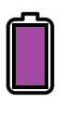





Legend
Stress
Energy
Swimming Speed
Salinity (psu)
Temperature ($C$)
$$V_{agent}$$
Current Velocity ($u$)
u
u
u
u
u
u
u
u
u
u
u
u
u
u
u
u
u
u
u
u
u
u
u
u
u
u
u
u
Environmental Conditions
1. Fish react to their environment with energy use and stress.
Notes:
If |Vpatch|>Vagent|𝑉𝑝𝑎𝑡𝑐ℎ|>𝑉𝑎𝑔𝑒𝑛𝑡 and Vagent≤Speedmin

Slide 7
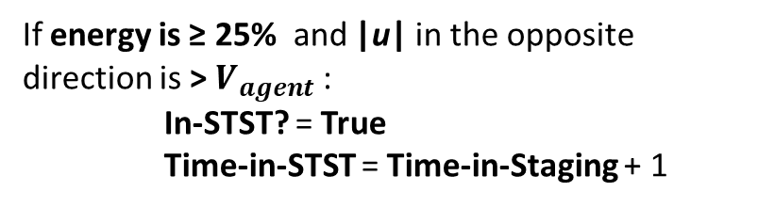
Stress
Energy
Swimming Speed
$$V_{agent}$$
u
u
u
u
u
u
u
u
u
u
u
u
u
u
Staging
Selective Tidal Stream Transport (STST)
If energy is ≤ 25% or stress > 50%:
Staging? = True
Time-in-Stage = Time-in-Stage + 1
Energy = Energy + 1
If energy is ≥ 25% and |u| in the opposite direction is > $V_{agent}$:
In-STST? = True
Time-in-STST = Time-in-Staging + 1
u
u
u
u
u
u
u
u
u
u
u
u
u
u
No Rest Needed
2. Fish Determine if Resting is Needed
Notes:
If |Vpatch|>Vagent|𝑉𝑝𝑎𝑡𝑐ℎ|>𝑉𝑎𝑔𝑒𝑛𝑡 and Vagent≤Speedmin

Slide 8
Stress
Energy
Swimming Speed
$$V_{agent}$$
STST: 0
Staged: 0
Environmental Conditions
3. Patches Track Fish Resting
Notes:
If |Vpatch|>Vagent|𝑉𝑝𝑎𝑡𝑐ℎ|>𝑉𝑎𝑔𝑒𝑛𝑡 and Vagent≤Speedmin

Slide 9
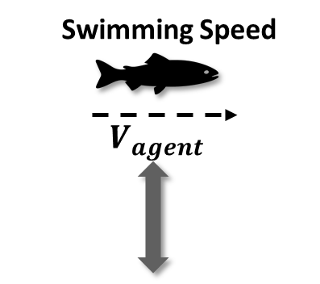

Stress
Energy
Swimming Speed
$$V_{agent}$$
u
u
u
u
u
u
u
u
u
u
u
u
u
u
u
u
u
u
u
u
u
u
u
u
u
u
u
u
Environmental Conditions
1. Fish react to their environment with energy use and stress.
Notes:
If |Vpatch|>Vagent|𝑉𝑝𝑎𝑡𝑐ℎ|>𝑉𝑎𝑔𝑒𝑛𝑡 and Vagent≤Speedmin

Slide 10
Stress
Energy
Swimming Speed
$$V_{agent}$$
u
u
u
u
u
u
u
u
u
u
u
u
u
u
Staging
Selective Tidal Stream Transport (STST)
If energy is ≤ 25% or stress > 50%:
Staging? = True
Time-in-Stage = Time-in-Stage + 1
Energy = Energy + 1
If energy is ≥ 25% and |u| in the opposite direction is > $V_{agent}$:
In-STST? = True
Time-in-STST = Time-in-Staging + 1
u
u
u
u
u
u
u
u
u
u
u
u
u
u
Staging Needed
Environmental Conditions
2. Fish Determine if Resting is Needed
Notes:
If |Vpatch|>Vagent|𝑉𝑝𝑎𝑡𝑐ℎ|>𝑉𝑎𝑔𝑒𝑛𝑡 and Vagent≤Speedmin

Slide 11
Stress
Energy
Swimming Speed
$$V_{agent}$$
STST: 0
STST: 0
Staged: 0
Staged: 1
Environmental Conditions
3. Patches Track Fish Resting
Notes:
If |Vpatch|>Vagent|𝑉𝑝𝑎𝑡𝑐ℎ|>𝑉𝑎𝑔𝑒𝑛𝑡 and Vagent≤Speedmin

Slide 12

Stress
Energy
Swimming Speed
$$V_{agent}$$
u
u
u
u
u
u
u
u
u
u
u
u
u
u
u
u
u
u
u
u
u
u
u
u
u
u
u
u
Environmental Conditions
1. Fish react to their environment with energy use and stress.
Notes:
If |Vpatch|>Vagent|𝑉𝑝𝑎𝑡𝑐ℎ|>𝑉𝑎𝑔𝑒𝑛𝑡 and Vagent≤Speedmin

Slide 13
Stress
Energy
Swimming Speed
$$V_{agent}$$
u
u
u
u
u
u
u
u
u
u
u
u
u
u
Staging
Selective Tidal Stream Transport (STST)
If energy is ≤ 25% or stress > 50%:
Staging? = True
Time-in-Stage = Time-in-Stage + 1
Energy = Energy + 1
If energy is ≥ 25% and |u| in the opposite direction is > $V_{agent}$:
In-STST? = True
Time-in-STST = Time-in-Staging + 1
u
u
u
u
u
u
u
u
u
u
u
u
u
u
STST Needed
Environmental Conditions
2. Fish Determine if Resting is Needed
Notes:
If |Vpatch|>Vagent|𝑉𝑝𝑎𝑡𝑐ℎ|>𝑉𝑎𝑔𝑒𝑛𝑡 and Vagent≤Speedmin

Slide 14
Stress
Energy
Swimming Speed
$$V_{agent}$$
STST: 0
STST: 0
STST: 1
Staged: 0
Staged: 1
Staged: 0
Environmental Conditions
3. Patches Track Fish Resting
Notes:
If |Vpatch|>Vagent|𝑉𝑝𝑎𝑡𝑐ℎ|>𝑉𝑎𝑔𝑒𝑛𝑡 and Vagent≤Speedmin

Slide 15


4. During Rest: Fish Move to Conserve Energy
Sufficient Energy
Low Energy
Low Stress
High Stress
Selective Tidal Stream Transport (STST)
Staging
Fish attempt to remain in place, move lower in the water column, and drift passively with the current to conserve energy use.
Fish identify and move to the most energy-efficient neighboring patches to rest
where:
|u| < $V_{agent}$

Slide 16


5. While in Rest: Fish Check for Better Conditions
Fish remain in STST until |u| in the opposite direction is < $V_{agent}$
Fish remain Staging until Stress is <= 10% and Energy >= 75%
Why it Matters:
Identifies critical recovery thresholds for migratory fish behavior.
Pinpoints locations where currents or temperature and salinity fluctuations impose energetic stress.
Supports fisheries management by revealing when and where fish pause most often, and assessing whether these resting zones overlap with areas of high contamination.

Slide 17
Individual-Specific Traits
Trait Type | Generalization
Stress | Related to an fish’s ability to mitigate salinity and temperature stress.
Energy
Swimming Speed

Slide 18
Outputs of Interest
Type | Variable | What It Tells Us
Temporal | STST? | When fish switch into passive drift due to unfavorable flow conditions.
 | Staging? | When fish stop active migration to recover from low energy or high stress.
 | Time-in-STST | Cumulative time fish spend utilizing STST throughout migration.
 | Time-in-Staging | Cumulative time fish spend staging throughout migration.
Spatial | STST-in-Patch | Where in the environment fish most frequently rely on STST behavior.
 | Staging-in-Patch | Where fish most often stop to recover based on flow and stress conditions.
 | STST-time | Which locations accumulate the most total time in passive drift.
 | Staging-time | Which locations accumulate the most total time spent resting or recovering.

Slide 19
Discussion Prompts
Accuracy & Realism
Do the triggers for STST or Staging (e.g., high current velocity, low energy, high stress) feel biologically reasonable?
Does it make sense that fish might rest more in certain areas or times due to hydrodynamics or salinity mismatch?
Missing Variables, Traits, or Parameters
Should a fish’s species, age, or size affect resting behavior?
Are there missing environmental stressors (e.g., predation, poor habitat quality in resting areas) that could influence resting?
Outputs of Interest
Which outputs are most useful for identifying critical habitat or management actions (e.g., resting hotspot maps, resting duration, overlap of these spots with contamination)?
Is it more helpful to track where fish rest or how long they remain in those states?

Slide 21
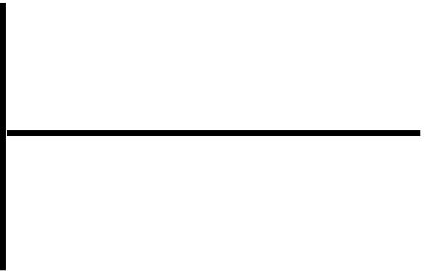


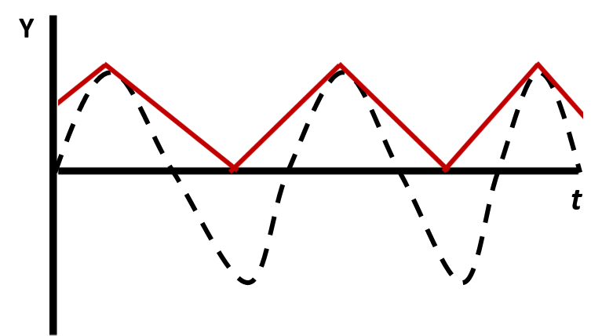
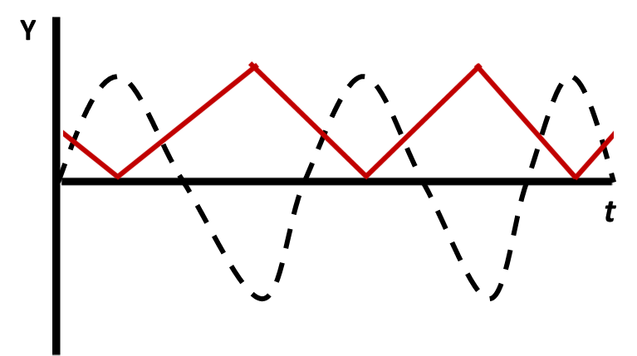
Y
Y
t
t

Slide 22




Slide 23
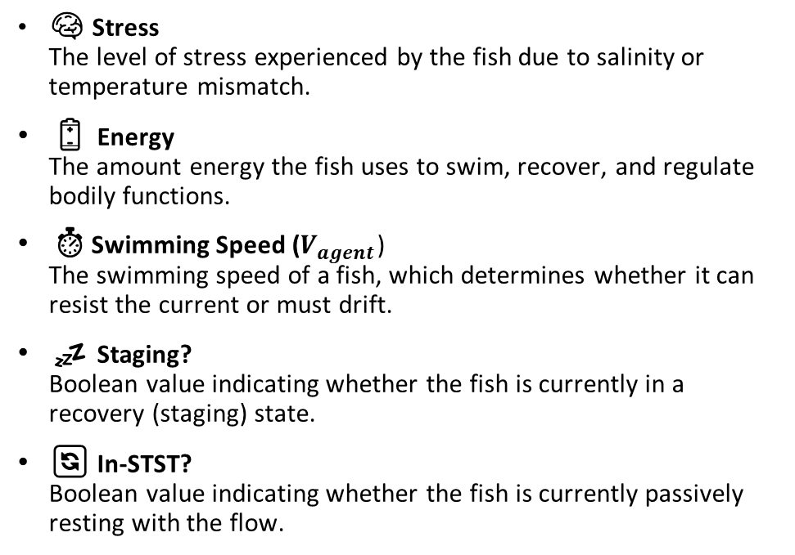
Key Variables for the Model
🌍 Environmental Variables
🐟 Individual (Fish) Variables
🌀 Velocity (u)
The along-channel flow velocity in a patch, influencing whether fish swim or drift.
🛑 Staging Location (Staging-in-Patch)
The number of agents currently resting (staging) in a patch, useful for identifying recovery zones.
🌊 Selective Tidal Stream Transport Location (STST-in-Patch)
The number of agents currently drifting via STST in a patch, highlighting passive transport zones
⏳ Time Spent Selective Tidal Stream Transport (STST-time)
The cumulative time fish spend resting in one location.
💤 Time Spent Staging (Staging-time)
The cumulative time fish spend staging in one location.
🧠 Stress
The level of stress experienced by the fish due to salinity or temperature mismatch.
🔋 Energy
The amount energy the fish uses to swim, recover, and regulate bodily functions.
⏱️Swimming Speed ($V_{agent}$)
The swimming speed of a fish, which determines whether it can resist the current or must drift.
💤 Staging?
Boolean value indicating whether the fish is currently in a recovery (staging) state.
🔄 In-STST?
Boolean value indicating whether the fish is currently passively resting with the flow.
Notes:
The along-channel flow velocity in a patch, influencing whether fish swim or drift.

Slide 25
Y
Y
t
t

Slide 27
Key Variables for the Model
🌍 Environmental Variables
🐟 Individual (Fish) Variables
🌀 Velocity (u)
The along-channel flow velocity in a patch, influencing whether fish swim or drift.
🛑 Staging Location (Staging-in-Patch)
The number of agents currently resting (staging) in a patch, useful for identifying recovery zones.
🌊 Selective Tidal Stream Transport Location (STST-in-Patch)
The number of agents currently drifting via STST in a patch, highlighting passive transport zones
⏳ Time Spent Selective Tidal Stream Transport (STST-time)
The cumulative time fish spend resting in one location.
💤 Time Spent Staging (Staging-time)
The cumulative time fish spend staging in one location.
🧠 Stress
The level of stress experienced by the fish due to salinity or temperature mismatch.
🔋 Energy
The amount energy the fish uses to swim, recover, and regulate bodily functions.
⏱️Swimming Speed ($V_{agent}$)
The swimming speed of a fish, which determines whether it can resist the current or must drift.
💤 Staging?
Boolean value indicating whether the fish is currently in a recovery (staging) state.
🔄 In-STST?
Boolean value indicating whether the fish is currently passively resting with the flow.
Notes:
The along-channel flow velocity in a patch, influencing whether fish swim or drift.

