Slide 1
Bioaccumulation Dynamics
Penobscot Estuary Community Modeling Workshop
ABM Draft Bioaccumulation Function
August 6th, 2025
Drafted By: Vanessa Quintana

Slide 2
Relevant Background Information
Term | Definition
Contamination | Harmful substances (like mercury and methylmercury) that can be found in the environment and affect fish health.
Suspended Particulate Matter (SPM) | Tiny floating particles in the water that can carry pollution and be absorbed through skin and gills exposure.
Stress | The strain a fish feels when something in the environment changes (like temperature, or salinity) that makes it harder for them to stay healthy.
Bioaccumulation | The buildup of harmful chemicals (like mercury and methylmercury) inside a fish over time, leading to fish toxicity.

Slide 3
Model Objectives
Purpose: Simulates exposure to contamination as fish move through the system
Objectives:
Simulate exposure dynamics Track how migratory fish encounter and accumulate mercury (Hg) and methylmercury (MeHg) across space and time.
Capture thresholds and exceedance Identify when exposure exceeds health thresholds that may trigger physiological stress or regulatory concern.
Quantify Bioaccumulation Risk Compute cumulative exposure and uptake risk by integrating environmental contamination, stress responses, and suspended particulate matter dynamics.

Slide 4
Key Variables for the Model
🌍 Environmental Variables
🐟 Individual (Fish) Variables
🧪 Mercury (Hg) The concentration of inorganic mercury in the water or on particles.
☠️ Methylmercury (MeHg) The toxic organic form of mercury that bioaccumulates in fish tissue.
🌫️ Suspended Particulate Matter (SPM) The amount of fine material suspended in the water column.
📍 Time Spent The total time a fish spends in one location.
⚠️ Patch Risk How likely a fish is to absorb Hg or MeHg in a specific area.
🧠 Stress The level of stress an agent experiences at the current time step.
🌫️ Exposure The amount of Hg and MeHg an agent is exposed to in the current time step.
📊 Exposure Total The total amount of Hg and MeHg fish are exposed to throughout their migration.
⏱️ Exposure Duration The amount of time an agent is exposed to Hg or MeHg above healthy levels throughout their migration.
⚠️ Uptake Risk The level of risk associated with uptake of Hg and MeHg from SPM at the current time step.

Slide 5
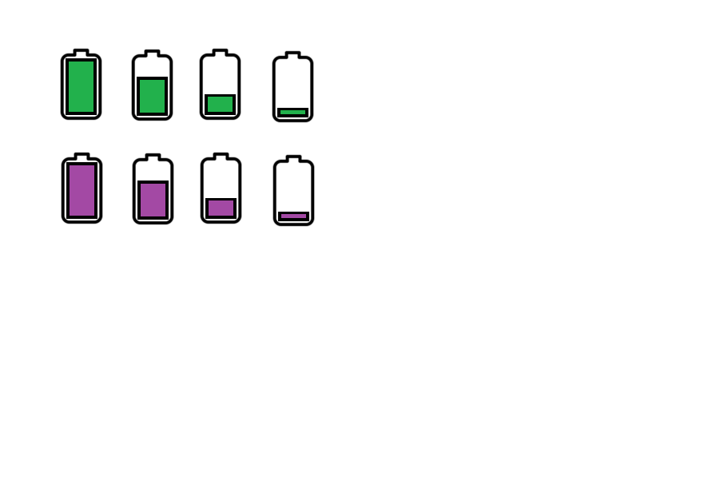
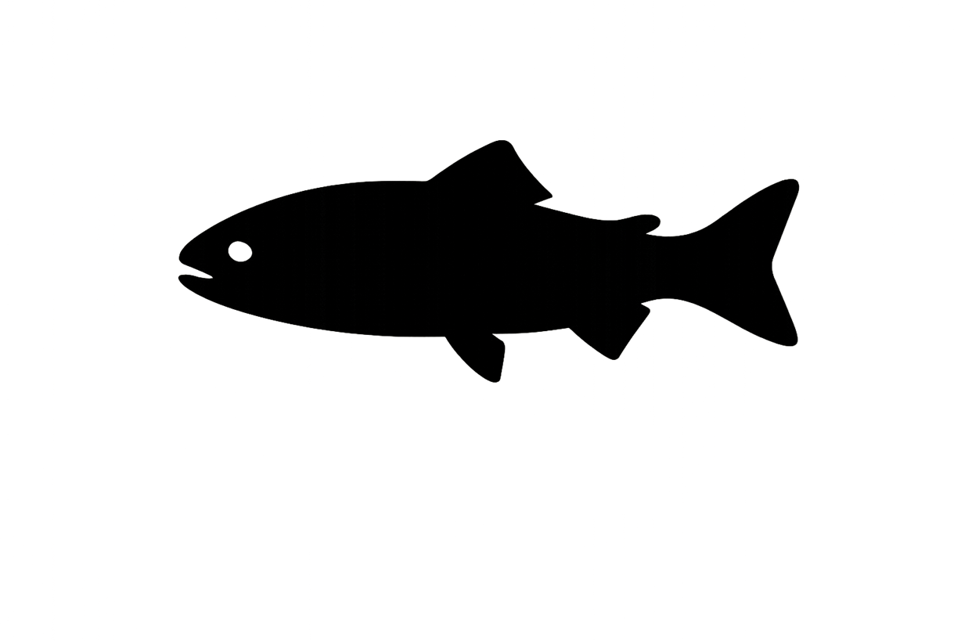
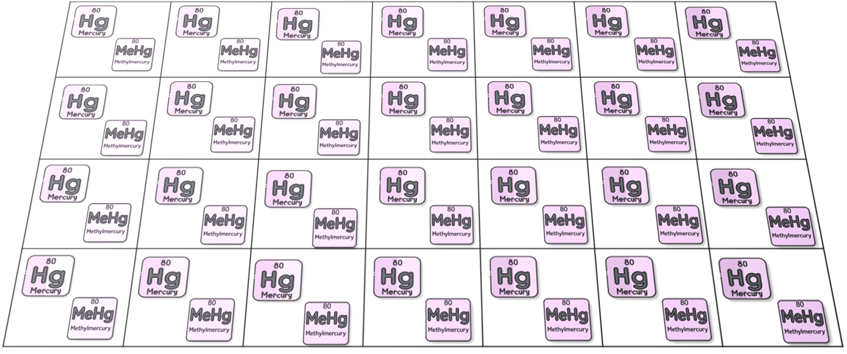
Fish Experience and Record Contamination Levels Along Migration.
Contamination Levels
Legend
Contamination
SPM
Environmental Contamination
(Mercury and Methylmercury)

Slide 6

Fish Track Time Exposed to Contamination Above NOAA Limits
NOAA
Exposure-Duration = 0
Contamination Levels
Legend
Each patch tracks how many fish visit and how long they stay.
Contamination
SPM
Time: 1
Fish: 1
Environmental Contamination
(Mercury and Methylmercury)

Slide 7
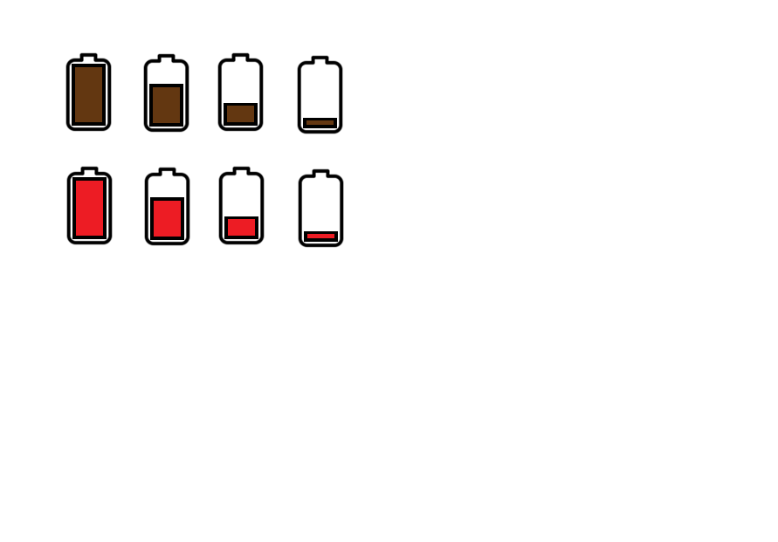
Fish Track Bioaccumulation Uptake Risk
=
NOAA
SPM
Stress
Contamination
Uptake Risk
Legend
Contamination
SPM
Time: 1
Fish: 1
Risk: 1.4
=
NOAA
SPM
Stress
Contamination
Uptake Risk
Environmental Contamination
(Mercury and Methylmercury)

Slide 8
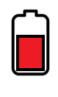
Fish are more likely to accumulate contaminants when they are stressed, surrounded by fine suspended particles, or exposed to high contamination levels.
x
🧠
x
=
Contamination Levels
Stress
SPM
Bioaccumulation Risk
x
🧠
x
=
Contamination Levels
Stress
SPM
Bioaccumulation Risk

Slide 9
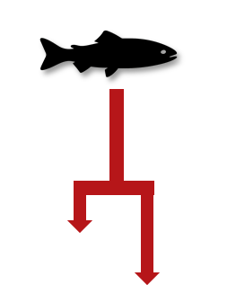
Fish Keep Track of Cumulative Contamination Throughout Migration
Contamination Levels
Contamination Levels
Legend
Each patch tracks how many fish visit and how long they stay.
Contamination
SPM
Time: 1
Time: 1
Fish: 1
Fish: 1
Risk: 1.4
Environmental Contamination

Slide 10
When fish enter a patch with contamination above NOAA limits, exposure time increases and is recorded for that location.
NOAA
Exposure-Duration = 0 + 1
Exposure-Duration = 0
Contamination Levels
Legend
Each patch tracks how many fish visit and how long they stay.
Contamination
SPM
Time: 1
Time: 1
Fish: 1
Fish: 1
Risk: 1.4
Environmental Contamination

Slide 11
Overlap of salinity shifts, SPM, and contamination in transitional zones raises bioaccumulation risk.
=
NOAA
Uptake-Risk = 1.4
SPM
Stress
Contamination
Uptake Risk
Legend
Each patch tracks how many fish visit and how long they stay.
Contamination
SPM
Time: 1
Time: 1
Fish: 1
Fish: 1
Risk: 1.4
Risk: 0.3
Environmental Contamination

Slide 12
Cumulative Contamination builds up as fish move through polluted areas.
Exposure-Duration = 0
Exposure-Duration = 1
Legend
Contamination
SPM
Each patch tracks how many fish visit and how long they stay.
Time: 1
Time: 1
Fish: 1
Fish: 1
Risk: 1.4
Risk: 0.3
Contamination Levels
Time: 1
Fish: 1
Environmental Contamination

Slide 13
Exposure time increases as fish move through highly polluted areas.
Exposure-Duration = 0
Exposure-Duration = 1
Legend
Contamination
Each patch tracks how many fish visit and how long they stay.
SPM
Time: 1
Time: 1
Fish: 1
Fish: 1
Risk: 1.4
NOAA
Exposure-Duration = 1+1
Contamination Levels
Time: 1
Fish: 1
Environmental Contamination

Slide 14
Bioaccumulation risk varies by patch as fish encounter different combinations of contamination, stress, and suspended particles during migration.
Uptake-Risk = 1.4
Uptake-Risk = 0.3
Legend
Contamination
Each patch tracks how many fish visit and how long they stay.
SPM
Time: 1
Time: 1
Fish: 1
Fish: 1
Risk: 1.4
Risk: 0.3
=
NOAA
SPM
Stress
Contamination
Uptake Risk
Time: 1
Fish: 1
Risk: 0.8
Environmental Contamination

Slide 15
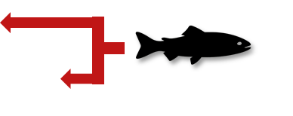
As fish migrate through contaminated areas, exposure accumulates over time, increasing overall contamination burden.
Exposure-Duration = 0
Exposure-Duration = 1
Legend
Contamination
SPM
Time: 1
Time: 1
Fish: 1
Fish: 1
Risk: 1.4
Risk: 0.3
Contamination Levels
Exposure-Duration = 2
Time: 1
Time: 1
Fish: 1
Fish: 1
Risk: 0.8
Environmental Contamination

Slide 16
Prolonged exposure to high contamination adds up over time, creating cumulative health risks for migrating fish.
Exposure-Duration = 0
Exposure-Duration = 1
Legend
Contamination
Each patch tracks how many fish visit and how long they stay.
SPM
Time: 1
Time: 1
Fish: 1
Fish: 1
Risk: 0.3
NOAA
Exposure-Duration = 2 + 0
Contamination Levels
Exposure-Duration = 2
Time: 1
Time: 1
Fish: 1
Fish: 1
Risk: 0.8
Environmental Contamination

Slide 17
Bioaccumulation risk varies by patch as fish encounter different combinations of contamination, stress, and suspended particles during migration.
Different environmental conditions across the migration path cause bioaccumulation risk to fluctuate from patch to patch.
Uptake-Risk = 1.4
Uptake-Risk = 0.3
Legend
Contamination
Each patch tracks how many fish visit and how long they stay.
SPM
Time: 1
Time: 1
Fish: 1
Fish: 1
=
Risk: 0.3
NOAA
SPM
Stress
Contamination
Uptake Risk
Uptake-Risk = 0.8
Time: 1
Time: 1
Fish: 1
Fish: 1
Risk: 1.5
Risk: 0.8
Environmental Contamination

Slide 18
Individual-Specific Traits
Trait Type | Generalization
Stress | Related to an fish’s ability to mitigate salinity and temperature stress.
Individual traits such as size, age, and species influence stress levels of fish.

Slide 19
Outputs of Interest
Type | Variable | What It Tells Us
Temporal | Hg-Exposure MeHg-Exposure | When during migration fish are in the most contaminated areas.
 | Hg-Exposure-Total MeHg-Exposure-Total | How much contamination fish have built up over their whole migration.
 | Hg-Exposure-Duration MeHg-Exposure-Duration | How long fish are exposed to harmful levels of contamination.
 | Hg-Uptake-Risk MeHg-Uptake-Risk | How much risk of mercury entering the body fish face at each moment.
Spatial | Time-Spent | Where in the environment fish spend the most time.
 | Hg-Patch-Risk MeHg-Patch-Risk | Where fish are most likely to absorb mercury based on stress and conditions
Outputs highlight contamination hotspots and periods of exposure that may increase fish toxicity and guide restoration priorities.

Slide 20
Discussion Prompts
Accuracy & Realism
Do the steps feel realistic based on your knowledge or experience?
Does it make sense that fish would be more at risk in certain areas or times based on conditions like salinity or pollution?
Missing Variables, Traits, or Parameters
Are there other traits (like swimming strength, spawning condition, or feeding behavior) that could influence exposure or risk?
Are there environmental conditions missing that affect mercury exposure or stress (e.g., salinity, temperature, turbidity)?
Outputs of Interest
Which outputs would help us understand risk to fish or guide management decisions (e.g., exposure maps, stress zones)?
Are time-based outputs (like how long fish are exposed) more useful, or location-based outputs (like where risk is highest)?

