Slide 1
Resting Behavior
Penobscot Estuary Community Modeling Workshop
ABM Draft Bioaccumulation Function
August 6th, 2025
Drafted By: Vanessa Quintana

Slide 2
Relevant Background Information
Term | Definition
Selective Tidal Stream Transport (STST) | A strategy where fish conserve energy by drifting with favorable tidal currents, usually by positioning themselves in slower or deeper water during migration.
Staging | A behavior where fish temporarily stop migrating to recover from low energy or high stress, often staying in one area until conditions improve.
Stress | The strain a fish feels when something in the environment changes (like temperature, or salinity) that makes it harder for them to stay healthy.

Slide 3
Model Objectives
Purpose: Simulate energy-conserving strategies fish use during migration
Objectives:
Reduce energy cost during high-flow events Enable fish to passively rest when swimming is inefficient, conserving energy for critical behaviors like migration and spawning.
Allow recovery during periods of physiological stress Let fish temporarily stop migrating to restore energy and acclimate to environmental changes such as salinity shifts or elevated flow resistance.
Track when and where resting occurs Identify the spatial and temporal patterns of resting behaviors, including staging hotspots and zones of selective tidal stream transport, to inform habitat quality assessments.
Notes:
Reduce energy cost during high-flow events Enable fish to passively drift with the current when swimming is inefficient, conserving energy for critical behaviors like spawning.
Allow recovery during periods of physiological stress Let fish temporarily stop migrating to restore energy and acclimate to environmental changes such as salinity shifts or elevated flow resistance.
Track when and where resting occurs Identify the spatial and temporal patterns of resting behaviors, including staging hotspots and zones of selective tidal stream transport, to inform habitat quality assessments.

Slide 4
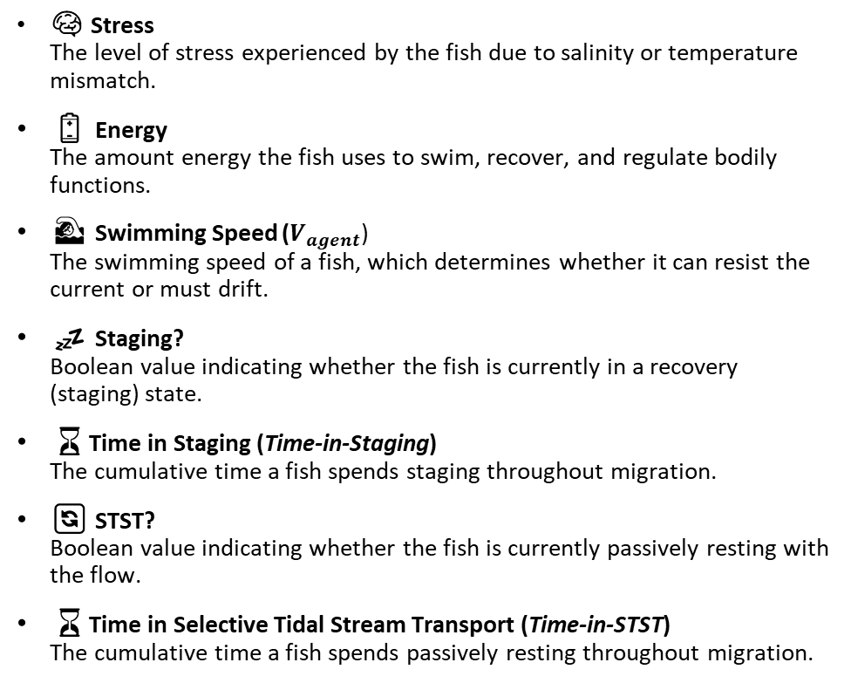
Key Variables for the Model
🌍 Environmental Variables
🐟 Individual (Fish) Variables
🌀 Velocity (u) The along-channel flow velocity in a patch, influencing whether fish swim or drift.
🛑 Staging Location (Staging-in-Patch) The number of agents currently resting (staging) in a patch, useful for identifying recovery zones.
🌊 Selective Tidal Stream Transport Location (STST-in-Patch) The number of agents currently drifting via STST in a patch, highlighting passive transport zones
⏳ Time Spent Selective Tidal Stream Transport (STST-time) The cumulative time fish spend resting in one location.
💤 Time Spent Staging (Staging-time) The cumulative time fish spend staging in one location.
🧠 Stress The level of stress experienced by the fish due to salinity or temperature mismatch.
🔋 Energy The amount energy the fish uses to swim, recover, and regulate bodily functions.
🏊 Swimming Speed ($V_{agent}$) The swimming speed of a fish, which determines whether it can resist the current or must drift.
💤 Staging? Boolean value indicating whether the fish is currently in a recovery (staging) state.
⏳Time in Staging (Time-in-Staging) The cumulative time a fish spends staging throughout migration.
🔄 STST? Boolean value indicating whether the fish is currently passively resting with the flow.
⏳Time in Selective Tidal Stream Transport (Time-in-STST) The cumulative time a fish spends passively resting throughout migration.
Notes:
The along-channel flow velocity in a patch, influencing whether fish swim or drift.

Slide 5
Conditions that Trigger Resting
Condition | Result | Mechanism
Current velocity > swimming speed | Passive resting | Selective Tidal Stream Transport
Energy ≤ 25% | Stop & actively recover | Staging
Stress > 50% | Stop & actively recover | Staging
Fish rest when environmental conditions exceed their ability to swim or cope.

Slide 6
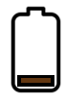
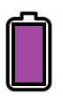
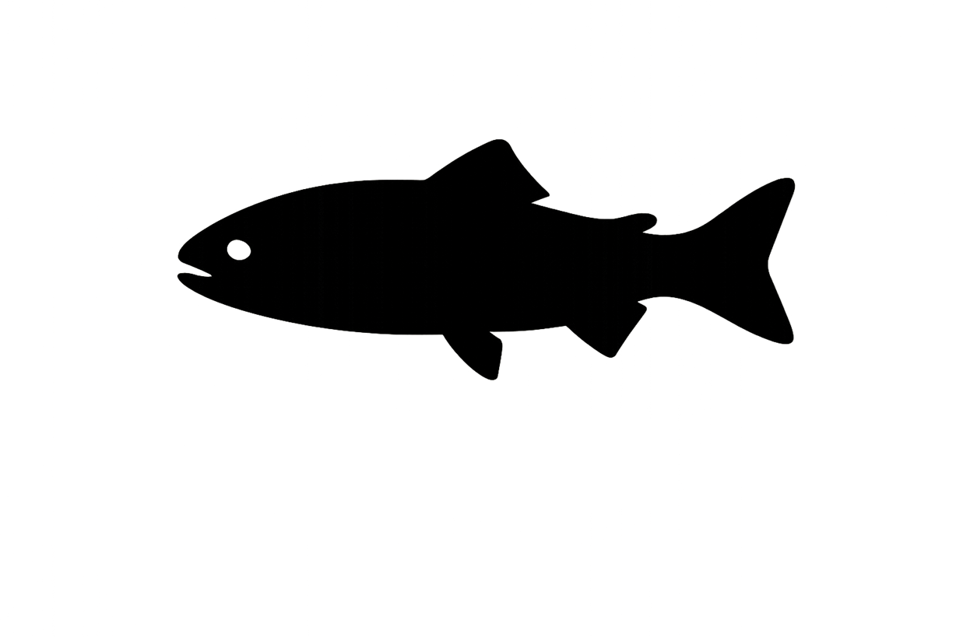




Legend
Stress
Energy
Swimming Speed
Salinity (psu)
Temperature ($C$)
$$V_{agent}$$
Current Velocity ($u$)
u
u
u
u
u
u
u
u
u
u
u
u
u
u
u
u
u
u
u
u
u
u
u
u
u
u
u
u
Environmental Conditions
Fish adjust energy and stress based on current speed, salinity, and temperature.
Notes:
If |Vpatch|>Vagent|𝑉𝑝𝑎𝑡𝑐ℎ|>𝑉𝑎𝑔𝑒𝑛𝑡 and Vagent≤Speedmin

Slide 7
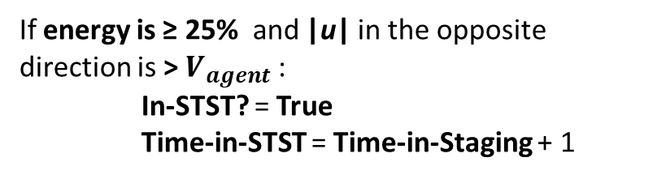
Stress
Energy
Swimming Speed
$$V_{agent}$$
u
u
u
u
u
u
u
u
u
u
u
u
u
u
Staging
Selective Tidal Stream Transport (STST)
If energy is ≤ 25% or stress > 50%:
Staging? = True
Time-in-Stage = Time-in-Stage + 1
Energy = Energy + 1
If energy is ≥ 25% and |u| in the opposite direction is > $V_{agent}$:
In-STST? = True
Time-in-STST = Time-in-Staging + 1
u
u
u
u
u
u
u
u
u
u
u
u
u
u
No Rest Needed
Fish compare their energy, stress, and swimming capacity to the environment to decide whether to pause and recover (staging) or drift passively (STST).
Notes:
If |Vpatch|>Vagent|𝑉𝑝𝑎𝑡𝑐ℎ|>𝑉𝑎𝑔𝑒𝑛𝑡 and Vagent≤Speedmin

Slide 8
Stress
Energy
Swimming Speed
$$V_{agent}$$
STST: 0
Staged: 0
Environmental Conditions
Each patch keeps track of when and where fish are resting, providing insight into tidal trapping, stress zones, and recovery areas.
Notes:
If |Vpatch|>Vagent|𝑉𝑝𝑎𝑡𝑐ℎ|>𝑉𝑎𝑔𝑒𝑛𝑡 and Vagent≤Speedmin

Slide 9
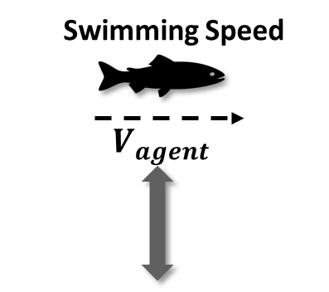

Stress
Energy
Swimming Speed
$$V_{agent}$$
u
u
u
u
u
u
u
u
u
u
u
u
u
u
u
u
u
u
u
u
u
u
u
u
u
u
u
u
Environmental Conditions
Each fish experiences different stress and energy use based on where it is and how it copes with changing environmental conditions.
Notes:
If |Vpatch|>Vagent|𝑉𝑝𝑎𝑡𝑐ℎ|>𝑉𝑎𝑔𝑒𝑛𝑡 and Vagent≤Speedmin

Slide 10
Stress
Energy
Swimming Speed
$$V_{agent}$$
u
u
u
u
u
u
u
u
u
u
u
u
u
u
Staging
Selective Tidal Stream Transport (STST)
If energy is ≤ 25% or stress > 50%:
Staging? = True
Time-in-Stage = Time-in-Stage + 1
Energy = Energy + 1
If energy is ≥ 25% and |u| in the opposite direction is > $V_{agent}$:
In-STST? = True
Time-in-STST = Time-in-Staging + 1
u
u
u
u
u
u
u
u
u
u
u
u
u
u
Staging Needed
Environmental Conditions
When conditions exceed a fish’s limits, it enters staging or STST mode depending on whether it needs to actively recover or passively drift.
Notes:
If |Vpatch|>Vagent|𝑉𝑝𝑎𝑡𝑐ℎ|>𝑉𝑎𝑔𝑒𝑛𝑡 and Vagent≤Speedmin

Slide 11
Stress
Energy
Swimming Speed
$$V_{agent}$$
STST: 0
STST: 0
Staged: 0
Staged: 1
Environmental Conditions
By tracking time spent staging or drifting, the model reveals hotspots where fish pause during migration due to environmental constraints.
Notes:
If |Vpatch|>Vagent|𝑉𝑝𝑎𝑡𝑐ℎ|>𝑉𝑎𝑔𝑒𝑛𝑡 and Vagent≤Speedmin

Slide 12

Stress
Energy
Swimming Speed
$$V_{agent}$$
u
u
u
u
u
u
u
u
u
u
u
u
u
u
u
u
u
u
u
u
u
u
u
u
u
u
u
u
Environmental Conditions
Environmental conditions affect how much effort fish need to stay on course.
Notes:
If |Vpatch|>Vagent|𝑉𝑝𝑎𝑡𝑐ℎ|>𝑉𝑎𝑔𝑒𝑛𝑡 and Vagent≤Speedmin

Slide 13
Stress
Energy
Swimming Speed
$$V_{agent}$$
u
u
u
u
u
u
u
u
u
u
u
u
u
u
Staging
Selective Tidal Stream Transport (STST)
If energy is ≤ 25% or stress > 50%:
Staging? = True
Time-in-Stage = Time-in-Stage + 1
Energy = Energy + 1
If energy is ≥ 25% and |u| in the opposite direction is > $V_{agent}$:
In-STST? = True
Time-in-STST = Time-in-Staging + 1
u
u
u
u
u
u
u
u
u
u
u
u
u
u
STST Needed
Environmental Conditions
Fish decide to stage or use STST based on their condition and flow direction.
Notes:
If |Vpatch|>Vagent|𝑉𝑝𝑎𝑡𝑐ℎ|>𝑉𝑎𝑔𝑒𝑛𝑡 and Vagent≤Speedmin

Slide 14
Stress
Energy
Swimming Speed
$$V_{agent}$$
STST: 0
STST: 0
STST: 1
Staged: 0
Staged: 1
Staged: 0
Environmental Conditions
Resting patterns help identify areas that may limit progress or increase contamination exposure risk.
Notes:
If |Vpatch|>Vagent|𝑉𝑝𝑎𝑡𝑐ℎ|>𝑉𝑎𝑔𝑒𝑛𝑡 and Vagent≤Speedmin

Slide 15


Sufficient Energy
Low Energy
Low Stress
High Stress
Selective Tidal Stream Transport (STST)
Staging
Fish attempt to remain in place, move lower in the water column, and drift passively with the current to conserve energy use.
Fish identify and move to the most energy-efficient neighboring patches to rest
where:
|u| < $V_{agent}$

Slide 16


While in Rest: Fish Check for Better Conditions
Fish remain in STST until |u| in the opposite direction is < $V_{agent}$
Fish remain Staging until Stress is <= 10% and Energy >= 75%
Why it Matters:
Identifies critical recovery thresholds for migratory fish behavior.
Pinpoints locations where currents or temperature and salinity fluctuations impose energetic stress.
Supports fisheries management by revealing when and where fish pause most often, and assessing whether these resting zones overlap with areas of high contamination.

Slide 17
Individual-Specific Traits
Trait Type | Generalization
Stress | Sensitivity to salinity and temperature changes.
Energy | Internal reserves used for movement and recovery.
Swimming Speed | How fast a fish can move and if they can overcome current velocity.
Each fish rests differently based on its own energy reserves, swimming speed, and ability to handle stress. These traits shape when, where, and how long it pauses during migration.

Slide 18
Outputs of Interest
Type | Variable | What It Tells Us
Temporal | STST? | When fish switch into passive drift due to unfavorable flow conditions.
 | Staging? | When fish stop active migration to recover from low energy or high stress.
 | Time-in-STST | Cumulative time fish spend utilizing STST throughout migration.
 | Time-in-Staging | Cumulative time fish spend staging throughout migration.
Spatial | STST-in-Patch | Where in the environment fish most frequently rely on STST behavior.
 | Staging-in-Patch | Where fish most often stop to recover based on flow and stress conditions.
 | STST-time | Which locations accumulate the most total time in passive drift.
 | Staging-time | Which locations accumulate the most total time spent resting or recovering.
Identifies where and when resting occurs during migration.

Slide 19
Discussion Prompts
Accuracy & Realism
Do the triggers for STST or Staging (e.g., high current velocity, low energy, high stress) feel biologically reasonable?
Does it make sense that fish might rest more in certain areas or times due to hydrodynamics or salinity mismatch?
Missing Variables, Traits, or Parameters
Should a fish’s species, age, or size affect resting behavior?
Are there missing environmental stressors (e.g., predation, poor habitat quality in resting areas) that could influence resting?
Outputs of Interest
Which outputs are most useful for identifying critical habitat or management actions (e.g., resting hotspot maps, resting duration, overlap of these spots with contamination)?
Is it more helpful to track where fish rest or how long they remain in those states?

