Slide 1
Risk and Exposure Dynamics
Penobscot Estuary Community Modeling Workshop
ABM Draft Mercury Risk and Exposure Dynamics Function
August 6th, 2025
Drafted By: Vanessa Quintana

Slide 2
Relevant Background Information
Term | Definition
Contaminant | Harmful substances (like mercury and methylmercury) that can be found in the environment and affect fish health.
Suspended Particulate Matter (SPM) | Tiny floating particles in the water that can carry pollution and be absorbed through skin and gills exposure or ingested.
Stress | A physiological response to perceived threats or unfavorable conditions in their environment
Bioaccumulation | The buildup of harmful chemicals (like mercury and methylmercury) inside a fish over time, leading to fish toxicity if consumed by others.

Slide 3
Model Objectives
Purpose: Simulates exposure to contamination as fish move through the system
Objectives:
Simulate Exposure Dynamics Track how migratory fish encounter and are exposed to mercury (Hg) and methylmercury (MeHg) across space and time.
Capture Thresholds and Exceedance Identify when exposure exceeds health thresholds that may trigger physiological stress or regulatory concern.
Quantify Risk Compute cumulative exposure and risk by integrating environmental contamination, stress responses, and suspended particulate matter dynamics.

Slide 4
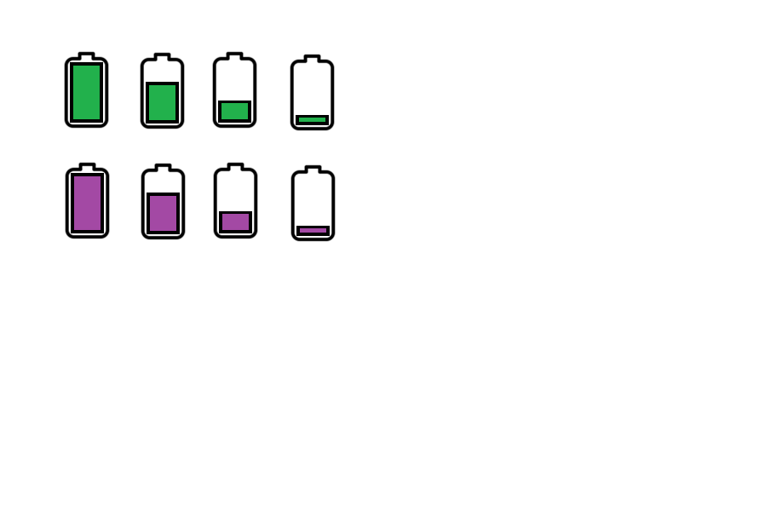
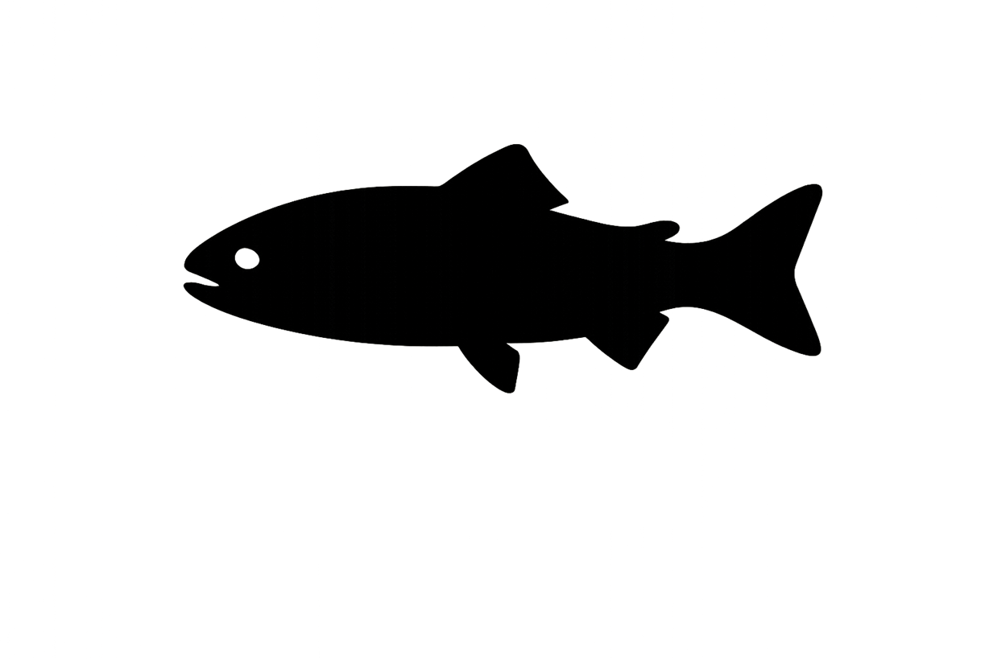
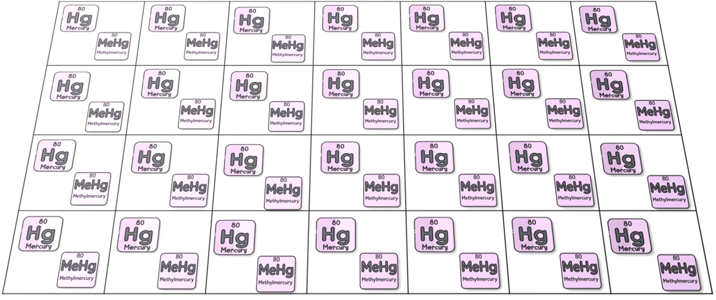
Fish Experience and Record Contamination Levels Along Migration.
Contamination Levels
Legend
Contamination
Suspended Particulate Matter (SPM)
Environmental Contamination
(Mercury and Methylmercury)

Slide 5

Fish Track Time Exposed to Contamination Above NOAA Limits
NOAA
Exposure-Duration = 0
Contamination Levels
Legend
Each patch tracks how many fish visit and how long they stay.
Contamination
Suspended Particulate Matter (SPM)
Time: 1
Fish: 1
Environmental Contamination
(Mercury and Methylmercury)

Slide 6
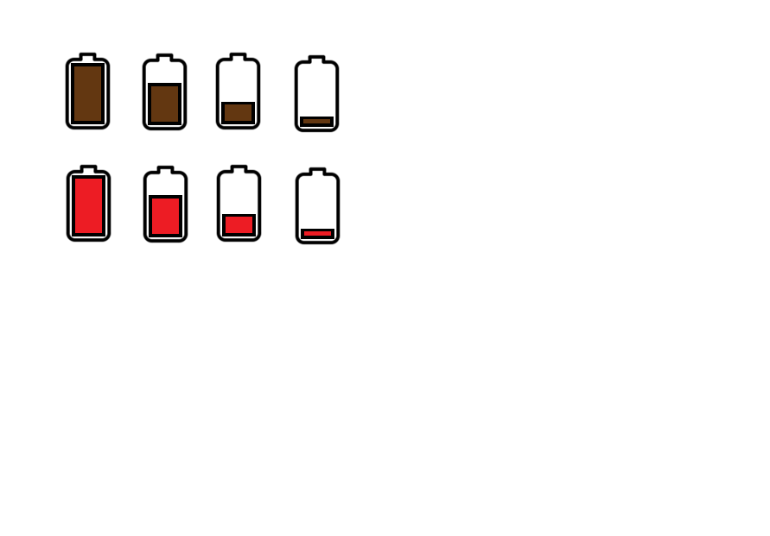
Fish Track Bioaccumulation Uptake Risk
=
NOAA
SPM
Stress
Contamination
Uptake Risk
Legend
Each patch also tracks the risk of bioaccumulation experiences in that location.
Contamination
Suspended Particulate Matter (SPM)
Time: 1
Fish: 1
Risk: 1.4
=
NOAA
SPM
Stress
Contamination
Uptake Risk
Environmental Contamination
(Mercury and Methylmercury)

Slide 7
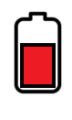
Stressed fish respirate more, increasing water flow over their gills and raising contaminant uptake, especially in areas with fine particles or high contamination.
x
🧠
x
=
Contamination Levels
Stress
SPM
Bioaccumulation Risk
x
🧠
x
=
Contamination Levels
Stress
SPM
Bioaccumulation Risk

Slide 8
Fish Keep Track of Cumulative Contamination Throughout Migration
Contamination Levels
Contamination Levels
Legend
Contamination
Suspended Particulate Matter (SPM)
Each patch tracks how many fish visit, how long they stay, and the risk they experience.
Time: 1
Time: 1
Fish: 1
Fish: 1
Risk: 1.4
Environmental Contamination

Slide 9
Overlap of salinity shifts, SPM, and contamination in transitional zones raises bioaccumulation risk.
=
NOAA
SPM
Stress
Contamination
Risk
Legend
Contamination
Each patch tracks how many fish visit, how long they stay, and the risk they experience.
Suspended Particulate Matter (SPM)
Time: 1
Time: 1
Fish: 1
Fish: 1
Risk: 1.4
Risk: 0.3
Environmental Contamination

Slide 10
When fish enter a patch with contamination above NOAA limits, exposure time increases and is recorded for that location.
NOAA
Exposure = 0 + 1
Contamination Levels
Legend
Contamination
Each patch tracks how many fish visit, how long they stay, and the risk they experience.
Suspended Particulate Matter (SPM)
Time: 1
Time: 1
Fish: 1
Fish: 1
Risk: 1.4
Environmental Contamination

Slide 11
Cumulative Contamination builds up as fish move through polluted areas.
Exposure = 1
Legend
Each patch tracks how many fish visit, how long they stay, and the risk they experience.
Contamination
Suspended Particulate Matter (SPM)
Time: 1
Time: 1
Fish: 1
Fish: 1
Risk: 1.4
Risk: 0.3
Contamination Levels
Time: 1
Fish: 1
Environmental Contamination

Slide 12
Exposure time increases as fish move through highly polluted areas.
Exposure = 1
Legend
Contamination
Each patch tracks how many fish visit, how long they stay, and the risk they experience.
Suspended Particulate Matter (SPM)
Time: 1
Time: 1
Fish: 1
Fish: 1
Risk: 1.4
NOAA
Exposure= 1+1
Contamination Levels
Time: 1
Fish: 1
Environmental Contamination

Slide 13
Bioaccumulation risk varies by patch as fish encounter different combinations of contamination, stress, and suspended particles during migration.
Legend
Exposure = 1
Contamination
Each patch tracks how many fish visit, how long they stay, and the risk they experience.
Suspended Particulate Matter (SPM)
Time: 1
Time: 1
Fish: 1
Fish: 1
Risk: 1.4
Risk: 0.3
=
NOAA
SPM
Stress
Contamination
Risk
Time: 1
Fish: 1
Risk: 0.8
Environmental Contamination

Slide 14
Individual-Specific Traits
Trait Type | Generalization
Stress | Related to a fish’s ability to mitigate salinity and temperature stress.
Individual traits such as size, age, and species influence individual stress levels in fish.

Slide 15
Outputs of Interest
Type | Variable | What It Tells Us
Temporal | Hg-Exposure MeHg-Exposure | When during migration fish are in the most contaminated areas.
 | Hg-Exposure-Total MeHg-Exposure-Total | How much contamination fish have built up over their whole migration.
 | Hg-Exposure-Duration MeHg-Exposure-Duration | How long fish are exposed to harmful levels of contamination.
 | Hg-Uptake-Risk MeHg-Uptake-Risk | How much risk of mercury entering the body fish face at each moment.
Spatial | Time-Spent | Where in the environment fish spend the most time.
 | Hg-Patch-Risk MeHg-Patch-Risk | Where fish are most likely to absorb mercury based on stress and conditions
Outputs highlight contamination hotspots and periods of exposure that may increase fish toxicity and guide restoration priorities.

Slide 16
Discussion Prompts
Accuracy & Realism
Are there other traits (like predation, spawning condition, or foraging behavior) that could influence exposure or risk?
Does it make sense that fish would be more at risk in certain areas or times based on conditions like salinity, temperature, or pollution levels?
Outputs of Interest
Which outputs would help us understand risk to fish or guide management decisions (e.g., exposure maps, stress zones)?
Are time-based outputs (like how long fish are exposed) more useful, or location-based outputs (like where risk is highest)?

