Slide 1
Predation Behavior
Penobscot Estuary Community Modeling Workshop
ABM Draft Predation Function
August 6th, 2025
Drafted By: Vanessa Quintana

Slide 2
Relevant Background Information
Term | Definition
Ectotherm | Swimming, survival, and energy use all depend on environmental temperature.
Optimal Temperature | Each fish has an optimal temperature for performance, and lethal limits for cold and heat.
Thermal Stress | Maximum prey size a predator can consume, based on its own size.
Predator | An agent that detects, selects, and consumes prey to gain energy.
Prey | Agents that avoid predators using fleeing behaviors based on visual detection and social cues.

Slide 3
Model Objectives
Purpose: This module simulates predator-prey interactions between migratory fish species (predators like striped bass and prey like alewife) during migration.
Objectives:
Link predator-prey interactions to environmental conditions Allow predators and prey to evaluate nearby environmental conditions, and adjust their behaviors accordingly.
Simulate optimal predation behavior Enable predators to prey on other agents based on the optimal foraging theory, and prey to flee from predators.
Link energy gain and depletion predator-prey behavior Predators gain energy from consuming prey, while prey lose energy when fleeing.
Notes:
Reduce energy cost during high-flow events Enable fish to passively drift with the current when swimming is inefficient, conserving energy for critical behaviors like spawning.
Allow recovery during periods of physiological stress Let fish temporarily stop migrating to restore energy and acclimate to environmental changes such as salinity shifts or elevated flow resistance.
Track when and where resting occurs Identify the spatial and temporal patterns of resting behaviors, including staging hotspots and zones of selective tidal stream transport, to inform habitat quality assessments.

Slide 4
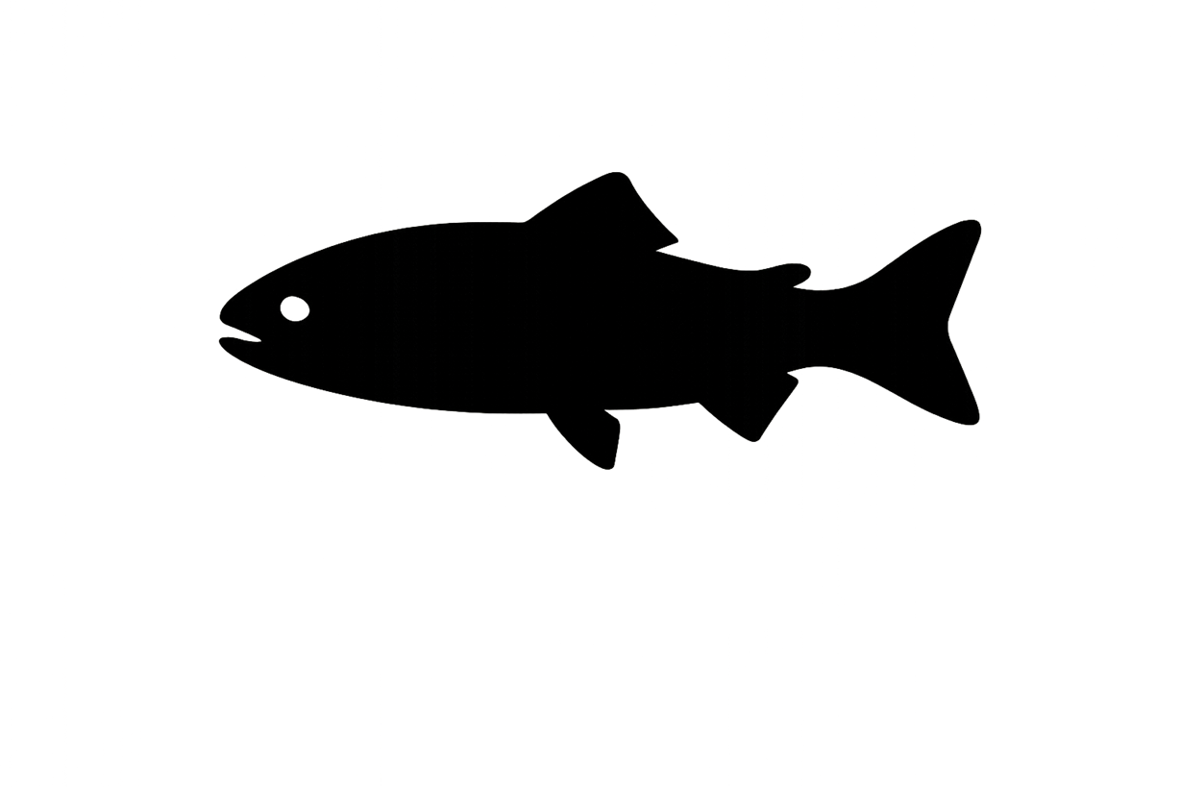

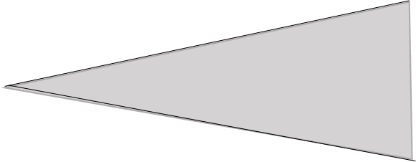
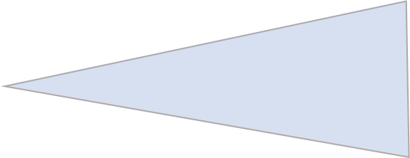
Visual Ability
Predator
Prey
Legend
SPM
Fish can only see each other if the water is clear enough, the other fish is large enough, and they are close enough.

Slide 5
Visual Ability
Predator
Prey
Legend
SPM
High SPM levels can decrease vision and make prey harder to find, and predators harder to recognize

Slide 6
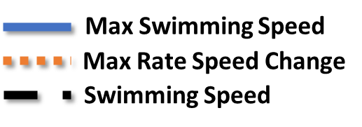
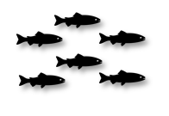
Fleeing and Pursuit Limits
Max Swimming Speed
Max Rate Speed Change
Swimming Speed
Y
$${Swim}_{max}$$
Swimming Speed
t
time
Fish can't instantly speed up. They have a natural limit to how fast they can accelerate, and each burst of speed uses energy.
Once a fish runs out of energy, it can't keep fleeing or chasing.

Slide 7

Predator
Prey
Legend
SPM
Predators weigh how hard it will be to catch and eat a fish. They prefer prey that are nearby, smaller than their mouth can handle, and part of a group.

Slide 8
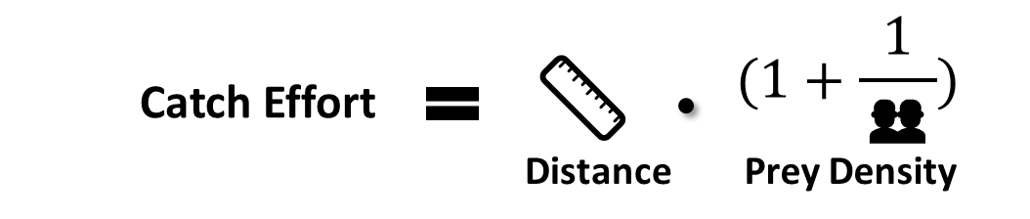
Calculate Catch Effort
🦷
Available prey for consumption is filtered out by an agent’s gape limit.
👥
Higher density of prey decreases the catch effort in predators.
📏
Closer prey require less energy to pursue and capture.

Slide 9
Every pursuit costs energy. Predators must choose wisely to avoid wasting energy on prey they can’t catch.
Predator Energy Use
Y
Y
Ecological Implication
c
Greater catch effort forces fish to use more energy to successfully capture prey.
t
High Catch Effort
High Energy Use
Y
Y
Lower catch effort requires less energy to successfully capture prey.
Low Catch Effort
t
Low Energy Use

Slide 10
Escaping predators burns energy, and prey that run out of energy become easy targets.
Prey Energy Use
Y
Y
Ecological Implication
Greater fleeing effort forces prey to use more energy to successfully evade predators.
t
High Fleeing Effort
High Energy Use
Y
Y
Lower fleeing effort requires less energy to successfully evade predators.
Low Fleeing Effort
t
Low Energy Use

Slide 11


Optimal Foraging Theory
Y
❌
Prey Size
(Energy Gain: Low)
Net Return: Low
t
High Energy Use
Y
✅
Prey Size
(Energy Gain: High)
Net Return: High
t
Low Energy Use
Predators choose prey that give them the most energy for the least effort.

Slide 12
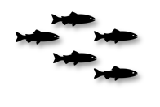
Predator
Prey
Legend
Each patch tracks where and when fish are eaten.
SPM
Eaten: 1
Eaten: 1
When one prey detects a predator, it triggers an alarm that causes the entire school to flee, reflecting how fish use group behavior to avoid predators.

Slide 13
Individual-Specific Traits
Trait Type | Generalization
Energy | Determines if predators can pursue or prey can escape.
Hunger Level | Determines if a predator is hungry or not.
Predation Ability | Determines reaction time to prey based on age and experience.
Fleeing Ability | Determines reaction time to predators based on age and experience.
Traits like energy and experience determine if and how fast a fish reacts, whether it can escape or chase, and how well it survives.

Slide 14
Outputs of Interest
Type | Variable | What It Tells Us
Temporal | Prey Consumed | Tracks when fish are consuming prey.
 | Prey Species | Tracks what type of prey fish are consuming.
Spatial | Predation Events | Areas where predation is concentrated.
 | Escape Events | Areas where predation is constantly avoided successfully.
These outputs help us understand where and when predator–prey interactions happen, and may point to habitat features that increase risk or provide refuge.

Slide 15
Discussion Prompts
Accuracy & Realism
Do predators always prioritize predation during migration, or are there situations when they are more likely to ignore nearby prey?
Does limiting predator pursuit by gape size, hunger levels, or energy availability reflect real-world behavior?
Missing Variables, Traits, or Parameters
Are there time-of-day, tidal phase, or species constraints that influence when predation is more likely or more successful?
What environmental (e.g., turbidity, salinity, visibility) or structural barriers (e.g., dams, culverts, entrainment zones) might inhibit predation or fleeing behavior?
Outputs of Interest
Should the model prioritize where predation and escape attempts happen or how often they occur?
Are there ways we could use these outputs to support habitat restoration or passage design?

