Slide 1
Thermoregulation Function
Penobscot Estuary Community Modeling Workshop
ABM Draft Thermoregulation Function
August 6th, 2025
Drafted By: Vanessa Quintana

Slide 2
Relevant Background Information
Term | Definition
Thermoregulation | How fish keep the right balance of salt and water inside their bodies, even when the water around them changes.
Ectotherm | Fish whose body temperature depends on the temperature of the surrounding water.
Optimal Temperature | The water temperature where a fish can swim, grow, and survive most efficiently.
Thermal Tolerance | The range of temperatures a fish can survive in, from the minimum to the maximum limit.
Homeostasis | The ability of fish to maintain stable internal conditions, like energy use and performance, even when water temperature changes.

Slide 3
Model Objectives
Purpose: Simulate how migratory fish experience and respond to temperature-related stress, including energy use, and swimming difficulty.
Objectives:
Quantify Thermal Stress Calculate the physiological stress experienced when water temperature deviates from a fish’s optimal thermal range.
Simulate Thermal Impacts Represent changes in swimming performance, behavior, and mortality risk under cold or hot conditions.
Estimate Energy Use Track the energy fish spend to maintain homeostasis, adjust to new temperatures, and move under thermal stress.

Slide 4
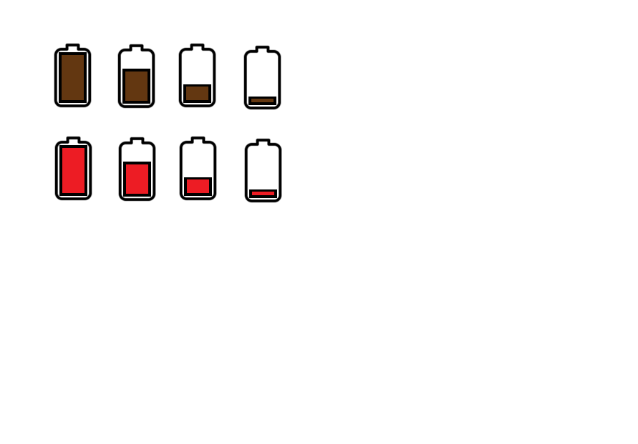

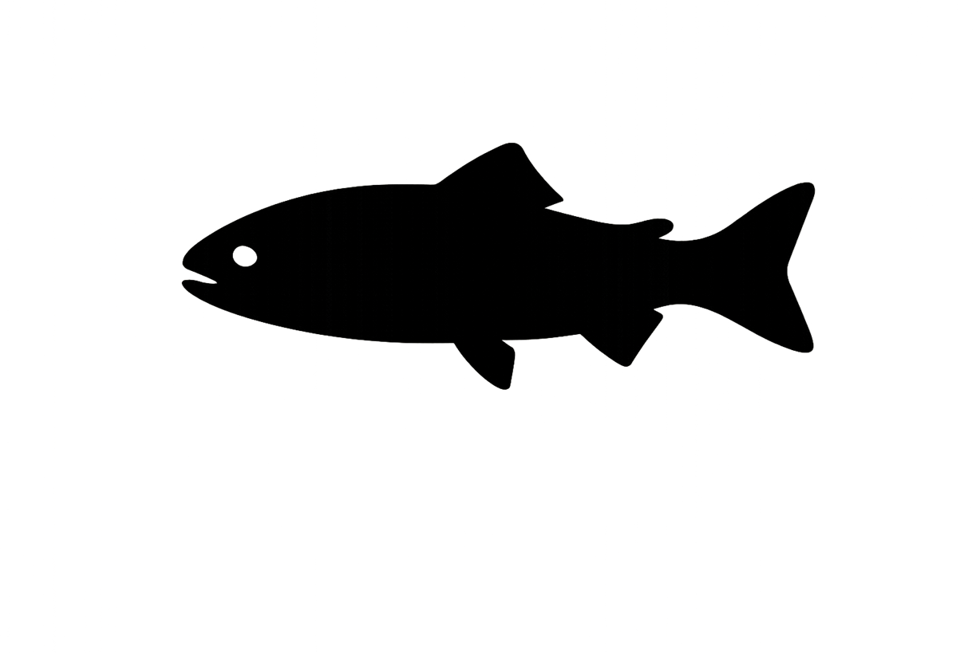
Fish feel stress when the water is too hot or too cold for them. They use more energy to survive and move when they’re outside their comfort zone.
=
Legend
Colder than Optimal Temperature (-)
External Temperature
Optimal Temperature
Thermal Stress
Warmer than Optimal Temperature (+)
Environmental Temperature

Slide 5
Thermal stress increases when environmental temperature doesn’t match the fish’s optimal temperature.
Y
c
Y
Ecological Implication
Fish is maintaining balance and thermal stress decreases.
X
X
Difference Decreases
Stress Decreases
Dependent on Acclimation Rate
Y
c
Y
Individual thermoregulation processes cannot keep up with maintaining balance of temperature in the fish and thermal stress increases.
X
X
Environmental Temperature
Optimal Temperature
Difference Increases
Stress Increases

Slide 6
Fish adjust their cellular and enzyme systems to function in new temperatures which costs energy.
Y
Y
Ecological Implication
Stress initializes the creation of new cells and enzymes to maintain homeostasis, limited by a fish’s acclimation rate.
X
X
Stress Increases
Energy Use Increases
Y
Y
Fish can remove excess chloride cells that are not needed to maintain balance.
New Cells and Enzymes
X
X
Stress Decreases
Energy Use Increases
Max Rate of Acclimation

Slide 7



Calculate Patch Stress
Tracks the highest level of stress experienced in a patch.
If Current Stress <= Patch-Stress
No Change
If Current Stress > Patch-Stress
Update Patch-Stress to Current Stress
Each location records how stressed fish were when they passed through, helping us see where temperature conditions are hardest on them.

Slide 8


Making new cells and enzymes uses more energy than removing them, but both add to the total cost of thermoregulation.
Y
Y
%
Current Cells
Creation Energy
X
Cell and Enzyme production Increase
X
Energy Cost is More
Stress initializes the production of new cells and enzymes which costs lots of energy
Y
Y
%
Current Cells
Energy to Destroy
X
Cell and Enzyme production Decrease
X
Energy Cost Is less
Fish can destroy cells and excess enzymes that are not needed, but this still uses some energy.

Slide 9
Cell Maintenance Energy
Y
%
Current Cells
Energy Cost of Maintenance
X
Net Energy Cost of Maintenance
Maintenance Energy: amount of energy a fish must use to keep its existing chloride cells functioning properly, even when no new cells are being created or removed.
Even without new cell growth or removal, fish must spend energy to maintain their existing cells and enzyme levels.

Slide 10
Y
Y
Y
X
X
Thermoregulation Energy Cost
X
Energy Cost of Creation
Energy Cost of Maintenance
Y
Y
Y
X
X
Thermoregulation Energy Cost
X
Energy Cost of Decay
Energy Cost of Maintenance
The total energy cost includes adjusting to temperature, staying balanced, and swimming less efficiently when conditions are poor.

Slide 11
Total Energy Balance
🔋
Y
🔥
Current Energy Levels
Energy Cost of Thermoregulation
X
Total Energy
Total Energy: amount of energy a fish has left to complete migration.
A fish’s total energy budget depends on how much it starts with minus what’s spent on thermoregulation

Slide 12
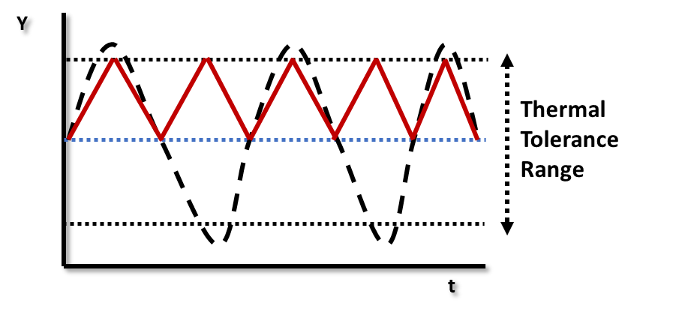
Temperature Impacts Swimming Difficulty
Optimal Temperature (C)
Y
Difficulty Factor (Df)
Temperature (C)
X
Max Difficulty: Lowest and Highest Boundary of Thermal Tolerance
Temperatures too high or too low impair swimming ability. Fish move slower and use more energy to keep going.
Notes:
If |Vpatch|>Vagent|𝑉𝑝𝑎𝑡𝑐ℎ|>𝑉𝑎𝑔𝑒𝑛𝑡 and Vagent≤Speedmin

Slide 13
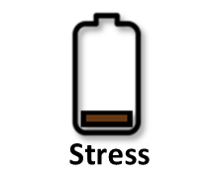
=
External Temperature
Optimal Temperature
Thermal Stress
Energy Use
Energy Levels
Each patch tracks maximum stress experienced in that location.
Colder than Optimal Temperature (-)
Warmer than Optimal Temperature (+)
Environmental Salinity
When optimal and environmental temperature are similar, fish experience low stress, expend less energy, and have less difficulty swimming .

Slide 14


=
External Temperature
Optimal Temperature
Thermal Stress
Energy Use
Energy Levels
Each patch tracks maximum stress experienced in that location.
Colder than Optimal Temperature (-)
Warmer than Optimal Temperature (+)
Environmental Salinity
When environmental temperature is higher than optimal temperature, fish experience higher stress, expend more energy, and have more difficulty swimming .

Slide 15
=
External Temperature
Optimal Temperature
Thermal Stress
Energy Use
Energy Levels
Each patch tracks maximum stress experienced in that location.
Colder than Optimal Temperature (-)
Warmer than Optimal Temperature (+)
Environmental Salinity
When environmental temperature is lower than optimal temperature, fish experience higher stress, expend more energy, and have more difficulty swimming .

Slide 16
Individual-Specific Traits
Trait Type | Generalization
Temperature Acclimation Rate | Higher for larger, older fish; species-dependent
Cell Growth/Decay Rate | Slower in larger, older fish
Creation Energy | Higher for large/old fish or energetically expensive species
Decay Energy | Lower than creation but still influenced by size and age.
Traits like age, size, and species affect how well a fish can handle temperature changes. Some fish adjust faster or are more vulnerable than others.
Notes:
Trait Type
Generalization
Salinity Acclimation Rate
Higher for larger, older fish; species-dependent
Cell Growth/Decay Rate
Slower in larger, older fish
Creation Energy
Higher for large/old fish or energetically expensive species
Decay Energy
Lower than creation but still influenced by size and age.

Slide 17
Outputs of Interest
Type | Variable | What It Tells Us
Temporal | Thermal-Stress | Shows how hard a fish is working to maintain normal processes as temperature changes. Higher stress means more physiological strain, and higher energy cost.
 | Energy | Tracks how much energy a fish is using over time to thermoregulate.
Spatial | Patch-Stress | Identifies locations where fish experience the highest thermal stress, which may reduce their ability to stay healthy.
 | Patch-Energy | Maps where fish are using the most energy to stay balanced, especially in areas with high or low temperatures.
Outputs highlight thermal stress hotspots and periods of high energy demand that may limit fish survival or guide restoration priorities.

Slide 18
Discussion Prompts
Accuracy & Realism
How might energetic state prior to thermal exposure (e.g., post-spawning depletion or migration fatigue) influence mortality risk?
Are current hydrodynamic models accurate enough to simulate localized thermal variation near structures like dams, culverts, or channels?
Missing Variables, Traits, or Parameters
Are there other traits that might affect how fish handle heat or cold, like body size, energy reserves, or age?
Are important environmental factors missing that could influence temperature exposure, like stratification or flow rate?
Outputs of Interest
Are maps of cumulative thermal stress or mortality risk more useful for identifying vulnerable zones and informing monitoring?
Could energy loss or avoidance behavior outputs help identify areas where restoration or engineered flow changes might reduce thermal bottlenecks?

