Slide 1
Osmoregulation Function
Penobscot Estuary Community Modeling Workshop
ABM Draft Osmoregulation Function
August 6th, 2025
Drafted By: Vanessa Quintana

Slide 2
Relevant Background Information
Term | Definition
Osmoregulation | How fish keep the right balance of salt and water inside their bodies, even when the water around them changes.
Gills | Organs that allow fish to breathe and also help control the salt and water balance in their bodies.
Chloride Cells | Special cells in the gills that help fish adjust to salty or fresh water by moving salt in or out of their bodies.
Homeostasis | The ability of fish to keep their internal conditions stable and healthy, even when the environment changes.

Slide 3
Model Objectives
Purpose: Simulates stress and energy use as fish adapt to changing salinity.
Objectives:
Quantify Salinity Stress by calculating the difference between environmental salinity and internal salinity.
Regulate Chloride Cell Density to maintain homeostasis by adjusting cell expression in response to stress.
Estimate Energy Costs associated with chloride cell creation, maintenance, and decay to track the metabolic trade-offs of osmoregulation.

Slide 4
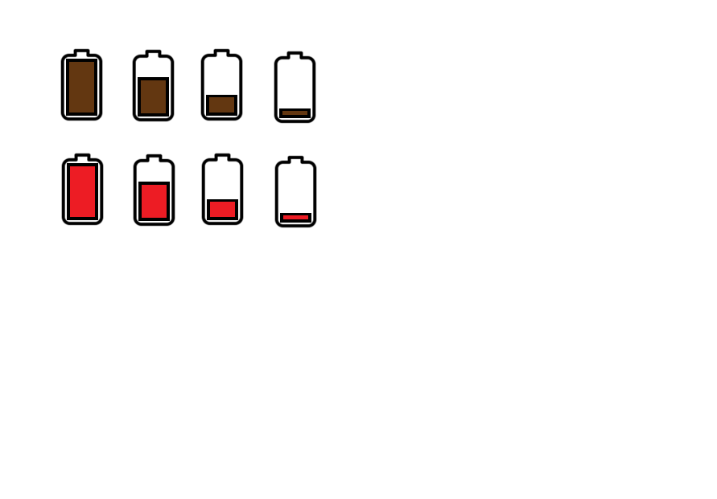
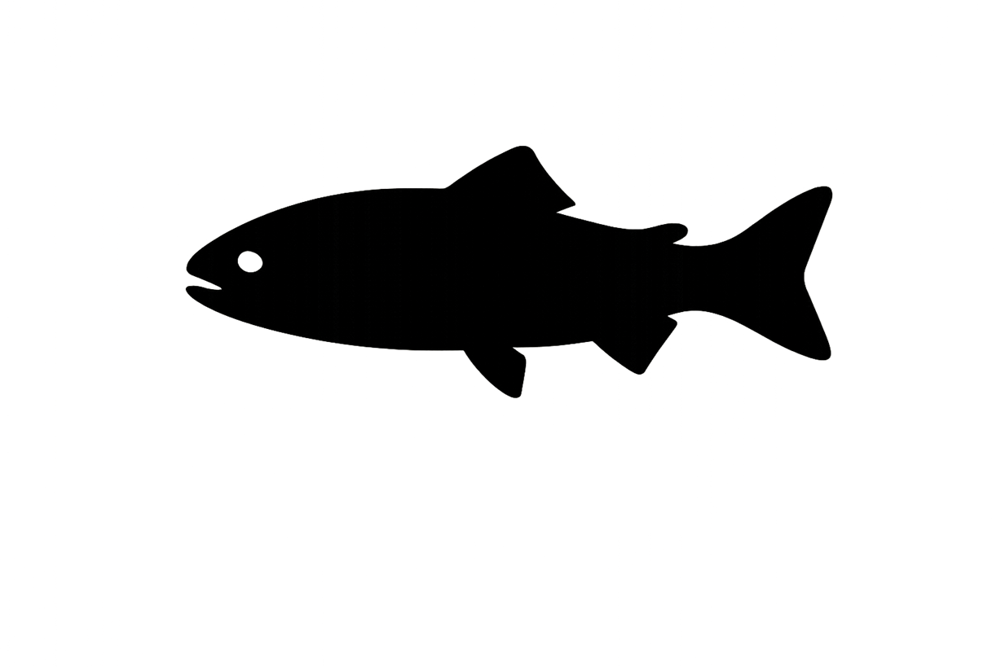
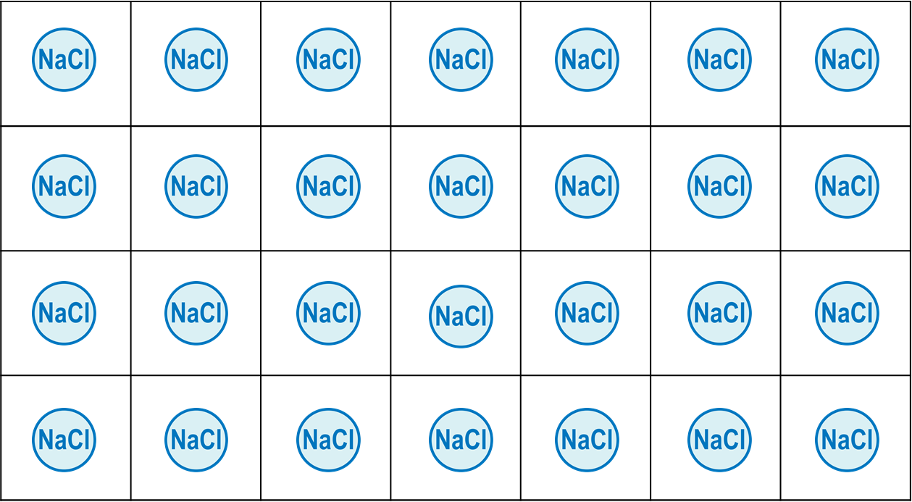
When environmental salinity differs from a fish’s internal balance, the fish experiences stress and must use energy to maintain homeostasis.
=
External Salinity
Internal Salinity
Salinity Stress
Legend
Acclimated Salinity
Salinity
Environmental Salinity

Slide 5
Stress increases when environmental salinity doesn’t match the fish’s acclimated salinity.
Y
Y
Ecological Implication
Individual osmoregulation processes cannot keep up with maintaining balance of salt in the fish and salinity stress increases.
X
X
Difference Increases
Stress Increases
Dependent on Acclimation Rate
Y
Y
Fish is maintaining balance and salinity stress decreases.
Acclimated Salinity
Environmental Salinity
X
X
Difference Decreases
Stress Decreases

Slide 6



Calculate Patch Stress
Tracks the highest level of stress experienced in a patch.
If Current Stress <= Patch-Stress
No Change
If Current Stress > Patch-Stress
Update Patch-Stress to Current Stress
Each patch records the highest stress fish have experienced there, helping identify zones of peak physiological challenge.

Slide 7
As stress increases, fish build more chloride cells to regulate salinity. When stress decreases, fish reduce unneeded cells to conserve energy.
Y
Y
Ecological Implication
Stress initializes the creation of new chloride cells to keep up with osmoregulation and maintain homeostasis, limited by a fish’s cell growth rate.
X
X
Stress Increases
Chloride Cells Increase
Limited by Growth Rate
Y
Y
Fish can remove excess chloride cells that are not needed to maintain balance.
Chloride Cells
X
X
Stress Decreases
Chloride Cells Decrease
Limited by Growth Rate
Max Rate of Cell Growth/Decay

Slide 8


Creating new chloride cells requires more energy than removing excess ones, but both processes contribute to the overall cost of osmoregulation.
Y
Y
%
Current Cells
Creation Energy
X
X
Chloride Cells Increase
Energy Cost is More
Stress initializes the creation of new chloride cells which costs lots of energy
Y
Y
%
Current Cells
Energy to Destroy
X
X
Chloride Cells Decrease
Energy Cost Is less
Fish can remove excess chloride cells that are not needed, but this still uses some energy.

Slide 9
Cell Maintenance Energy
Y
%
Current Cells
Energy Cost of Maintenance
X
Net Energy Cost of Maintenance
Maintenance Energy: amount of energy a fish must use to keep its existing chloride cells functioning properly, even when no new cells are being created or removed.
Even without new cell growth or removal, fish must spend energy to maintain their existing chloride cells and keep them functioning.

Slide 10
Y
Y
Y
X
X
Osmoregulation Energy Cost
X
Energy Cost of Creation
Energy Cost of Maintenance
Y
Y
Y
X
X
Osmoregulation Energy Cost
X
Energy Cost of Decay
Energy Cost of Maintenance
Total osmoregulation cost is the sum of energy used to create, destroy, and maintain chloride cells.

Slide 11
Total Energy Balance
🔋
Y
🔥
Current Energy Levels
Energy Cost of Osmoregulation
X
Total Energy
Total Energy: amount of energy a fish has left to complete migration.
A fish’s total energy budget depends on how much it starts with minus what’s spent on osmoregulation.

Slide 12

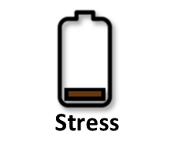
=
External Salinity
Internal Salinity
Salinity Stress
Energy Use
Energy Levels
Legend
Internal Salinity
Salinity
Environmental Salinity
When internal and environmental salinity are similar, fish experience low stress and expend less energy.

Slide 13
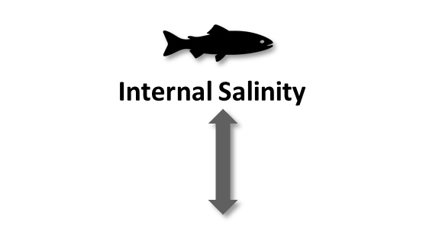
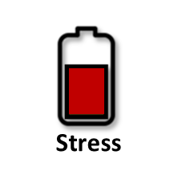
=
External Salinity
Internal Salinity
Salinity Stress
Energy Use
Energy Levels
Internal Salinity
Environmental Salinity
Differences between internal and environmental salinity create stress, requiring fish to spend energy to maintain balance.

Slide 14

=
External Salinity
Internal Salinity
Salinity Stress
Energy Use
Energy Levels
Internal Salinity
Each patch tracks the level of stress experienced in that location.
Environmental Salinity
Energy loss increases along migration routes as fish navigate salinity changes, with the highest stress in transitional zones.

Slide 15
Individual-Specific Traits
Trait Type | Generalization
Salinity Acclimation Rate | Higher for larger, older fish; species-dependent
Cell Growth/Decay Rate | Slower in larger, older fish
Creation Energy | Higher for large/old fish or energetically expensive species
Decay Energy | Lower than creation but still influenced by size and age.
Individual traits such as size, age, and species affect how fish regulate salinity. These differences influence stress levels, energy use, and overall osmoregulatory cost.
Notes:
Trait Type
Generalization
Salinity Acclimation Rate
Higher for larger, older fish; species-dependent
Cell Growth/Decay Rate
Slower in larger, older fish
Creation Energy
Higher for large/old fish or energetically expensive species
Decay Energy
Lower than creation but still influenced by size and age.

Slide 16
Outputs of Interest
Type | Variable | What It Tells Us
Temporal | Salinity-Stress | Shows how hard a fish is working to maintain internal balance as salinity changes. Higher stress means more physiological strain, and higher energy cost.
 | Energy | Tracks how much energy a fish is using over time to regulate its salt balance.
Spatial | Patch-Stress | Identifies locations where fish experience the highest salinity stress, which may reduce their ability to stay healthy.
 | Patch-Energy | Maps where fish are using the most energy to stay balanced, especially in areas with fluctuating salinity.
Outputs highlight stress hotspots and periods of high energy demand that may limit fish survival or guide restoration priorities.

Slide 17
Discussion Prompts
Accuracy & Realism
Do the steps feel realistic based on your knowledge or experience?
Does it make sense that fish would use more energy to manage salinity stress in certain areas or times?
Missing Variables, Traits, or Parameters
Are there other traits that might affect how well a fish regulates salinity (like stress, body condition, or energy reserves, individual acclimation ability)?
Are there environmental factors or variables missing (e.g. temperature, precipitation) impacting a fishing ability to manage stress?
Outputs of Interest
Which outputs from the osmoregulation function would help us better understand how salinity affects fish, or help guide management and restoration decisions (e.g. stress zones, osmoregulation energy expenditure)?
Are time-based outputs (like how fish expend energy over time) more useful, or location-based outputs (like where fish are expending the most energy)?

Slide 18
Key Variables for the Model
🌍 Environmental Variable
🐟 Individual (Fish) Variables
🧂 Salinity How salty the surrounding water is (Affects how much the fish needs to regulate)
🌡️ Patch-Stress Locations where fish experience the highest salinity stress
⚡Patch-Energy Locations where fish are using the most energy to stay balanced
⚡ Energy Available energy for physiological processes
💧 Acclimated Salinity The salt level the fish internally acclimated to (Assumes internal physiological processes managing internal salt levels)
🌊 Salinity Stress Difference between acclimated and external salinity
🧫 Chloride Cell Density Percent of specialized gill cells expressed for salt regulation

