Slide 1
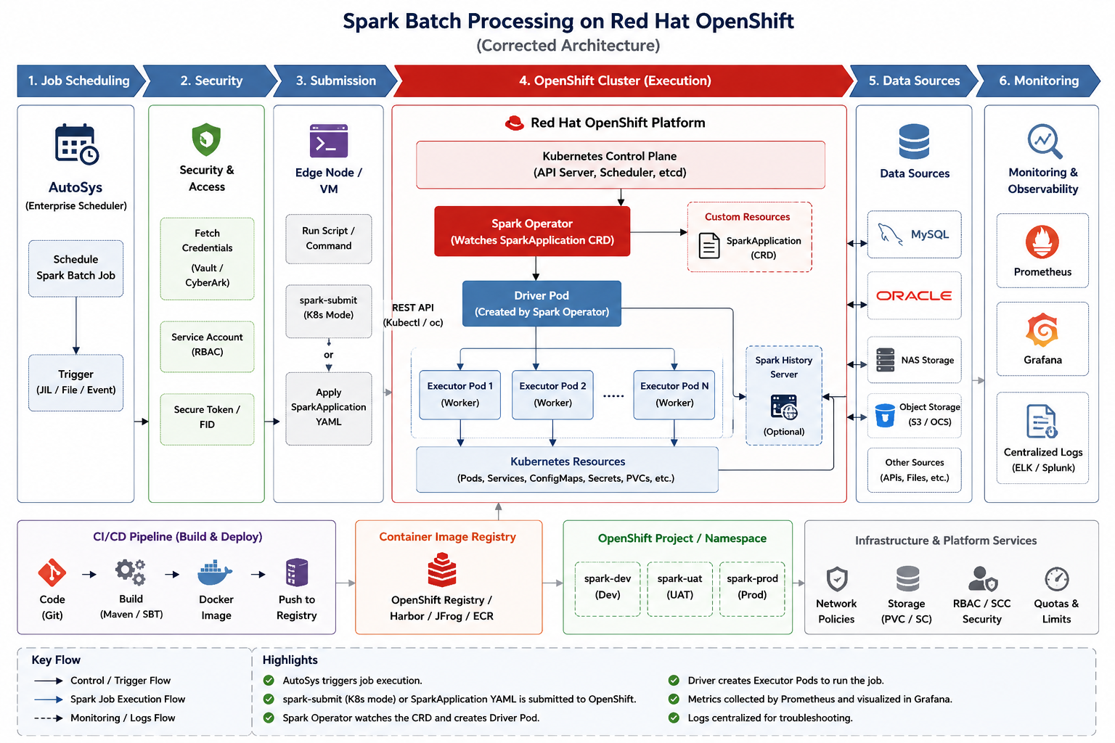

Slide 2
Spark Batch Processing on Red Hat OpenShift
1. Job Scheduling
2. Security
3. Submission
4. OpenShift Cluster
5. Data Sources
6. Monitoring
Red Hat OpenShift Platform
AutoSys
Scheduler
Vault /
CyberArk
spark-submit
or
SparkApplication
Kubernetes Control Plane
MySQL
Prometheus
Spark Operator
Oracle
Grafana
Object
Storage
ELK /
Splunk
Driver Pod
Executor 1
Executor 2
Executor N
CI/CD Pipeline - Build & Deploy
Code
Build
Docker
Scan
Registry
Deploy
Env

