Slide 1


Short project : Subject n°2
Calculation of the solvent accessible surface of a protein
Malassigné Victor - Year 2022-2023

Slide 2
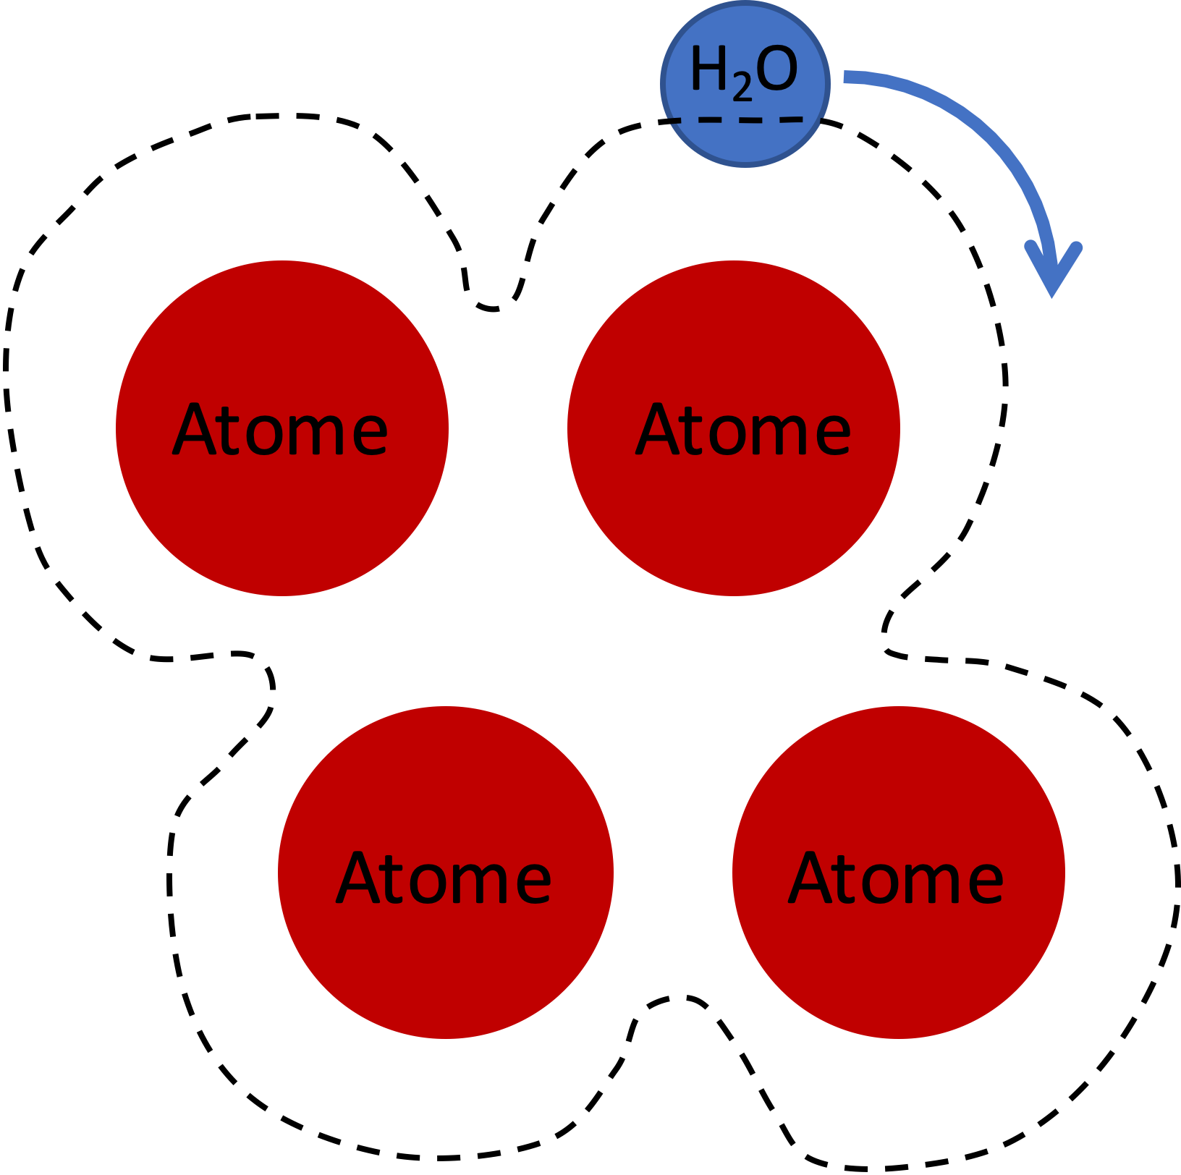
Objectif
Calculation of the protein’s surface incorporating the water molecule.
This method uses the principle of rolling a water molecule over the atoms to determine the accessible solvant surface.
1

Slide 3
Pipeline
Parser PDB
Coordinated atoms
Identification of atoms
Residue per atoms
Residues
2

Slide 4
Pipeline
Parser PDB
Distance matrix
Distance matrix between each atom
2

Slide 5
Pipeline
Parser PDB
Distance matrix
Data in the distance matrix
For each atom we selected :
all atoms with a distance <10 Å
Searching neighbour
2

Slide 6
Pipeline
Parser PDB
Distance matrix
Creating the sphere around the atom.
Sphere consists of 92 points
The radius of the sphere is composed of the Wan der Waals radius of the water and the Wan der Waals radius of the atom.
Searching neighbour
Sphere
2

Slide 7
Pipeline
1
Parser PDB
Neighbour
Atom
Distance matrix
Neighbour
2
Searching neighbour
Neighbour
Neighbour
Sphere
Calculation of the distance between a point on the sphere and the neighbouring atoms.
distance < radius of neighbouring Wan der Waals + water
1 : free point
2 : not free point
Determined the point of sphere free
2

Slide 8
Pipeline
Parser PDB
Distance matrix
Calculation the ASA
Calculation the relative ASA
Calculation the accessiblity percentage
Searching neighbour
Sphere
Determined the point of sphere free
Output calculation
2

Slide 9
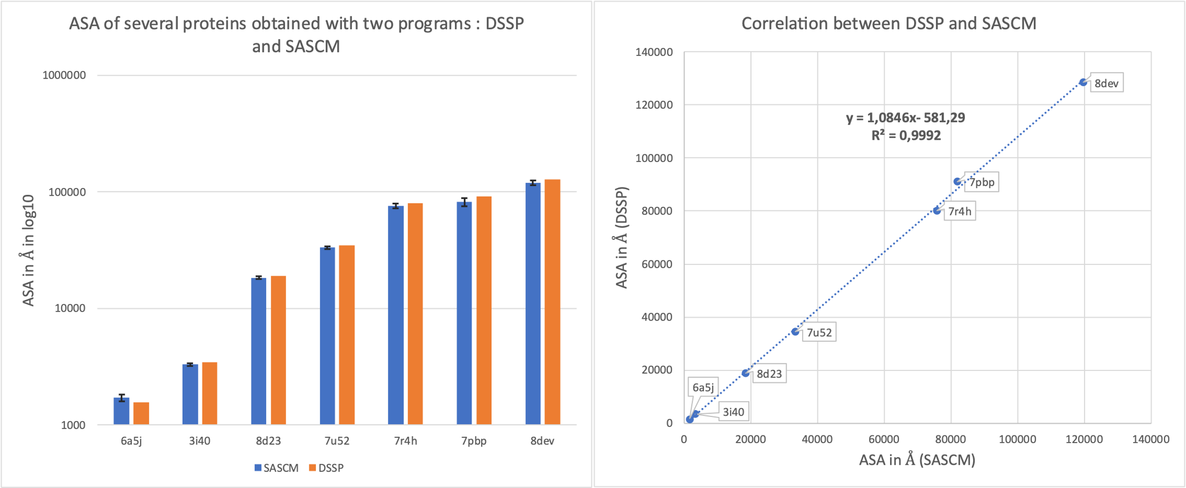
Results
3

Slide 10
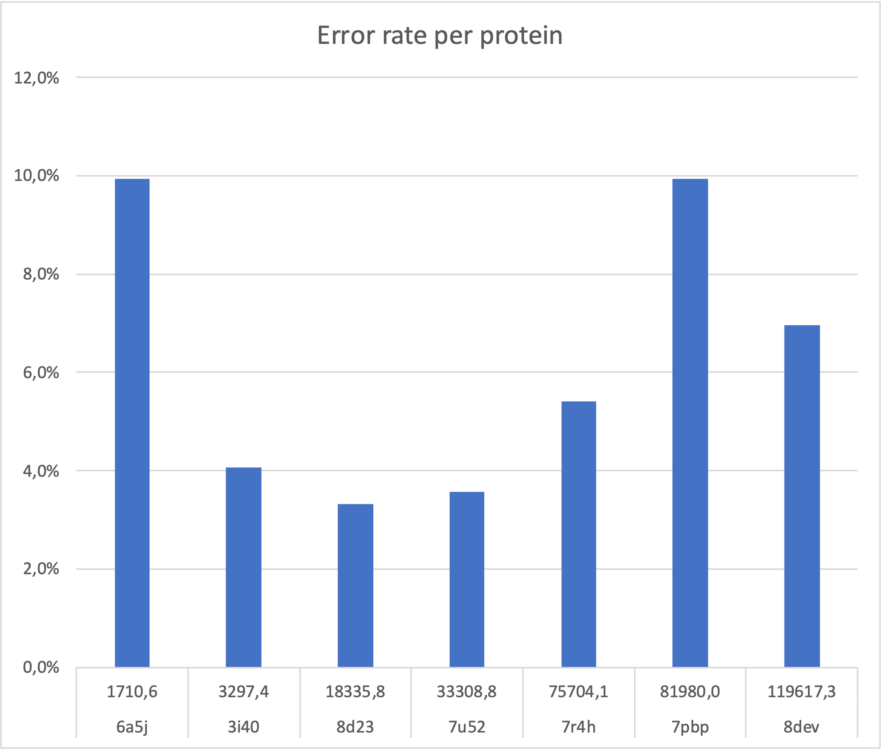
Results
4

Slide 11
Conclusion
Similar results between DSSP and SASCM with an error percentage varying between 3 and 10%.
Longer time of execution : a few seconds to a few minutes depending on the size of the protein.
To save time → implement parallelization.
5

