Slide 1

Data-dependent and Scale-invariant Kernel for Support Vector Machine Classification
Vinayaka Vivekananda Malgi*, Sunil Aryal*, Zafaryab Rasool, David Tay
School of Information Technology
Deakin University, Australia
sunil.aryal@deakin.edu.au
*Contributed equally
26 May 2023

Slide 2
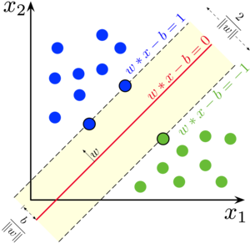
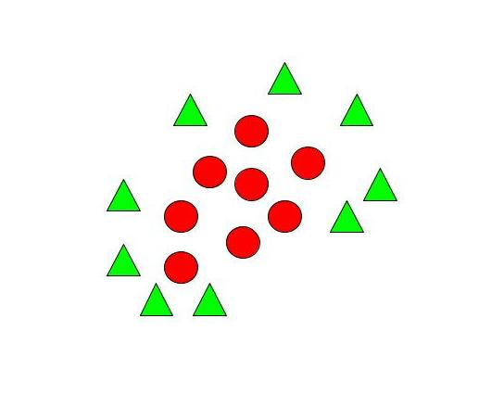
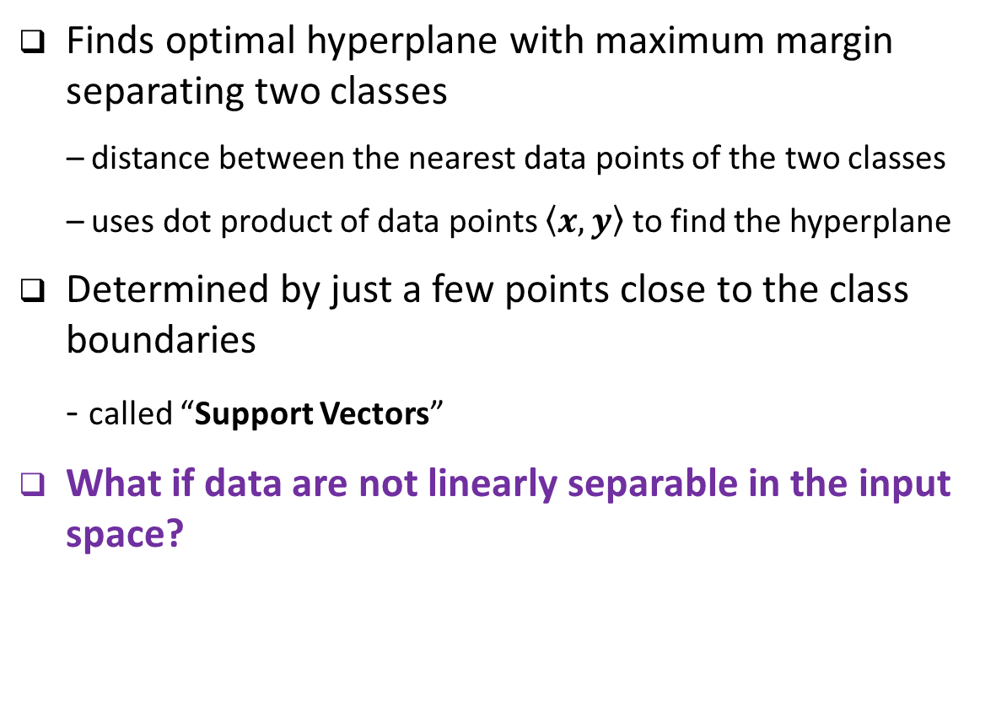
Support Vector Machine (SVM) Classifier
Finds optimal hyperplane with maximum margin separating two classes
– distance between the nearest data points of the two classes
– uses dot product of data points $\left\langle x, y\right\rangle$ to find the hyperplane
Determined by just a few points close to the class boundaries
- called “Support Vectors”
What if data are not linearly separable in the input space?
Support Vectors

Slide 3
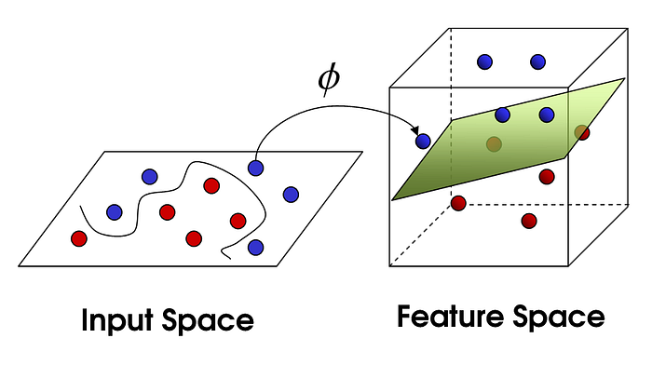
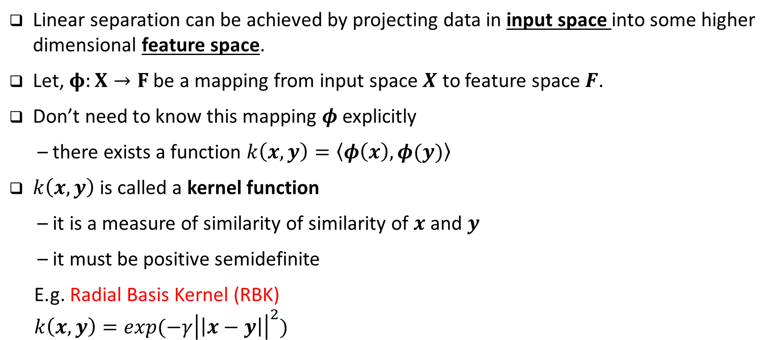
Kernel Trick
Linear separation can be achieved by projecting data in input space into some higher dimensional feature space.
Let, $φ:X→F$ be a mapping from input space $X$ to feature space $F$.
Don’t need to know this mapping $φ$ explicitly
– there exists a function $k\left(x,y\right)=\left\langle φ\left(x\right),φ(y)\right\rangle$
$k\left(x,y\right)$ is called a kernel function
– it is a measure of similarity of similarity of $x$ and $y$
– it must be positive semidefinite
E.g. Radial Basis Kernel (RBK)
$k\left(x,y\right)=exp(−γ{\left|\left|x−y\right|\right|}^{2})$

Slide 4
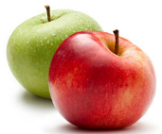

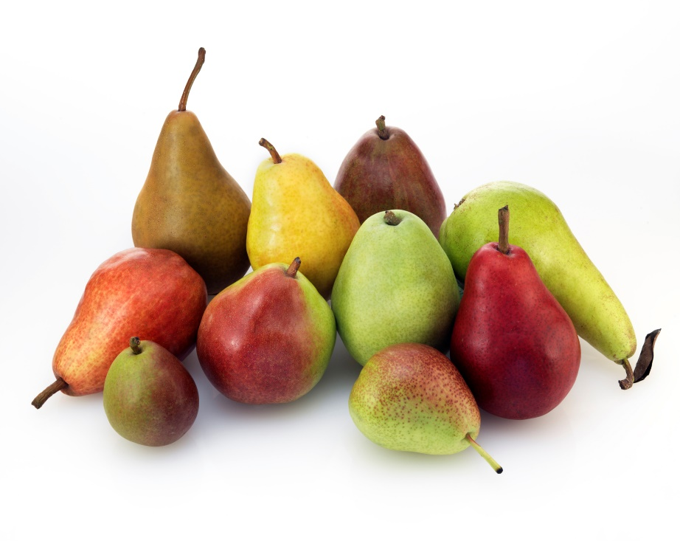
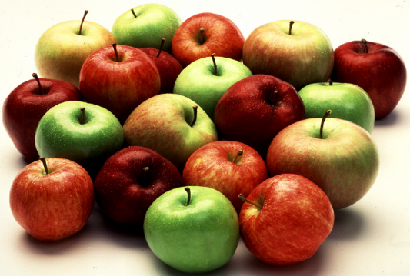
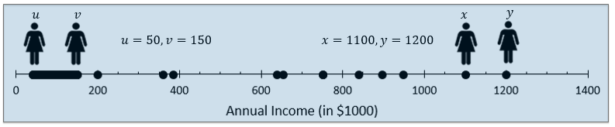
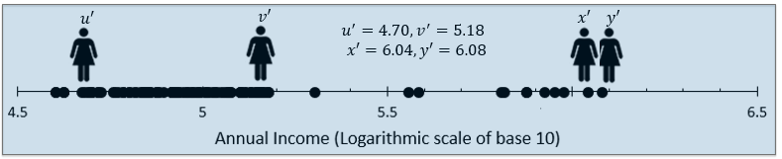




Existing Kernel Functions
Uses spatial distance between data points in the input space to compute their similarity
Issues of distance-based notion of similarity
1. Data-independent
- similarity of two points is independent of data distribution
- psychologists argue that the human judged similarity of two objects is
influenced by the distribution of other objects
- Two objects in a denser region are less similar than two objects with the same distance in sparse region
2. Sensitive to data representation
- unit distance has the same meaning everywhere in the space, it may not be true if data are given in different representations (units/scales)
$$y$$
$$y$$
$$x$$
$$x$$

Slide 5

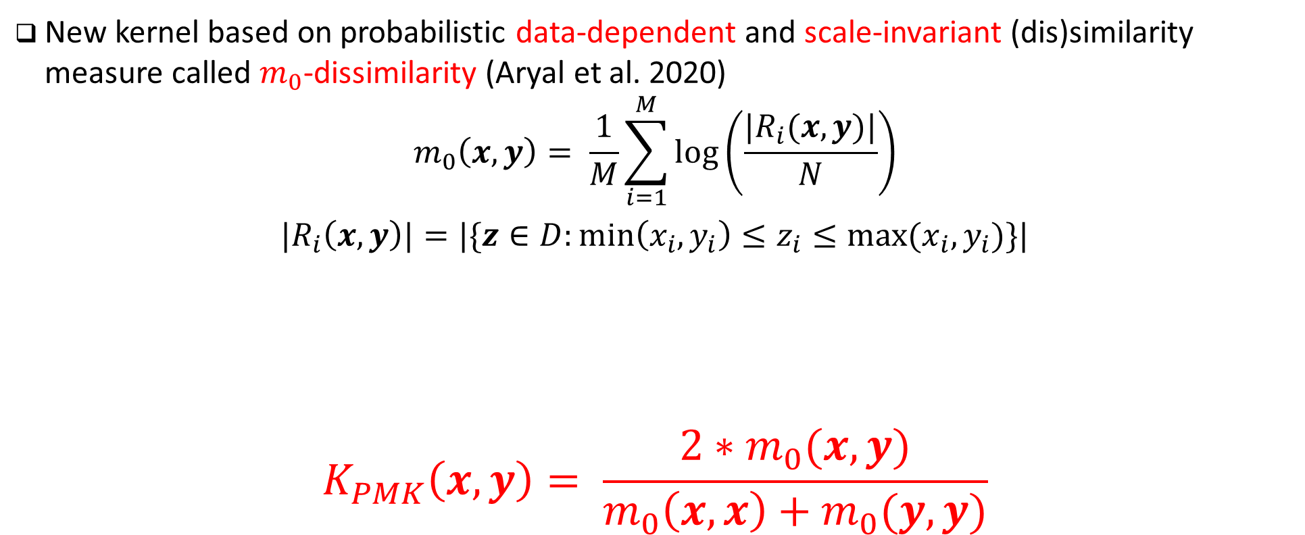



Probability Mass-based Kernel (PMK)
New kernel based on probabilistic data-dependent and scale-invariant (dis)similarity measure called $m_{0}$-dissimilarity (Aryal et al. 2020)
$$m_{0}\left(x,y\right)= \frac{1}{M}\sum_{i=1}^{M}{\log\left(\frac{|R_{i}(x,y)|}{N}\right)}$$
$$|R_{i}\left(x,y\right)|=|\{z∈D:min\left(x_{i}, y_{i}\right)≤z_{i}≤max⁡(x_{i},y_{i})\}|$$
$$K_{PMK}\left(x,y\right)= \frac{2∗m_{0}(x,y)}{m_{0}\left(x,x\right)+m_{0}(y,y)}$$
$$x_{i}$$
$$y_{i}$$
$$R_{i}\left(x,y\right)$$
Data distribution in dimension $i$
Aryal, S., Ting, K. M., Washio, T., & Haffari, G. (2020). “A comparative study of data-dependent approaches without learning in measuring similarities of data objects”. Data Mining and Knowledge Discovery, 34(1), 124-162.

Slide 6
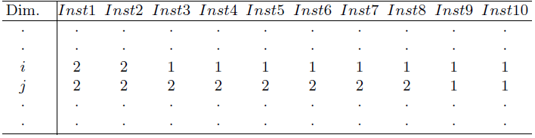
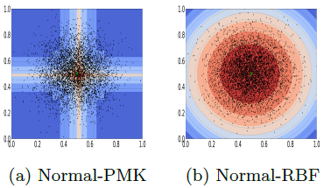
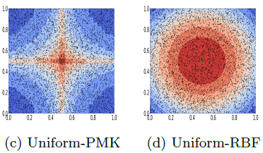

Properties of PMK
Data distribution dependent when both $x_{i}≠y_{i}$ and $x_{i}=y_{i}$
Data distribution dependent when both $x_{i}≠y_{i}$ and $x_{i}=y_{i}$

Slide 7
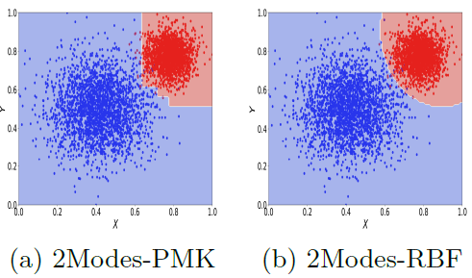
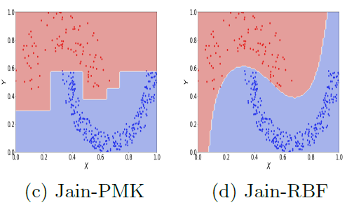
Decision Boundaries
Existing distance-based kernels are biased to dense class
- decision boundary is pushed over the sparse class
PMK is biased to sparse class – decision boundary is pushed towards the dense class

Slide 8
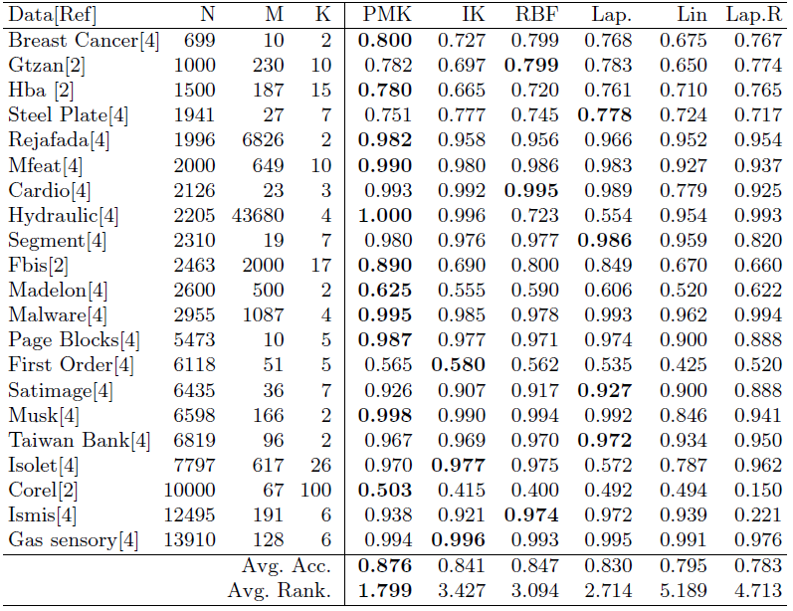
Results: SVM Classification
Data-dependent and data-independent kernel functions in SVM Classification

Slide 9
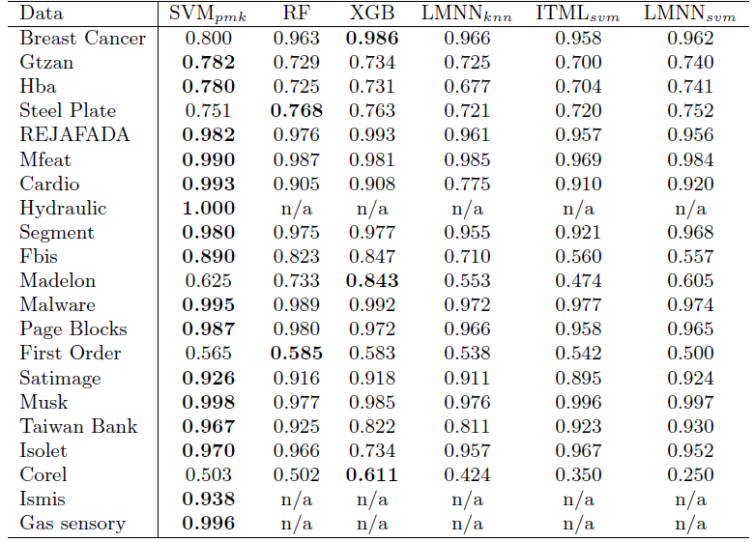
Results: SOTA Classification
SVM-PMK against SOTA Classifiers and SVM after metric learning

Slide 10
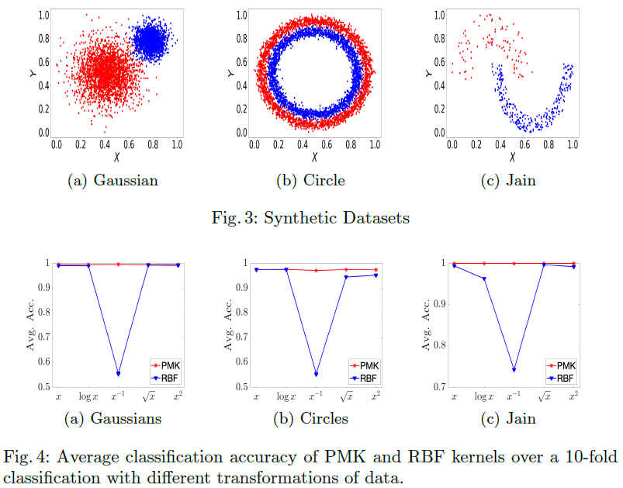
Robustness to data representation
Classification Accuracy after non-linear scaling of data

Slide 11
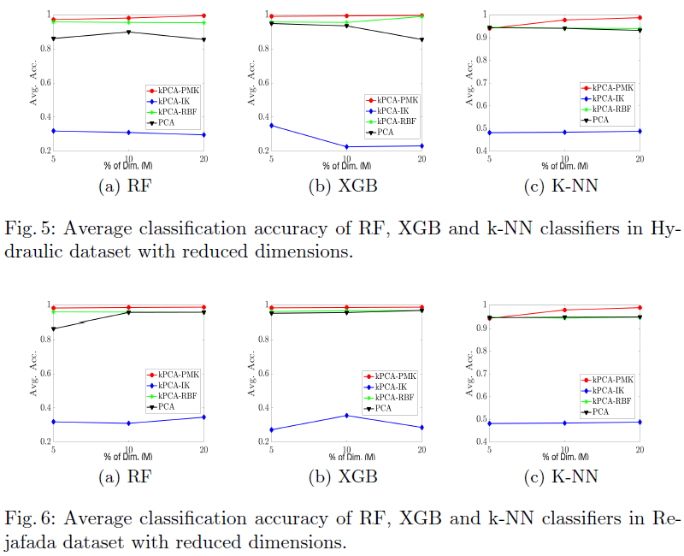
Dimensionality reduction using Kernel PCA
Classification Accuracy

Slide 12
Conclusions
Existing distance-based kernels are not data-dependent and sensitive to data representation
- performance vary significantly across datasets, particularly in real-world applications where different data features are captured by different sensors and represented in different units/scales, e.g., IoT systems
In real-world application, data representation can change due to various reasons:
- device or sensor settings
- domain/user requirements
- compression or encryption for storage/transmission
kernels that are adaptive to data distribution (data-dependent) and robust to the variation in the units/scales used to represent data (scale-variant) are preferred
- we proposed one such kernel function called Probability Mass-based Kernel (PMK) and show its consistent performance in SVM classification across a wide range of datasets

Slide 13

Thank you
Questions/Comments?
Sunil Aryal
sunil.aryal@deakin.edu.au

