Slide 1

Automated Healthcare Finance Ecosystem
APPLICATION ENGINEERING & DEVELOPMENT
SPRING 2020
Presented by Team: Exception-Handlers
Vaishnavi Mande
Pooja Vaikos
Aurobindo Samantaray

Slide 2
PROBLEM STATEMENT AND SOLUTION
Is healthcare easily accessible by general masses ?
Solution:
Abridge the gap between government and healthcare institutions for fund disbursal during pandemics.
Streamline urban as well as rural healthcare services.
Provide affordable healthcare services.
Less commuting time as health care services will be situated in locality.

Slide 3
SYSTEM USAGE
This healthcare model is touted to facilitate paperless insurance processing between 3 big plays in insurance claims:
Insurance corporation
Insurance Claim
Health Institution
Bridge gap between insurance policies, customers and healthcare centres.
Streamlines patient’s treatment process.
Can prove to be of crucial use where time is of essence, treating and maintaining patient records is critical

Slide 4
APPLICATION KEY FUNCTIONALITIES
Healthcare Admin adds enterprise (Hospitals, Health centres, Insurance, Companies, Government health care department.
Doctors will examine and treat patients.
If patient is not cured in health center, the he/she will be transferred to specialty hospitals.
Government department provides funding to Enterprises.
Insurance Agent approves patient bills.
Reimbursement of approved bills from insurance companies.

Slide 5

ROLES & CAPABILITY
Government officer
Insurance Financier
Policy Planner
Patients
Doctors
Admins
Secretary
Accountants
Lab assistants
Insurance Agents
Treasurer

Slide 6
DIAGRAMS:
Ecosystem Architecture Diagram.
UML Sequence Diagram
UML CLass Diagram
Diagrams

Slide 7
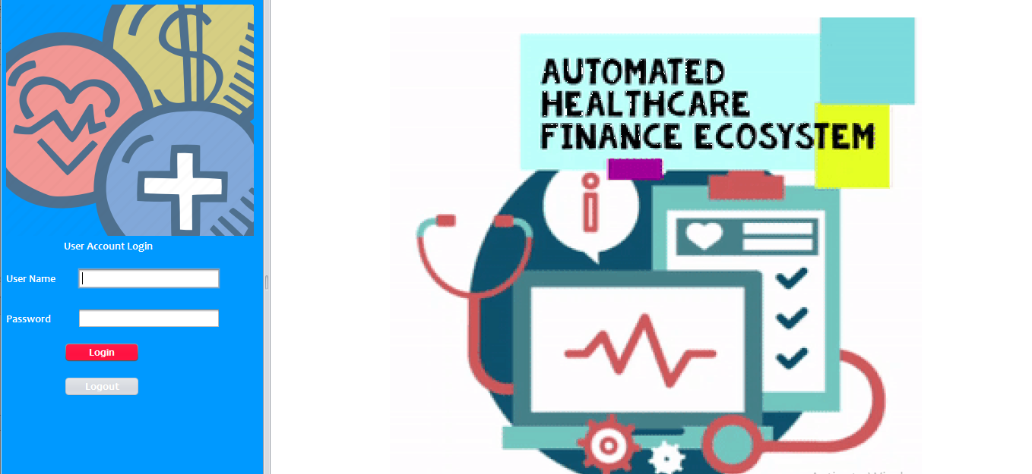
Home Page

Slide 8
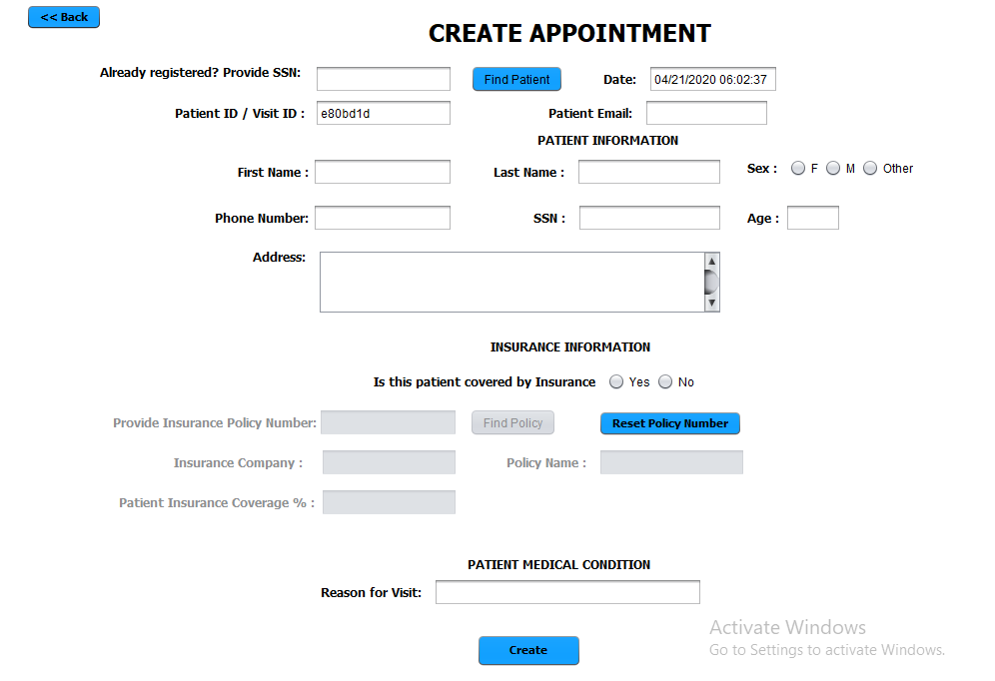
Patient Registration Page

Slide 9
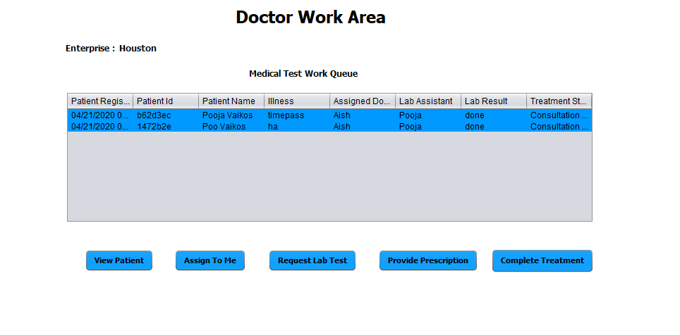

Slide 10
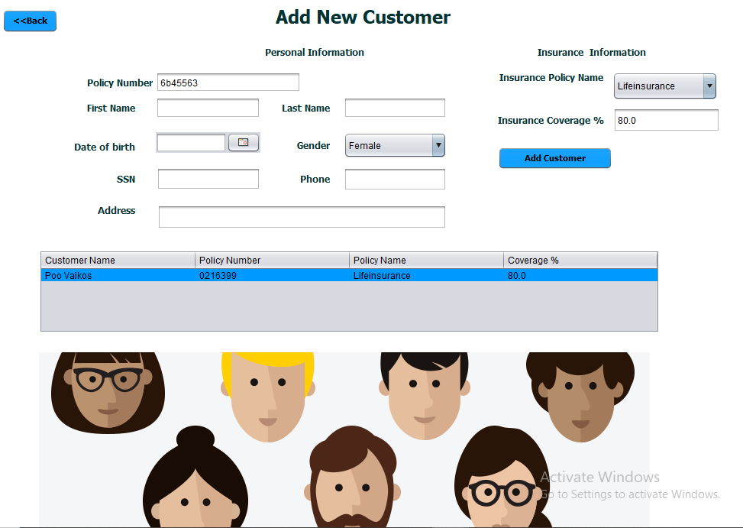
Insurance

Slide 11
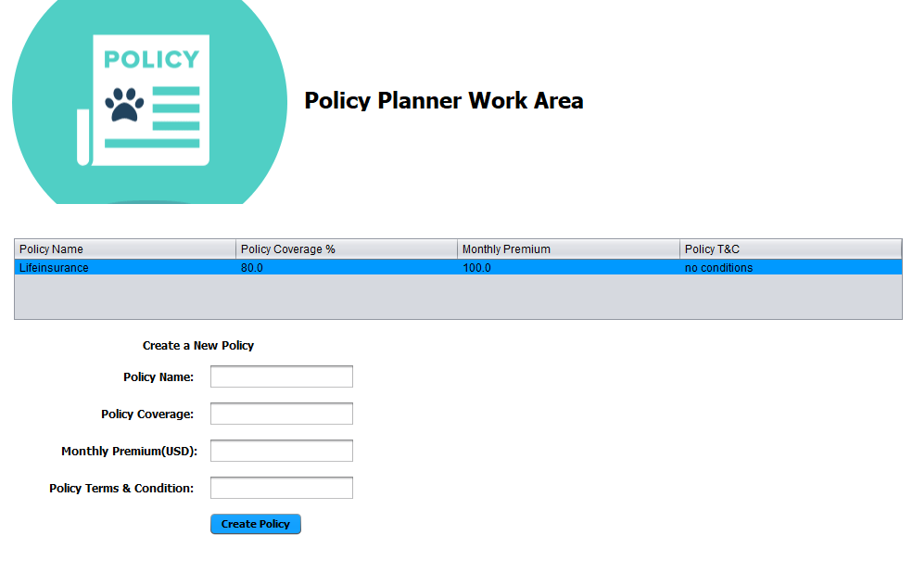
Insurance

Slide 12
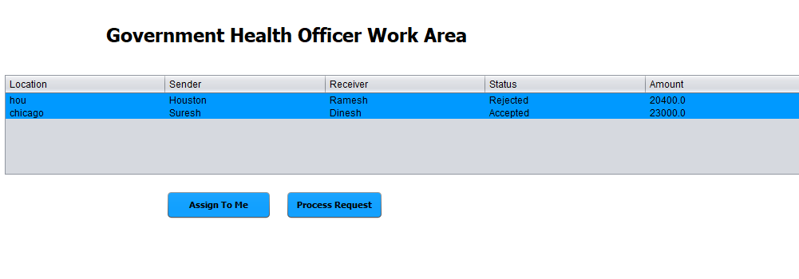

Slide 13
Thank You!

