Slide 1


Vývoj mobilných aplikácií úvod
Peter Borovanský
KAI, I-18
borovan 'at' ii.fmph.uniba.sk
http://dai.fmph.uniba.sk/courses/VMA/android/00MITInventor/

Slide 2
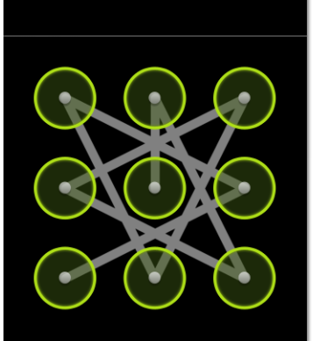
Prémiovo-orientované vyučovanie
prihláste sa do L.I.S.T. (ak ste v ňom nikdy neboli, ozvite sa)
sledujte L.I.S.T.
prémie sa budú objavovať

Slide 3
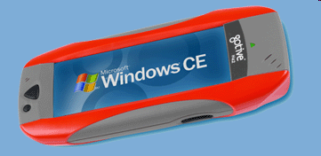

Mobilné OS
http://www.gotive.com/
aplikácie na rôznych obmedzených HW platformách pod rôznymi OS:
Windows Mobile 5.0, 6 - najrôznejšie pda, hand heldy,… fy. Microsoft
Windows CE – pre embeded systémy, fy. Microsoft
Palm OS, webOS – propietárny OS pre Palm fy. HP, linux kernel
Maemo 5 – debian-like od fy.Nokia
Symbian (S60, S80, S90) – open source OS pre smartphony, fy.Nokia,
Samsung, SonyEricsson, Panasonic
iOS – iPhone, iPod (unix-like), fy. Apple,
Android - Google
Bada - Samsung (odpoveď na Android)
BlackBerry OS
Windows Phone -> Windows 10 Mobile
Firefox OS
Ubuntu Touch

Slide 4
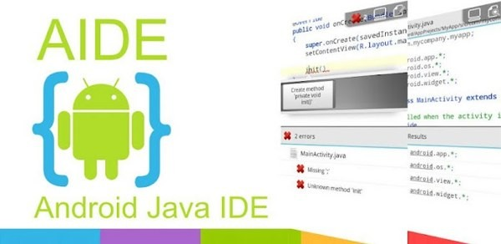
Vývojové jazyky/nástroje
Symbian
  C++, Java ME, Python, …
Windows Mobile 6
  C# (MS Visual Studio)
iOS
  Objective-C -> Swift 3/4 (Xcode) iOS - Apple Center kurz
Android
  scratch (MIT Inventor)
  java (Android SDK + plugin pre Eclipse) -> (Android Studio)
  java (A.I.D.E.)
  Kotlin (Android Studio 3+)
  C++ (Android NDK)
Multi-platform
  C# (Xamarin iOS, Android, Windows) – fy. MS, Visual Studio 2015
  Pascal (Delphi XE5 iOS, Android, Windows 10) – fy. Embarcadero
  JavaScript (React Native)
  Flutter od Google
game engine 1-AIN-303/15
  C# (Unity 2D/3D) ...

Slide 5







Vývoj a nástroje
(detailnejšie)
natívne aplikácie
  Android
    Java
    Kotlin
  iOS
    Objective-C
    Swift
hybridné aplikácie
  Cordova
  ionic
Priamy prístup k všetkým fičúrkam a
komponentom OS, aj tým najnovším ...
Web-app na báze .html,. css, .js, ktoré púšťame v prostredí WebView=browser/wrapper bez browserových ovládačov

Slide 6

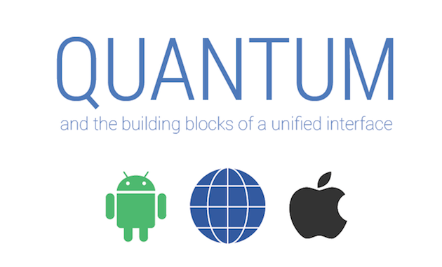


Vývoj a nástroje
(detailnejšie)
kompilované aplikácie
  React Native
    JavaScript
    Facebook
    nekompiluje do natívneho kódu
    obmedzená množina widgets
  Flutter (Dart framework od Googlu)
    Dart
    Google
    kompilované do ARM C++
    bohatšia množina widgets
    Material design (Quantum Paper)– Google 2014
  NativeScript
    JavaScript

Slide 7

Jeden príbeh
Here is a summary of the reasons why Airbnb is dropping React Native:
Framework Immaturity —Since React Native is a new framework …
Dynamically Typed — JavaScript is, of course, dynamically typed which makes refactoring a “nightmare”
Inconsistencies Between iOS and Android — Although React Native should be consistent across both native platforms, some tiny details are still being worked out, e.g. some differences in JavaScriptCore that runs the darn thing.
Three Environment Expertise — Instead of writing the code once, engineers actually had to maintain three environments: React.js, Android, and iOS.
https://medium.com/braus-blog/airbnb-is-dropping-react-js-should-you-too-dcbff36def5c

Slide 8






Aspekty programátora
Code sharing (write once, use everywhere)
Cordova, ionic
Flutter (Material Design)
ReactNative
Java, Swift
Knowledge sharing (learn once, use everywhere)
Cordova, ionic, ReactNative (.js), Flutter (Dart)
Java, Swift
Widget library
Java, Swift, Cordova, ionic
Flutter (Dart)
ReactNative (.js)
https://www.youtube.com/watch?v=bnYJRYFsrSw&feature=youtu.be

Slide 9
Aspekty programátora
Eco-system (schopnosť nájsť riešenie/radu/blog na stackoverflow, ...)
Java, Swift
Cordova, ionic (.js)
Kotlin
ReactNative (.js, React)
Flutter (nové ale zlepšuje sa)
Popularita
Java, Swift
Cordova, ionic, ReactNative, Flutter (pushujú Fbook a Google)

Slide 10
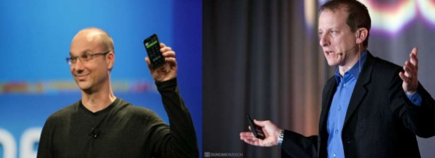
Trochu (dávnej) histórie
Android, Inc., founded in Palo Alto in Oct 2003 by Andy Rubin, Rich Miner
aim to develop:
"smarter mobile devices that are more aware of its owner's location and preferences“
an advanced operating system for digital cameras,
founders and early employees, Android Inc. operated secretly, just working on software for mobile phones
Current (!) rivals Symbian and Windows Mobile
(Apple's iPhone had not been released at the time … 2007).
Rubin ran out of money. Steve Perlman (QuickTime, WebTV, later working on iPhone, iPods), a close friend of Rubin, brought him $10,000 in cash in an envelope and refused a stake in the company.
http://en.wikipedia.org/wiki/Android_%28operating_system%29

Slide 11
História sa opakuje z 1997
https://youtu.be/WxOp5mBY9IY

Slide 12

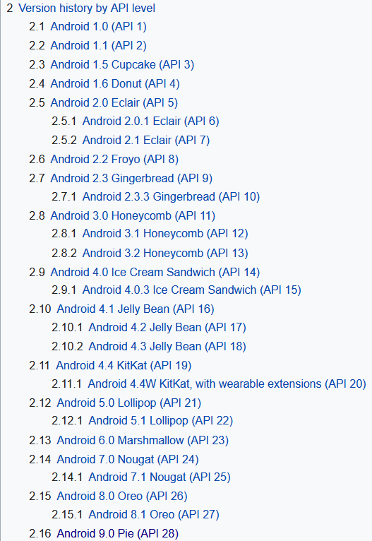
Android a Google
2005 Google acquired Android Inc.
with Rubin, Miner et at.
2007 Open Handset Alliance, a consortium
  device manufacturers: HTC, Sony and Samsung,
  wireless carriers: T-Mobile, ...
  chipset makers: Qualcomm, Texas Instruments,
includes Google with a goal to develop
open standards for mobile devices
major release named in alphabetical order
after a dessert or sugary treat
  2.3 Gingerbread
  4.3 Jelly Bean, July, 2012,
  4.4 KitKat, announced, October, 2013,
  5.1 Lollipop, November, 2014,
  6.0 Marsmallow, October, 2015,
  7.0 Nougat, August, 2016.
  8.0 Oreo, August, 2017,
  9.0 Pie, Augustt, 2018.
http://en.wikipedia.org/wiki/Android_version_history

Slide 13
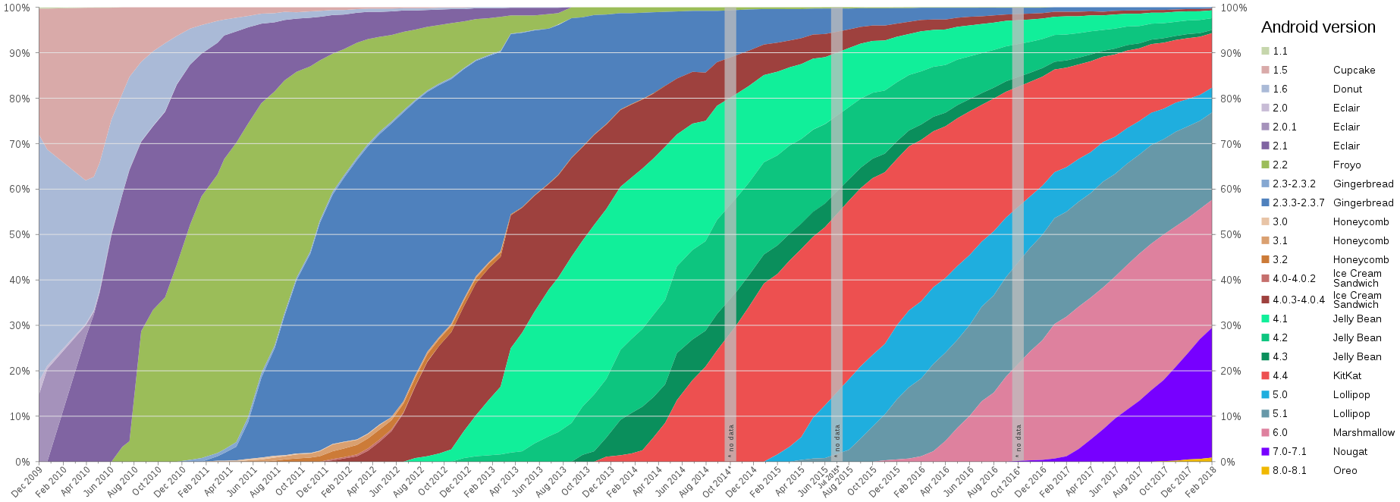

Nekupujte hneď nový mobil
http://en.wikipedia.org/wiki/File:Android-dist-by-dessert.png

Slide 14
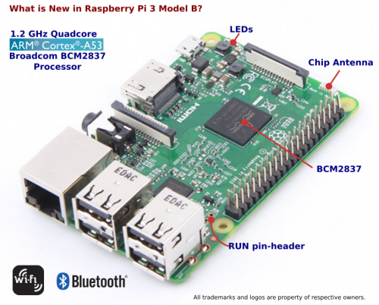

Raspberry PI 3
Iné (nemobilné) zariadenia
UK, Raspberry Pi Foundation
charity,2009, to study of basic
computer science in schools
GPIO - Broadcom BCM2837
Quadc.ARM 1.2GHz, 64 bit RISC
1GB RAM,
4x USB, HDMI,
RJ-45, microSD slot
OS:
Raspbian (Debian Wheezy)
Pidora (Fedora Remix)
OpenELEC (An XBMC Media Centre)
RaspBMC (An XBMC Media Centre)
Android PI
Microsoft Windows 10 !!!
37E

Slide 15
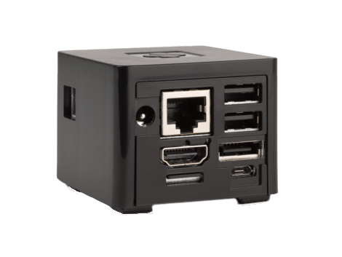
CuBox Pro
Iné (nemobilné) zariadenia
Solid Run, Israel (http://www.solid-run.com/product/cubox-i4pro/)
System On Chip i.MX6 Quad Core
Memory size 2GB/8GB
GPU GC2000, 3D GPU Type,
OpenGL ES1.1,2.0
HDMI 1080p with CEC 1.4, 3D support
WiFi 11n BlueTooth
Ethernet 10/100/1000 Mbps (*)
eSata II 3Gbps
OS:
Android 4.3 Jelly Bean
Linaro Ubuntu 11.10
Debian Jessie
XBMC image
GeeXboX, LinXBMC, OpenELEC
15OE

Slide 16
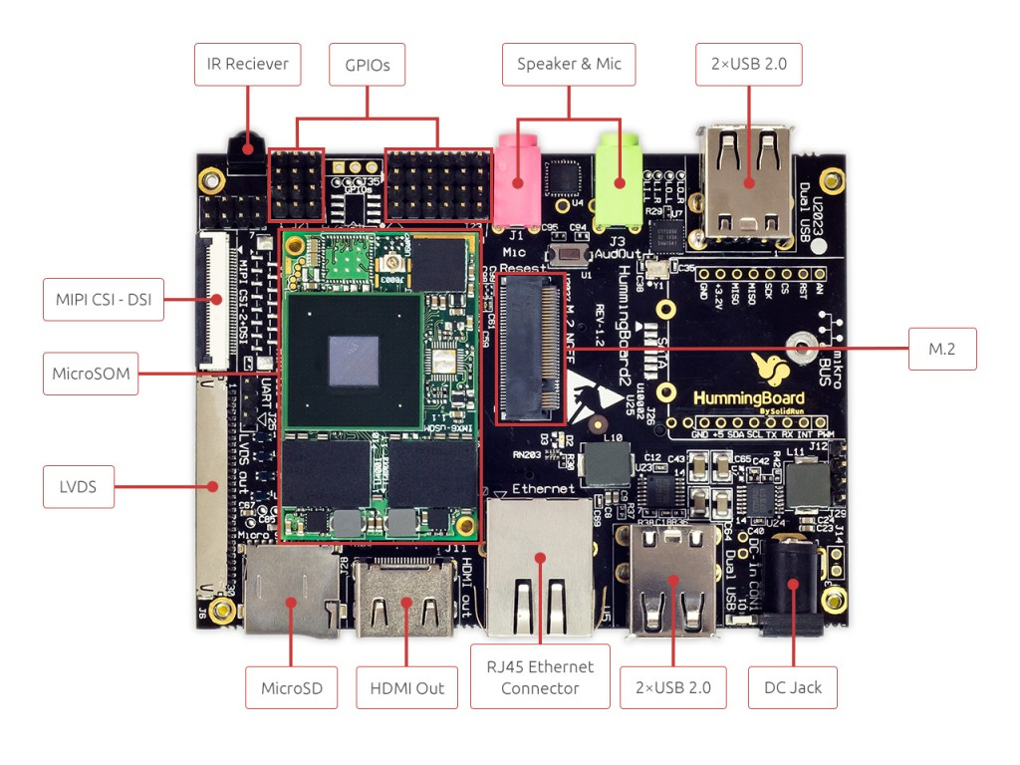
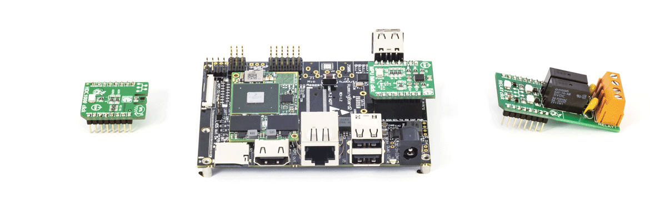
HumingBoard
Iné (nemobilné) zariadenia
SolidRun and MikroElektronika jointly announce:
An advanced Single Board Computer platform starting at $49.99

