Slide 1

Android Studio
(ako začať)
Jazyk Kotlin
(ako neskončiť)
Peter Borovanský
KAI, I-18
MS-Teams: 2sf3ph4, List, github
borovan 'at' ii.fmph.uniba.sk

Slide 2
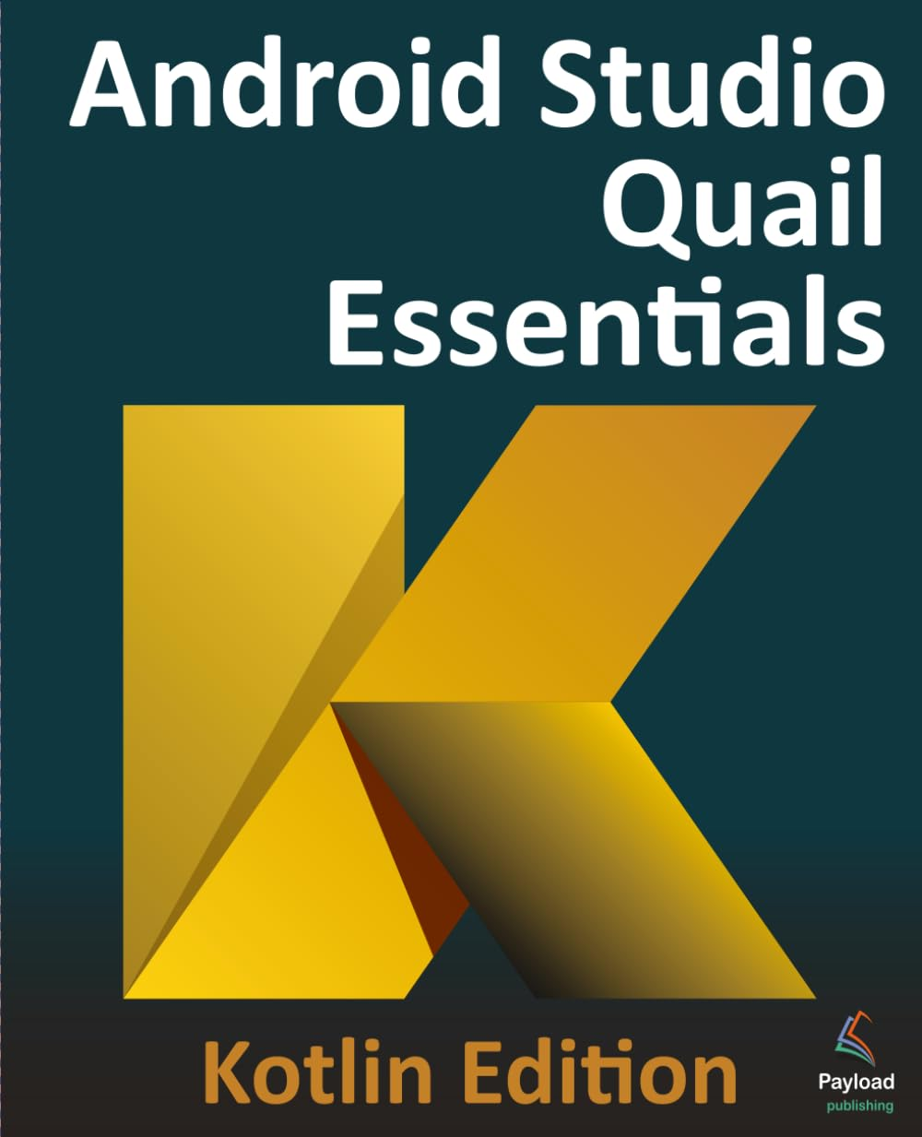

Základné info o kurze
Stránka predmetu
  https://dai.fmph.uniba.sk/courses/VMA/
  prihláste sa do L.I.S.T.
  ak ste v ňom nikdy neboli, ozvite sa mi mailom
  sledujte LIST, všetky zadania budú v ňom
  sledujte Teams 2sf3ph4, komunikácia/prednášky/oznamy
veľká časť kurzu bude dobre sledovateľná z knihy
Android Studio Quial Essentials - Kotlin Edition: Developing Android Apps Using Android Studio and Kotlin , Neil Smyth https://www.payloadbooks.com/product/android-studio-koala-essentials-kotlin-edition-ebook/
.pdf pre staršiu verziu Giraffe je k dispozícii... https://www.amazon.com/Android-Studio-Giraffe-Essentials-Developing/dp/1951442776
Android Studio Quail Essentials - Compose Edition: Developing Android Apps with Android Studio, Jetpack Compose, and Kotlin, https://www.amazon.com/Android-Studio-Quail-Essentials-Developing/dp/1965764436/ref=sr_1_1?dib=eyJ2IjoiMSJ9.RV7TfYX4py0FmL-jSTnU01d-cZjhA7RPIi1sA0M8J9jn7gIm-bdiMcWGRZbQC3Sk_lTVgmSHKFw7VJUx2vksCeeijv065Y10sMYiqyzfyP92uQc0V4D-n4K5xNHJxxAoDTtdMwh0INcaVmejCo214QqRyFEeMOLCU7KYnxUyxe83lF2cJSauxmKftnSOcOGZFX3wJJMxWAAAZc_RH4L5hhVynytFOhK9TbwSS0sZB0Y.RZer1DK1jxJ04mQauGGiC0ifGruk9ms7zJv4aHRIpEE&dib_tag=se&keywords=Android+Studio+Development+Essentials+-+Neil+Smyth&qid=1786614317&s=books&sr=1-1

Slide 3
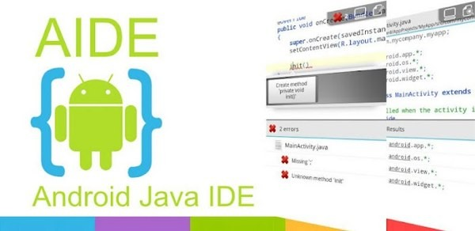
Vývojové jazyky/nástroje
Symbian
  C++, Java ME, Python, …
Windows Mobile 6
  C# (MS Visual Studio)
iOS
  Objective-C -> Swift 3/4/5 (Xcode) iOS - Apple Center kurz
Android
  scratch (MIT Inventor)
  java (Android SDK + plugin pre Eclipse) -> (Android Studio)
  java (A.I.D.E.)
  Kotlin (Android Studio 4+)
  C++ (Android NDK)
Multi-platform
  C# (Xamarin iOS, Android, Windows) – fy. MS, Visual Studio 2015
  Pascal (Delphi XE5 iOS, Android, Windows 10) – fy. Embarcadero
  JavaScript/TypeScript (React Native)
  Flutter od Google
game engine 1-AIN-303/24
  C# (Unity 2D/3D), C++ (Unreal Engine) ...

Slide 4

Unity
(game engine)
#1 Unreal Engine
#2 Unity
Obľúbený nástroj pre tvorbu multi-platform aplikácií pre bakalárske práce
2-INF-263/15 magisterský predmet: Tvorba a dizajn počítačových hier
  http://sccg.sk/~mferko/tdh/
  https://candle.fmph.uniba.sk/ucitelia/Michal-Ferko
1-AIN-303/24 bakalársky predmet: Game Engines
  Šimko

Slide 5







Vývoj a nástroje
(detailnejšie)
natívne aplikácie
  Android
    Java
    Kotlin
  iOS
    Objective-C
    Swift
hybridné aplikácie
  Cordova
  ionic
Priamy prístup k všetkým fičúrkam a
komponentom OS, aj tým najnovším ...
Web-app na báze .html,. css, .js, ktoré púšťame v prostredí WebView=browser/wrapper bez browserových ovládačov

Slide 6

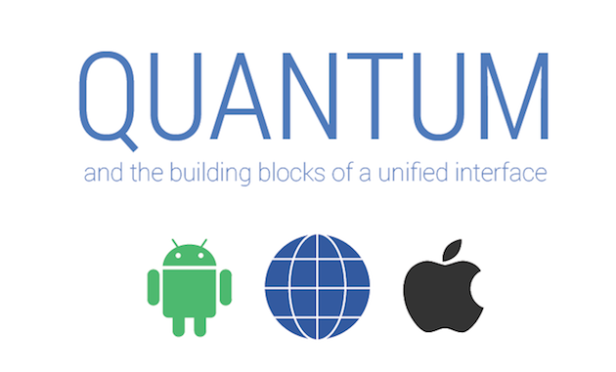


Vývoj a nástroje
(detailnejšie)
kompilované aplikácie
  React Native
    JavaScript
    Facebook
    nekompiluje do natívneho kódu
    obmedzená množina widgets
  Flutter (Dart framework od Googlu)
    Dart
    Google
    kompilované do ARM C++
    bohatšia množina widgets
    Material design (Quantum Paper)– Google 2014
  NativeScript
    JavaScript

Slide 7






Aspekty programátora
Code sharing (write once, use everywhere)
Cordova, ionic
Flutter (Material Design)
ReactNative
Java, Kotlin, Swift
Knowledge sharing (learn once, use everywhere)
Cordova, ionic, ReactNative (.js), Flutter (Dart)
Java, Kotlin, Swift
Widget library
Java, Swift, Cordova, ionic
Flutter (Dart)
ReactNative (.js)
https://www.youtube.com/watch?v=bnYJRYFsrSw&feature=youtu.be

Slide 8
Aspekty programátora
Eco-system (schopnosť nájsť riešenie/radu/blog na stackoverflow,..)
Java, Swift, Kotlin
Cordova, ionic (.js)
ReactNative (.js, React)
Flutter (nové ale zlepšuje sa)
Popularita
Java, Swift, Kotlin
Cordova, ionic, ReactNative, Flutter (pushujú FB a Google)

Slide 9
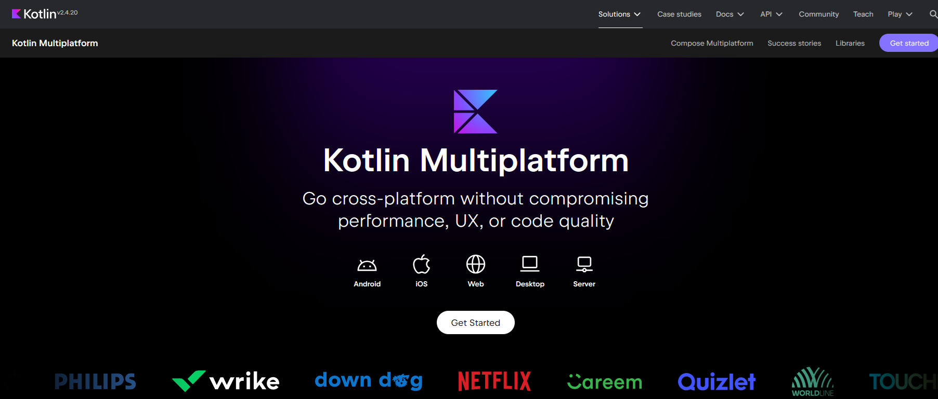
Kotlin Multiplatform
KMM is an SDK designed to simplify creating cross-platform mobile applications (Android, iOS iPhone, watchOS, Windows, Linux)
share common code between iOS and Android apps
write platform-specific code
plaftorms jvm, js, wasm
xcode (mac) is necessary to build an iOS app
https://kotlinlang.org/lp/multiplatform/

Slide 10
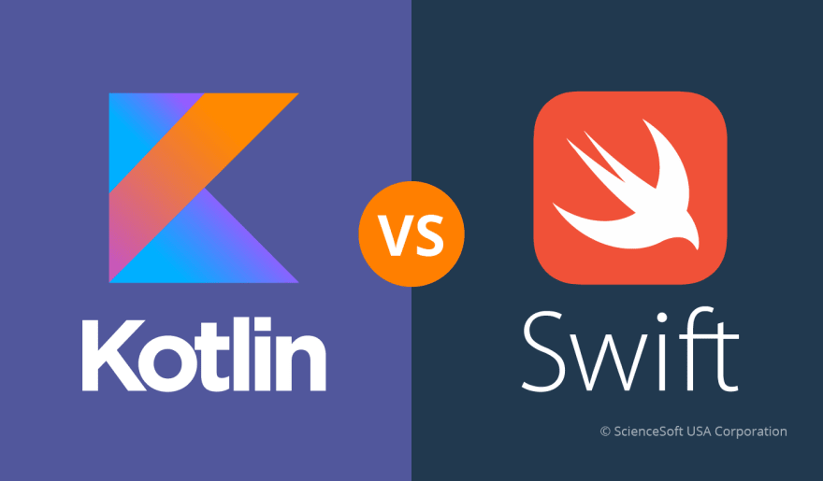
Java vs. Kotlin
tradičný VMA kurz postavený na Java už šiesty rok beží v jazyku Kotlin
Dôvody:
ako iOS má svoj moderný jazyk Swift (3/4/5), aj Android má svoj Kotlin
Java je trochu skamenelina medzi modernými jazykmi (Swift, Kotlin, Scala)
Kotlin je Googlom oficiálne podporovaným vývojový nástroj pre Android
projekt Kotlin má už >15 rokov
kompiluje do JVM
funguje s Android Studiom
na JetBrains produkty ste si asi zvykli, a sú top
oboznámite sa s niektorými princípmi moderných jazykov
Reference: https://kotlinlang.org/docs/reference/
Online: https://play.kotlinlang.org/byExample/

Slide 11
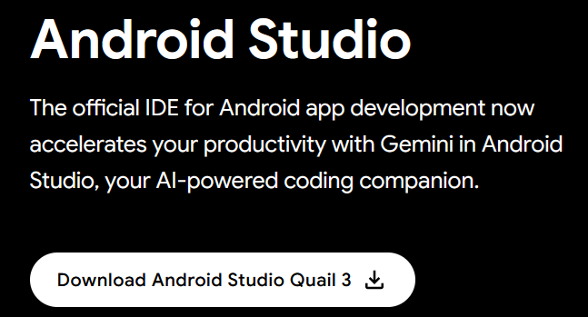
Android Studio Quail
Kotlin Edition
https://www.payloadbooks.com/product/android-studio-koala-essentials-kotlin-edition-ebook/
https://www.amazon.com/Android-Studio-Giraffe-Essentials-Developing/dp/1951442776
https://www.ebookfrenzy.com/errata/giraffekotlin.html
sources: https://www.ebookfrenzy.com/retail/giraffekotlin/index.php
Inštalácia Android Studio:
https://developer.android.com/studio
Predmet má cvičenie, ale aj tak:
ozvite sa v prípade problémov inštalácie na platformy, napr. Linux, Mac.
posnažíme problém vyriešiť
Inštalácia Android Studia:
SDK Packages: Tools/SDK Manager tab SDK Platforms
AVD: Android Virtual Device

Slide 12
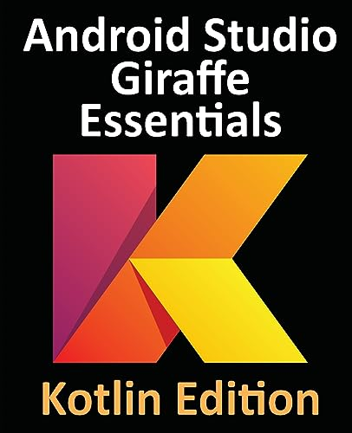
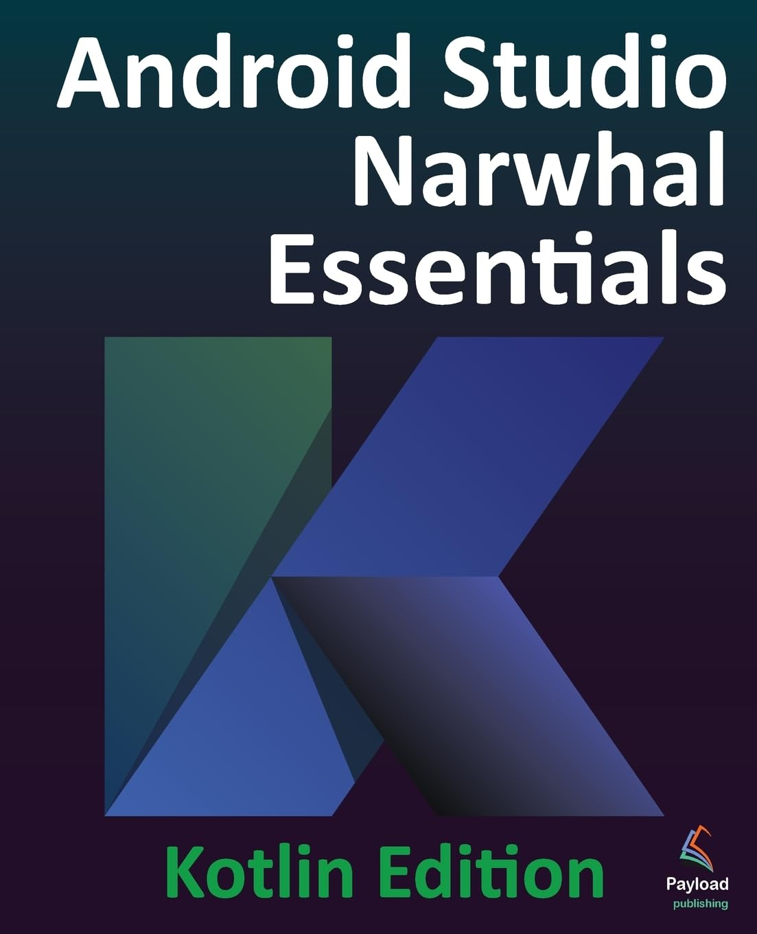
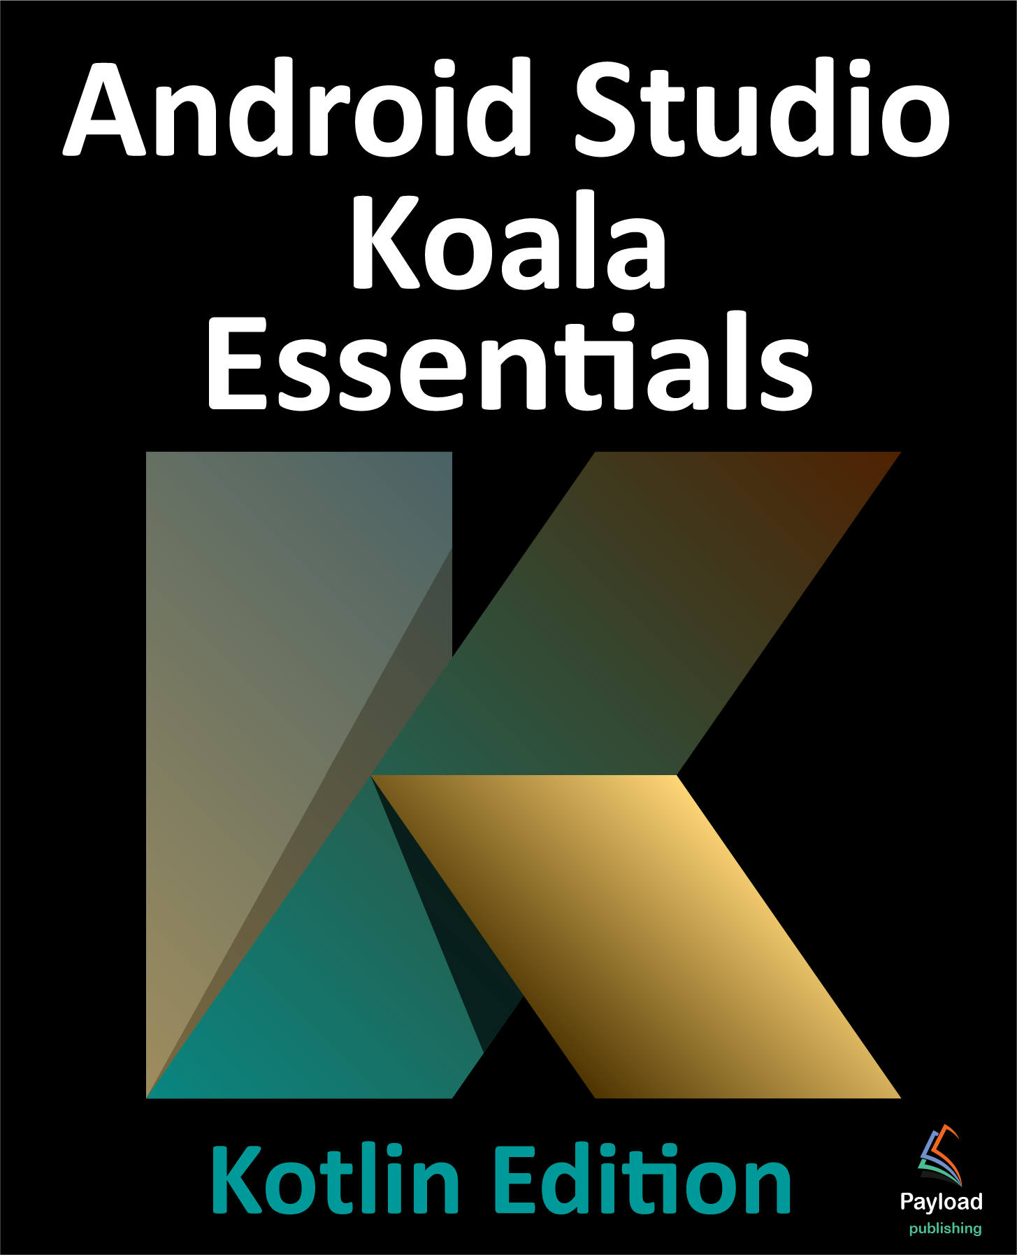
Android Studio Quail
Kotlin Edition
https://www.payloadbooks.com/product/android-studio-koala-essentials-kotlin-edition-ebook/
https://www.amazon.com/Android-Studio-Giraffe-Essentials-Developing/dp/1951442776
https://www.ebookfrenzy.com/errata/giraffekotlin.html
sources: https://www.ebookfrenzy.com/retail/giraffekotlin/index.php
2. Setting up an Android Studio Development Environment (mac/Windows/Linux)
3. Creating an Example Android App in AS
4. Creating an Android Virtual Device (AVD) in AS
5. Using and Configuring the Android Studio AVD Emulator
6. A tour of the Android Studio User Interface
7. Testing Android Studio App on a Physical Android Device
8. The Basics of the Android Studio Code Editor.
9. An Overview of the Android Architecture
10. The Anatomy of an Android App
11. An Introduction to Kotlin
12. Kotlin Data Types, Variables, and Nullability
13. Kotlin Operators and Expressions
14. Kotlin Control Flow
15. An Overview of Kotlin Functions and Lambdas
16. The Basics of Object Oriented Programming in Kotlin
17. An Introduction to Kotlin Inheritance and Subclassing
…
91. An Overview of Gradle in Android Studio

Slide 13

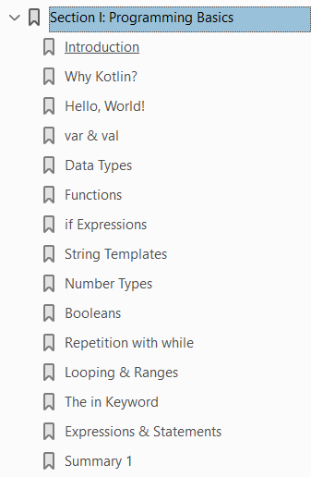
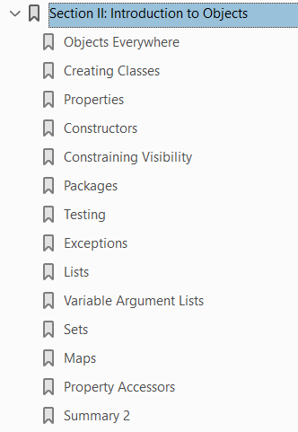
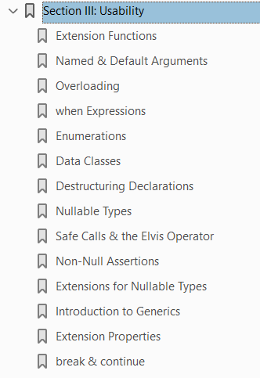
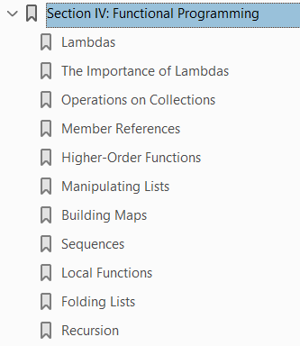
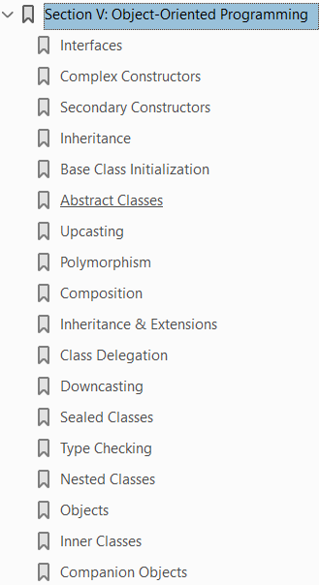
Atomic Kotlin
https://www.amazon.com/Atomic-Kotlin-Bruce-Eckel/dp/0981872557
Notes:
https://www.amazon.com/Atomic-Kotlin-Bruce-Eckel/dp/0981872557

Slide 14
Why Teach Kotlin
Kotlin is basically becoming the language of Android.
Decrease in boilerplate helps us to quickly identify which fundamental Android concepts students are missing.
On numerous courses, where we proceed through Java to Kotlin, we are considering a Kotlin-first approach.
Students are happy to have the chance to program in something they may have heard about.
I think our students benefit in general from being exposed to a wide range of programming languages, and I think it is valuable for them to gain experience in using more modern languages alongside the more traditional ones like Java and C++.
My Kotlin students in fact understand OO concepts better than my Java students do.
One of Kotlin’s advantages is a good combination of strong typing and nullability.
https://kotlinlang.org/education/why-teach-kotlin.html

Slide 15

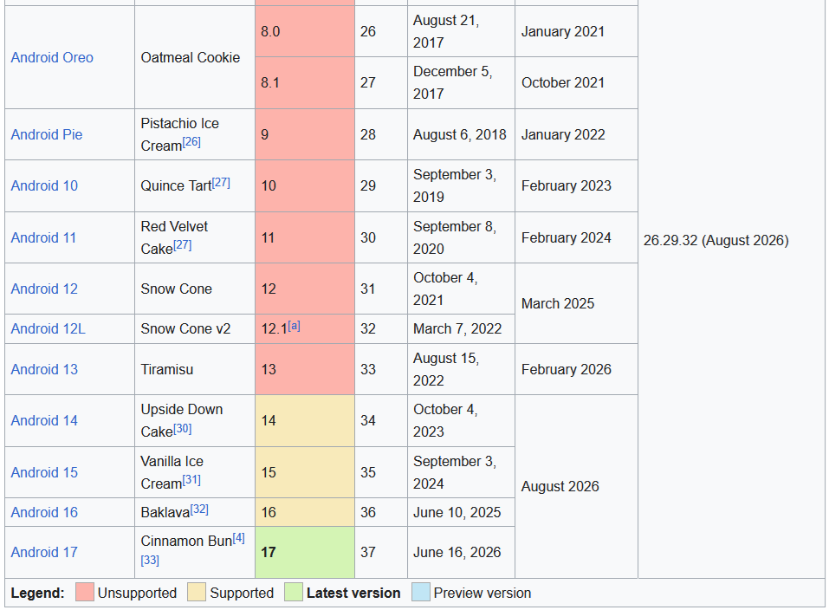
Android a Google
2005 Google acquired Android Inc.
with Rubin, Miner et at.
2007 Open Handset Alliance, a consortium
  device manufacturers: HTC, Sony and Samsung,
  wireless carriers: T-Mobile, ...
  chipset makers: Qualcomm, Texas Instruments,
includes Google with a goal to develop
open standards for mobile devices
major release named in alphabetical order
after a dessert or sugary treat
  2.3 Gingerbread
  4.3 Jelly Bean, July, 2012,
  4.4 KitKat, announced, October, 2013,
  5.1 Lollipop, November, 2014,
  6.0 Marsmallow, October, 2015,
  7.0 Nougat, August, 2016.
  8.0 Oreo, August, 2017,
  9.0 Pie, August, 2018,
  10.0 Android 10, September 2019
  11.0 Android 11, …
http://en.wikipedia.org/wiki/Android_version_history

Slide 16
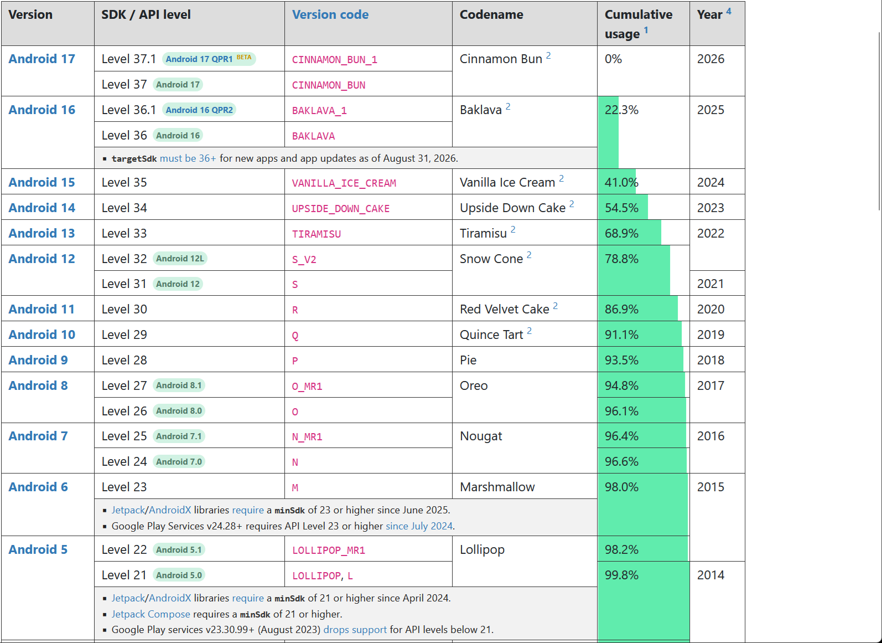
API Levels
https://apilevels.com/

Slide 17
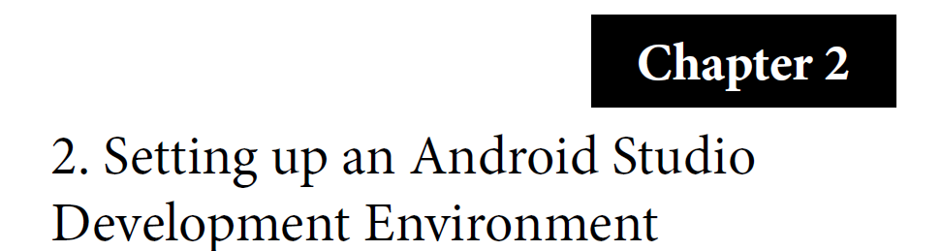
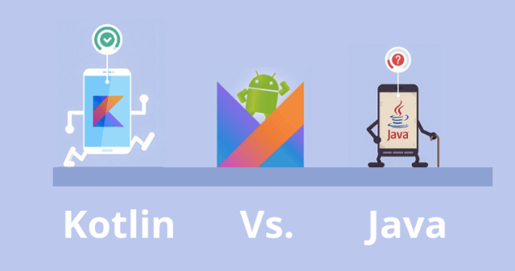
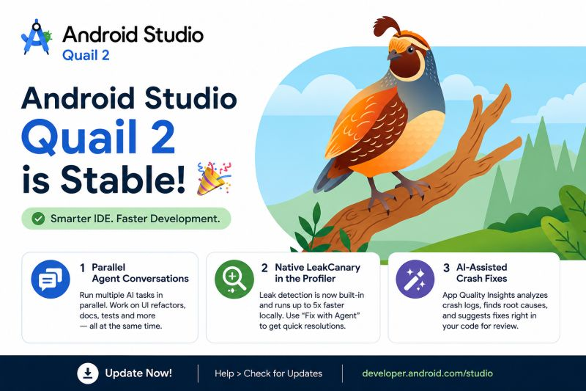
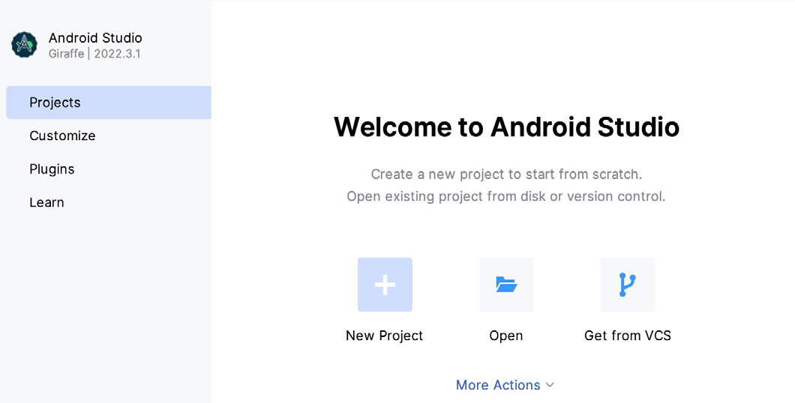
Inštalácia
System requirements
• Windows 8/10/11 64-bit
• macOS 10.14 or later running on Intel or Apple silicon
• Chrome OS device with Intel i5 or higher
• Linux systems with version 2.31 or later of the GNU C Library (glibc)
• Minimum of 8GB of RAM
• Approximately 8GB of available disk space
• 1280 x 800 minimum screen resolution
https://developer.android.com/studio/index.html

Slide 18
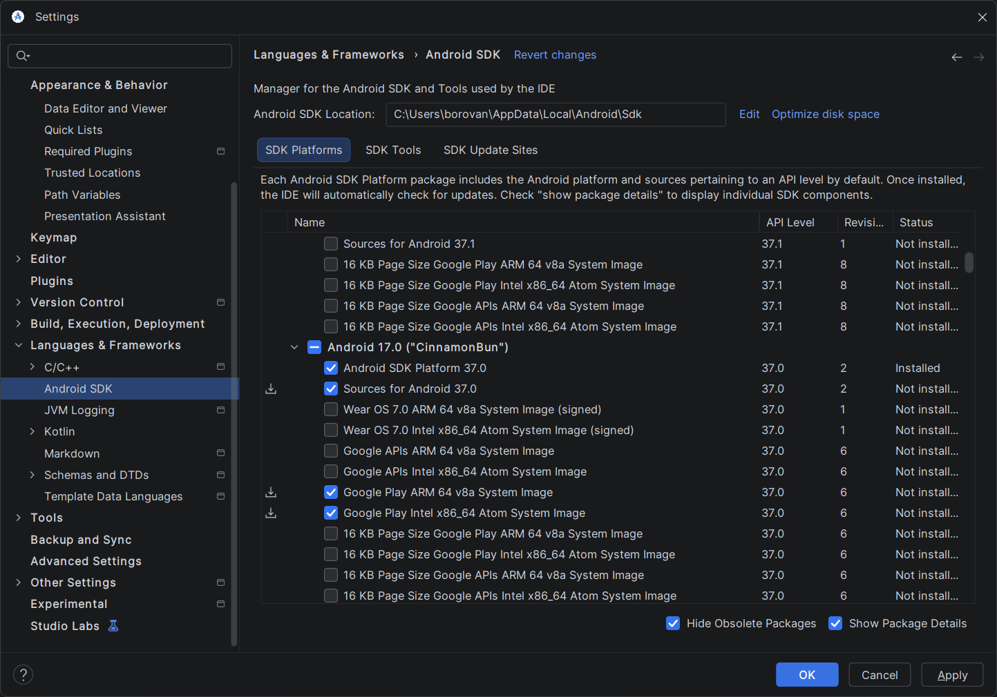
Android SDK Packages
Tools/SDK Manager tab SDK Platforms - API 37

Slide 19
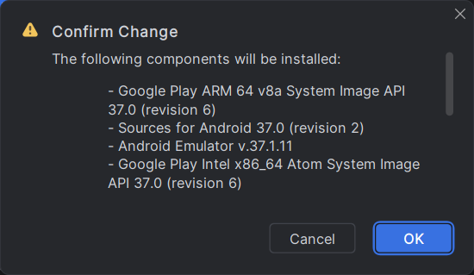
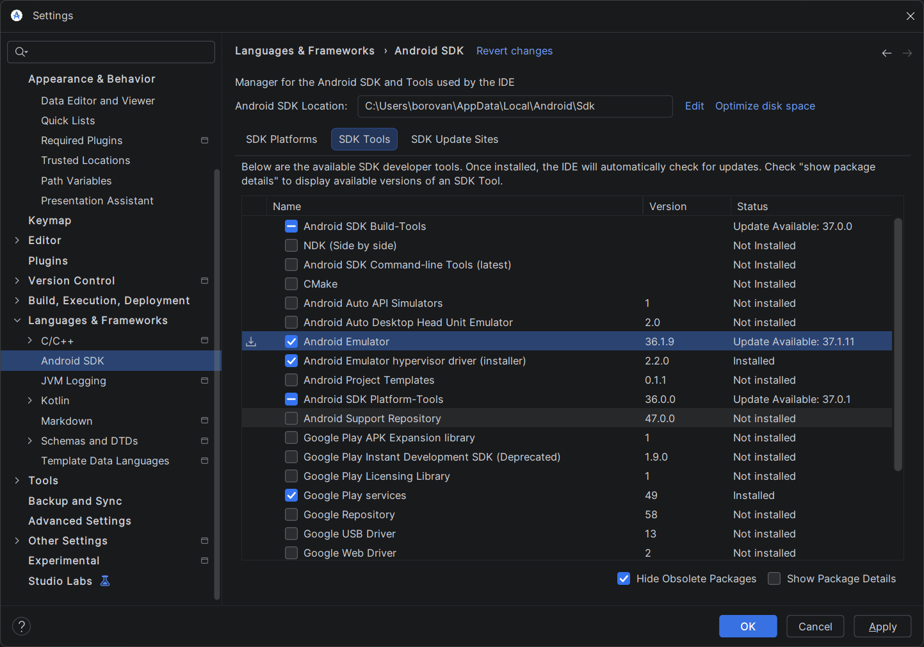
Android SDK Packages
Tools/SDK Manager tab SDK Tools

Slide 20
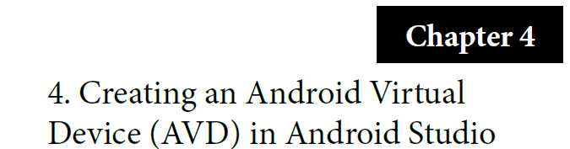
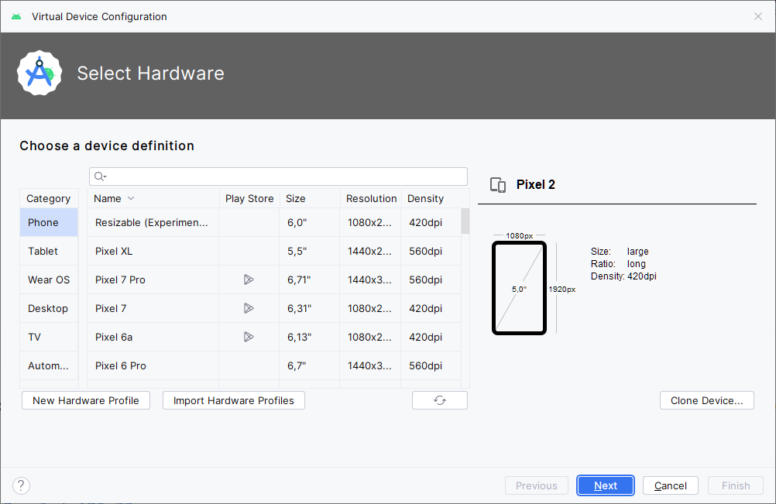
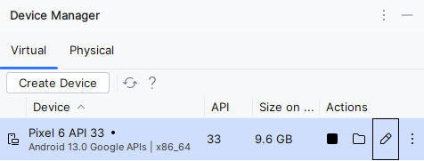
Android Virtual Device
Tools/AVD manager
Nakonfigurujte si AVD zodpovedajúci vášmu zariadeniu
alebo si vyberte zo
zoznamu
predvolených,
Create Device
modifikujte
nastavenia
podľa vášho
zariadenia

Slide 21
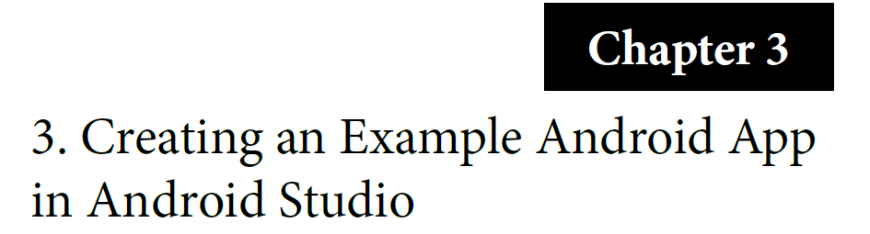
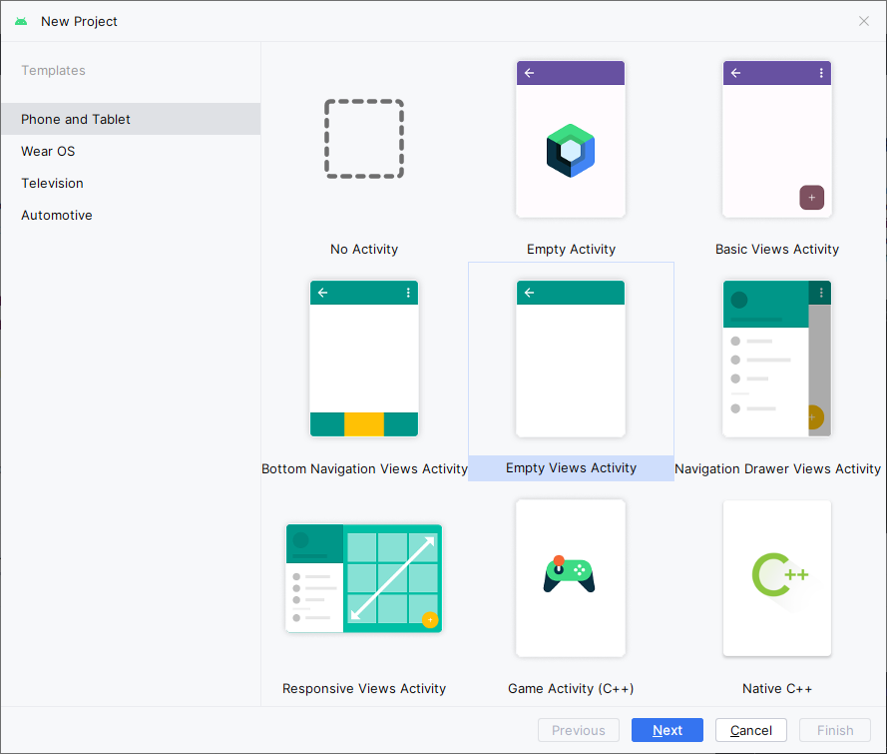
Nový projekt
(File/New/New Android Project)

Slide 22
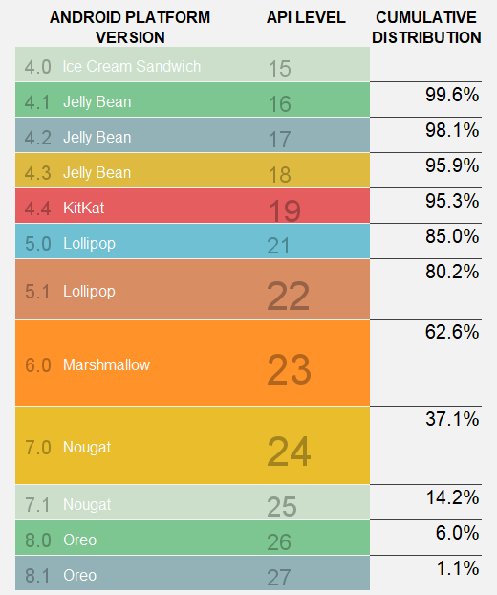
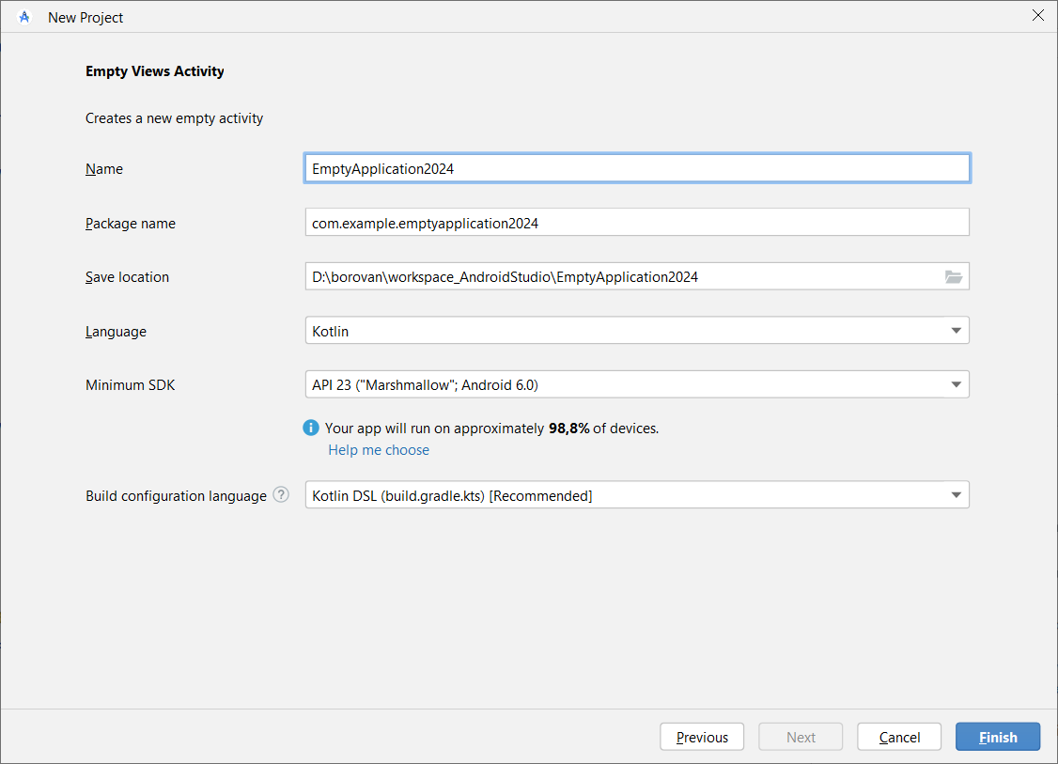
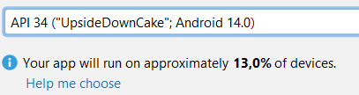
Nový projekt
(File/New/New Android Project)
Submitovanie riešení: Android SDK 17 (API 37), (compileSdkVersion 37, buildToolsVersion "37.*"), a min.požadované SDK (minSdkVersion 24)

Slide 23
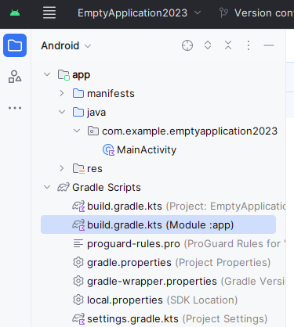
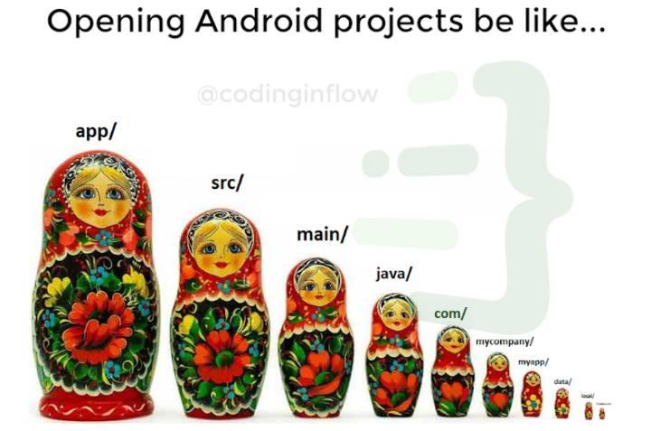
Nový projekt
(File/New/New Android Project)
plugins {
id("com.android.application")
id("org.jetbrains.kotlin.android")
}
Submitovanie riešení: Android SDK 17 (API 37), (compileSdkVersion 37, buildToolsVersion "37.*"), a min.požadované SDK (minSdkVersion 24)
android {
namespace = "com.example.emptyapplication2024"
compileSdk = 37
defaultConfig {
applicationId = "com.example.emptyapplication2026"
minSdk = 24
targetSdk = 37
versionCode = 1
versionName = "1.0"

Slide 24

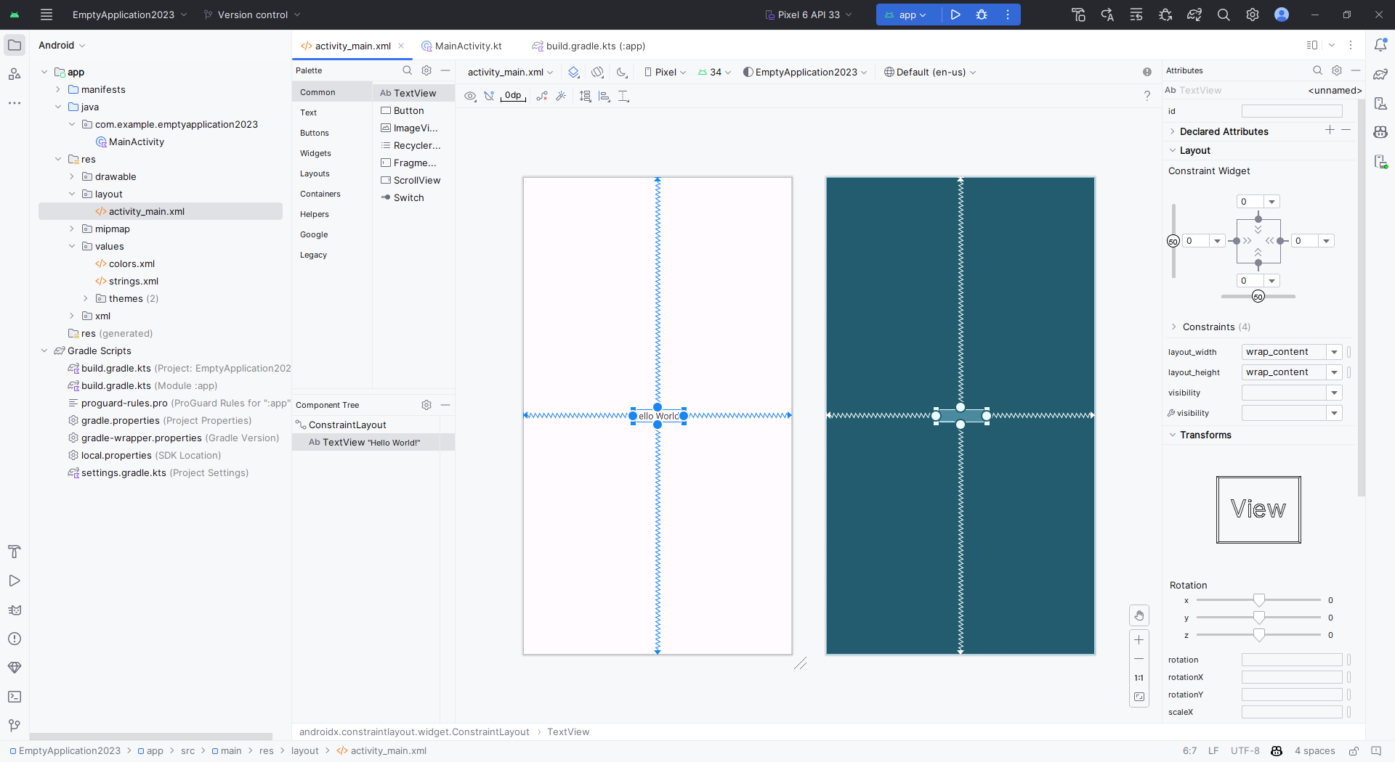

Nový projekt
(Empty views activity)

Slide 25

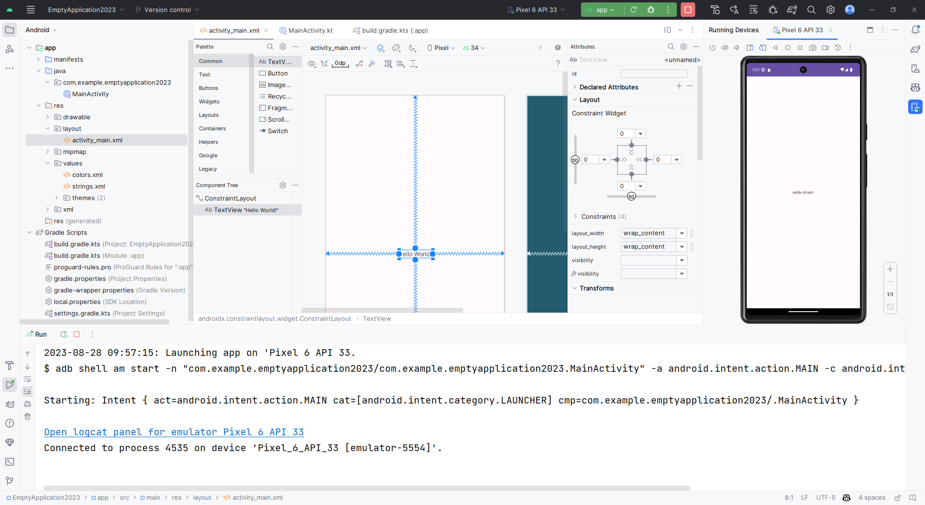
Pýtajte sa kým nedostanete
Emulátor
-
je pomalý, dĺho bootuje
neposkytuje všetky služby ako konkrétne zariadenie
o senzoroch ani nehovoriac
dá sa použiť na začiatku
+
má ho každý, nič nestojí
dokonca má viac platforiem
netreba sync-driver
Keď už beží, tak ho nezabíjajte !

Slide 26
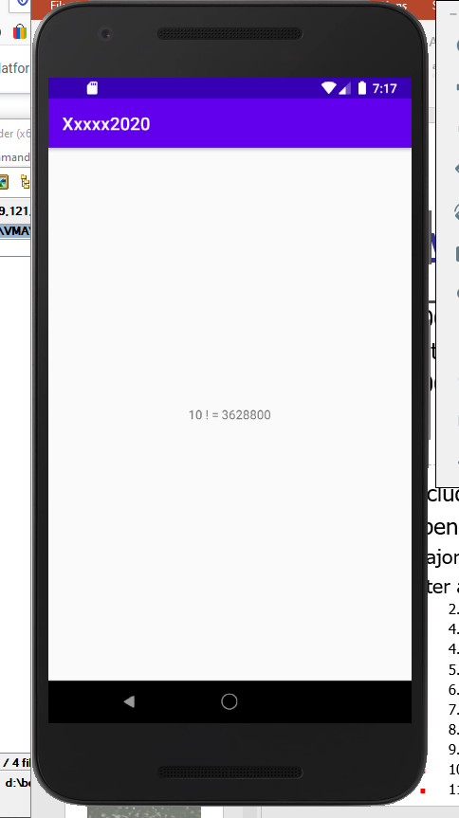
Ako si skúšať Kotlin v AS
(kým sa nedozvieme viac)
class MainActivity : AppCompatActivity() {
override fun onCreate(savedInstanceState: Bundle?) {
super.onCreate(savedInstanceState)
setContentView(R.layout.activity_main)
//println(fact(10))
for (i in 0..10) {
Log.d("TAG", "$i ! = ${fact(i)}")
// vypisuje do konzoly Logcat, pouzite filter s "TAG"
val tv = findViewById<TextView>(R.id.tv)
tv.text = "$i ! = ${fact(i)}"
// vypise do View komponentu, ktory je v Activite
Toast.makeText(this, "$i ! = ${fact(i)}",
Toast.LENGTH_SHORT).show()
// Toast alias Notifier (MITI)
}
}
fun fact(n : Int) : Int = if (n == 0) 1 else n * fact(n-1)
}
Notes:
class MainActivity : AppCompatActivity() {
override fun onCreate(savedInstanceState: Bundle?) {
super.onCreate(savedInstanceState)
setContentView(R.layout.activity_main)
//println(fact(10))
for (i in 0..10) {
Log.d("TAG", "$i ! = ${fact(i)}")
// vypisuje do konzoly Logcat, pouzite filter s "TAG"
val tv = findViewById<TextView>(R.id.tv)
tv.text = "$i ! = ${fact(i)}"
// vypise do View komponentu, ktory je v Activite
Toast.makeText(this, "$i ! = ${fact(i)}",
Toast.LENGTH_SHORT).show()
// Toast alias Notifier (MITI)
}
}
fun fact(n : Int) : Int = if (n == 0) 1 else n * fact(n-1)
}

Slide 27
Break point
(štruktúrou projektu pokračujeme na budúce)
Switch to kotlin intro

