Slide 1
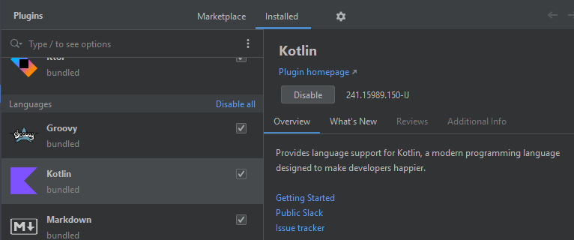
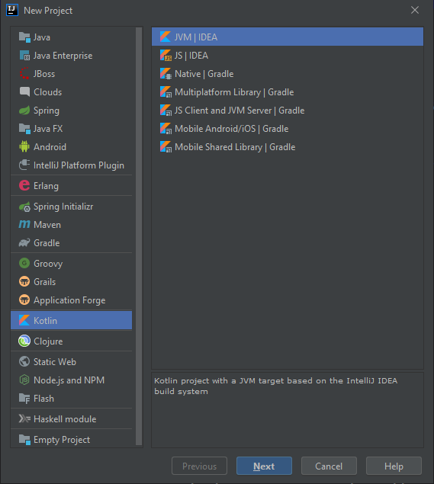

Kotlin
Peter Borovanský, KAI, I-18, borovan(a)ii.fmph.uniba.sk
Kotlin Plugin in IntelliJ
File/Settings/Plugins
MarketPlace/Kotlin
Plugin od JetBrains
https://www.youtube.com/playlist?list=PLVUm4IewkTXqwzuRXZisWg7shMTiQhUtz
Notes:
https://www.youtube.com/playlist?list=PLVUm4IewkTXqwzuRXZisWg7shMTiQhUtz

Slide 2
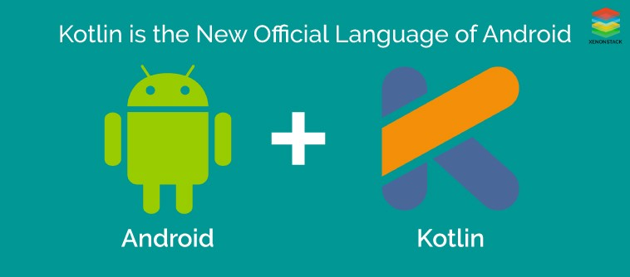
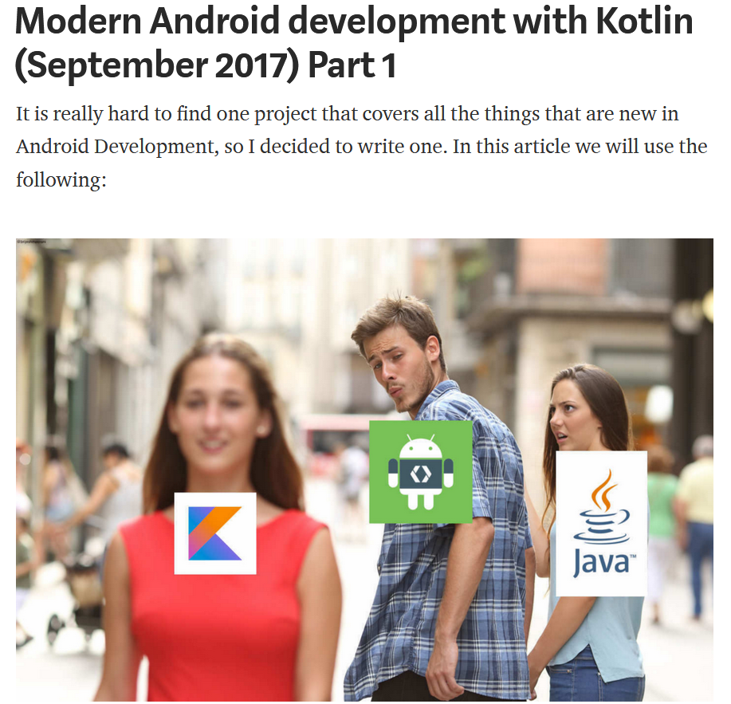
Kotlin
Rýchly nadhľad
nad vlastnosťami jazyka Kotlin, dotyk s prvými aplikáciami
https://proandroiddev.com/modern-android-development-with-kotlin-september-2017-part-1-f976483f7bd6
https://proandroiddev.com/modern-android-development-with-kotlin-september-2017-part-2-17444fcdbe86
Notes:
https://proandroiddev.com/modern-android-development-with-kotlin-september-2017-part-1-f976483f7bd6

Slide 3

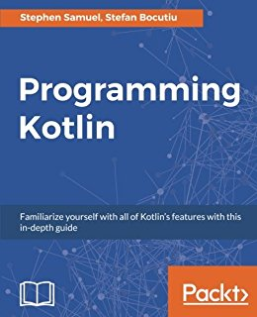

Literatúra serióznejšie čítanie
Kotlin in Action
https://www.manning.com/books/kotlin-in-action
Programming in Kotlin
https://www.packtpub.com/application-development/programming-kotlin

Slide 4
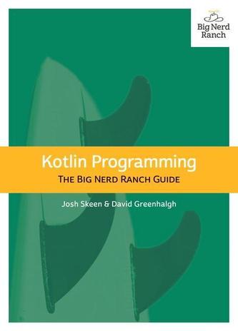
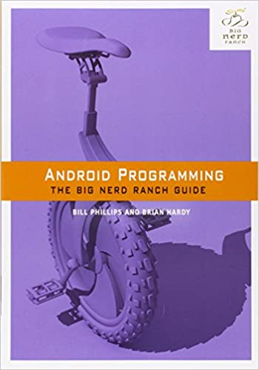
Literatúra for nerds
Kotlin Programming – The Big Nerd Ranch Guide
https://www.amazon.com/Kotlin-Programming-Nerd-Ranch-Guide/dp/0135161630
Android Programming: The Big Nerd Ranch Guide (4th Edition)
https://www.bignerdranch.com/books/android-programming-the-big-nerd-ranch-guide-4th/

Slide 5


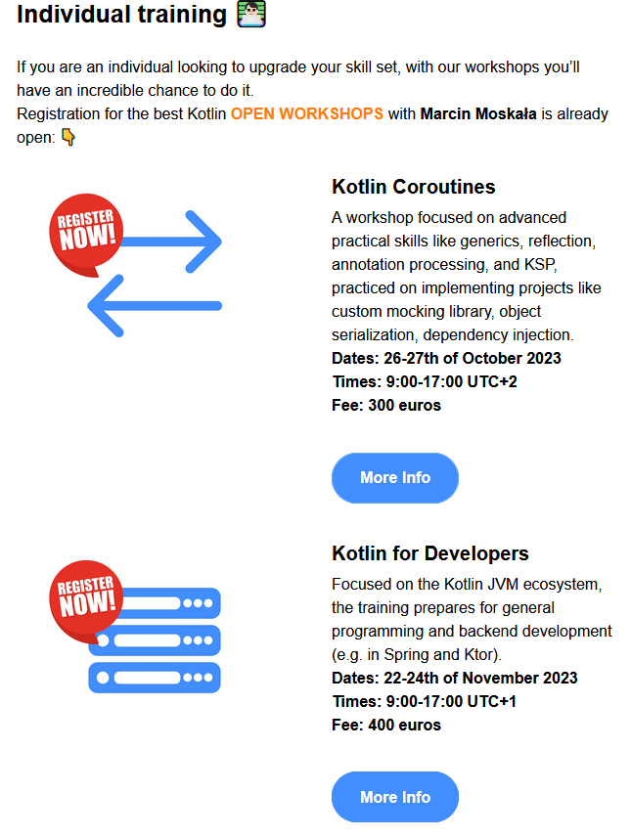


Literatúra nežný úvod
Bruce Eckel, Svetlana Isakova: Atomic Kotlin - ideálne pre začiatočníkov https://www.amazon.com/Atomic-Kotlin-Bruce-Eckel/dp/0981872557
Marcin Moskala: Effective Kotlin – Best Practices - ideálne pre pokročilejších
https://www.amazon.com/Effective-Kotlin-practices-Marcin-Moskala/dp/8395452837

Slide 6
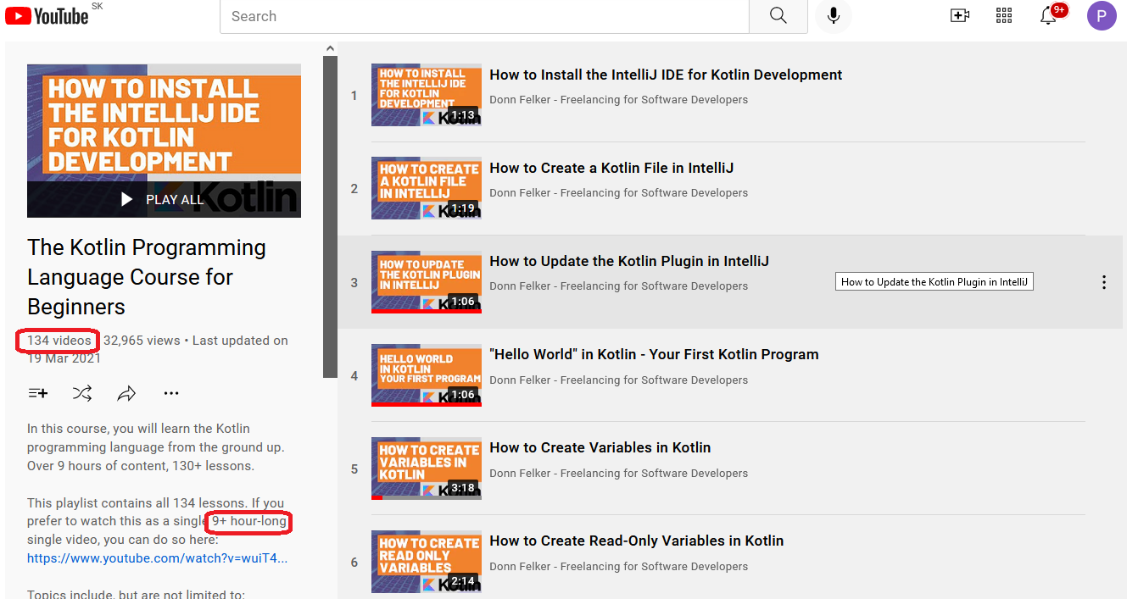
Literatúra ideálne pre „youtuberov“
https://www.youtube.com/playlist?list=PLVUm4IewkTXqwzuRXZisWg7shMTiQhUtz
Notes:
https://www.youtube.com/playlist?list=PLVUm4IewkTXqwzuRXZisWg7shMTiQhUtz

Slide 7
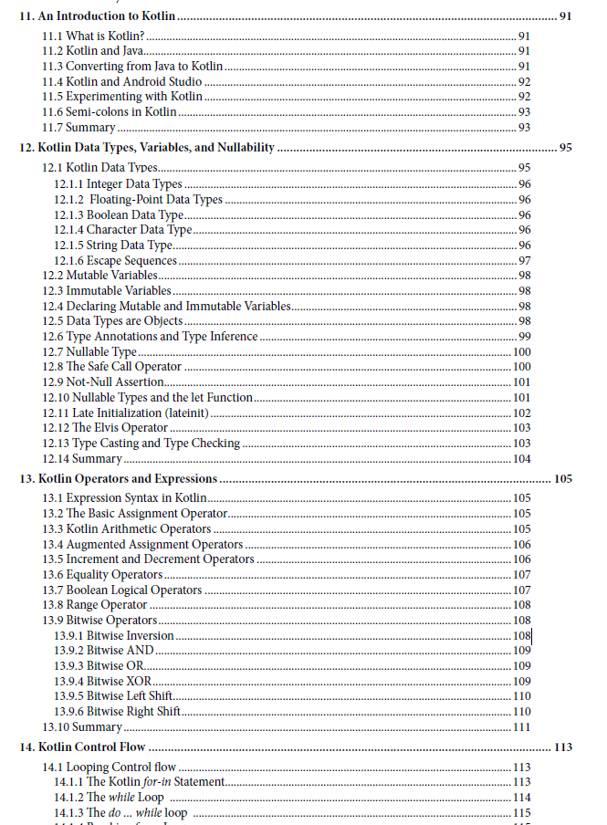

Android Studio Giraffe Essentials - Kotlin Edition
🦒 Developing Android
Apps Using Android Studio
2022.3.1 and Kotlin,
Neil Smyth

Slide 8

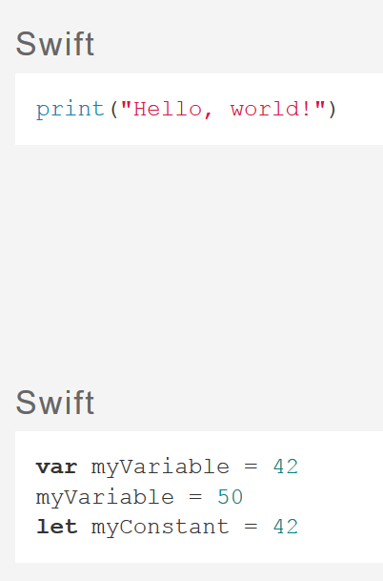
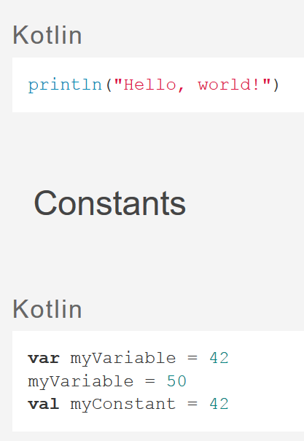
Kotlin vs. Swift
https://kotlinlang.org/ Kotlin Playground (https://play.kotlinlang.org/)
Swift is like Kotlin (http://nilhcem.com/swift-is-like-kotlin/)
prekladový slovník
pre iOSákov

Slide 9

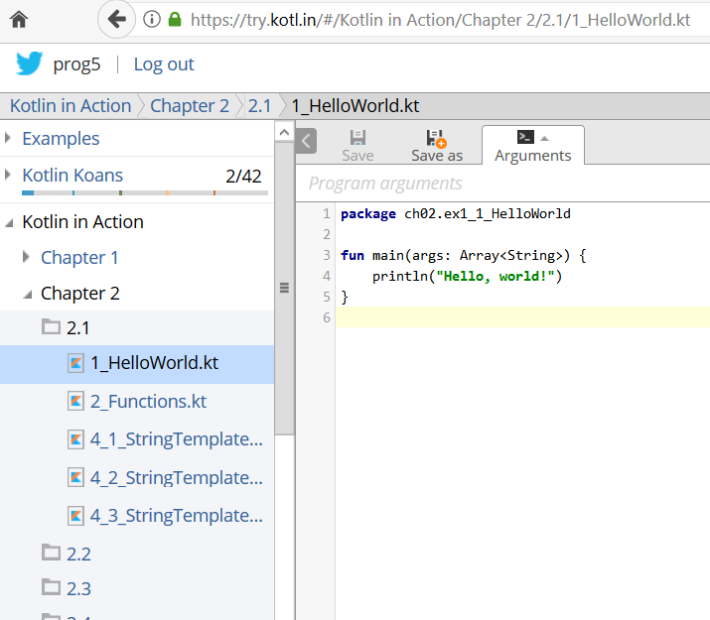
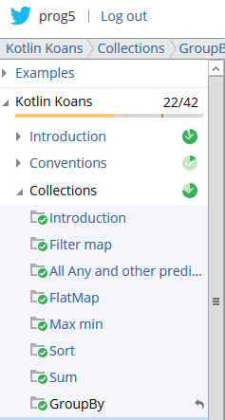
Kotlin Playground https://play.kotlinlang.org/
Cvičenie - 1
Pošli screenshot s Koans, dostaneš
Math.floor(3*% /100)
Notes:
https://play.kotlinlang.org/

Slide 10
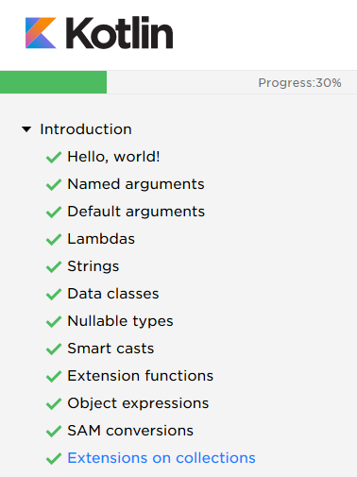
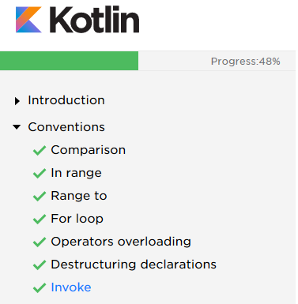
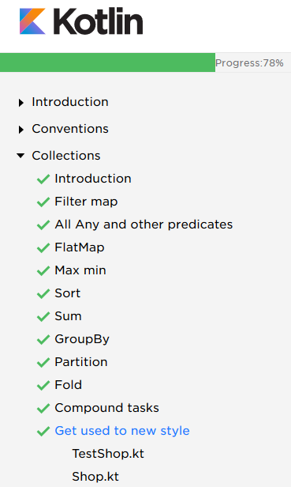

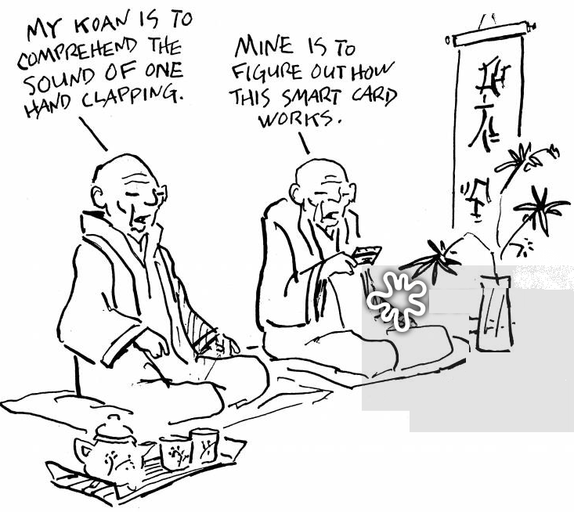
Čo sa naučíte na play.kotlinlang.org
https://play.kotlinlang.org/koans/
Cvičenie - 1
Pošli screenshot s Koans, dostaneš
Math.floor(3*% /100)
Notes:
https://play.kotlinlang.org/koans/

Slide 11
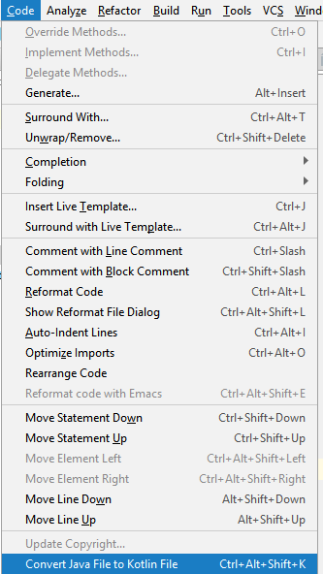
Java -> Kotlin
„klasický“ Java kód pre Fibonacciho s memoizáciou
public class Fib {
static Integer[] table = new Integer[100];
private static int fib(int n) {
Integer result = table[n];
if (result == null) {
if (n < 2)
result = 1;
else
result = fib(n - 2) + fib(n - 1);
table[n] = result;
}
return result;
}
public static void main(String[] args) {
for(int i = 0; i<20; i++)
System.out.println("fib(" + i + ")=" + fib(i));
}
}
Automatická konverzia do Kotlinu
Notes:
public class Fib { static Integer[] table = new Integer[100]; private static int fib(int n) { Integer result = table[n]; if (result == null) { if (n < 2) result = 1; else result = fib(n - 2) + fib(n - 1); table[n] = result; } return result; } public static void main(String[] args) { for(int i = 0; i<20; i++) System.out.println("fib(" + i + ")=" + fib(i)); }
}

Slide 12
Java -> Kotlin výsledok automatickej konverzie
Čo nás prekvapilo
object fib {
internal var table = arrayOfNulls<Int>(100)
private fun fib(n: Int): Int {
var result: Int? = table[n]
if (result == null) {
if (n < 2)
result = 1
else
result = fib(n - 2) + fib(n - 1)
table[n] = result
}
return result
}
@JvmStatic fun main(args: Array<String>) {
for (i in 0..19)
println("fib(" + i + ")=" + fib(i))
}
}
Už nenájdete pôvodný zdroják
DÚ podobne vygenerované sa neuznajú

Slide 13
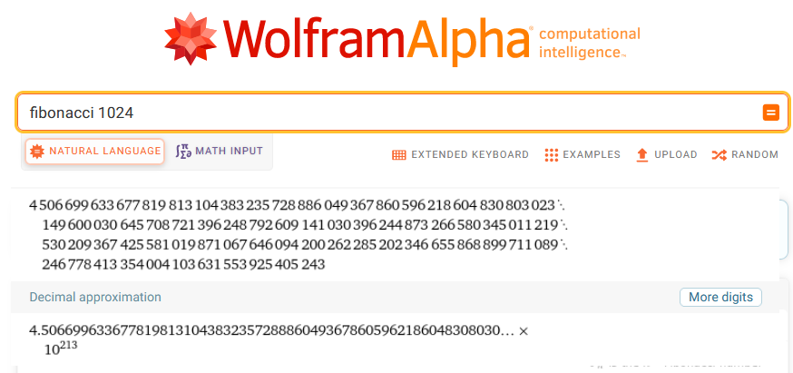
Kotlinish verzia
import java.math.BigInteger
val table = mutableMapOf<Int, BigInteger>() // HashMap
fun fib(n: Int): BigInteger = table.getOrPut(n) {
if (n <= 2)
BigInteger.ONE
else
fib(n - 1) + fib(n - 2)
}
fun main() {
println(fib(1024))
}
https://www.wolframalpha.com/input/?i=fibonacci+1024
Notes:
import java.math.BigInteger
val table = mutableMapOf<Int, BigInteger>() // HashMap
fun fib(n: Int): BigInteger = table.getOrPut(n) {
if (n <= 2)
BigInteger.ONE
else
fib(n - 1) + fib(n - 2)
}
fun main() {
println(fib(1024))
}

Slide 14
if je výraz
if je výraz
fun binCifSum(n : Int) : Int =
if (n <= 0) 0
else binCifSum(n/2) + if (n % 2 == 0) 0 else 1
else binCifSum(n/2) + (n % 2 == 0)
fun binCifSumClassic(n : Int) : Int {
if (n <= 0) return 0
else if (n % 2 == 0) return binCifSumClassic(n / 2)
else return 1 + binCifSumClassic(n / 2)
}
fun main(args:Array<String>) : Unit {
for (n in 0..10)
println("binCifSum $n je ${binCifSum(n)}")
}
0.kt

Slide 15
when je switch, tiež je to výraz
val kategoria =
if (vek < 6) "predskolsky"
else if (vek <= 11) "1.stupen"
else if (vek <= 18) "2.stupen"
else "mimo"
val kategoria1 =
when (vek) {
in 0..5 -> "predskolsky"
in 5..11 -> "1.stupen"
in 12..18 -> "2.stupen"
else -> "mimo"
}
var kategoria2 = "mimo"
when (vek) {
in 0..5 -> kategoria2 = "predskolsky"
in 5..11 -> kategoria2 = "1.stupen"
in 12..18 -> kategoria2 = "2.stupen“
}
0.kt

Slide 16
For/foreach cyklus
for (x in 1..10) println(x) // 1, 2, …, 10
for (x in (1..10).toList()) println(x) // 1, 2, …, 10
for (x in (10 downTo 1).toList()) println(x) // 10, 9, …, 1
for (x in 10 downTo 1) println(x) // 10, 9, …, 1
for (x in 1 until 10) println(x) // 1, 2, …, 9
for (x in 1 until 10 step 2) println(x) // 1, 3, 5, 7, 9
for (x in listOf(2,3,5,7,11,13)) println(x)
for (x in 'a'..'z') println(x) // a, b, …, z
for ((index, value) in ('a'..'z').withIndex()) println("[$index]=$value") // [0]=a, [1]=b,…
val map=mapOf(1 to "gula",2 to "zelen",3 to "zalud",4 to"srdce")
for ((key, value) in map) println("[$key]=$value")
// [1]=gula, [2]=zelen, [3]=zalud, [4]=srdce
0.kt

Slide 17
Cykly
fun main(args: Array<String>) {
for(a in args)
print("$a, ")
for (c in 'A'..'F’)
println(Integer.toBinaryString(c.code()))
for (c in ' '..'z')
if (c in 'a'..'z' || c in 'A'..'Z')
print(c)
for (c in ' '..'z’)
when (c) {
in '0'..'9' -> println("digit")
in 'a'..'z', in 'A'..'Z' -> println("letter")
}
}
7.kt

Slide 18
Operátory porovnania
podobne ako Java <=, <, >=, >, !=
ale
== je porovnanie hodnôt
=== je porovnanie referencií
val a = "kot"
val b = "lin"
val c = (a+b).trim()
val d = "kotlin"
println("c==d ${c==d}, c===d ${c===d}")
c==d true, c===d false
0.kt

Slide 19
Kolekcie
val set = hashSetOf(2, 3, 5, 7, 11, 13, 17)
val list = arrayListOf(-1, 0, 1)
val map = hashMapOf("sedma" to 7, "osma" to 8, "dolnik" to 11,
"hornik" to 12, "kral" to 13, "eso" to 15)
println(set) println(set.javaClass)
println(list) println(list.javaClass)
println(map) println(map.javaClass)
for(x in list) // cyklus cez list
for(y in set) // cyklus cez set
for((key, value) in map) // cyklus cez map
println("$x $y $key $value")
[17, 2, 3, 5, 7, 11, 13]
class java.util.HashSet
[-1, 0, 1]
class java.util.ArrayList
{kral=13, eso=15, sedma=7, osma=8,
dolnik=11, hornik=12}
class java.util.HashMap
8.kt

Slide 20
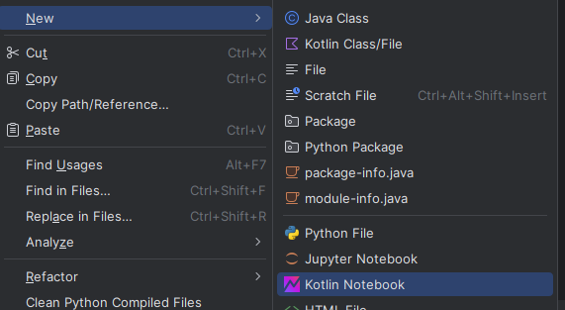
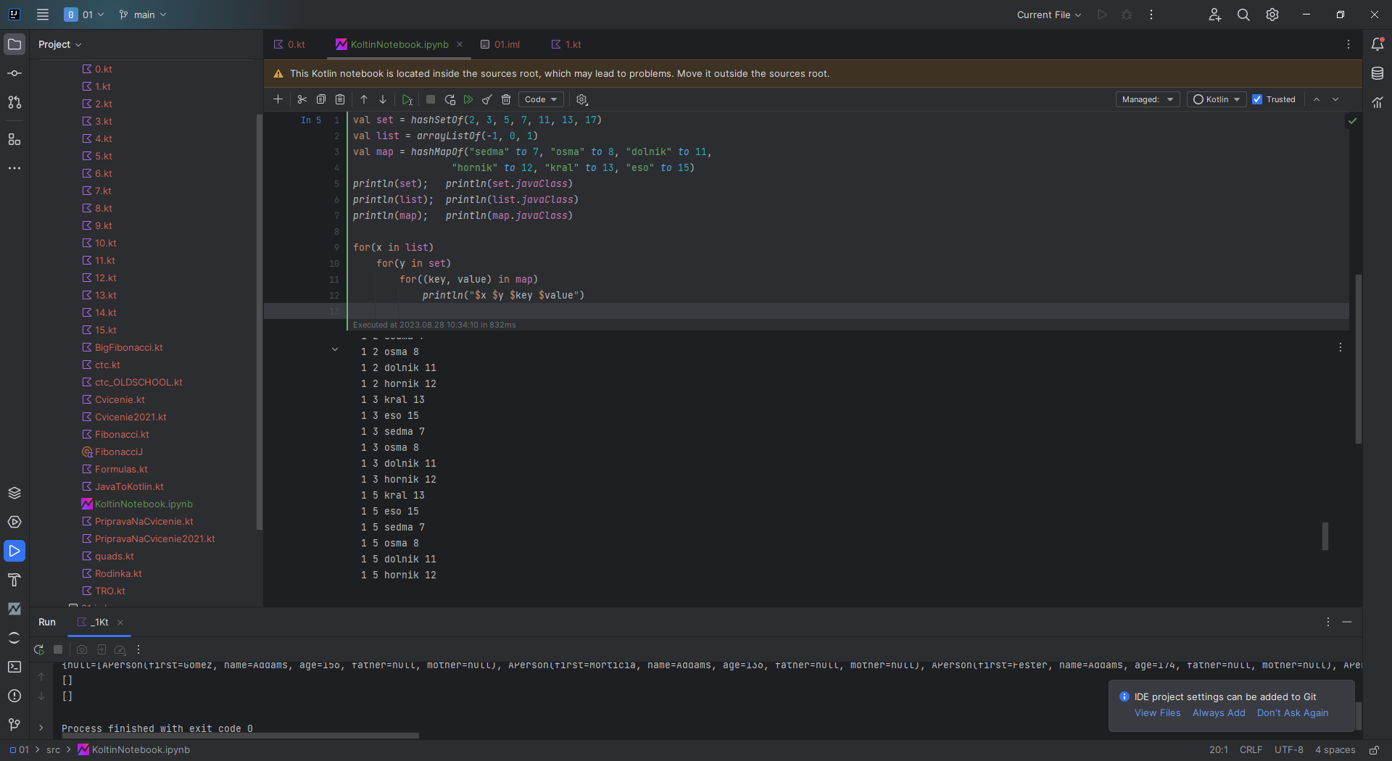
Kotlin Notebook

Slide 21
Číselné funkcie, String template
fun fib(n: Int): Int {
return if (n < 2) 1 else fib(n-1) + fib(n-2)
}
fun fib1(n: Int): Int {
fun fib(n: Int, a : Int = 0, b : Int = 1): Int {
return if (n < 0) a else fib(n-1, b, a+b)
}
return fib(n)
}
fun main(args: Array<String>) {
val lst = listOf(1,2,3,4,5,6,7,8,9,10)
println(lst.map { n -> fib(n) })
println(lst.map { fib1(it) })
lst.forEach { println("fib($it) = ${fib1(it)}")}
for(i in 1..11) println("fib($i) = ${fib1(i)}" )
println("Maximum:${lst.map { fib(it) }.max()}")
}
2.kt

Slide 22
Funkcie a it
val fcia = { x:Int, y : Int -> println("sucet $x+$y"); x+y}
val proc = { x:Int, y : Int -> println("sucet $x+$y")}
println(fcia(12,7))
proc(13,9)
println({ x:Int -> x+1 }(2))
; // inak neopochopí, že nejde o blok, ale lambda konštantu
{ x:Int -> println(x)}(4)
// preto jasnejší zápis
run {{ x:Int -> println(x)}(4)}
val delta = 5
println(listOf(1,2,3)
.map { it + delta} // x -> x + delta, clojure
.filter {it % 2 == 0} )
10.kt

Slide 23
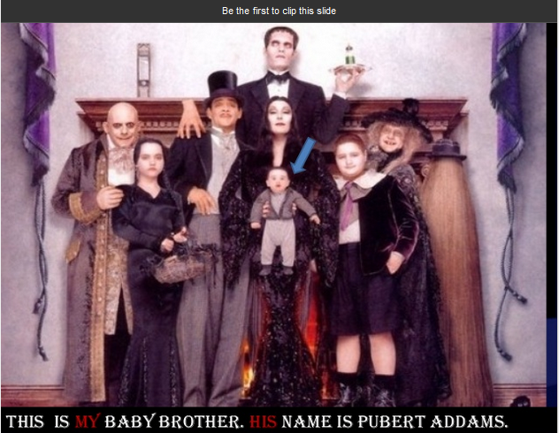
Addams Kotlin family
data class Person(val first : String, val name: String,
val age: Int? = null,
val father : Person?, val mother : Person?)
Data class je class s predgenerovanými equals, hashCode, toString, copy
fun main(args: Array<String>) {
val father = Person("Gomez", "Addams", 156, null, null)
val mother = Person("Morticia", "Addams", 136, null, null)
val daugther = Person("Wednesday", "Addams", 46, father, mother)
val son = Person("Pugsley", "Addams", 36, father, mother)
val family = listOf( father, mother, daugther, son,
Person("Fester", "Addams", 174, null, null), // uncle
Person("Pubert", "Addams", null, null, null) // on the picture
)
val oldest = family.maxBy { it.age ?: 0 }
println("The oldest is: $oldest")
}
1.kt

Slide 24
Funkcionály
println(family.map { it.first }) // mapToObj
println(family.filter { it.age?:0 > 100 } )
println(family.all { it.age?:0 < 100 } )
println(family.all { it.name == "Dracula" } )
println(family.groupBy { it.father } )
println(family.filter { it.age ==
(family.maxBy { person: APerson -> person.age ?: 0 }.age?: 0) } )
println(family.filter { it.age ==
(family.map { it.age?:0 }.max()) } )
Ak by .age bol Int, nie Int?
it.age == family.maxBy { person: Person -> person.age }?:0 } )
val numbers = mapOf(0 to "zero", 1 to "one")
for((father, persons) in family.groupBy { it.father })
println("${persons.size} ma otca $father")
println(listOf("a", "aba", "b", "ba", "abba").groupBy { it.length })
println(listOf("a", "aba", "b", "ba", "abba").flatMap { it.toList() })
1.kt

Slide 25
Funkcie
class Book(val title: String, val authors: List<String>)
val books = listOf(
Book("Action in Kotlin", listOf("Dmitry Jemerov", "Svetlana Isakova")),
Book("Mort", listOf("Terry Pratchett")),
Book("Good Omens", listOf("Terry Pratchett", "Neil Gaiman")),
Book("Discworld", listOf("Terry Pratchett", "Paul Kidby")))
println(books.flatMap { it.authors }.toSet())
listOf(1, 2, 3, 4)
.asSequence()
.map { print("map($it) "); it * it }
.filter { print("filter($it) "); it % 2 == 0 }
.toList()
val nats = generateSequence(1) { it + 1 }
println(nats.takeWhile { it <= 100 }.sum())
println(nats.takeWhile { it <= 10 }.reduce({ x:Int, y : Int -> x*y}))
10.kt

Slide 26
Collection vs. sequence
val collection = (-100..100)
.filter {it % 2 == 0}
.map { it * 2 }
.map { it/it }
.take(10)
println(collection)
java.lang.ArithmeticException
val sequence = (-100..100)
.asSequence()
.filter {it % 2 == 0}
.map { it * 2 }
.map { it/it }
.take(10)
println(sequence.toList())
[1, 1, 1, 1, 1, 1, 1, 1, 1, 1]
Kolekcie:
vyhodnocujú sa dravo -eager
každá transformácia sa aplikuje na celú kolekciu
vytvorí sa nová kolekcia
dobré pre neveľké kolekcie
Sekvencie:
vyhodnocujú sa lenivo -lazy
každá transformácia sa aplikuje element-po-elemente
nevytvorí sa nová kolekcia
vhodné pre veľké kolekcie

