Slide 1


MIT Inventor prvý dotyk aplikácie
Peter Borovanský
KAI, I-18
borovan 'at' ii.fmph.uniba.sk

Slide 2


Ako začať s App Inventor http://appinventor.mit.edu/explore/ai2/setup-emulator.html
potrebujete google-mail účet
http://ai2.appinventor.mit.edu/
Počítač:
platformy: MS-Windows, Mac OS X, Ubuntu, Debian
browser: FF, Safari, Chrome, IE
setup page: http://appinventor.mit.edu/explore/ai2/setup.html
pre MS-Windows treba pustiť MIT_Appinventor_Tools_2.3.0 (~80 MB)
Na zariadení:
https://play.google.com/store/apps/details?id=edu.mit.appinventor.aicompanion3
Android Mobil (ale prežijete aj s emulátorom):
v mobile: Setting/Application/Development/, 7xklik na Build Number
USB Debugging = ON (môžete uploadovať vlastné aplikácie .apk)
Stay awake = ON (nebude vám uspávať, kým ho máte na kábli)
Allow mock location = ON (ak chcete používať nejaké fake GPS – neskôr)
Sound & Display/Orientation = OFF

Slide 3
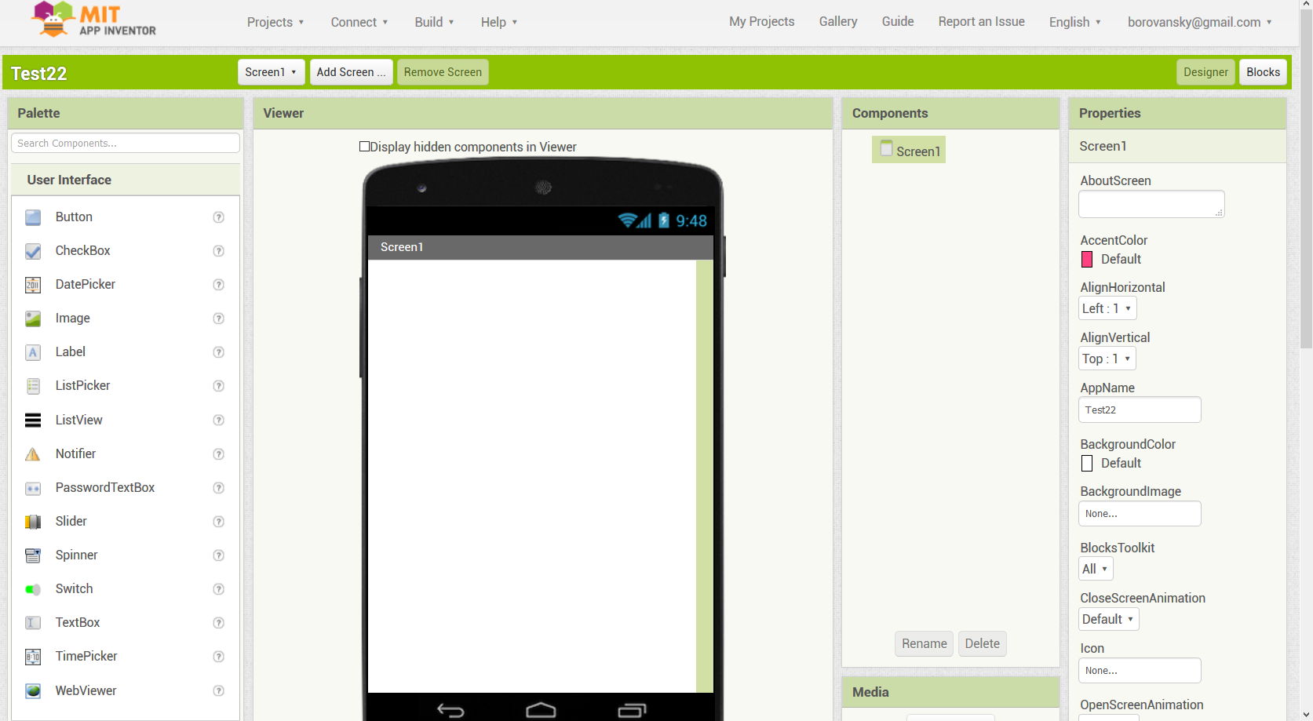
MIT Inventor – hlavný panel
http://ai2.appinventor.mit.edu/
http://ai2.appinventor.mit.edu/

Slide 4

Android Apps with App Inventor: The Fast and Easy Way to Build Android Apps
J.H.Kloss, Amazon: 4.4/5
Installing and configuring App Inventor
Building modern, attractive mobile user interfaces
Controlling Android media hardware, including the camera
Saving data locally with TinyDB, or in the cloud with TinyWebDB
Streamlining and automating phone, text, and email communications
Tracking orientation, acceleration, and geoposition
Integrating text-to-speech and speech-to-text in your apps
Controlling other apps and Web services with ActivityStarter
Building mobile mashups by exchanging data with Web APIs
Testing your apps for diverse hardware with the Android Emulator
Example apps
http://books.google.sk/books?id=rfKyt6TRLloC&pg=SA4-PA7&lpg=SA4-PA7&dq=laughter+android+kloss&source=bl&ots=Kht9zKTIyK&sig=YqHJbc8v77VtR28RmpZccyV2ScY&hl=sk&sa=X&ei=bGOZUMmgDMbesgbA64HIBg&ved=0CCkQ6AEwAQ#v=onepage&q&f=true
http://www.amazon.com/Android-Apps-App-Inventor-Build/dp/0321812700/ref=sr_1_7?s=books&ie=UTF8&qid=1322522259&sr=1-7

Slide 5

Iné zdroje
AppInventor at MIT (http://appinventor.mit.edu/)
Kurz edX: Mobile Computing with App Inventor - CS Principles (english)
(https://courses.edx.org/courses/course-v1:TrinityX+T007x+1T2017/course/)
Kurz Learn2Code: MIT Inventor (slovensky)
(https://www.learn2code.sk/kurzy/mit-app-inventor)
príklady hotových projektov, ak radšej čítate hotové projekty:
App Inventor Snippets (http://puravidaapps.com/snippets.php)
App Inventor Teach – pre učiteľov (http://appinventor.mit.edu/explore/teach.html)
MIT Inventor Tutorials – Hour of Code (http://appinventor.mit.edu/explore/hour-of-code.html)
MIT Inventor Public Open Source (http://appinventor.mit.edu/appinventor-sources/)
Dlho očakávané MIT Inventor for iOS (http://doesappinventorrunonios.com/)

Slide 6
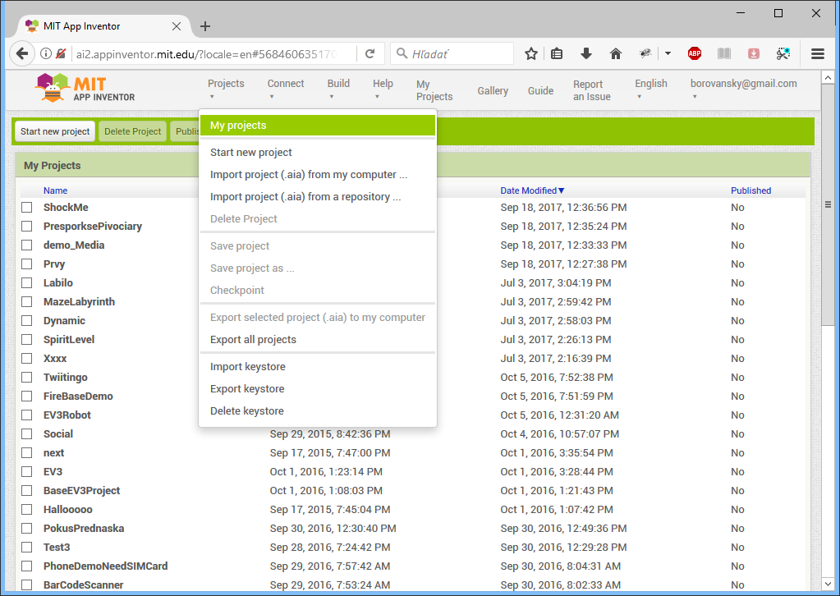

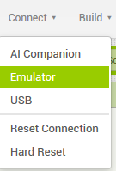

My projects
zoznam
mojich projektov
import
export
Connect
login
Build

Slide 7
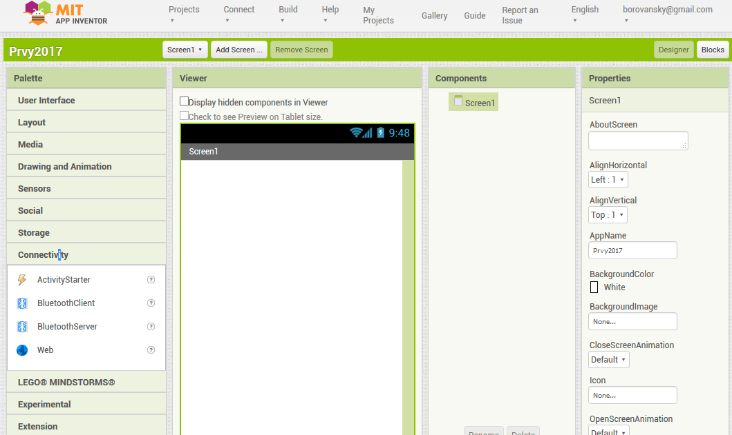
Prvý projekt

Slide 8
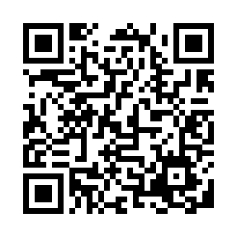

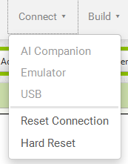
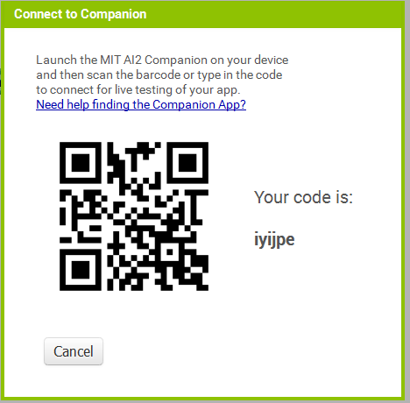
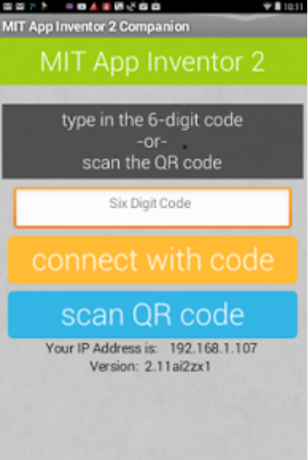
Connect WiFi
Nainštalujte MIT AI2 Companion App cez Google Play Store
https://play.google.com/store/apps/details?id=edu.mit.appinventor.aicompanion3
Connect to Device
spusti MIT AI2 Companion App

Slide 9
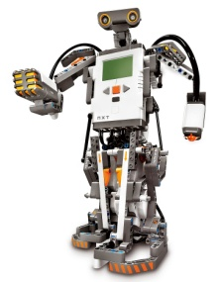
Palety komponentov
User Interface
  Button, CheckBox, Clock, Image, Label, List/Time/Date-Picker, Password, Slider, TextBox
Layout
  Horizontal/Vertical/Table Arrangement [Scrollable]
Media
  Camcoder, Camera, ImagePicked, Player, Sound, VideoPlayer, TextToSpeech, SpeechRecognizer
Drawing and Animation
  Ball, Canvas, ImageSprite
Social
  ContactPicker, EmailPicker, PhoneNumberPicker, PhoneCall, Texting, Twitter, Sharing
Sensor
  Accelerometer, Location, Orientation, Gyro, Pedometer, Proximity, Bar Code Scanner
Storage
  File, TinyDB, FireBaseDB
Connectivity
  BluetoothClient-Server, ActivityStarter
Lego MINDSTORMS

Slide 10
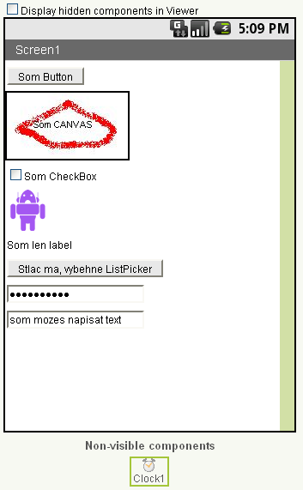
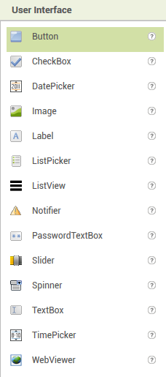
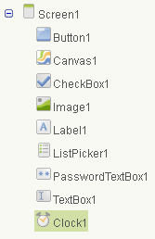
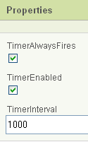
User Interface
Ilustrujeme si základné vizuálne komponenty:
Button
CheckBox
Clock
Image
Label
List/Time/Date-Picker
PasswordTextBox
TextBox
Notifier
WebViewer
BasicComponents.apk

Slide 11
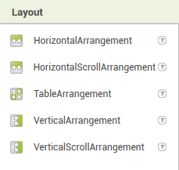
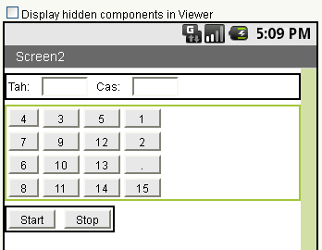
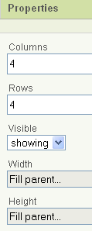
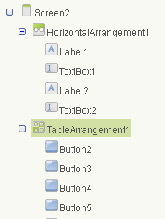
Layouts (Arrangement)
HorizontalArrangement
TableArrangement
VerticalArrangement
BasicComponents.apk

Slide 12
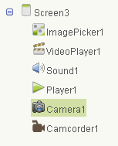
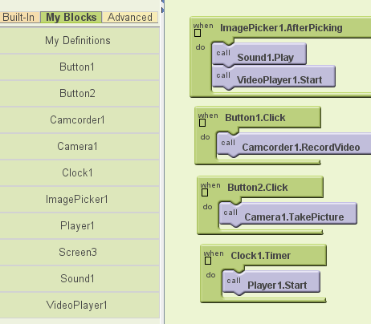
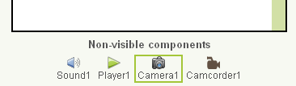
Media
Spustiť: block editor
Uložiť (strýčko Google si to ukladá sám v MyProjects:-)
Camera
ImagePicker
Player
Sound
VideoPlayer
BasicComponents.apk

Slide 13
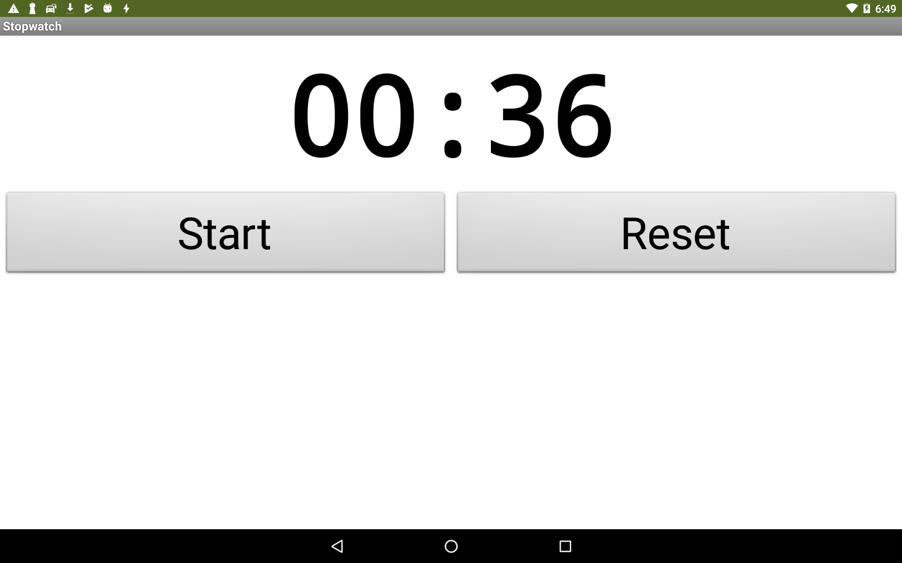
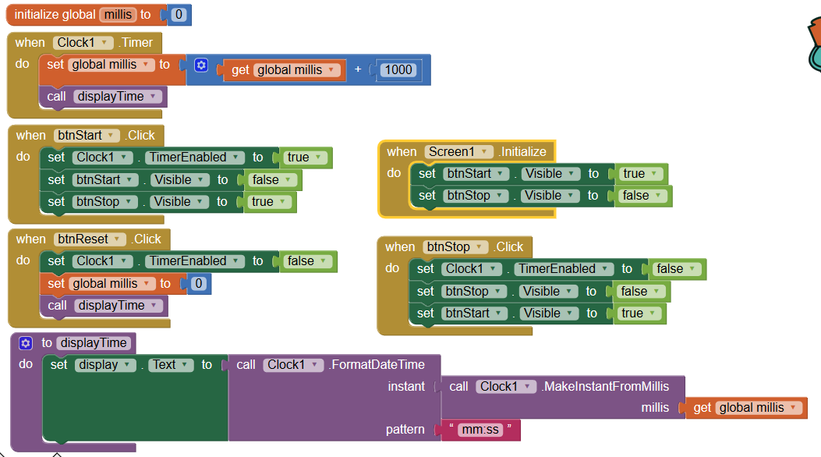
Stopky
(clock – timer)
L2CStopky.apk

Slide 14
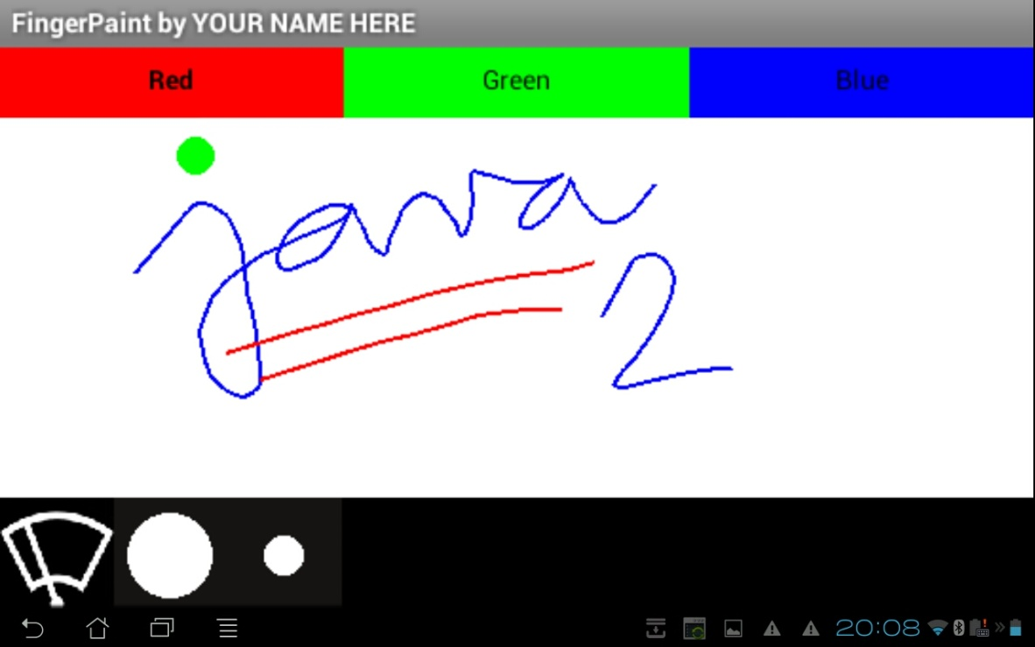
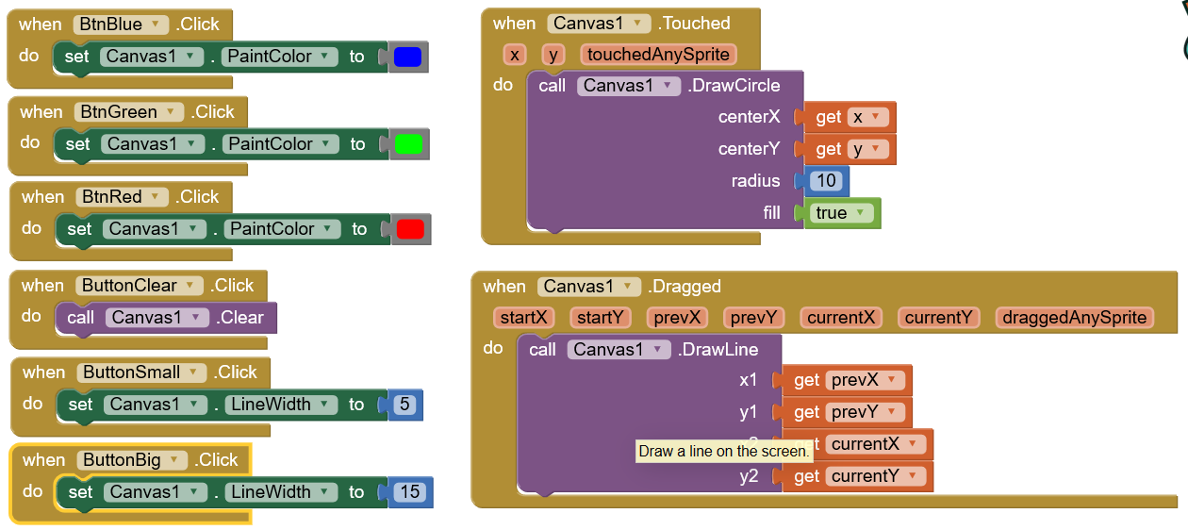
FingerPaint1
jednoduché malovátko prstom
FingerPaint1.apk

Slide 15
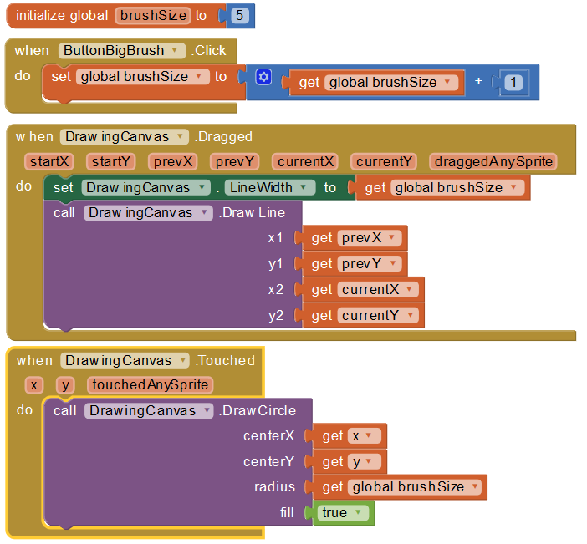
FingerPaint2
Pokročilejšia verzia
Hrúbka pera
  globálna premenná
  brushSize
Kreslenie čiar
  drawingCanvas.Dragged
FingerPaint2.apk

Slide 16
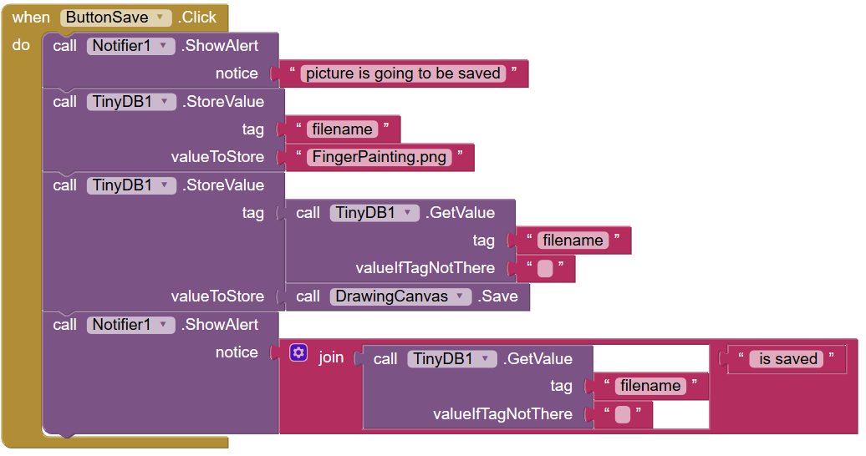
FingerPaint2
Ukladanie obrázku
  Persistencia
Práca s TinyDB
  čo je HashMap<String, Object>
The data in TinyDB is persistent only when you have packaged and downloading your app. If you are developing connected to the phone, and you restart the Appinventor application, or if you disconnect and reconnect the phone, then the data base will start fresh. This is a case where the application is not merely being stopped and restarted; it is being removed from the phone and then reloaded.
Ak chcete zmazať perzistentné dáta, Settings/Application/ClearData
FingerPaint2.apk

Slide 17
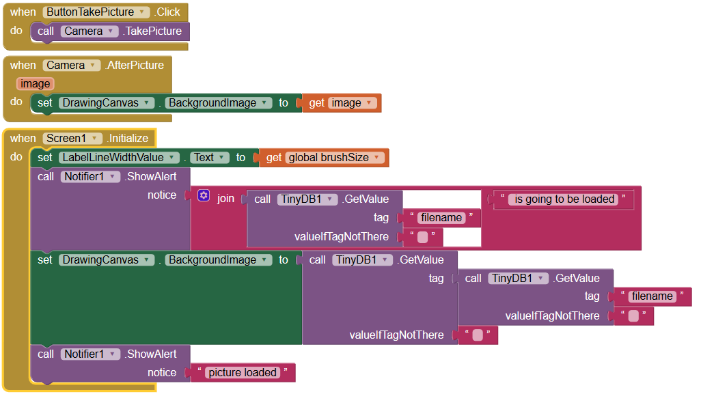
FingerPaint2
Fotka ako pozadie obrázku
  CameraTakePicture
Inicializácia obrazovky
FingerPaint2.apk

Slide 18
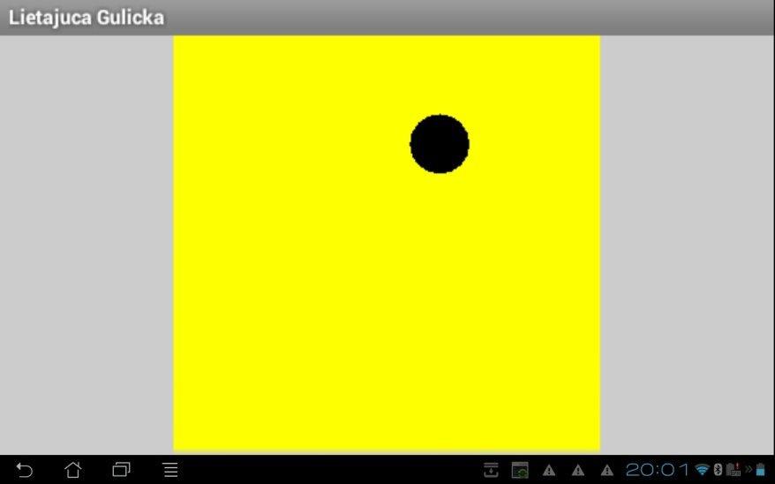
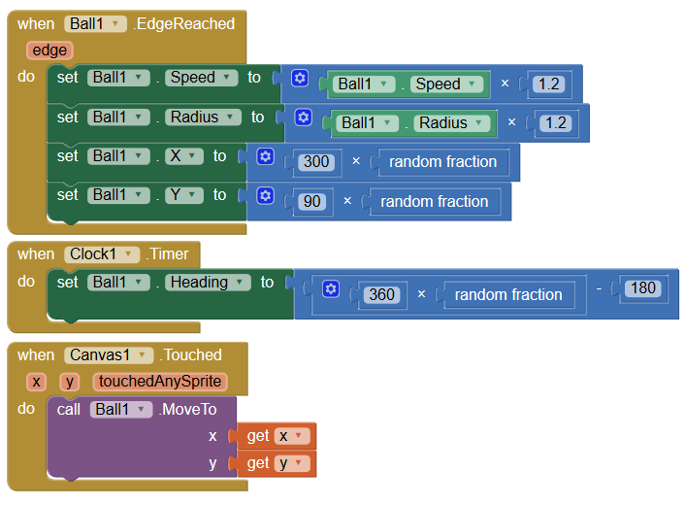
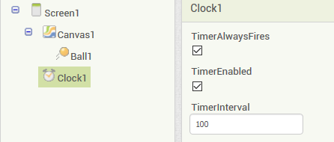
Dynamic
(random)
heading
Dynamic.apk

Slide 19

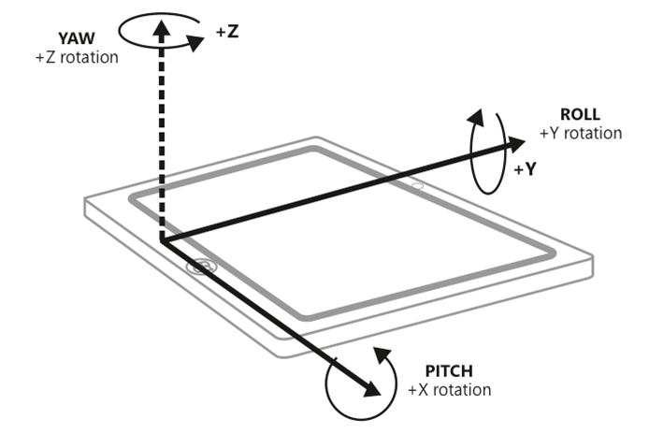
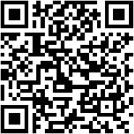
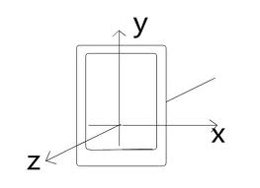
Orientácia
Orientačný senzor nájdete v každom mobile
Jeho výstupom sú tri reálne čísla, pitch (X), roll (Y), yaw (Azimut)…

Slide 20
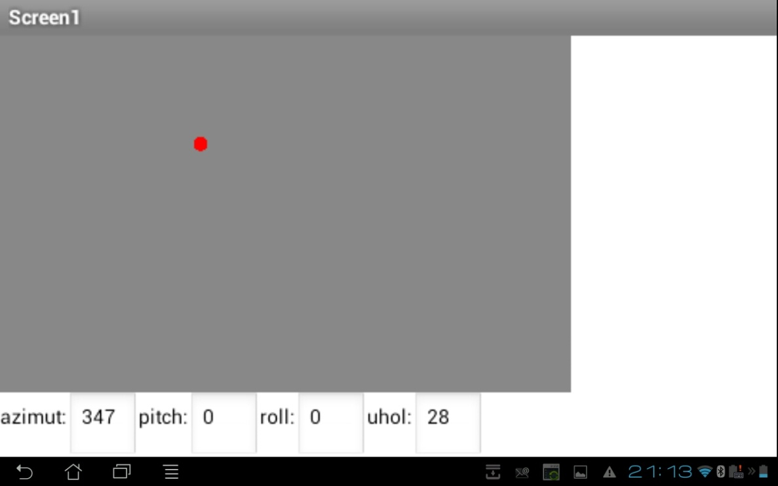
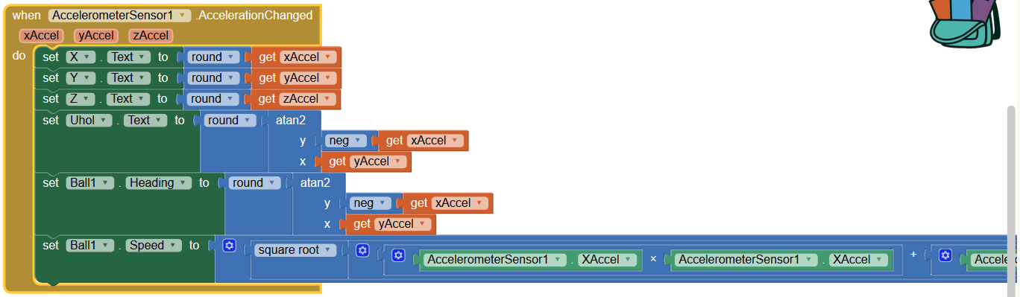
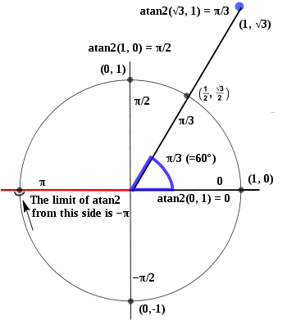
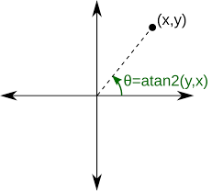
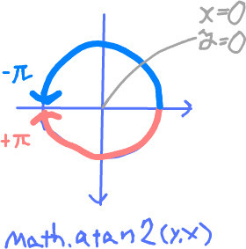
Labilo
(atan2)
Labilo.apk

Slide 21
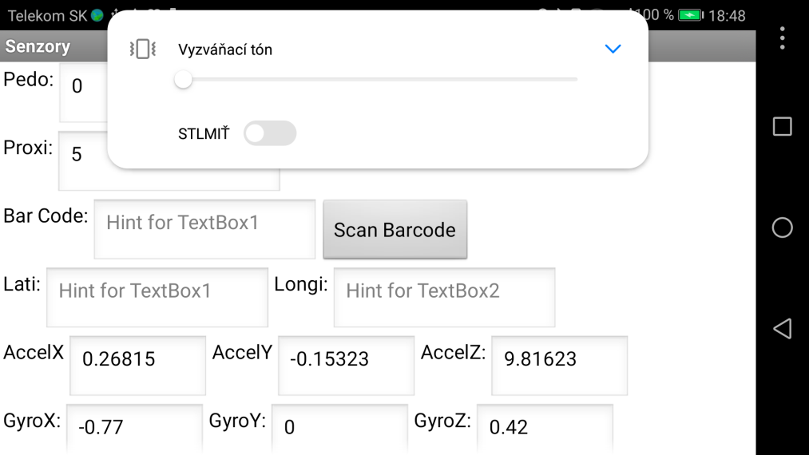
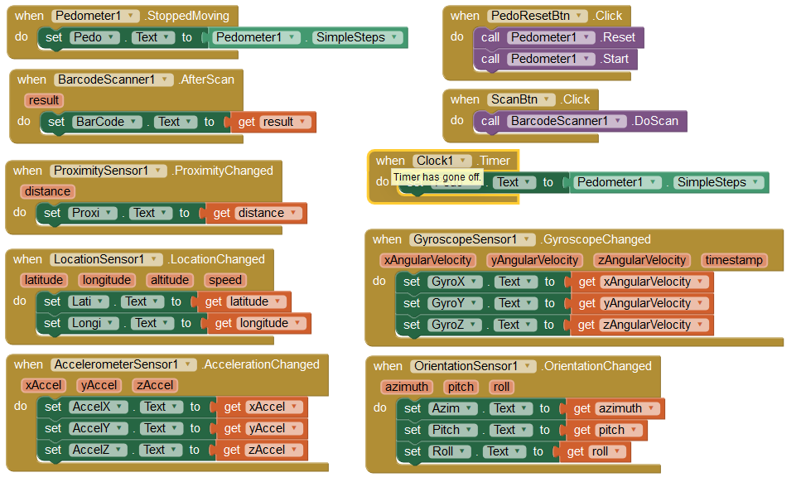
Senzory
(accel, barcode, gyro, NFC, GPS, kompas, pedo, proximity)
Senzory.apk

Slide 22
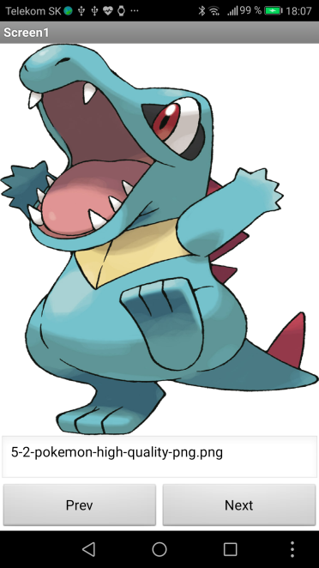
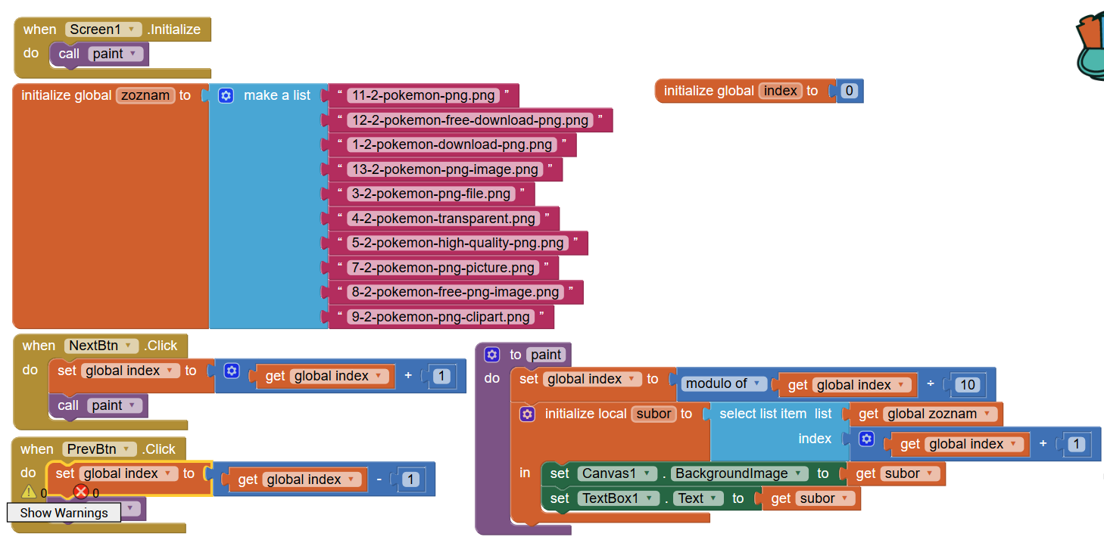
Zoznam
(zoznam)
Pokemoni.apk

Slide 23
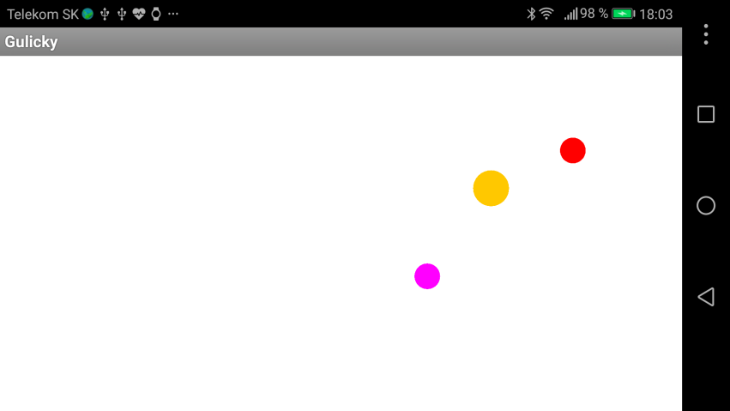
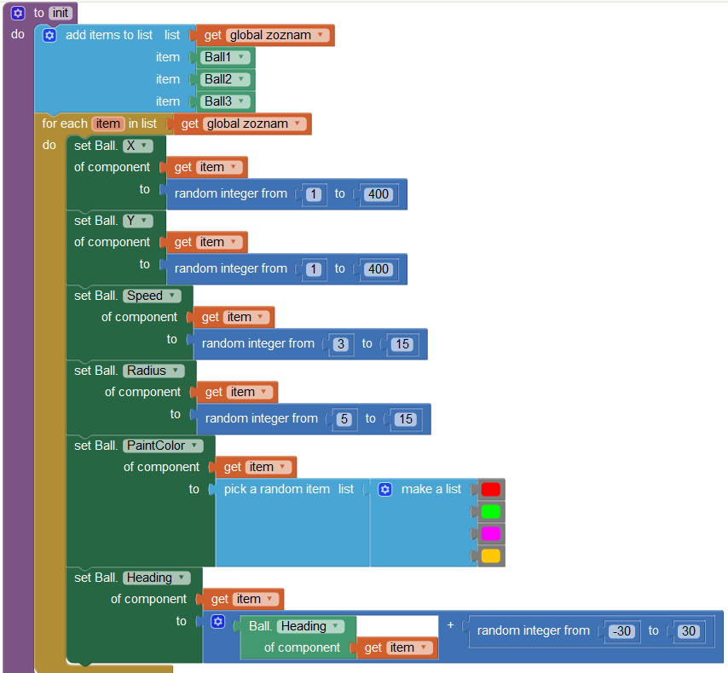
Zoznam objektov
(for each)
foreach object in a list
Gulicky.apk

Slide 24
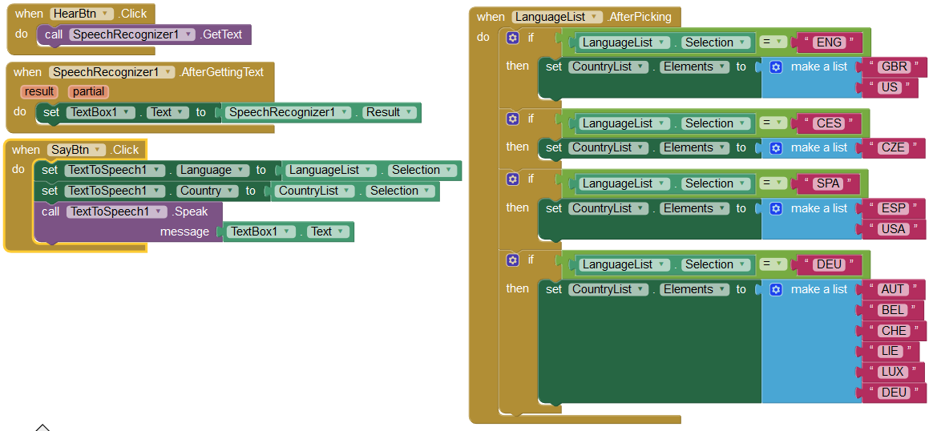
TextToSpeech
Nainštaluj eSpeak
https://play.google.com/store/apps/details?id=com.googlecode.eyesfree.espeak&hl=sk
Text2Speech.apk

Slide 25
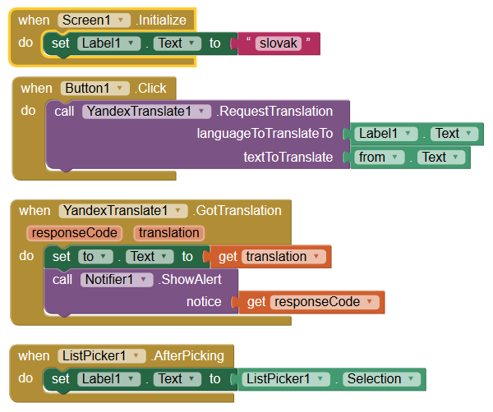
Translator
Translator.apk

Slide 26
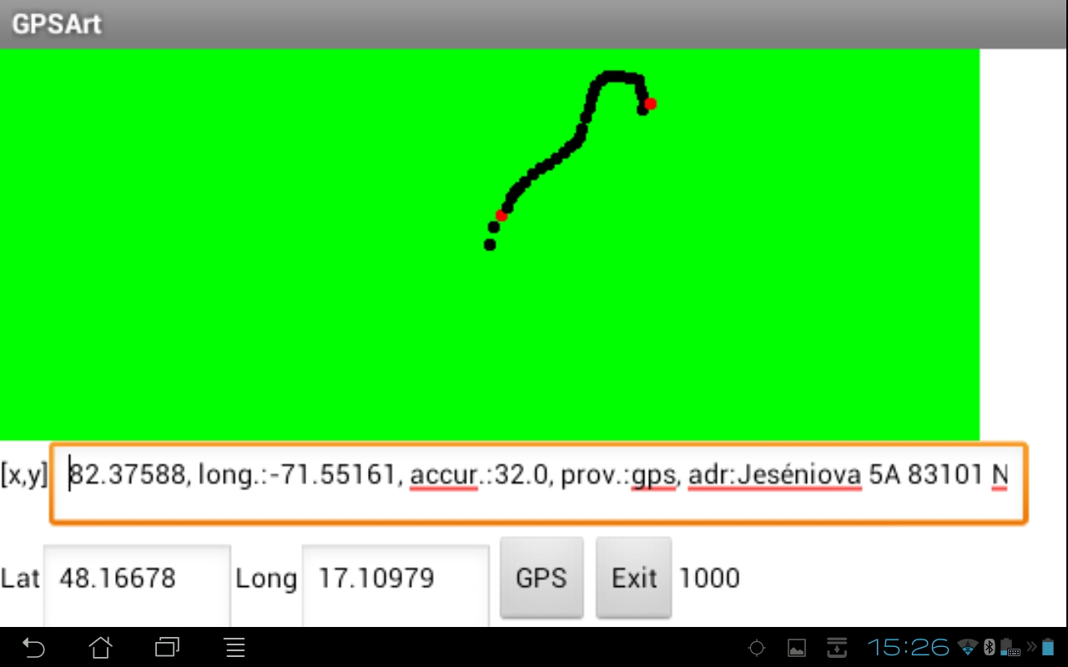
GPS Art

Slide 27
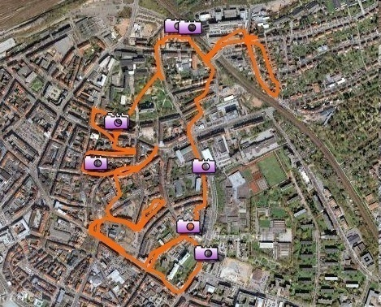
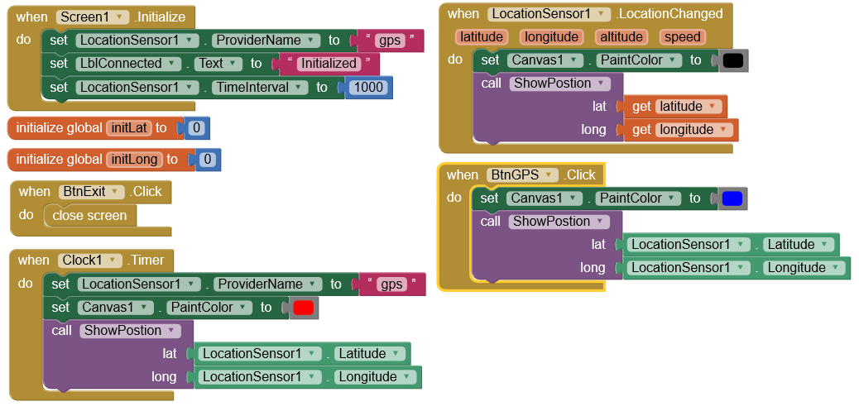
GPS Art
GPSArt.apk

Slide 28
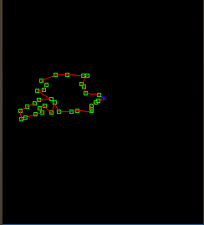

GPS Art
GPSArt.apk

Slide 29


GPS Art

