Slide 1
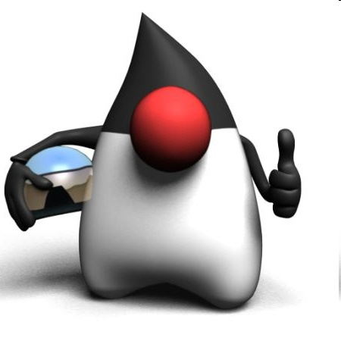

Vývoj mobilných aplikácií úvod
Peter Borovanský
KAI, I-18
borovan 'at' ii.fmph.uniba.sk

Slide 2
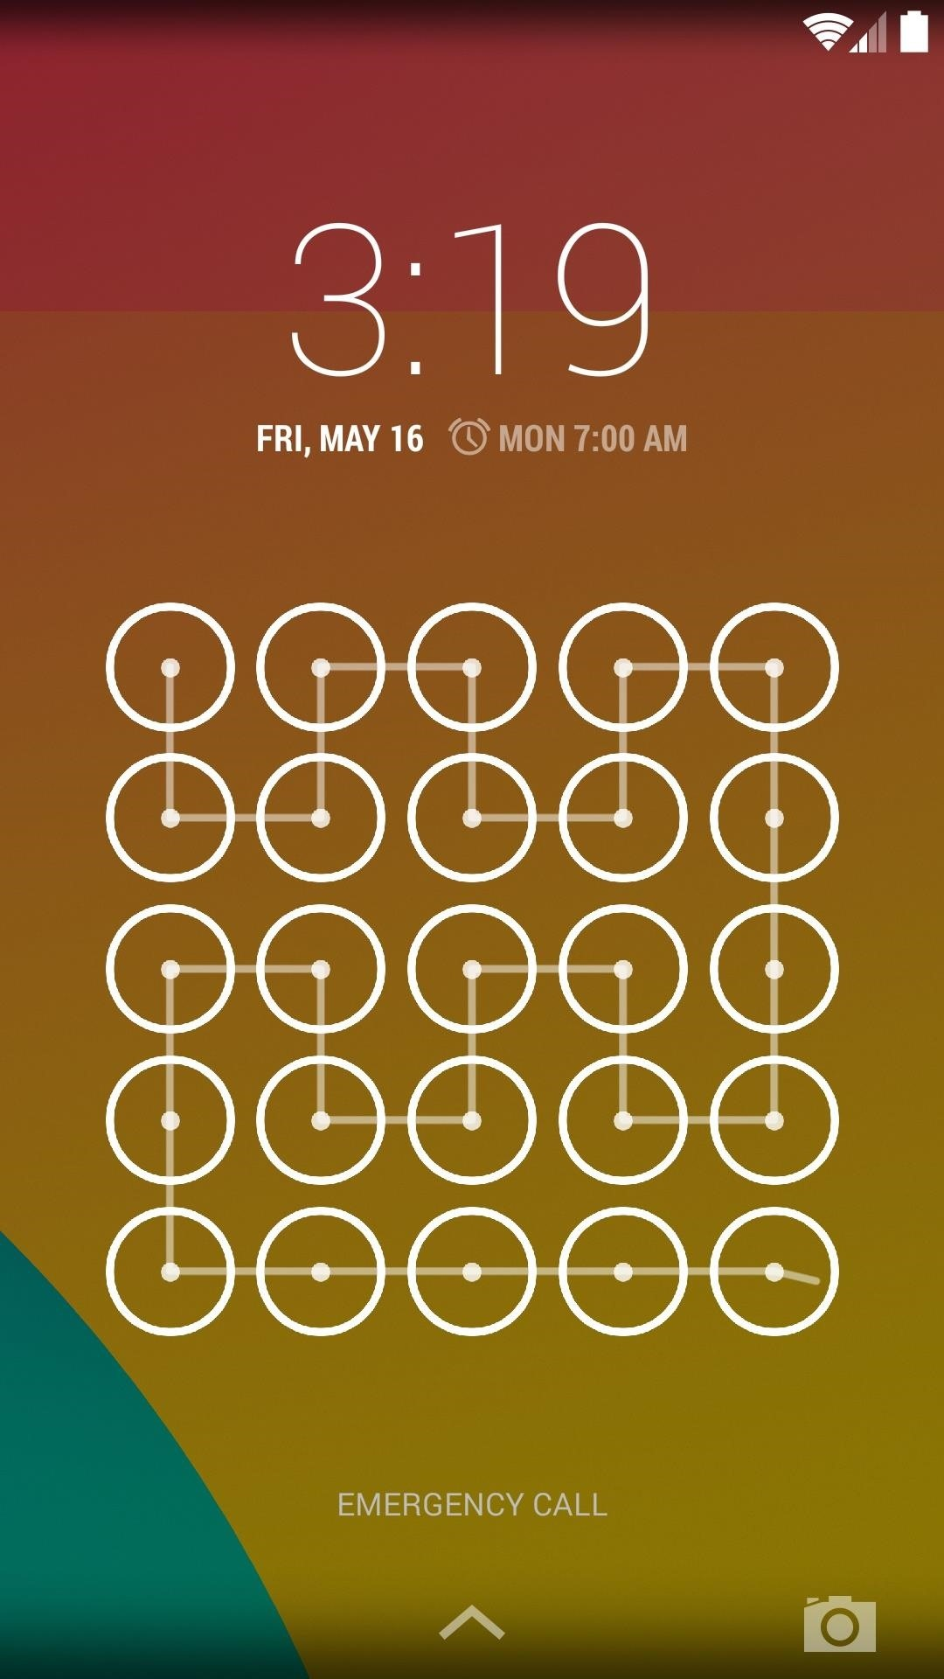
Prémiovo-orientované vyučovanie
prihláste sa do L.I.S.T.
ak ste v ňom nikdy neboli, ozvite sa mi…
sledujte LIST, všetky zadania budú v ňom
prémie sa budú sporadicky objavovať a sú plnohodnotná alternatíva k domácim úlohám
prvá už tam visí…

Slide 3
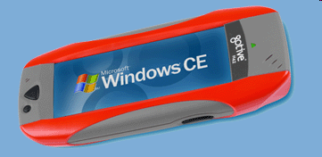

Mobilné OS
aplikácie na rôznych obmedzených HW platformách pod rôznymi OS:
Windows Mobile 5.0, 6 - najrôznejšie pda, hand heldy,… fy. Microsoft
Windows CE – pre embeded systémy, fy. Microsoft
Palm OS, webOS – propietárny OS pre Palm fy. HP, linux kernel
Maemo 5 – debian-like od fy.Nokia
Symbian (S60, S80, S90) – open source OS pre smartphony, fy.Nokia,
Samsung, SonyEricsson, Panasonic
iOS – iPhone, iPod (unix-like), fy. Apple,
Android - Google
Bada - Samsung (odpoveď na Android)
BlackBerry OS
Windows Phone -> Windows 10 Mobile
Firefox OS
Ubuntu Touch
Huawei OS

Slide 4
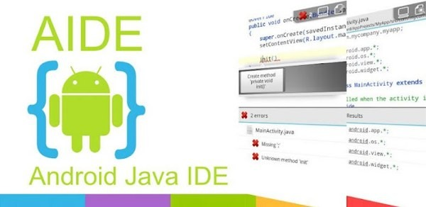
Vývojové jazyky/nástroje
Symbian
  C++, Java ME, Python, …
Windows Mobile 6
  C# (MS Visual Studio)
iOS
  Objective-C -> Swift 3/4/5 (Xcode) iOS - Apple Center kurz
Android
  scratch (MIT Inventor)
  java (Android SDK + plugin pre Eclipse) -> (Android Studio)
  java (A.I.D.E.)
  Kotlin (Android Studio 3+)
  C++ (Android NDK)
Multi-platform
  C# (Xamarin iOS, Android, Windows) – fy. MS, Visual Studio 2015
  Pascal (Delphi XE5 iOS, Android, Windows 10) – fy. Embarcadero
  JavaScript/TypeScript (React Native)
  Flutter od Google
game engine 1-AIN-303/15
  C# (Unity 2D/3D) ...

Slide 5

Unity
(game engine)
#1 Unreal Engine
#2 Unity
Obľúbený nástroj pre tvorbu multi-platform aplikácií na bakalárske práce
2-INF-263/15 magisterský predmet: Tvorba a dizajn počítačových hier
  začiatok: 26. 9. - 20. 12. 2019
  http://sccg.sk/~mferko/tdh/
  https://candle.fmph.uniba.sk/ucitelia/Michal-Ferko
1-AIN-303/15 bakalársky predmet: Game Engines
  http://www.agentspace.org/ge/
  https://candle.fmph.uniba.sk/ucitelia/Andrej-Lucny

Slide 6
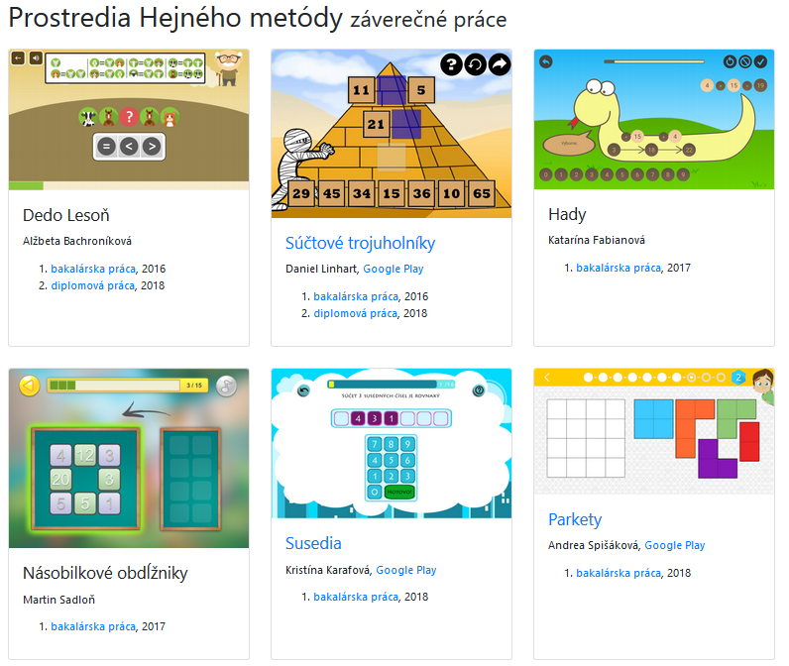



Príklady bakalárskych prác
(hejny.sk)

Slide 7







Vývoj a nástroje
(detailnejšie)
natívne aplikácie
  Android
    Java
    Kotlin
  iOS
    Objective-C
    Swift
hybridné aplikácie
  Cordova
  ionic
Priamy prístup k všetkým fičúrkam a
komponentom OS, aj tým najnovším ...
Web-app na báze .html,. css, .js, ktoré púšťame v prostredí WebView=browser/wrapper bez browserových ovládačov

Slide 8

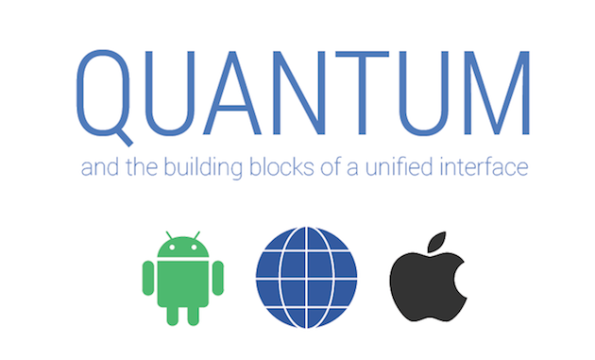


Vývoj a nástroje
(detailnejšie)
kompilované aplikácie
  React Native
    JavaScript
    Facebook
    nekompiluje do natívneho kódu
    obmedzená množina widgets
  Flutter (Dart framework od Googlu)
    Dart
    Google
    kompilované do ARM C++
    bohatšia množina widgets
    Material design (Quantum Paper)– Google 2014
  NativeScript
    JavaScript

Slide 9






Aspekty programátora
Code sharing (write once, use everywhere)
Cordova, ionic
Flutter (Material Design)
ReactNative
Java, Swift
Knowledge sharing (learn once, use everywhere)
Cordova, ionic, ReactNative (.js), Flutter (Dart)
Java, Kotlin, Swift
Widget library
Java, Swift, Cordova, ionic
Flutter (Dart)
ReactNative (.js)
https://www.youtube.com/watch?v=bnYJRYFsrSw&feature=youtu.be

Slide 10
Aspekty programátora
Eco-system (schopnosť nájsť riešenie/radu/blog na stackoverflow, ...)
Java, Swift
Cordova, ionic (.js)
Kotlin
ReactNative (.js, React)
Flutter (nové ale zlepšuje sa)
Popularita
Java, Swift, Kotlin
Cordova, ionic, ReactNative, Flutter (pushujú FB a Google)

Slide 11
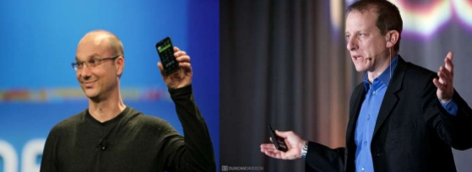

Trochu (dávnej) histórie
Android, Inc., founded in Palo Alto in Oct 2003 by Andy Rubin, Rich Miner
aim to develop:
"smarter mobile devices that are more aware of its owner's location and preferences“
an advanced operating system for digital cameras,
founders and early employees, Android Inc. operated secretly, just working on software for mobile phones
Current (!) rivals Symbian and Windows Mobile
(Apple's iPhone had not been released at the time … 2007).
Rubin ran out of money. Steve Perlman (QuickTime, WebTV, later working on iPhone, iPods), a close friend of Rubin, brought him $10,000 in cash in an envelope and refused a stake in the company.
http://en.wikipedia.org/wiki/Android_%28operating_system%29

Slide 12

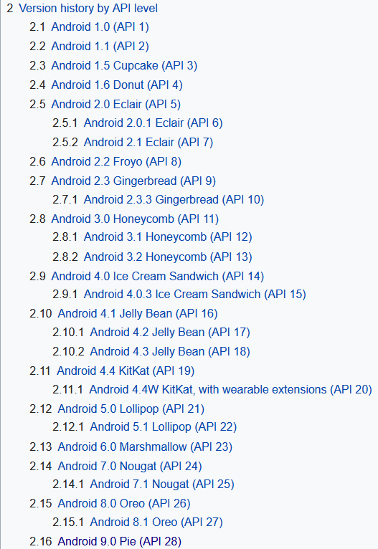
Android a Google
2005 Google acquired Android Inc.
with Rubin, Miner et at.
2007 Open Handset Alliance, a consortium
  device manufacturers: HTC, Sony and Samsung,
  wireless carriers: T-Mobile, ...
  chipset makers: Qualcomm, Texas Instruments,
includes Google with a goal to develop
open standards for mobile devices
major release named in alphabetical order
after a dessert or sugary treat
  2.3 Gingerbread
  4.3 Jelly Bean, July, 2012,
  4.4 KitKat, announced, October, 2013,
  5.1 Lollipop, November, 2014,
  6.0 Marsmallow, October, 2015,
  7.0 Nougat, August, 2016.
  8.0 Oreo, August, 2017,
  9.0 Pie, Augustt, 2018.
http://en.wikipedia.org/wiki/Android_version_history

Slide 13
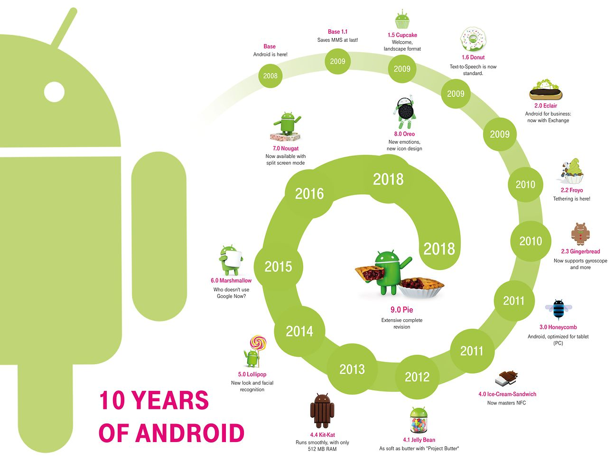

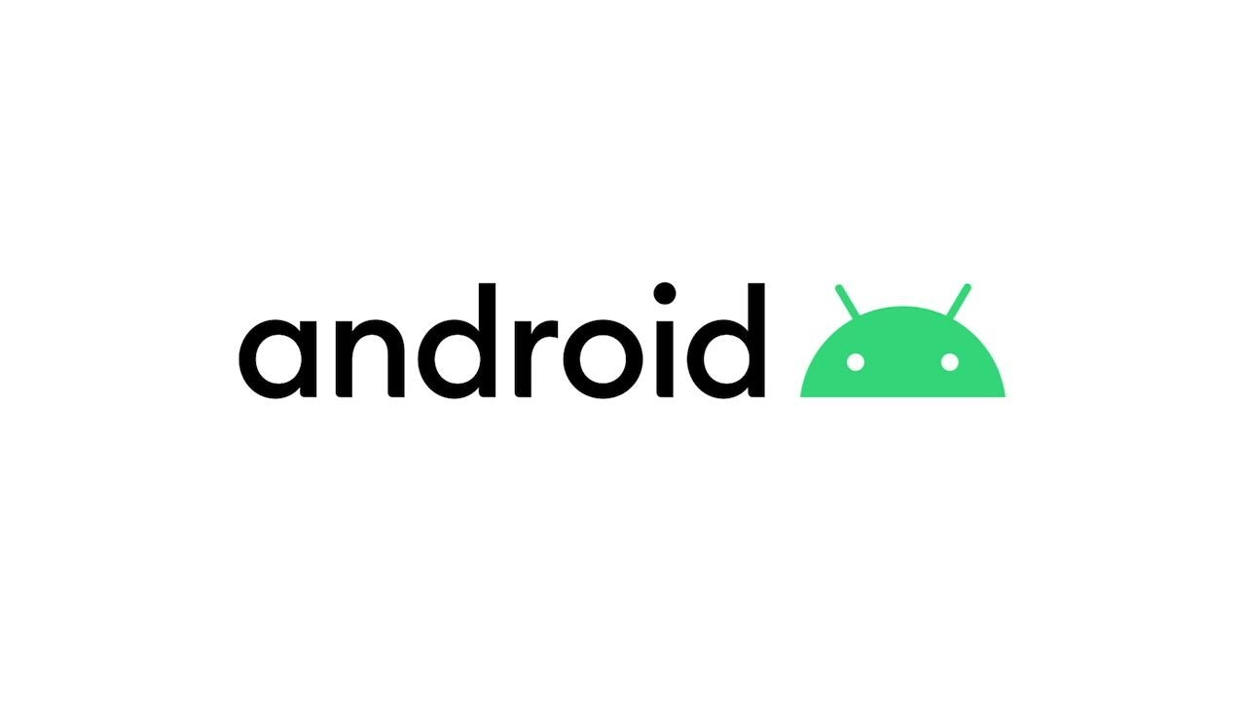

https://www.telekom.com/en/blog/group/article/10-years-of-android-541108

Slide 14
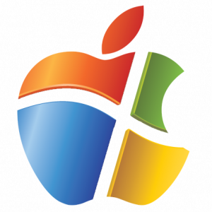
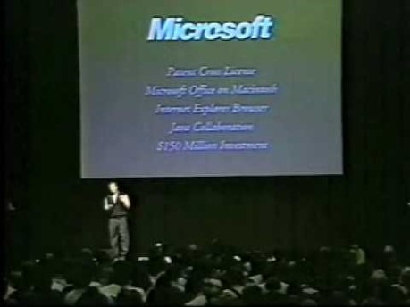
História sa opakuje
Macworld, Boston, 1997
https://www.youtube.com/watch?v=YV9ykB8slJE
https://youtu.be/WxOp5mBY9IY?t=271

Slide 15
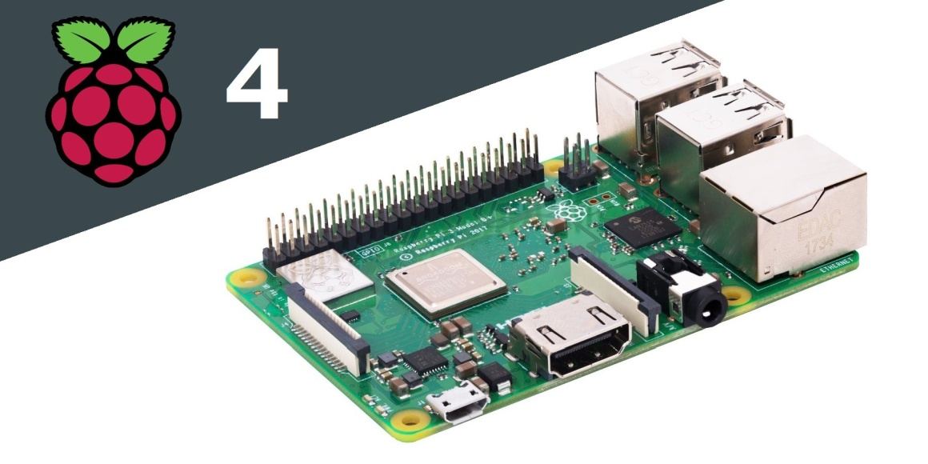
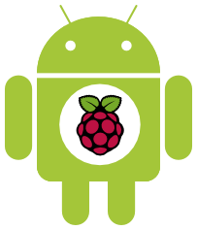
Raspberry PI 4
Iné (nemobilné) zariadenia
UK, Raspberry Pi Foundation
charity,2009, to study of basic
computer science in schools
GPIO - Broadcom BCM2711
Quadc.ARM 1.5GHz, 64 bit RISC
4GB RAM,
2xUSB 2.0, 2xUSB 3.0, HDMI,
RJ-45, microSD slot, BT 5.0
OS:
Raspbian (Debian Wheezy)
Pidora (Fedora Remix)
OpenELEC (An XBMC Media Centre)
RaspBMC (An XBMC Media Centre)
Android PI
Microsoft Windows 10 !!!
65E

Slide 16
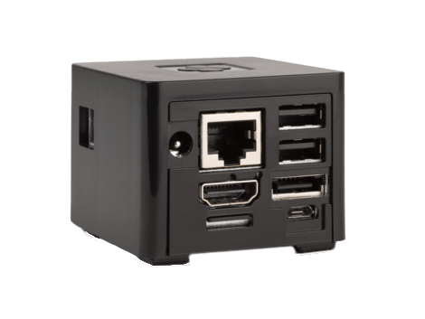
CuBox Pro
Iné (nemobilné) zariadenia
Solid Run, Israel (http://www.solid-run.com/product/cubox-i4pro/)
System On Chip i.MX6 Quad Core
Memory size 2GB/8GB
GPU GC2000, 3D GPU Type,
OpenGL ES1.1,2.0
HDMI 1080p with CEC 1.4, 3D support
WiFi 11n BlueTooth
Ethernet 10/100/1000 Mbps (*)
eSata II 3Gbps
OS:
Android 4.3 Jelly Bean
Linaro Ubuntu 11.10
Debian Jessie
XBMC image
GeeXboX, LinXBMC, OpenELEC
15OE

