Slide 1

Android
- asynchrónnosť
Peter Borovanský
KAI, I-18
borovan 'at' ii.fmph.uniba.sk
AsyncTask
Kotlin coroutines

Slide 2
Hádanka 1
Log.d(TAG, "Start")
val list = listOf<Int>(1,2,3,4,5,6,7,8,9,10)
val newList = list.stream().map {
Thread.sleep(1000)
it*it // return it * it
}
Log.d(TAG, "End")
newList.forEach {// výpis kolekcie
Log.d(TAG, it.toString())
}
08:59:32.832 Start
08:59:32.834 End Start+0sec.
08:59:33.839 1
08:59:34.841 4
08:59:35.842 9
08:59:36.844 16
08:59:37.846 25
08:59:38.849 36
08:59:39.851 49
08:59:40.854 64
08:59:41.856 81
08:59:42.858 100
stream bez .collect() je lenivá kolekcia

Slide 3
Hádanka 2
Log.d(TAG, "Start")
val list = listOf<Int>(1,2,3,4,5,6,7,8,9,10)
val newList = list.stream().map {
Thread.sleep(1000)
it*it // return it * it
} .collect(Collectors.toList())
Log.d(TAG, "End")
newList.forEach {// výpis kolekcie
Log.d(TAG, it.toString())
}
09:02:23.363 Start
09:02:33.389 End Start+10sec.
09:02:33.389 1
09:02:33.389 4
09:02:33.389 9
09:02:33.389 16
09:02:33.389 25
09:02:33.389 36
09:02:33.390 49
09:02:33.390 64
09:02:33.390 81
09:02:33.390 100

Slide 4
Hádanka 3
Log.d(TAG, "Start")
val list = listOf<Int>(1,2,3,4,5,6,7,8,9,10)
val newList = list.parallelStream().map {
Thread.sleep(1000)
it*it // return it * it
} .collect(Collectors.toList())
Log.d(TAG, "End")
newList.forEach {// výpis kolekcie
Log.d(TAG, it.toString())
}
parallelStream používa
toľko paralelizmu, koľko je #cores
Runtime.getRuntime()
.availableProcessors() == 4
09:04:06.410 Start
09:04:09.420 End Start+3sec.
09:04:09.420 1
09:04:09.420 4
09:04:09.420 9
09:04:09.420 16
09:04:09.420 25
09:04:09.420 36
09:04:09.421 49
09:04:09.421 64
09:04:09.421 81
09:04:09.422 100

Slide 5
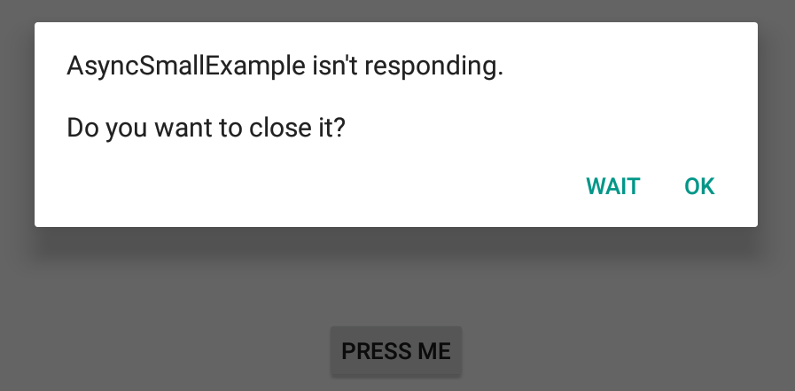
Asynchrónne operácie
nie je možné robiť časovo náročné operácie v hlavnom vlákne aplikácie
  extra komplikovaný (matematický) výpočet
  simuláciu procesu spomaľovanú napr. Thread.sleep(…)
  trvajúce požiadavky (napr. http/sql-request), ktoré môžu trvať netriviálne dlho
Takýto kód zablokuje hlavné vlákno, a ak vyvoláte GUI eventy (napr. pochabým klikaním v priebehu 20s), správca aplikácií usúdi, že aplikácia je mŕtva zavre ju
fun buttonClick(view: View) {
var i = 0
while (i <= 20) {
try {
Thread.sleep(1000)
i++
}
catch (e: Exception) {
e.printStackTrace()
}
}
Project:AsyncSmallExample.zip

Slide 6
Async Task
(doInBackground)
Parametrizovaná trieda AsyncTask je thread-wrapper riešením problému od API-3
typ parametrov, type progresu, typ výsledku
private inner class MyTask : AsyncTask<String, Int, String>() {
override fun onPreExecute() { … } // vykoná sa pred doInBackground
// celé jadro toho, čo sa má vykonávať v extra vlákne
override fun doInBackground(vararg params: String): String {
while (i in 0..20) {
try {
Thread.sleep(1000)
publishProgress(i)
} catch (e: Exception) { … }
}
return "Button Pressed"
}
override fun onProgressUpdate(vararg values: Int?) { … }
override fun onPostExecute(result: String) { … } // po doInBackgr.
}
Project:AsyncSmallExample.zip

Slide 7
Async Task
(onPre/PostExecue)
private inner class MyTask : AsyncTask<String, Int, String>() {
var color : Int = Color.BLACK
override fun onPreExecute() {
color = ... Random Color ...
}
override fun doInBackground(vararg params: String): String { ...}
// varargs je variabilný počet argumentov, ako ... v Jave
override fun onProgressUpdate(vararg values: Int?) {
myTextView.setTextColor(color) // beží v main threade
val counter = values.get(0)
myTextView.text = "Counter = $counter"
}
override fun onPostExecute(result: String) { // "Button Pressed"
myTextView.setTextColor(color)
myTextView.text = result
}
}
Project:AsyncSmallExample.zip

Slide 8
Async Task
(spustenie)
Štandardne sa rôzne inštancie AsyncTask spúšťajú sériovo, kým nedobehne jedna, ostatné čakajú vo fronte
val task1 = MyTask().execute() // serial run of AsyncTask
Ak ich chceme spustiť viacero a paralelne, tak cez POOL_EXECUTOR
task = MyTask().executeOnExecutor(AsyncTask.THREAD_POOL_EXECUTOR)
Ale počet paralelne bežiacich AsyncTaskov je limitovaný, v závislosti od počtu jadier CPU
val cpu_cores = Runtime.getRuntime().availableProcessors()
Reálne väčším problémom, že napriek popularite a jednoduchosti používania AsyncTask je od Android 11 AsyncTask zastaralý (deprecated)
https://www.xda-developers.com/asynctask-deprecate-android-11/amp/?__twitter_impression=true
Z toho zatiaľ nie je jasné, že ho Google odstráni, ale ...
Project:AsyncSmallExample.zip

Slide 9
Alternatívy
Čo je alternatíva:
RX-library
Java’s Concurrency framework
Kotlin coroutines od verzie Kotlin 1.3
build.gradle:
implementation "org.jetbrains.kotlinx:kotlinx-coroutines-core:1.3.2"
import
import kotlinx.coroutines.*
tutorial:
https://kotlinlang.org/docs/tutorials/coroutines/coroutines-basic-jvm.html

Slide 10

Corutina
je odľahčené vlákno
non-preemptive multitasking
1958 zaviedli Donald Knuth a Melvin Conway
vyskytujú sa v iných jazykoch, C#, javascript
suspend je modifikátor funkcie, ktorá vykonávaná v corutine môže byť pozdržaná
await() je čaká na hodnotu výpočtu bez blokovania corutiny.

Slide 11
Corutina
(Spustenie – blokujúce, neblokujúce)
.launch spustí novú corutinu podobne ako .start() Thread
.join počká na dokončenie spustenej korutiny, ako Thread
Log.d(TAG, "Start")
GlobalScope.launch { // Start a coroutine, non-blocking
delay(1000) // wait 1s.
Log.d(TAG, "Hello")
}
Thread.sleep(3000) // wait for 3s.
Log.d(TAG, "Stop")
runBlocking { // Start a coroutine, blocking
delay(4000L)
}
Log.d(TAG, "Finish")
21:22:18.220 Start
21:22:19.225 Hello Start+1sec.
21:22:21.222 Stop Start+3sec.
21:22:25.225 Finish Start+7sec.
https://simply-how.com/kotlin-coroutines-by-example-guide

Slide 12
Corutina
(suspend)
Log.d(TAG, "Start")
runBlocking {
printHello()
}
Log.d(TAG, "Finish")
suspend fun printHello() {
delay(1000L)
Log.d(TAG,"Hello")
}
21:27:34.083 Start
21:27:35.089 Hello Start+1sec.
21:27:35.089 Finish Start+1sec.
https://simply-how.com/kotlin-coroutines-by-example-guide

Slide 13
Corutina
(suspend)
Log.d(TAG,"The main program is started")
GlobalScope.launch {
Log.d(TAG,"Background processing started")
delay(1000L)
Log.d(TAG,"Background processing finished")
}
Log.d(TAG,"The main program continues")
runBlocking {
delay(2000L)
Log.d(TAG,"The main program is finished")
}
21:33:51.083 The main program is started
21:33:51.084 Background processing started
21:33:51.084 The main program continues
21:33:52.090 Background processing finished Start+1sec.
21:33:53.086 The main program is finished Start+2sec.
https://simply-how.com/kotlin-coroutines-by-example-guide

Slide 14
Corutina
(async/await)
21:38:31.369 Awaiting computations...
21:38:32.375 Computation1 finished Start+1sec.
21:38:33.376 Computation2 finished Start+2sec.
21:38:33.378 The result is 3 Start+2sec.
.async spustí novú corutinu ktorá počíta nejaký výsledok
.await čaká na tento výsledok
runBlocking {
val result1 = async { computation1() }
val result2 = async { computation2() }
Log.d(TAG, "Awaiting computations...")
val result = result1.await() + result2.await()
Log.d(TAG, "The result is $result")
} }
suspend fun computation1(): Int {
delay(1000L) // simulated computation
Log.d(TAG,"Computation1 finished")
return 1 }
suspend fun computation2(): Int {
delay(2000L)
Log.d(TAG,"Computation2 finished")
return 2 }
https://simply-how.com/kotlin-coroutines-by-example-guide

Slide 15
Corutina
(cancel)
21:44:52. Processing 0 ...
21:44:53. Processing 1 ...
21:44:54. Processing 2 ...
21:44:55. Processing 3 ...
21:44:56. Processing 4 ...
21:44:57. Processing 5 ...
21:44:58. Processing 6 ...
21:44:59. Processing 7 ...
21:45:00. Processing 8 ...
21:45:01. Processing 9 ...
21:45:02. main: The user requests the cancellation
21:45:02. main: The batch is cancelled
runBlocking {
val job = launch { // Emulate some batch processing
repeat(30) { i ->
Log.d(TAG, "Processing $i ...")
delay(1000L)
}
}
delay(10000L)
Log.d(TAG, "main: The user requests the cancellation")
job.cancelAndJoin()
// cancel the job and wait for it's completion
Log.d(TAG, "main: The batch is cancelled")
}
https://simply-how.com/kotlin-coroutines-by-example-guide

Slide 16
Corutina
(withTimeout)
21:47:57 Processing 0 ...
21:47:58 Processing 1 ...
21:47:59 Processing 2 ...
21:48:00 Processing 3 ...
21:48:01 Processing 4 ...
21:48:02 Processing 5 ...
21:48:03 Processing 6 ...
21:48:04 Processing 7 ...
21:48:05 Processing 8 ...
21:48:06 Processing 9 ...
21:48:07 The processing return status is: null
runBlocking {
val status = withTimeoutOrNull(10000L) {
repeat(30) { i ->
Log.d(TAG, "Processing $i ...")
delay(1000L)
}
"Finished"
}
Log.d(TAG, "The processing return status is: $status")
}
https://simply-how.com/kotlin-coroutines-by-example-guide

