Slide 1


Pokračovanie
Layout, View, Intent
List, Canvas, Menu
Peter Borovanský
KAI, I-18
borovan 'at' ii.fmph.uniba.sk

Slide 2
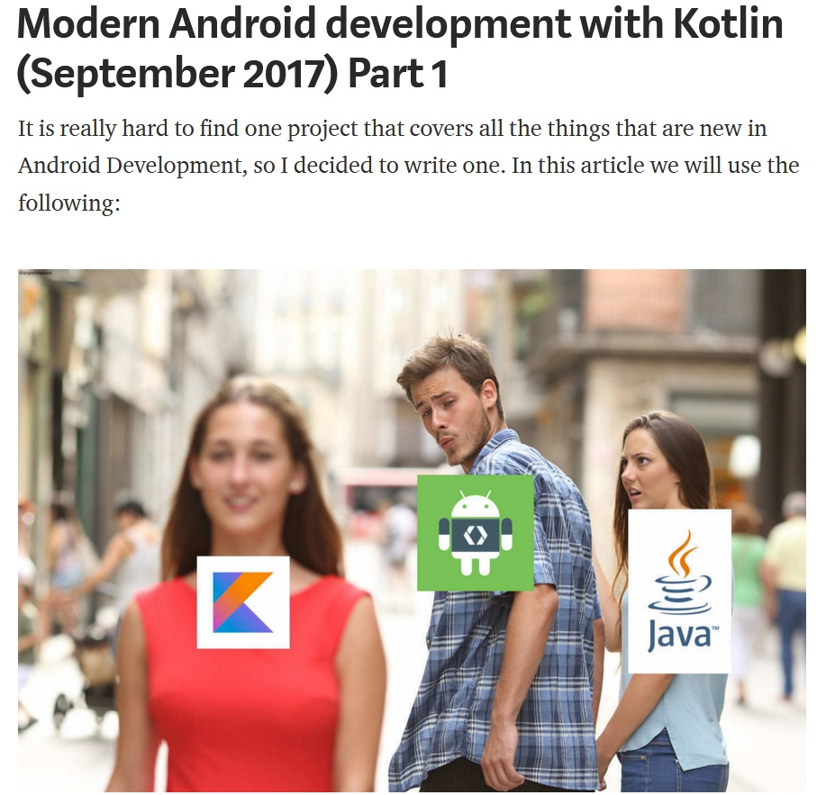
Hitparáda
(Hall of Fame)
Kalkulačka, 12 riešení
DominikaK, DenisČ, ŠimonB, ZuzkaH, LindaJ, MonikaV
java:
Integer.toString(15,7) = "21"
Integer.parseInt(Integer.toString(15,7))
= 21
Integer.parseInt("21",7) = 15
Integer.parseInt(""+21,7) = 15
kotlin:
println(15.toString(7))
21
println("21".toInt(7))
15

Slide 3
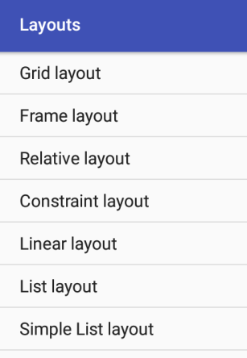
Intent
(filter)
Pohľad do AndroidManifest: intent-filter hovorí, na aký intent aktivita reaguje
<activity android:name=".MainActivity">
<intent-filter>
<action android:name="android.intent.action.MAIN" />
<category android:name="android.intent.category.LAUNCHER" />
</intent-filter>
</activity>
<activity android:name=".ListActivity">
<intent-filter>
<category android:name="android.intent.category.DEFAULT" />
</intent-filter>
</activity>
Spustí sa ako prvá
nespustí sa
Project: Layouts2.zip

Slide 4
Intent
(startActivity)
listViewID.adapter = ArrayAdapter<String>(
this, android.R.layout.simple_list_item_1,
arrayListOf("Grid layout","Frame layout","Relative layout",
"Constraint layout",)) // dáta nepatria do kódu, ale .xml
resources.getStringArray(R.array.activities)
listViewID.setOnItemClickListener {
adapterView, view, index, l ->
Log.d("LISTPICK",
"click: $index:${adapterView.getItemAtPosition(index)}")
if (index < klasy.size)
startActivity(Intent(this@MainActivity,klasy[index]))
}
private val klasy = arrayOf(
GridLayoutActivity::class.java,
FrameLayoutActivity::class.java,
... .
MainActivity::class.java
)
Project: Layouts2.zip

Slide 5
List project
V ďalšom uvidíme sériu rôznych nezávislých aktivít, ktoré ilustrujú:
intro_activity
  logo, intent, CountDown/Timer, MediaPlayer
  email_activity
  listView, intent.putExtra, startActivityForResult, Toast
  canvas_activity
  canvas/view – Draw, MultiTouch, onTouch, Option & Context Menu
  pisky_activity
  piškvorky, začiatok aj koniec jednoduchej hry
  login_activity
  ukladanie informácie pomocou SharedPreferences
Project: List.zip

Slide 6
Intent - filter
CATEGORY_BROWSABLE - ovláda web browser
CATEGORY_LAUNCHER - ovláda spúšťač aplikácie
android.intent.action.MAIN – vstupný bod programu
<intent-filter>
<action android:name="android.intent.action.MAIN" />
<category android:name="android.intent.category.LAUNCHER" />
</intent-filter>
CATEGORY_DEFAULT – startActivity/startActivityForResults
<intent-filter>
<action android:name="com.example.actilist.CanvasActivity" />
<category android:name="android.intent.category.DEFAULT" />
</intent-filter>
spustenie:
startActivity(
Intent(this@IntroActivity, MainActivity::class.java))
ak máme:
class MainActivity : AppCompatActivity() {
Project: List.zip

Slide 7
Reflexivita
Aby sme nemuseli mať konštantu ako pole všetkých tried, trieda sa dá vyrobiť z mena triedy pomocou reflexívneho volania Class.forName
class MainActivity : AppCompatActivity() {
...
listView1.setOnItemClickListener {
adapterView, view, index, l ->
val hodnota = adapterView.getItemAtPosition(index)
Log.d(TAG, "list item click: $index:$hodnota")
val klasa = Class.forName("com.example.list.$hodnota")
.kotlin
//val intent = Intent(this, IntroActivity::class.java)
Log.d(TAG, "class name: ${klasa.qualifiedName}")
val intent = Intent(klasa.qualifiedName)
startActivity(intent)
}
Project: List.zip

Slide 8
IntroActivity
(Intent, timer)
IntroActivity – CountDownTimer odpočítavajúci čas pre úvodné logo+.mp3
override fun onCreate(savedInstanceState: Bundle?) {
super.onCreate(savedInstanceState)
setContentView(R.layout.activity_intro)
object: CountDownTimer(4000,1000) {
override fun onTick(millisUntilFinished: Long) {}
override fun onFinish() {
Log.d(TAG, "go back to mainActivity")
startActivity(
Intent(this@IntroActivity, MainActivity::class.java)
)
}
}.start()
Project: List.zip

Slide 9
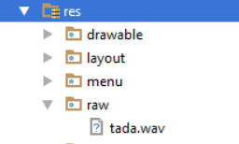
MediaPlayer
(lokálne – adresár raw)
tada.mp3 [.wav] uložíme do project/res/raw
... a bude zakompilovaná do apky, a zazipovaná do zipky ☺
lateinit var mp : MediaPlayer // globálna premenná
// ak je muzička lokálna, v res/raw/tada.wav
mp = MediaPlayer.create(this, R.raw.tada)
mp.isLooping = false
mp.start()
override fun onPause() { // ak je IntroActivity pauzovaná, keď super.onPause() // odštartujeme com.example.actilist.MainActivity
mp.release() // uvoľníme MediaPlayer objekt, mp
finish() // akonáhle sa rozbehne MainActivy, // IntroActivity zanikne
// to rieši aj navigáciu, problém s back buttonom
}
Project: List.zip

Slide 10
MediaPlayer
(onPreparedListener)
iná možnosť, tada.mp3 je prístupná niekde na sieti, dotiahneme ju a zahráme
lateinit var mp : MediaPlayer
try { // ak je muzička na webe, jej dotiahnutie može niečo trvať
val uri = Uri.parse("http://dai.fmph.uniba.sk/courses/VMA/wave.mp3")
mp.setAudioStreamType(AudioManager.STREAM_MUSIC)
mp.setOnPreparedListener { mp.start() }
mp.setDataSource(getApplicationContext(), uri)
mp.prepare() // tu sa spustí doťahovanie súboru
} catch (e:IOException) {
e.printStackTrace()
Toast.makeText(this, "file error", Toast.LENGTH_SHORT).show()
}
do AndroidManifest.xml
treba deklarovať povolenie aplikácie prístupu na internet
<uses-permission android:name="android.permission.INTERNET" />
// problém:apka musí deklarovať, že chce prístup na internet
http://dai.fmph.uniba.sk/courses/VMA/wave.mp3
Project: List.zip
Notes:
http://dai.fmph.uniba.sk/courses/VMA/wave.mp3

Slide 11
MediaPlayer
(na SD-karte, resp. v internej pamäti)
Môžeme sa skúšať triafať do správnej cesty muziky, obrázku, či súboru:
mp.setDataSource("/mnt/sdcard/Music/tada.wav")
mp.setDataSource("/mnt/sdcard/Music/wave.mp3")
mp.setDataSource("/storage/sdcard0/Music/wave.mp3")
mp.setDataSource("/Removable/SD/Music/wave.mp3")
// ale správna cesta k prístupu k Music je cez root external storage
val filePath = Environment.getExternalStorageDirectory().toString()
+ "/Music/tada.wav“
Log.d(TAG, filePath) // vždy si zalogujte cestu,
// aby ste vedeli, kde súbor hľadá
mp = MediaPlayer()
mp.setDataSource(filePath) // hneď viete, prečo to nehrá..
mp.setOnPreparedListener { mp.start() }
mp.prepare()
Project: List.zip

Slide 12
EmailActivity
(data do intentu, startActivityForResult s callbackom)
val emailString = edtEmail.text.toString() // dáta z formulára
val subjectString = edtSubject.text.toString()
val bodyString = edtBody.text.toString()
Toast.makeText(this@EmailActivity, "posielam mail",
Toast.LENGTH_LONG).show()
val intent = Intent(android.content.Intent.ACTION_SEND) // SEND
intent.type = "text/plain"
intent.putExtra(android.content.Intent.EXTRA_SUBJECT,subjectString)
intent.putExtra(android.content.Intent.EXTRA_EMAIL,
arrayOf(emailString) ) // pole adresátov
intent.putExtra(android.content.Intent.EXTRA_TEXT, bodyString)
// startActivity(intent);
startActivityForResult(intent, REQUEST_SEND_EMAIL)
private val REQUEST_SEND_EMAIL = 777
Project: List.zip

Slide 13
EmailActivity
(onActivityResult = callback)
private val REQUEST_SEND_EMAIL = 777
override fun onActivityResult( // CALLBACK pre startActivityForResult
requestCode: Int,
resultCode: Int,
data: Intent?) {
// Check which request we're responding to
if (requestCode == REQUEST_SEND_EMAIL) {
Toast.makeText(
this@EmailActivity, "email poslany, alebo aj nie",
Toast.LENGTH_SHORT
).show();
}
}
https://developer.android.com/reference/android/content/Intent.html#ACTION_SEND
Project: List.zip

Slide 14
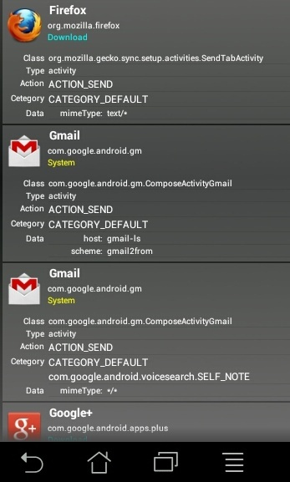

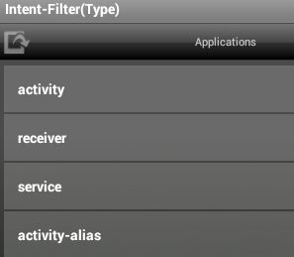
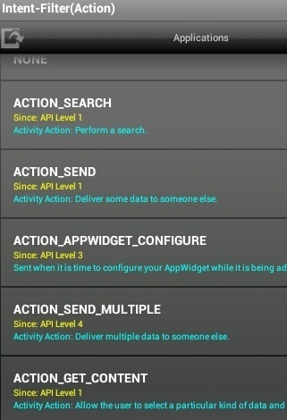
Kto všetko chytá intent ? android.content.Intent.ACTION_SEND
Nainštalujeme si
ManifestViewer,
resp. podobnú apku
https://play.google.com/store/apps/details?id=jp.susatthi.ManifestViewer

Slide 15
PhotoActivity
(data z intentu)
Princíp intent-startActivityForResult spolu s onActivityResult ešte raz:
val takePictureIntent = Intent(MediaStore.ACTION_IMAGE_CAPTURE);
if (takePictureIntent.resolveActivity(getPackageManager()) != null) {
Toast.makeText(this@PhotoActivity,
"smile ... taking picture", Toast.LENGTH_LONG).show();
startActivityForResult(takePictureIntent, REQUEST_IMAGE_CAPTURE);
} else {
Toast.makeText(this@PhotoActivity,
"sorry ... no picture", Toast.LENGTH_LONG).show();
}
private val REQUEST_IMAGE_CAPTURE = 690
Project: List.zip
https://developer.android.com/reference/android/provider/MediaStore.html#ACTION_IMAGE_CAPTURE

Slide 16
PhotoActivity
(data z intentu)
V callback onActivityResult získavame z indentu data/odfotený obrázok:
private val REQUEST_IMAGE_CAPTURE = 690
override fun onActivityResult(requestCode: Int,
resultCode: Int, data: Intent?) {
// Check which request we're responding to
if (requestCode == REQUEST_IMAGE_CAPTURE &&
resultCode == RESULT_OK) {
Toast.makeText(this@PhotoActivity, "thanks ...",
Toast.LENGTH_LONG).show()
val extras = data?.getExtras()
val imageBitmap = extras?.get("data") as Bitmap
pictureImageView.setImageBitmap(imageBitmap)
}
Project: List.zip

Slide 17
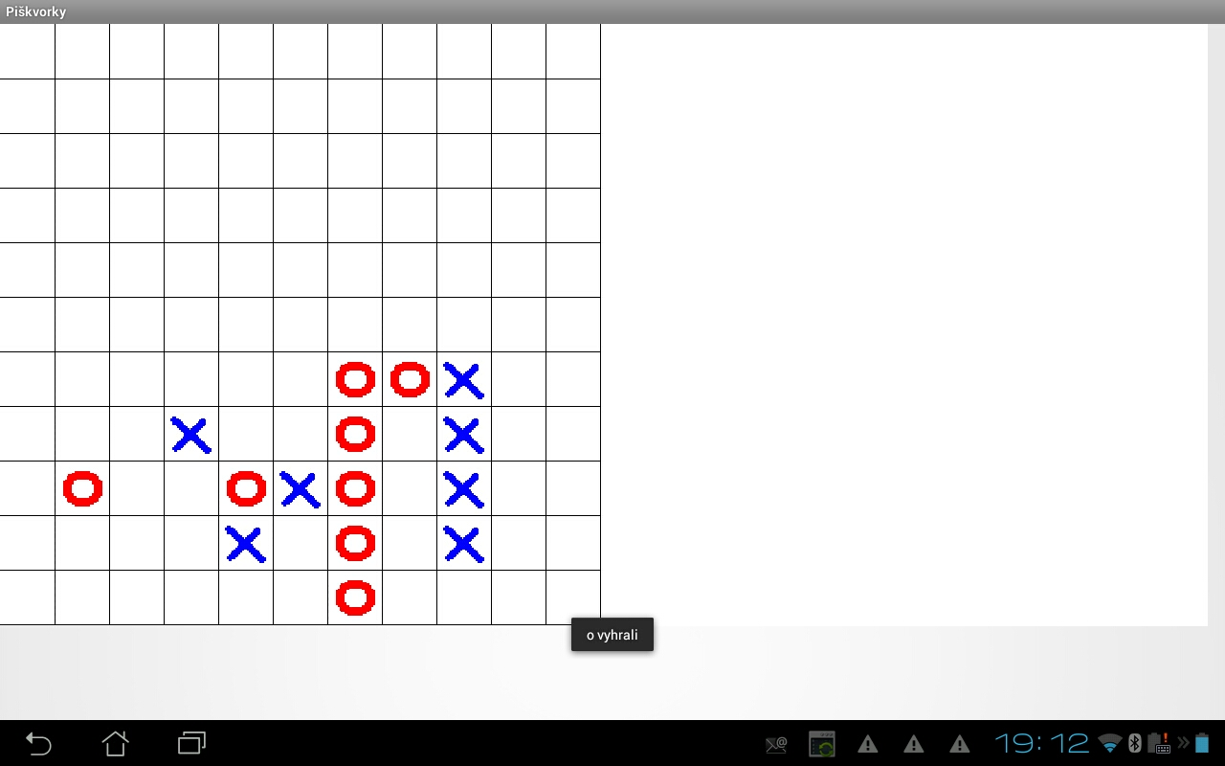
Piškvorky
(logická hra v canvase)
Príklad logickej hry (hlavolamu), kde
v pozadí nebeží žiadne vlákno,
nehýbu sa postavičky,
nemusíme pravideľne prekreslovať
plochu, aby sme navodili ilúziu
  hry
  simulácie
Na príklade Piškvorky ilustrujeme, že View má metódy:
onTouch
onDraw
Project:List.zip

Slide 18

onTouch vo View
(onTouchEvent)
class PiskyView(context: Context, attrs: AttributeSet) : View(context) { // Piskvorky sú View
// načítanie bitmapy obrázkov, postavičiek
o_img = resources.getDrawable(R.drawable.o).toBitmap()
x_img = resources.getDrawable(R.drawable.x).toBitmap()
override fun onTouchEvent(e:MotionEvent): Boolean {
if (e.action == MotionEvent.ACTION_DOWN) {
val iX = (e.x / cellSize).toInt() // transformácia
val iY = (e.y / cellSize).toInt() // pixlov na bunku
if (iX >= SIZE || iY >= SIZE) return true // mimo hraciu dosku
if (playGround[iY][iX] == -1) { // voľné políčko ?
playGround[iY][iX] = onTurn // polož značku hráča
onTurn = 1 – onTurn // na ťahu, a ide súper
invalidate() // toto nakoniec prekreslí view
val winner = check(iX, iY) // vyhodnotenie víťazov...
if (winner != -1)
Toast.makeText(getContext(),“x vyhrali",Toast.LENGTH_LONG).show()
} else
Project:List.zip

Slide 19
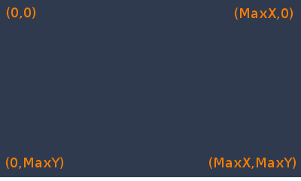
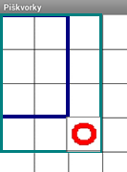
onDraw vo View
x
y
override protected fun onDraw(canvas: Canvas) {// paint()
canvas.drawColor(Color.WHITE)
val p = Paint()
p.setColor(Color.BLACK)
p.setStrokeWidth(1F)
for (i in 1..SIZE) {
canvas.drawLine(i*cellSize, 0F, i*cellSize, minSize, p)
canvas.drawLine(0F,i*cellSize, minSize, i*cellSize, p)
}
for (y in 0 until SIZE) {
for (x in 0 until SIZE) {
...
canvas.drawBitmap(o_img, srcRect,
destRect,
p);
Project:List.zip

Slide 20
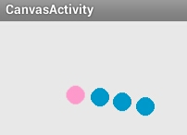
Vlákno (Thread) vo View
(dynamická hra v canvase)
class CanvasView(context: Context, attrs: AttributeSet) :
View(context), View.OnTouchListener, View.OnKeyListener {
var touchX = 100f; var touchY = 100f
var ballX = 200f; var ballY = 200f
init {
setOnTouchListener(this) setOnKeyListener(this)
val th = object : Thread() {
override fun run() {
while (!stopped) {
if (!paused) {
ballX += (touchX-ballX)/touches/50
ballY += (touchY-ballY)/touches/50
touchX = (ballX+50*touchX[i])/51
touchY = (ballY+50*touchY[i])/51
try {
Thread.sleep(100)
postInvalidate()
} catch (e: InterruptedException) {
th.start()
}
Project:List.zip

Slide 21
onDraw, onTouch vo View
@Override
protected void onDraw(Canvas canvas) { // paint z Appletov
super.onDraw(canvas);
if (canvas != null) {
Paint p = new Paint(); // kreslenie guličiek
p.setColor(getResources().getColor(R.color.red));
canvas.drawCircle(touchX, touchY, 10, p);
p.setColor(getResources().getColor(R.color.blue));
canvas.drawCircle(ballX, ballY, 10, p);
} else
Log.d("Canvas", "null");
}
public boolean onTouch(View v, MotionEvent event) {
touchX = event.getX(); // netestujeme typ eventu
touchY = event.getY(); // zoberieme len X,Y súradnice
return true;
}
Project:List.zip

Slide 22
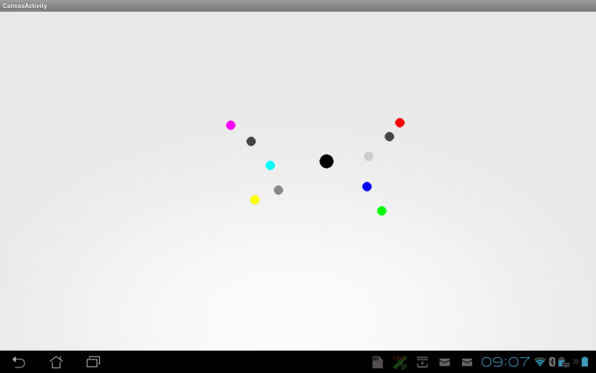
MultiTouch
override fun onTouch(v: View, event: MotionEvent): Boolean {
Log.d("Canvas", "counts:" + event.pointerCount)
val maskedAction = event.actionMasked
if (maskedAction == MotionEvent.ACTION_DOWN ||
maskedAction == MotionEvent.ACTION_POINTER_DOWN) {
touches = event.pointerCount
for (i in 0 until event.pointerCount) {
Log.d("Canvas", "X:" + event.getX(i))
Log.d("Canvas", "Y:" + event.getY(i))
touchX[i] = event.getX(i)
touchY[i] = event.getY(i)
}
return true
Žiadne dva
prsty sa
nedotknú
naraz
Project:List.zip

Slide 23
onKey vo View
override fun onKey(arg0: View, arg1: Int, arg2: KeyEvent):
Boolean {
val rnd = Random()
when (arg1) {
KeyEvent.KEYCODE_DPAD_LEFT -> ballX -= rnd.nextInt(50)
KeyEvent.KEYCODE_DPAD_RIGHT -> ballX += rnd.nextInt(50)
KeyEvent.KEYCODE_DPAD_UP -> ballY -= rnd.nextInt(50)
KeyEvent.KEYCODE_DPAD_DOWN -> ballY += rnd.nextInt(50)
KeyEvent.KEYCODE_SPACE -> {
ballX += rnd.nextInt(100) - 50
ballY += rnd.nextInt(100) - 50
}
else -> return false
}
invalidate()
return true // event handled
}
Project:List.zip

Slide 24
Option Menu
(onCreateOptionMenu)
<menu
xmlns:android="http://schemas.android.com/apk/res/android">
<item android:id="@+id/pause" android:icon="@drawable/pause“ android:title="Pause">
</item>
<item android:id="@+id/play" android:icon="@drawable/play" android:title="Play">
</item>
<item android:id="@+id/stop" android:icon="@drawable/stop" android:title="Stop">
</item>
</menu>
override fun onCreateOptionsMenu(menu: Menu): Boolean {
val inflater = menuInflater
inflater.inflate(R.menu.activity_canvas, menu)
return super.onCreateOptionsMenu(menu)
}
Project:List.zip

Slide 25
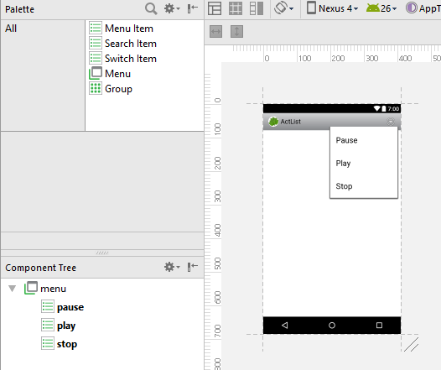
Option Menu
(onCreateOptionMenu)
Rovnako dobre to môžete
navrhovať v editore
Spôsob zobrazenia a
renderovania závisí na
API level zariadenia
<menu
xmlns:android="http://schemas.android.com/apk/res/android">
<item android:id="@+id/pause" android:icon="@drawable/pause“ android:title="Pause">
</item>
<item android:id="@+id/play" android:icon="@drawable/play" android:title="Play">
</item>
<item android:id="@+id/stop" android:icon="@drawable/stop" android:title="Stop">
</item>
</menu> @Override
Project:List.zip

Slide 26
Option Menu
Thread th = new Thread() {
fun run() {
while (!stopped) {
if (!paused) {
...
override fun onOptionsItemSelected(item: MenuItem): Boolean {
when (item.getItemId()) {
R.id.pause -> {
canvasView1.paused = true
return true
}
R.id.play -> {
canvasView1.paused = false
return true
}
R.id.stop -> {
canvasView1.stopped = true
return true
}
else -> return super.onOptionsItemSelected(item)
}
}
Project:List.zip

Slide 27
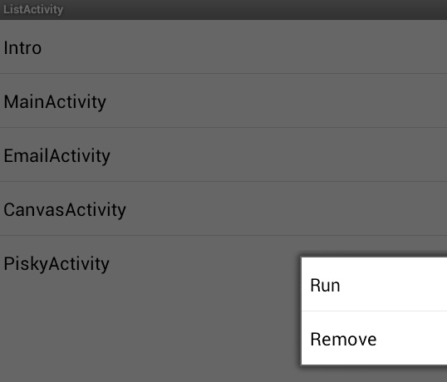

Context Menu
Override fun onCreate(
savedInstanceState:Bundle?) { ...
registerForContextMenu(listView1); // na rozdiel od
} // OptionMenu, ContextMenu treba registrovať k príslušnému view
override fun onCreateContextMenu(menu: ContextMenu?, v: View?, menuInfo: ContextMenu.ContextMenuInfo? ) {
getMenuInflater().inflate(R.menu.list_menu, menu)
}
override fun onContextItemSelected(item: MenuItem): Boolean {
val info = item.getMenuInfo() as AdapterContextMenuInfo
val className = actList.get(info.id.toInt())
when (item.getItemId()) {
R.id.remove -> {
actList.removeAt(info.id.toInt())
la.notifyDataSetChanged()
return true
}
Project:List.zip

Slide 28
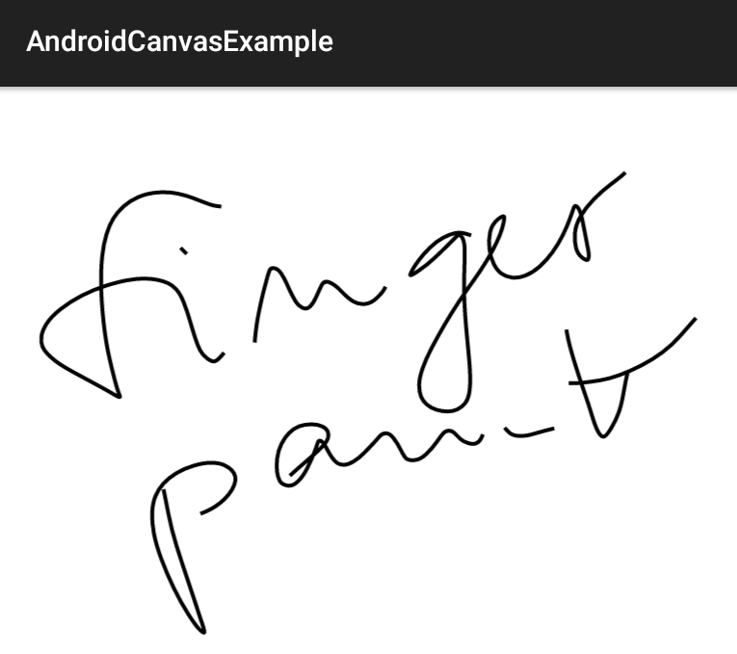
Maľovátko
(MotionEvent actions)
private val mPath: Path
override protected fun onDraw(canvas: Canvas) {
super.onDraw(canvas)
canvas.drawPath(mPath, mPaint)
}
override fun onTouchEvent(event: MotionEvent): Boolean {
val x = event.x
val y = event.y
when (event.action) {
MotionEvent.ACTION_DOWN -> {
startTouch(x, y) invalidate() }
MotionEvent.ACTION_MOVE -> {
moveTouch(x, y) invalidate() }
MotionEvent.ACTION_UP -> {
upTouch() invalidate() }
}
return true
}
https://examples.javacodegeeks.com/android/core/graphics/canvas-graphics/android-canvas-example/
Project:CanvasExample.zip

Slide 29
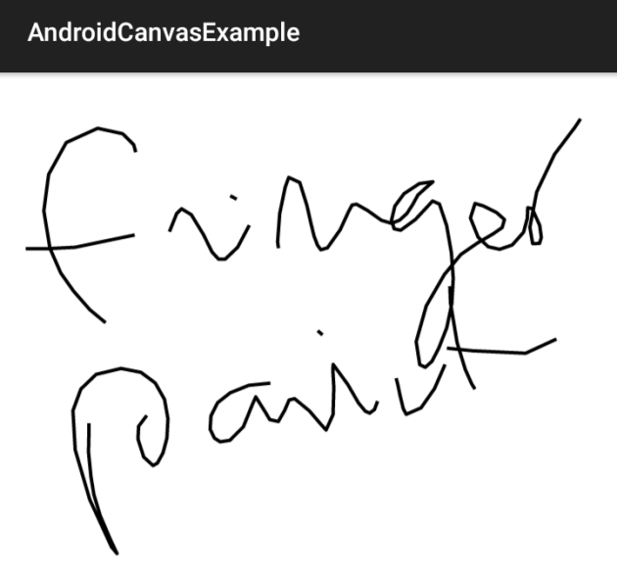
Maľovátko
(bezier vs. linear - nebezier)
private fun startTouch(x: Float, y: Float) {
mPath.moveTo(x, y)
lastX = x
lastY = y
}
private val TOLERANCE = 5f
private fun moveTouch(x: Float, y: Float) {
val dx = Math.abs(x - lastX)
val dy = Math.abs(y - lastY)
if (dx >= TOLERANCE || dy >= TOLERANCE) {
// mPath.quadTo(lastX, lastY, (x+lastX)/2, (y+lastY)/2)
mPath.lineTo(x, y);
lastX = x
lastY = y
}
}
https://examples.javacodegeeks.com/android/core/graphics/canvas-graphics/android-canvas-example/
Project:CanvasExample.zip

Slide 30
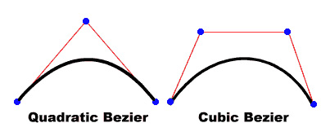

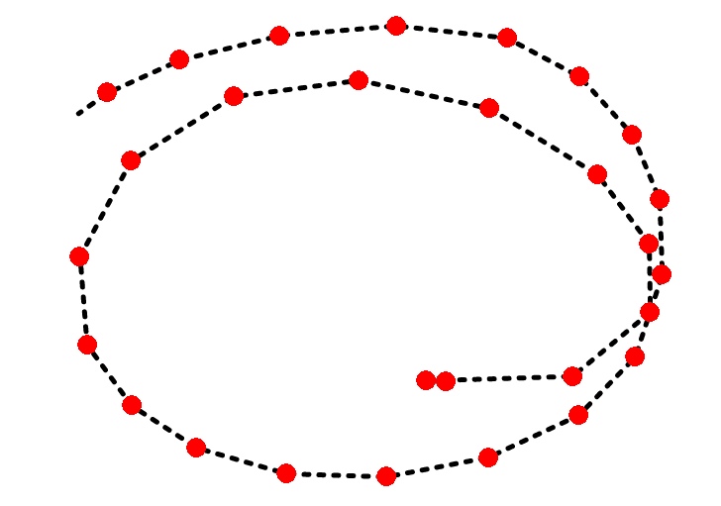
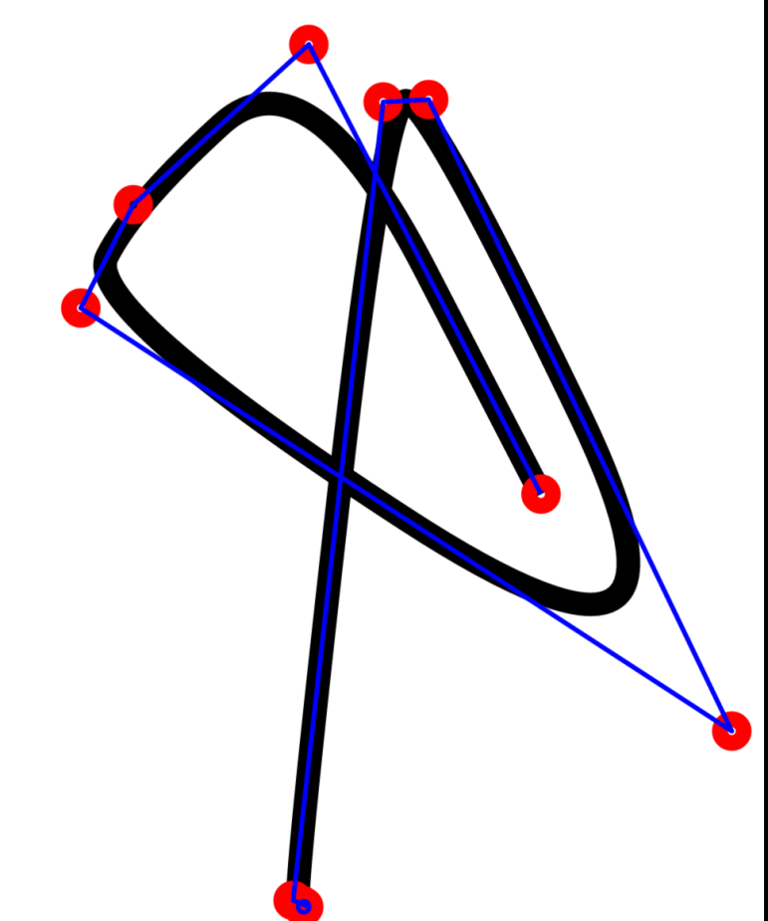
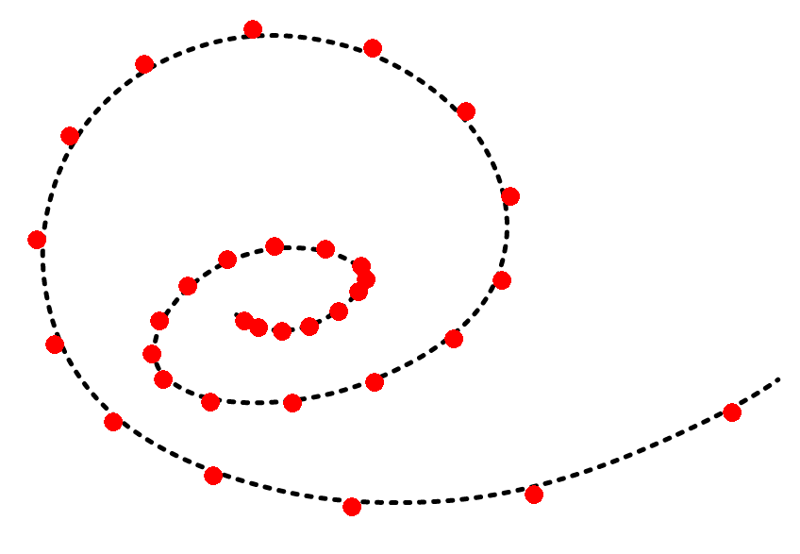
Bézier
lineTo(x,y)
quadTo(controlX, controlY, x, y)
cubeTo(controlX1, controlY1, controlX2, controlY2, x, y)

Slide 31
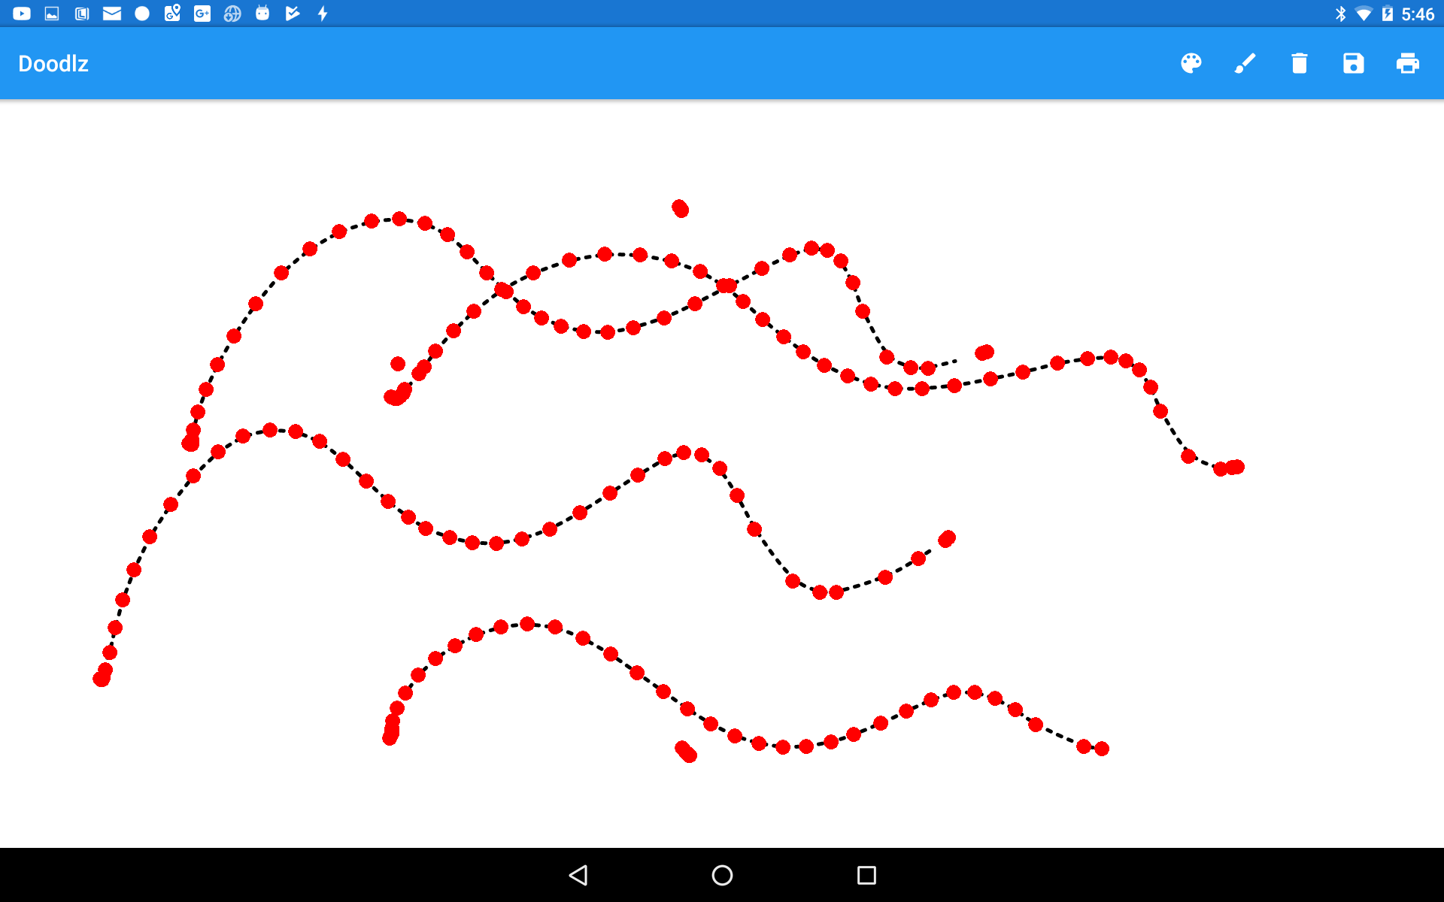
Prémia
(na tému maľovátka)

