Slide 1

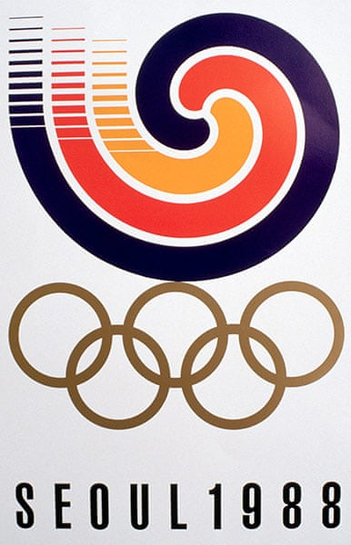
Florence Griffith Joyner
Flo-Jo
American Track & Field Legend
World Record Holder 100m & 200m
Tragic Death in 1998, only 38 years old
Married to Al Joyner – Triple Jump Gold Medalist, 1984 Olympics
USA
Table 3
Ali, Rosana, Chhaya, Victor, Kosta
Notes:
the cause of death was suffocation during a severe epileptic seizure.^{[54]}

Slide 2
Distribution of medals
Medals Won 1984 & 1988
Flo-Jo
USA

