Slide 1
Git and Github
Git Gud
Data Analytics

Slide 2

Horror Story
You’re working on a paper or tweaking and re-tweaking an application that might change your life.
Your head grows heavy, and your sight grows dim.
You close the program.
All that is not saved is lost.
You search desperately in the chaos of folders and files with slightly altered names.
Was it super_important_doc_v12.txt or super_important_doc_latest.txt …
The wolves howl outside.

Slide 3

Git your memory, Git your bonfire, Git Gud
open source and free Source Control Management (SCM) program created in 2005 based on the Linux operating system
version control, manage and changes to files over time
update and roll back iterations of software
cooperate between multiple developers
a platform for combining components of programs into a single cohesive work

Slide 4

Github, Instagram for Programmers
- currently owned by Microsoft, is a company founded in 2008 that makes tools which integrate with git.
- A website that allows users to store their work and collaborate on Git repositories remotely over the internet.
- Tool for showcasing work and learning new methods.
compatible with Git and can be interacted with through a Git terminal without the use of a GUI.

Slide 5
Github, Instagram for Programmers
- You do not need GitHub to use git, but you cannot use GitHub without using git.
- There are other alternatives to GitHub, such as GitLab and BitBucket, but we will focus exclusively on GitHub in this class.

Slide 6
Pause For Github Tour

Slide 7
Github, Instagram for Programmers
This lesson will focus on:
1. Getting Git and Github up and running on your system 2. Creating repositories to save and version your work 3. Staging, Committing, Pushing to and Pulling from Github 4. Basic Troubleshooting

Slide 8
Github, Instagram for Programmers
0: Git/GitHub groundwork
1. Download from this site: https://www.git-scm.com/ 2. Download Gitbash (Windows Only) https://gitforwindows.org/ 3. Configure name and email
git config --global user.name "firstname lastname" git config --global user.email firstname.lastname@email.com git config --global init.default branch main

Slide 9
1: Create a new Remote repository:
1. Go to https://github.com/new 2. Type in repository name 3. Keep “Public” selected 4. Select “Add a README” file 5. Click “Create Repository”

Slide 10
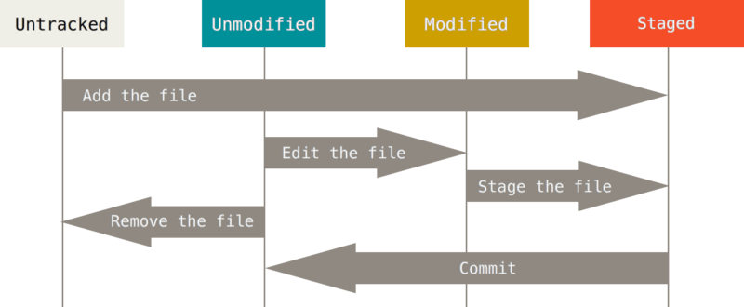
5: Tracking files / staging environment
Tracking
git add filename.extension --> when you only want to add one file in the directory
git add -A --> adds all files in the directory git add . --> adds all new files
Untracking
git rm --cached [filename.extension] git restore --staged [filename.extension]

Slide 11
Permanently Ignore File
Create a new text document called .gitignore
`touch` .gitignore `open` .gitignore
Good for .DStore, private files, Log files and anything you don't want in your project

Slide 12
6: Create a commit
A commit is a snapshot of your repository at the time of the commit.
git commit -m "message" --> commits your staging area for upload git commit -a -m "message" --> skips over the staging step git restore "filename.extension”. --> discards changes in working directory

Slide 13
7: Push to GitHub
1. Git push
8: Pull from Github
1. Git pull

Slide 14
Command | Purpose
clear | clears terminal
-h | help flag provides information on any command it is placed after
git help [command] | additional on computer information about selected command
git status | highlights in red all files in dir that are not in the git staging area
git reset | removes all files from staging area
git log | shows an activity history for dir including user, commit_id and date
git config | allows you to configure your git bash
git config –list | lists your current config settings
git help <verb> | provides help for the verb in question ex/ git help add
rm -rf | deletes directory and connection
git clone | copies remote repository to local machine
git diff | show difference between commits

Slide 16
SELECT Order of Operations
SELECT - is a statement use to determine the entire working set which is relevant for the query.
FROM – clause that will be evaluated first, to define the entire working data, relevant for the query.
WHERE – clause used to filter the data according to the conditions set.
GROUP BY – clause where you can split the data into pieces or buckets.
HAVING – clause where you can filter the pieces or buckets of data.
ORDER BY – is the clause to sort the data when the query is executed.

