Slide 1
Introduction to Numpy
Python Module 8
Data Analytics

Slide 2













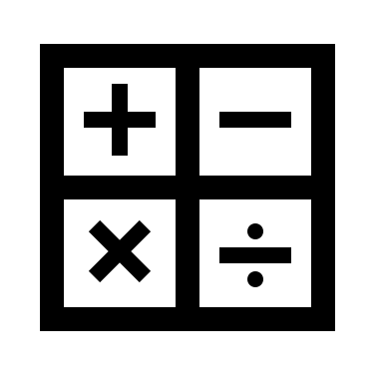











Anaconda
Jupyter
Data Types
Classes
loops
Containers
Machine Learning
You are here!
Data Science

Slide 3
Agenda
Introduction/Clown Opera – 10 min
Module 8 Lessons 1-4 – 50 min
Demos - 90 min
Challenge – 30 min
Break – 10 min
Module 9 Lessons 1-4 – 60 mi
Introduction to Matplotlib- 90 min
Challenge- Remaining class time

Slide 4
Module 8 Learning Outcomes
Define key terminology for NumPy
Demonstrate how to create arrays
Demonstrate how to install NumPy
Demonstrate creating random numbers
Demonstrate how to slice arrays
Identify how to read and index arrays

Slide 5
Introduction to Numpy
https://numpy.org/

Slide 6
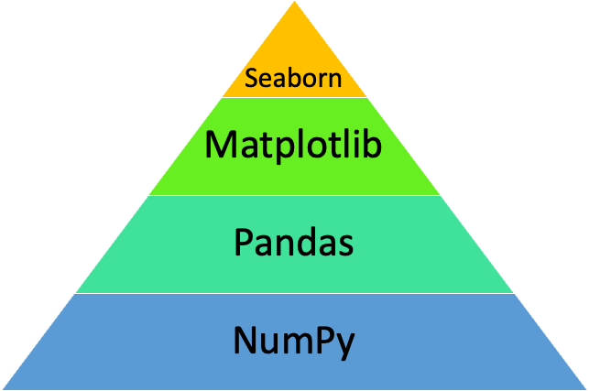
What is NumPy?
NumPy is a Python library that works with multidimensional array objects
Also contains routines to process the arrays
An array is a grid of values of the same type
It is indexed by a tuple of integers that the size of the array along each axis
Arrays are useful when you have to manipulate only specific data type values

Slide 7
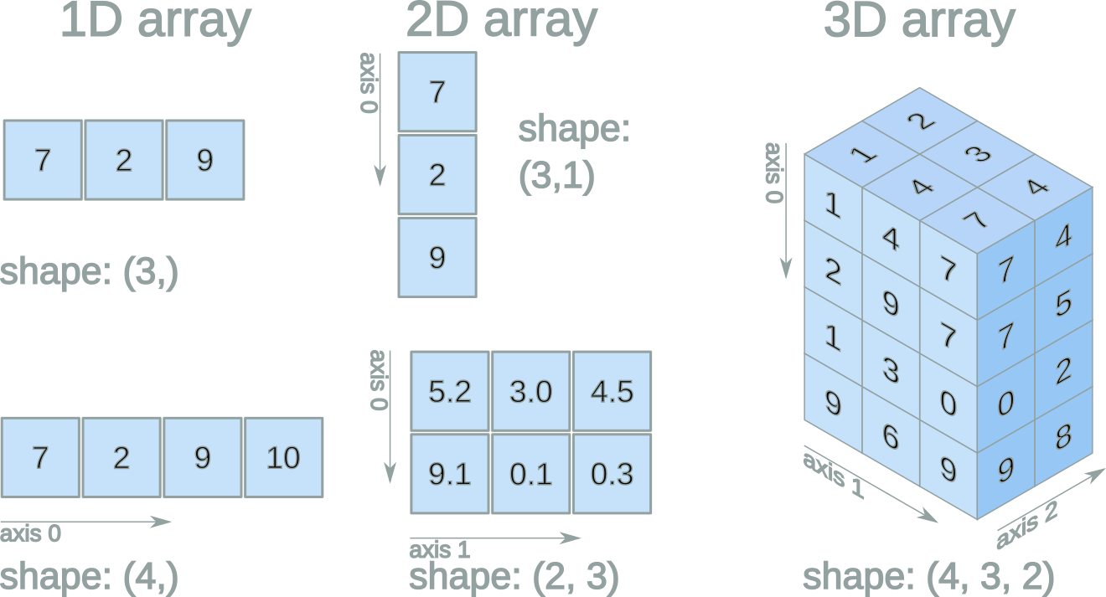

Slide 8
NumPy vs Pandas
NumPy | Pandas
Works with numerical data | Works with tabular data
Powerful tool is Array | Powerful tools are DataFrame and Series
Provides objects for multidimensional arrays | Offers 2 dimensional table objects called DataFrames
Consumes less memory | Consumes more memory
Has better performance with 50k or less rows | Has better performance with 500k or more rows
Indexing is very fast | Indexing is very slow

Slide 9
Using ndarray
Uses n-dimensional array, which means it allows an infinite amount of dimensional arrays
import numpy as np
arr = np.array([5,6,7,8,9])
print(arr)
Numpy ex.
Data Types
import numpy as np
arr = np.array([4,5,6], dtype = ‘i')
print(arr)
Declaring data type
I | Integer
b | Boolean
u | Unsigned integer
f | Float
c | Complex float
m | Timedelta
M | datetime
O | Object
S | string
U | Unicode string
V | Fixed chunk of memory for other type (void)
import numpy as np
arr = np.array([4.0,5.0,6.0])
print(arr.dtype)
Printing data type
import numpy as np
arr = np.array([4,5,6],[1,2,3])
print(arr)
Multidimensional
array

Slide 10
Array Shapes
arr = np.array([4,6,7,8,9])
print(arr.shape)
(5,)
arr = np.array([[5,6,7], [8,9,10]])
print(arr.shape)
(2, 3)
arr = np.array([[[5,6,7],[8,9,10]],[[5,6,7],[8,9,10]],[[5,6,7],[8,9,10]]])
print(arr.shape)
(3, 2, 3)

Slide 11
Array Indexing
Very similar to indexing other Python data types
Same concept as INDEX in Excel
arr = np.array([1, 2, 3, 4])
print(arr[1])
2
arr = np.array([[1,2,3,4,5], [6,7,8,9,10]])
print('2nd element on 1st row: ', arr[0, 1])
2nd element on 1st row: 2
arr = np.array([[[1, 2, 3], [4, 5, 6]], [[7, 8, 9], [10, 11, 12]]])
print('1st dimension, 2nd group, 3rd item ')
print(arr[0, 1, 2])
1st dimension, 2nd group, 3rd item
6

Slide 12
Array Slicing
Slicing is similar to slicing a list except you can do it in more than one dimension
#Slicing a list
a = [10,11,12,13,14]
b = a[1:4]
Pass slice instead of index like this:[start:end]
Define the step, like this: [start:end:step]
If no pass start is identified, it’s considered 0
If no pass end is identified it will be the length of array in that dimension
If no pass is identified it’s considered 1
#Slicing an array
a = [10,11,12,13,14]
b = a[:4] #returns first 4 values
c = a[2:] #returns the last 3 values
d=a[:]
e=a[1:4] #Returns values 2-4
f=a[-4:-1] #

Slide 13
np.arrange and np.linspace
The essential difference between NumPy linspace and NumPy arange is that linspace enables you to control the precise end value, whereas arange gives you more direct control over the increments between values in the sequence
np.linspace allows you to define how many values you get including the specified min and max value. It infers the stepsize:
np.linspace(0,1,11)
array([0. , 0.1, 0.2, 0.3, 0.4, 0.5, 0.6, 0.7, 0.8, 0.9, 1. ])
np.arange allows you to define the stepsize and infers the number of steps
np.arange(0,1,.1)
array([0. , 0.1, 0.2, 0.3, 0.4, 0.5, 0.6, 0.7, 0.8, 0.9])

Slide 14
Random Number Arrays in NumPy
np.random.rand(3,2)
array([[0.35707683, 0.23166076],
[0.18022768, 0.48352998],
[0.45160769, 0.96049389]])
np.random.normal(25, 10, 20)
array([19.93076944, 19.50294629, 17.04642258, 21.5304681 , 6.77681438,
28.43279994, 24.8042853 , 20.62758238, 26.7005858 , 27.44640333,
38.23373597, 22.27466237, 19.03158495, 11.11706392, 29.07818992,
17.16703753, 19.74609386, 23.984733 , 17.51191059, 21.35716586])

Slide 15
Array Outputs
Type of array object | type(arr)
Type of array dimensions (axes) | arr.ndim
Shape of an array | arr.shape
Size (or number of elements in array) | arr.size
Type of elements in an array | arr.dtype
Create an array from list with type float | np.array([[1,2,4],[5,8,7]],dtype = ‘float’)
Create an array from tuple | np.array((1,3,2))
Creating an array with all zeros | np.zeros((3,4))
Constant value array of complex type | np.full((3,3), 6, dtype=‘complex’)
Array with random values | np.random.random((2,2))
Create an array with sequence of integers | np.arange(0,30,5)
Create a sequence of 10 values in range 0 to 5 | np.linspace(0,5,10)
Reshaping an array | arr.reshape(2,2,3)
Flatten array | arr.flatten

