Slide 1
Python Module 4
Control Flow and Statements
Data Analytics

Slide 2













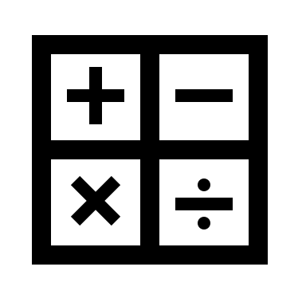











Anaconda
Jupyter
Data Types
Classes
Containers
Machine Learning
Data Science

Slide 3
Module 4 Learning Outcomes
Define control flow statements
Identify different types control flow statements
Identify the purpose of loops
Recognize what functions and arguments can do

Slide 4
Built-in containers
Strings
Lists
Tuples
Sets
Dictionaries
[1, 3, 5, 7, 9]
Ordered, mutable
Collections of
Any data type
(1, 3, 5, 7, 9)
Ordered, immutable
Collections of
Any data type
“New York”
Collection of
characters
{’red, ‘green’, ‘blue’}
Unorder, immutable
Collections of
Any data type
mycar = {
”key": ”value",
“color”: “blue”
” year”: 1933
}

Slide 5
Python Collections
List [] | An ordered sequence of items. It is most commonly used data type in Python. It is very flexible. Uses brackets [ ]
Tuple () | An ordered sequence of items, same as list. The only difference is that tuple are immutable. Once it’s created it cannot be modified. With single values, a comma be at the end
Set {} | An unordered collection of unique items. Set is defined by values separated by comma inside braces. Items are not ordered.
Dictionary { : } | An unordered collection of key-value pairs. Very similar to json data. It is used when you have a large amount of data. To retrieve the data you must know the key.

Slide 6
Logical Conditions
Equal to | a==b
Not Equal to | a!=b
Less than | a < b
Less than or equal to | a <= b
Greater than | a > b
Greater than or equal to: | a >=b

Slide 7
IF ELIF ELSE Statements
if condition:
#Perform some actions
print “Condition is True”
elif condition != True
#Perform some other actions
print “Condition is not True”
else:
#perform default or fall-through actions
print “Anomaly: Condition is neither True nor False”
False
If Condition
IF statements are used for conditional executions
Used to control workflow process
True
Do Something
False
eIif Condition
True
Do Something Else
Do Something

Slide 8
if (elif) else
a = 30
b = 20
if b > a:
print("b is greater than a")
elif b < a:
print("b is not greater than a")
else:
print ("a and b are the same")
don’t forget the colon
indent after the colon
to indicate the code block. the block ends when the indent ends
you can have multiple elif conditions
the else is the catchall at the end

Slide 9
AND OR NOT Statements
These are boolean statements combined with conditional statements
a= 100
b= 30
c=400
If a > b and c > a:
Print(“Conditions are True)
If a>c or c< a:
print(“One of the conditions is True”)
NOT | If the value is True it returns False if the value is False it returns True
AND | Combines two or more conditional statements
OR | Returns the first object that results to true or the last object in the expression, regardless of true value

Slide 10
Loops and Loop Control Statements
A Loop statement executes a statement or group of statements sequentially and repeatedly until final loop condition is false
While Loop | Repeats of statement or group of statements while a give condition is TRUE. It tests the condition before executing the loop body. Can also be a do…while loop
For Loop | Executes a sequence of statements multiple times and abbreviates the code that manages the loop variable.
Nested Loop | You can use one more loop inside any other while for or or do..while loop
Break | Terminates the loop statement and transfers execution to the statement immediately following the loop
Continue statement | Causes the loop to skip the remainder of its body and immediately retest its condition prior to reiterating
Pass Statement | The pass statement in Python is used when a statement is required syntactically but you do not want any common or code to execute

Slide 11
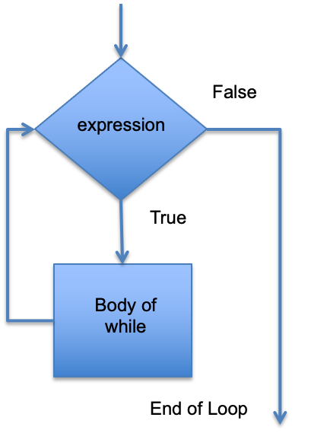
While Loops
Syntax
while condition:
statement
Example
x = 1
while x < 10:
print x
x=x+1

Slide 12
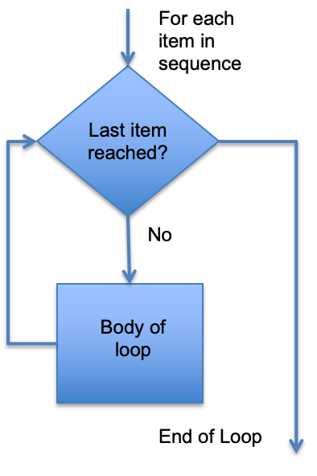
For Loops
Syntax
for value in sequence:
statement(s)
#Check if variable is divisible by 2
n = [9,4,2,6,7,10,3,8]
for val in n:
print(val%2==0)

Slide 13
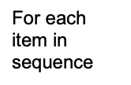
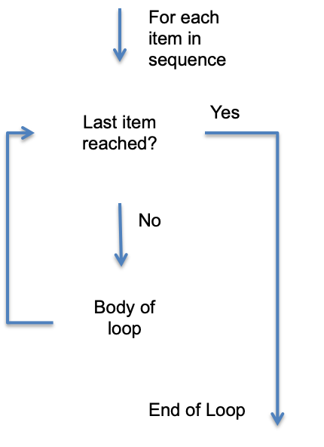
Nested Loops
Syntax
for value in sequence:
for value in sequence:
statement(s)
Example
adj = [‘red’, ‘big’, ‘tasty’]
fruits = [‘apple’, ‘banana’, ‘cherry’]
for x in adj:
for y in fruits:
print(x,y)
2 loops → 2 indents

Slide 14
Break, Continue, Pass
break
The break statement in Python terminates the loop containing it.
continue
The continue statement is used to skip the remaining code inside a loop for the current iteration only.
pass
The pass statement does nothing, and is used as a placeholder

Slide 15
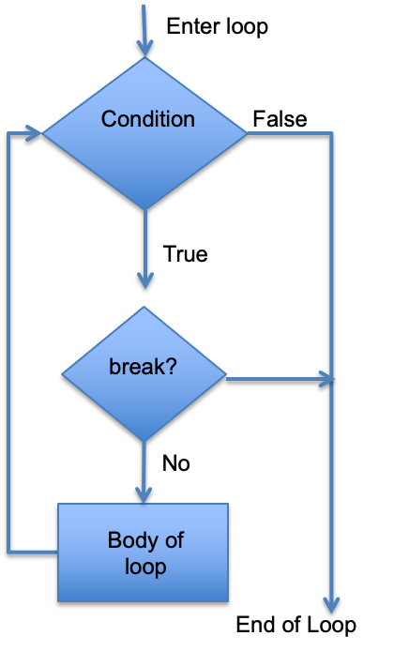
Break
Syntax
for value in sequence:
statement
Break
Example
#Check if variable is divisible by 2
n = [9,4,2,6,7,10,3,8]
for val in n:
If val == 6:
break
print(val%2==0)

Slide 16
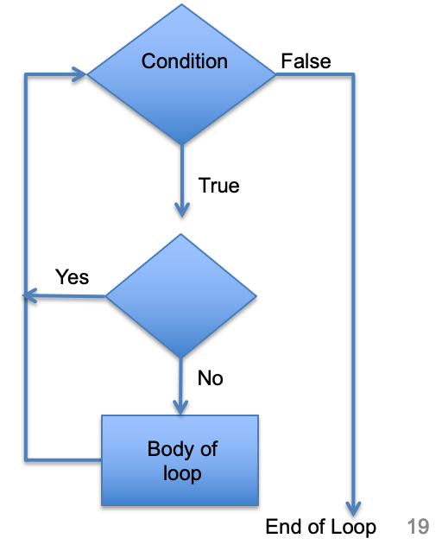
Continue
Syntax
for value in sequence:
condition statement
continue
Example
#Check if variable is divisible by 2
n = [9,4,2,6,7,10,3,8]
for val in n:
if val == 6:
continue
print(val%2==0)
Continue

Slide 17
Pass
Syntax
for value in sequence:
condition statement
pass
Example
#Check if variable is divisible by 2
n = [9,4,2,6,7,10,3,8]
for val in n:
If val == 6:
Pass
print(val%2==0)
print(‘Not divisible by 2’)
Continue

Slide 18
little challenge
Create a list with 5 items
Create a loop that iterates through the list and prints each item
Declare a variable x = 1
Create a while loop that runs while x is less than 10
and prints x*33
Increment x by 3

