Slide 1
Introduction to Pandas
Python Module 6
Data Analytics

Slide 2

























Anaconda
Jupyter
Data Types
Classes
Containers
Machine Learning
Data Science

Slide 3
Agenda
Introduction/Recap – 10 min
Read Lessons in Module 6 – 60 min
Lists, Dictionaries, and Pandas Series - 90 min
Start Challenge – 30 min
Break – 60 min
Pandas Dataframes - 90 min
Complete Challenge- Remaining class time

Slide 4
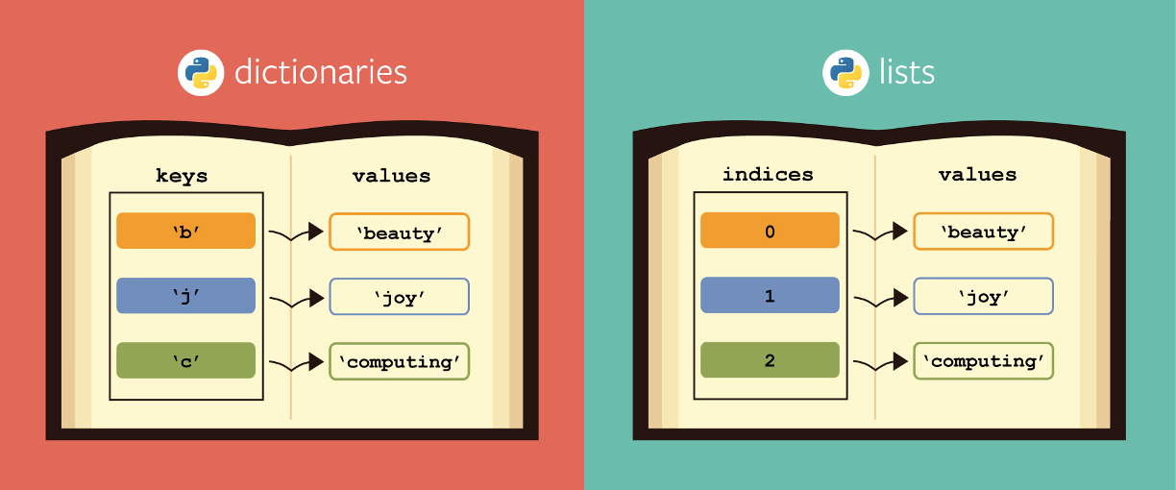
Lists and Dictionaries

Slide 5
Creating Lists
newGrocerylist = ["apple", "guava", "mango", "pineapple", "orange"]
list.append(x)
Add an item to the end of the list. Equivalent to a[len(a):] = [x].
list.insert(i, x)
Insert an item at a given position. The first argument is the index of the element before which to insert, so a.insert(0, x) inserts at the front of the list, and a.insert(len(a), x) is equivalent to a.append(x).
list.remove(x)
Remove the first item from the list whose value is equal to x. It raises a ValueError if there is no such item.
list.pop([i])
Remove the item at the given position in the list, and return it. If no index is specified, a.pop() removes and returns the last item in the list.
list.clear()
Remove all items from the list. Equivalent to del a[:].
list.count(x)
Return the number of times x appears in the list.

Slide 6
Creating Dictionaries
dict1 = {'A':[11, '2', 53], 'B':[4, 50]}
dict2 = dict(X=[5, 7, 9], Y = [41, 15])
dict3 = dict([(1, [6, 5, 8]), (4, [9, 1, 2])])
print(dict1)
print(dict2)
print(dict3)

Slide 7
Creating a Dictionary from Lists
employee_firstname=['Don', 'Shawn', 'Toni']
employee_lastname=['Drysdale', 'Wilson', 'Bowden']
employee_age = [ 24, 27, 43]
dict1 = {'firstname': employee_firstname, 'lastname': employee_lastname, 'age':employee_age}

Slide 8
Accessing Dictionary Data
dict1 = {'X':[1, 2, 3], 'Y':[4, 5, 6]}
print(dict1['X'])
print(dict1['X'][0])

Slide 9
Dictionary Stuff
clear() Removes all the elements from the dictionary
copy() Returns a copy of the dictionary
get() Returns the value of the specified key
items() Returns a list containing a tuple for each key value pair
keys() Returns a list containing the dictionary's keys
pop() Removes the element with the specified key
popitem() Removes the last inserted key-value pair
update() Updates the dictionary with the specified key-value pairs
values() Returns a list of all the values in the dictionary

Slide 10

import pandas as pd
https://pandas.pydata.org/
https://pandas.pydata.org/docs/user_guide/index.html
https://pandas.pydata.org/docs/reference/index.html

Slide 11
Series Dataframe
 | Name
0 | Jose
1 | Sam
2 | Amir
3 | Maria
 | Name | Age | FavoriteColor
0 | Jose | 54 | Blue
1 | Sam | 33 | Green
2 | Amir | 27 | Red
3 | Maria | 75 | Yellow

Slide 12
pandas.Series
my_series.shape() =(5,)
my_series.shape() =(4,)
 | data
Name | Jose
Class | 2024
Height | 79
DOB | 3/5/2002
Position | Guard
 | Name
0 | Jose
1 | Sam
2 | Amir
3 | Maria
 | Age
0 | 46
1 | 25
2 | 62
3 | 35
import pandas as pd
my_series=pd.Series()

Slide 13
Creating a Series from a List
name_list=[‘Jose’, ‘Sam’, ’Amir’, ‘Maria’]
my_series = pd.Series(name_list)
 | Name
0 | Jose
1 | Sam
2 | Amir
3 | Maria

Slide 14
Creating a Series from a Dictionary
# import the pandas lib as pd import pandas as pd # create a dictionary dictionary = {'Name' : 'Ned', 'Boro' : 'Bronx', 'Age' : 30} # create a series series = pd.Series(dictionary) print(series)
 | Name
Name | Ned
Boro | Bronx
Age | 30

Slide 15
Things you can do with a pandas.Series
Things you can do with a pandas.Series
Create it from lists
Determine size, shape
Slice it!
Math functions
Create a .csv or .xlsx file from it

Slide 16
pandas.Series Methods
Information about the Series | Math functions (for numerical data) | Accessing specific data
pandas.Series.info() pandas.Series.shape pandas.Series.dtype pandas.Series.size pandas.Series.empty … | pandas.Series.min() pandas.Series.max() pandas.Series.mean() pandas.Series.median() | pandas.Series.head() pandas.Series.tail() my_series[index] my_series[start: stop: increment] my_series[:-1]

Slide 17
.size and .shape
name_list=[‘Jose’, ‘Sam’, ’Amir’, ‘Maria’]
my_series = pd.Series(name_list)
my_series.size
4
my_series.shape
(4,)

Slide 18
.min(), .max(), .mean()
number_list=[5,4,2,6,3]
my_series = pd.Series(number_list)
my_series.min()
2
my_series.max()
6
my_series.mean()
4.0

Slide 19
.head and .tail
my_ss = pd.Series(['cat', 'dog', 'rabbit', 'deer', 'bear', 'fox', 'squirrel'])
my_ss.head(2)
0 cat
1 dog
dtype: object
my_ss.tail(2)
5 fox
6 squirrel
dtype: object

Slide 20
.to_csv() and .to_excel()
my_ss = pd.Series(['cat', 'dog', 'rabbit', 'deer', 'bear', 'fox', 'squirrel'])
my_ss.to_csv('animals.csv')
my_ss.to_excel('animals.xlsx')

Slide 21
.to_dict()
new_dictionary=series.to_dict()
print (new_dictionary)

Slide 22
Challenge part 1*
Create a new notebook
Import pandas as pd
Create 3 lists with 5 elements each (i.e. five employees)
employee_firstname=[]
employee_lastname=[]
employee_age = []
Create a data dictionary from the 3 lists
Create a pandas Series from the employee age list
Determine the average employee age
Write the Series to a .csv file
*don’t submit yet. More this afternoon

Slide 23
pandas.DataFrame
 | Header1 | Header2 | Header3 | Header4
0
1
2
Axis 0
Axis 1

Slide 24
Things you can do with pandas.DataFrame
Build it from 1 or more data dictionaries
Math functions
Transpose
Slice it
Summary Stats
Pivot tables
Drop row, drop column

Slide 25
Create a DataFrame from a Data Dictionary
data_dictionary={
'First_Name':[‘Sonny', ‘Fredo', ‘Michael'],
'Last_Name': [‘Corleone',’Corleone', ‘Corleone'],
'Age’: [35, 30, 25],
'Borough': [‘Brooklyn’, ’Brooklyn’, ‘Brooklyn’]
}
my_frame = pd.DataFrame(data_dictionary)
 | First_Name | Last_Name | Age | Borough
0
1
2

Slide 26
pandas.dataframe Methods
Information about the dataframe | Math functions (for numerical data) | Accessing specific data
pandas.dataframe.info() pandas.Series.shape pandas.Series.size pandas.Series.empty … | my_frame[‘column_name’].min() my_frame[‘column_name’].max() my_frame[‘column_name'].median() my_frame[‘column_name’].mean() … | myframe.head() myframe.tail() my_frame.iloc[index] my_frame.iloc[start: stop: increment] my_frame.iloc[:-1] my_frame.iloc[3,4] my_frame.at[1,”column_name”] …

Slide 27
.info()
my_frame.info()
<class 'pandas.core.frame.DataFrame'>
RangeIndex: 3 entries, 0 to 2
Data columns (total 4 columns):
# Column Non-Null Count Dtype
--- ------ -------------- -----
0 First_Name 3 non-null object
1 Last_Name 3 non-null object
2 Age 3 non-null int64
3 Borough 3 non-null object
dtypes: int64(1), object(3)
memory usage: 224.0+ bytes

Slide 28
Dataframe Column Notation
df.Population.mean()
or
df['Population'].mean()
dot notation (no quotes or brackets)
bracket notation (no dot)

Slide 29
.size and .shape
data_dictionary={
'First_Name':[‘Sonny', ‘Fredo', ‘Michael'],
'Last_Name': [‘Corleone',’Corleone', ‘Corleone'],
'Age’: [35, 30, 25],
'Borough': [‘Brooklyn’, ’Brooklyn’, ‘Brooklyn’]
}
my_frame = pd.DataFrame(data_dictionary)
my_frame.size
12
my_frame.shape
(3, 4)
 | first_name | Last_Name | Age | Borough
0 | Sonny | Corleone | 35 | Brooklyn
1 | Fredo | Corleone | 30 | Brooklyn
2 | Michael | Corleone | 25 | Brooklyn

Slide 30
.min(), .max(), .mean()
my_frame.Age.min()
my_frame.Age.max()
my_frame.Age.mean()
my_frame['Age'].min()
my_frame['Age'].max()
my_frame['Age'].mean()

Slide 31
.head and .tail
my_frame.head()
my_frame.head(5)
my_frame.tail()
my_frame.tail(5)

Slide 32
iloc and Dataframes
my_frame.iloc[0:4]
my_frame.iloc[3:4]
my_frame.iloc[1:3:2]
first 5 records
4th and 5th records
2nd and 4th records

Slide 33
Subset of DataFrame
above_35 = my_frame[ my_frame["Age"] > 35]
new dataframe
original dataframe
criteria for inclusion in the new DataFrame

Slide 34
Read and Write .csv files with Pandas
import pandas as pd
df=pd.read_csv("<path>.<file>.csv")
olympic_frame=pd.read_csv("OlympicEvents.csv")
batting_frame=pd.read_csv(“Batting.csv”)

Slide 35
Read and Write .xlsx files with Pandas
import pandas as pd
df=pd.read_excel("<path>.<file>.xlsx")
df.to_excel("<path>.<file>.xlsx")

Slide 36
Read and Write .json files with Pandas
import pandas as pd
df=pd.read_json("<path>.<file>.json")
df.to_json("<path>.<file>.json")

Slide 37
Challenge part 2*
Download ‘21st century MLB Batting.csv’ from slack
Import the .csv into Python as a dataframe
print the first 5 items in the dataframe
print the last 6 items in the dataframe
calculate the average of the HR column
calculate the max of the SO column
save the dataframe as an excel file
save the dataframe as a json file
create a subset of the dataframe for players with more than 40 HR
*submit your notebook with part 1 and 2 to Canvas

Slide 38
SQL Alchemy
SQL Alchemy is a python module that enables you to run SQL queries in python
It should already be installed in your Anaconda install
If not open a new terminal window in Jupyter
type ‘conda install sqlalchemy’
You will also need a driver for PostgreSQL
Open a new terminal window in Jupyter
type ‘conda install psycopg2
In your Jupyter notebook start with these imports:
from sqlalchemy import create_engine
import pandas as pds
import psycopg2

Slide 39
SQL with Pandas
from sqlalchemy import create_engine, text
import pandas as pds
import psycopg2
engine = create_engine(postgresql+psycopg2://<username>:<password@<url>:<port>/<database>)
table_df = pds.read_sql("SELECT * FROM categories", con=engine)
table_df
_______________________________________________________________
from sqlalchemy import create_engine
import pandas as pds
import psycopg2
sql_text="""select * from orders as o
join customers as c on o.customer_id=c.customer_id
where o.order_date between '1996-08-01' and '1996-08-31'"""
sql_dframe = pds.read_sql(sql_text,con=engine)
sql_dframe.head(5)

Slide 40
Bonus Challenge
install SQL alchemy using conda
get psycopg2 driver
connect to the dvdrental database
execute a query to get the Actors whose last_name begins with ‘G’
store the results in a dataframe
Host: database-test.cxtidmp4j8wi.us-east-2.rds.amazonaws.com
Port: 5432
Database: dvdrental
Username: analyst
Password: m00nbase
*submit your notebook with part 1 and 2 to Canvas

