Slide 1
Python Module 3
Simple Calculations and Collections
Data Analytics

Slide 2















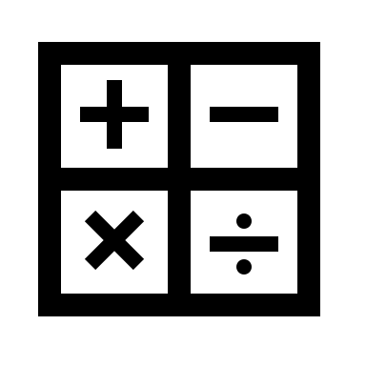










Anaconda
Jupyter
Data Types
Classes
Containers
Machine Learning
Data Science

Slide 3
Module 3 Learning Outcomes
Define Python calculations using string and integers
Identify different types of data collections
Describe what data collections can do
Apply basic calculations

Slide 4
Built-in containers
Strings
Lists
Tuples
Sets
Dictionaries
[1, 3, 5, 7, 9]
Ordered, mutable
Collections of
Any data type
(1, 3, 5, 7, 9)
Ordered, immutable
Collections of
Any data type
“New York”
Collection of
characters
{’red, ‘green’, ‘blue’}
Unorder, immutable
Collections of
Any data type
mydog = {
”key": ”value",
“color”: “blue”
” year”: 1933
}

Slide 5
Python Collections
List [] | An ordered sequence of items. It is most commonly used data type in Python. It is very flexible. Uses brackets [ ]
Tuple () | An ordered sequence of items, same as list. The only difference is that tuple are immutable. Once it’s created it cannot be modified. With single values, a comma be at the end
Set {} | An unordered collection of unique items. Set is defined by values separated by comma inside braces. Items are not ordered.
Dictionary { : } | An unordered collection of key-value pairs. Very similar to json data. It is used when you have a large amount of data. To retrieve the data you must know the key.

Slide 6
Simple Calculations Using Integers
Python can perform simple calculations
Expression syntax include operators, numbers, and parenthesis
Grouping numeric data types is done with parentheses()
Addition | 8+8
Subtraction | 8-1
Multiplication | 8*8
Division | 8/4
Floor Division | 8//3
Exponents | 8**2

Slide 7
string = ‘cold wind’
index
0 | 1 | 2 | 3 | 4 | 5 | 6 | 7 | 8
c | o | l | d |  | w | i | n | d
contents
string [7]

Slide 8
colors = [‘red’, ’green’, ‘blue’]
index
0 | 1 | 2
red | green | blue
contents
len(colors) = 3
colors [2]

Slide 9
Keywords for Data Collection Types
Ordered | Items have a defined order, and that order will not change | Lists, Tuples
Unordered | Items in the list do not have a defined order. You cannot refer to an item using an index if there is no order | Sets, Dictionaries
Unchangeable | You cannot change, add or remove items after the tuple has been created | Tuples, Dictionaries
Allow duplicates | The data collection type is indexed and can have duplicate members | Lists, Tuples
No duplicates | Cannot have 2 items with the same key | Sets, Dictionaries

Slide 10
Simple Calculations Using Strings
Strings are collections of characters
String characters are accessed with brackets
It is based on a sequence in which they are created using single, double or triple quotations (triple for multi-line strings)

Slide 11
Slicing and Indexing
Ways to manipulate data and identify strings
Slicing can omit characters in a string
Slicing can also all you to obtain a substring of the string data type. Used with brackets and number position of the variable
Indexing identifies the character position of a string
Strings can be sliced, indexed and concatenated
Concatenate | ‘Data’ + ‘Analytics’
Slicing | someword[0:2] ‘Da’
Indexing | someword[0] ‘D’
Length | len(someword) 4
Notes:
Why does the slicing return DA?

Slide 12
Lists
Lists are data structures that can be manipulated and placed into an ordered sequence of elements
Values and elements inside of a list are called items
It is defined by square brackets
Allows you to perform methods and operations on multiple values at the same time
Numeric List | num_list = [1,2,2,3,4,5,5,10]
String List | str_list = [‘house’, ‘condo’, ‘apartment’]
Combining List | combo_list = str_list + num_list combo_list
Count Items in a List | len(combo_list)

Slide 13
Ordered
Unordered
Mutable
String
Dictionaries
Lists
Immutable
Tuple
Sets

Slide 14
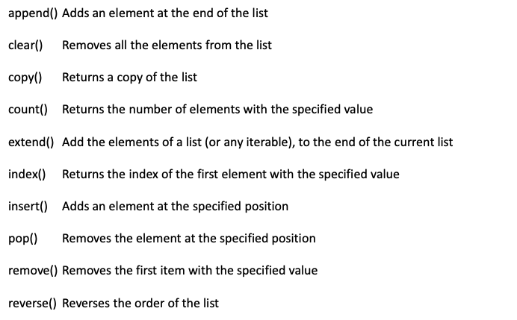
Lists []
Ordered
Mutable
Heterogenous
ex. Students

Slide 15
Tuples ()
Ordered
Immutable
Heterogeneous
Ex. weekdays

Slide 16
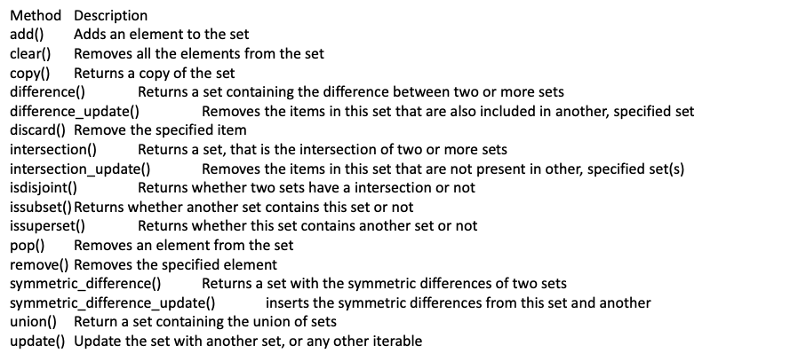
Sets {}
Unordered
Heterogeneous
Mutable
No Duplicates
ex. family

Slide 17
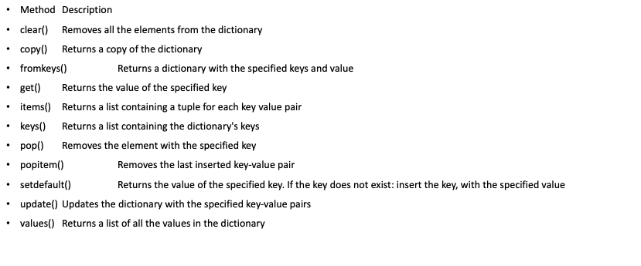
Dictionaries { : }
Unordered
Heterogenous
Mutable
No Duplicates
ex. patients

Slide 18
List of Dictionaries
bob = {
“name”: ‘Bob’,
“age”: 61,
“borough”: “Brooklyn”
}
…
patients= [bob, jacob, sasha]
print(patients)
Index
0
1
2
“name” : “Bob”
“age” : 61
“borough”: “Brooklyn”
“name” : “Jacob”
“age” : 35
“borough”: “Queens”
“name” : “Sasha”
“age” : 21
“borough”: “Bronx”
Notes:
Why does it do this?

