Slide 1
Tableau Module 9
Data Analytics

Slide 2



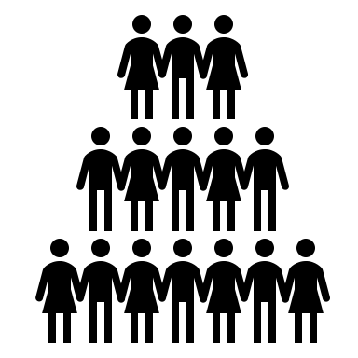















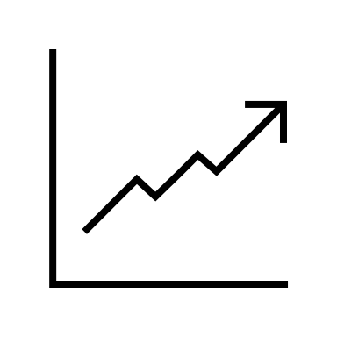







Common Charts
Data Views
Hierarchies
Data Structures
Basic Navigation
Dashboards
Data Stories
Calculations
Advanced
Charts
You are here
Certification Springs
Blending
Done

Slide 3
Module 9 Learning Outcomes
Understand value of trend analysis
Demonstrate adding reference lines
Demonstrate reference distributions
Describe the value of box plots

Slide 4
Trends
Trend refers to behavior over long period of time independent of short-term fluctuation
Increasing
Decreasing
Stable
Trends can be mixed: not monotonically increasing or decreasing*
A trendline can be applied to time series data and it will calculate a regression equation
*Remember the Cod fish!!

Slide 5
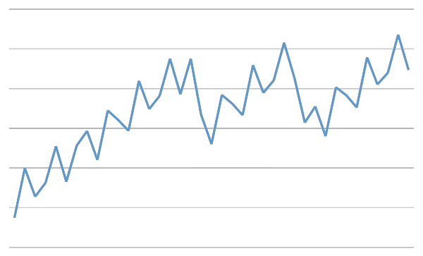
Periodic Data
Cycle
Seasonality – patterns occurring at regular intervals
Daily
Weekly
Monthly
Winter, Spring, Summer, Fall
Annual
Cyclic – repeated pattern, irregular intervals
Season

Slide 6
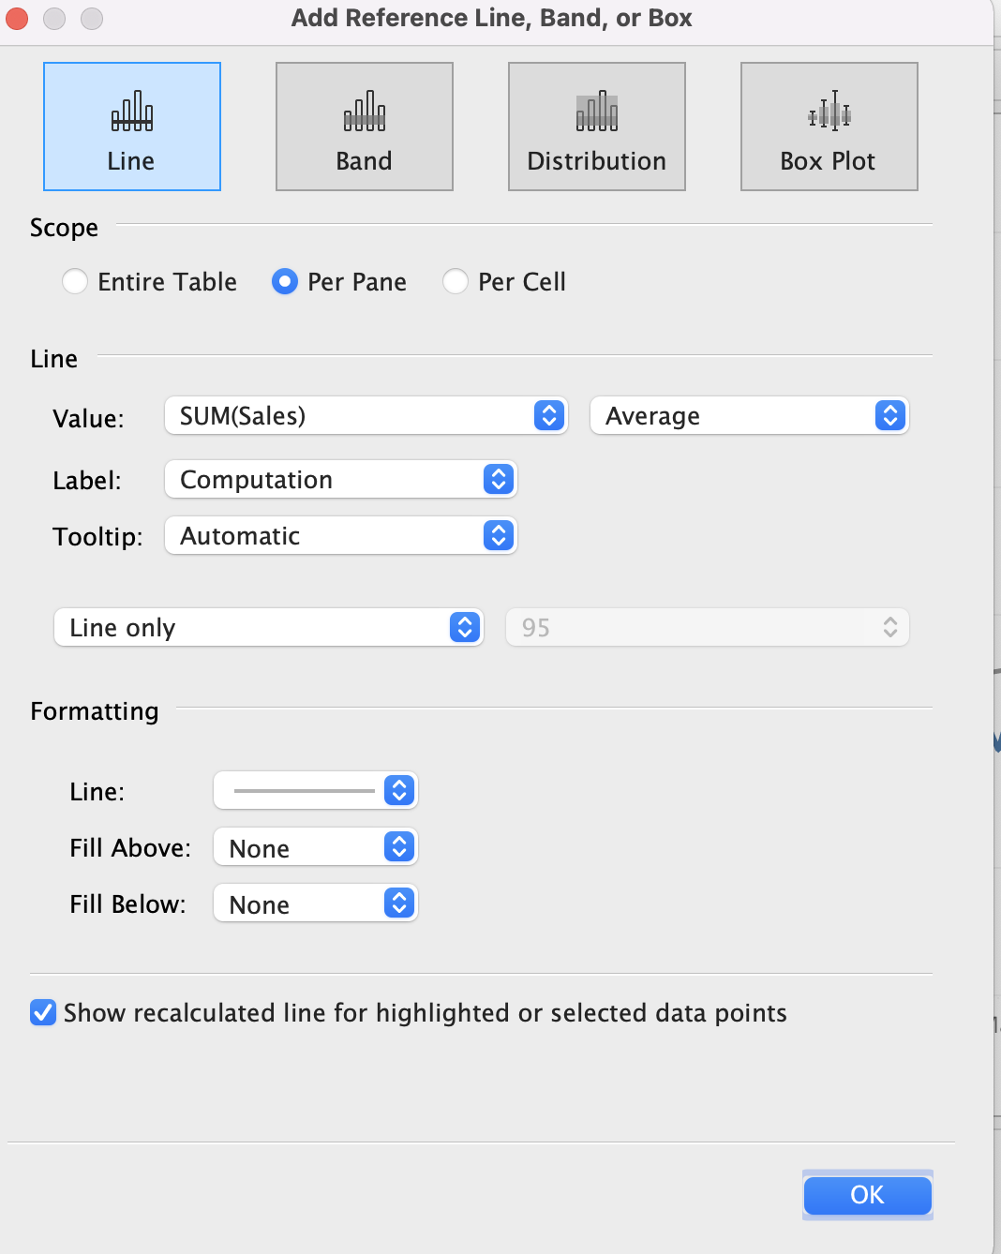
Reference Lines, Bands, Distributions, and Box Plots

Slide 7
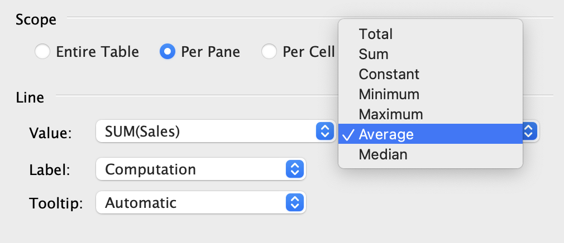
Reference Lines

Slide 8
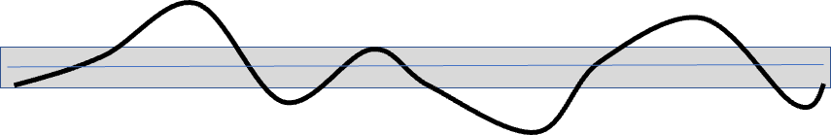
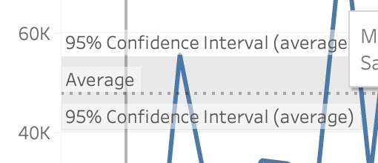
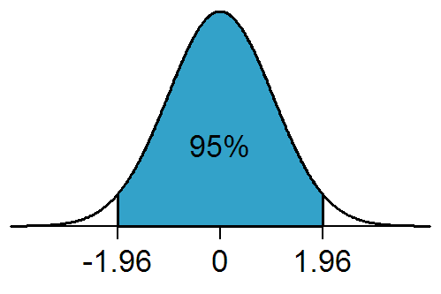
Reference Lines - Confidence Intervals
Confidence intervals are useful for stable processes, not useful for measures that are generally increasing or decreasing or chaotic.
A 95% confidence interval means that there is a 95% probability that the true mean value (μ) falls within the confidence interval.

Slide 9
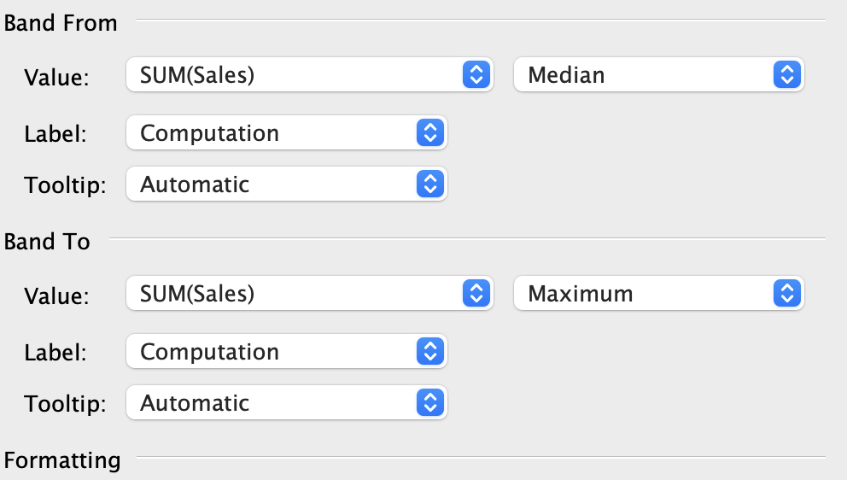
Reference Bands

Slide 10
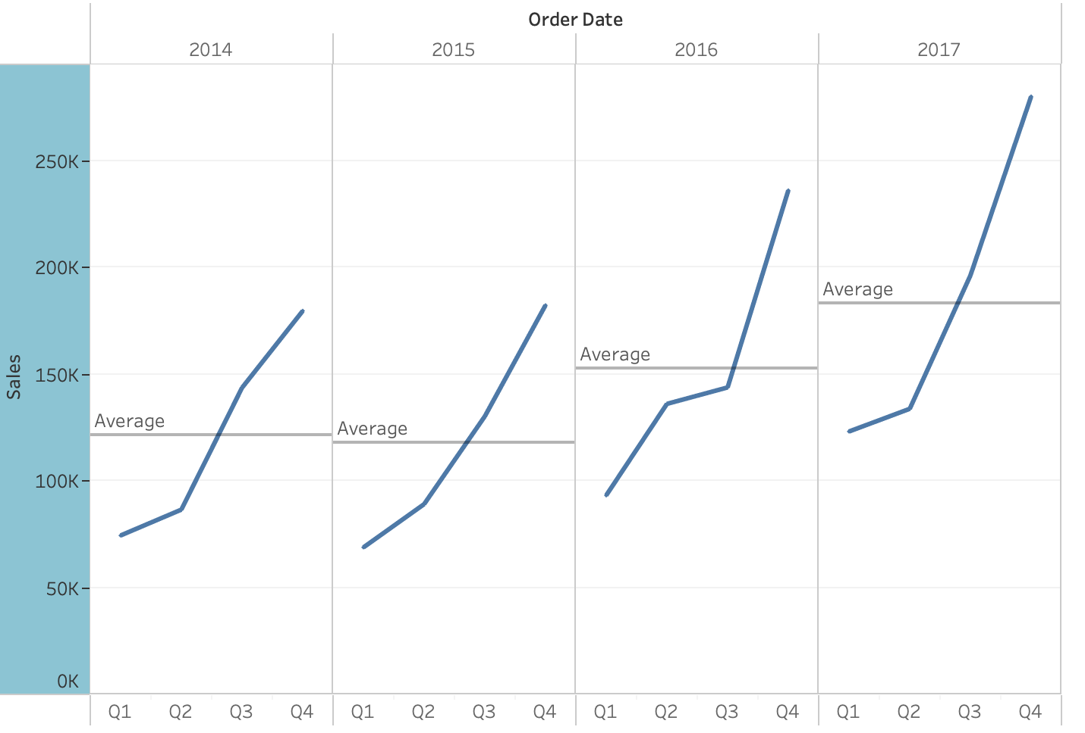
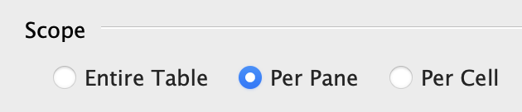
Reference Lines Per Pane

Slide 11
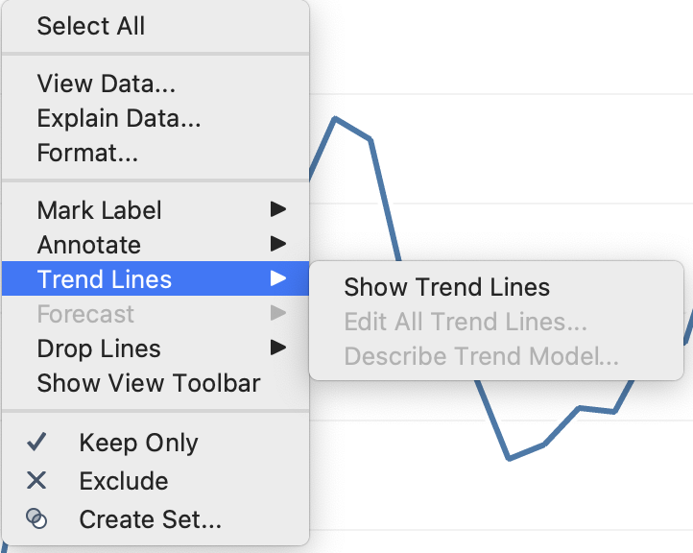
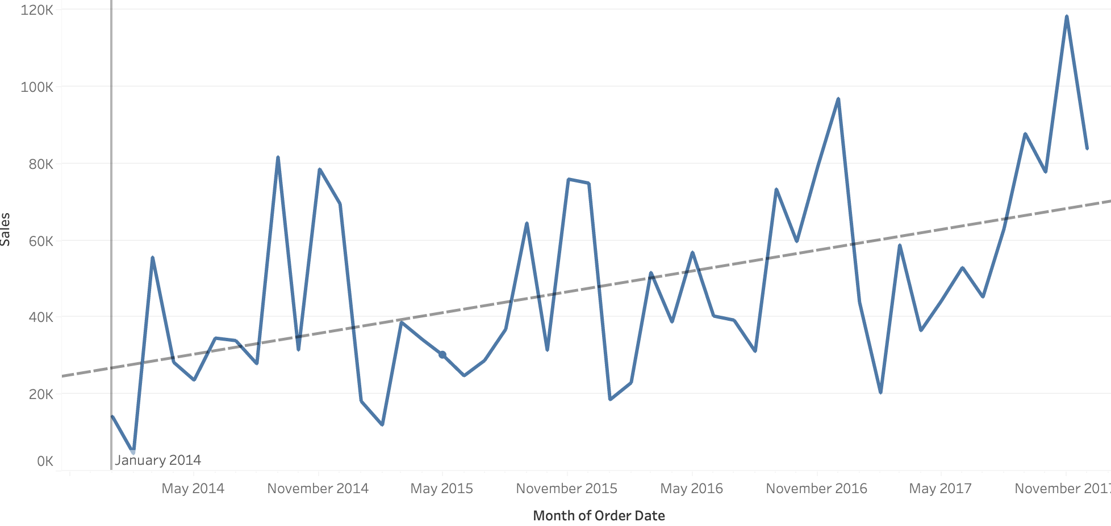
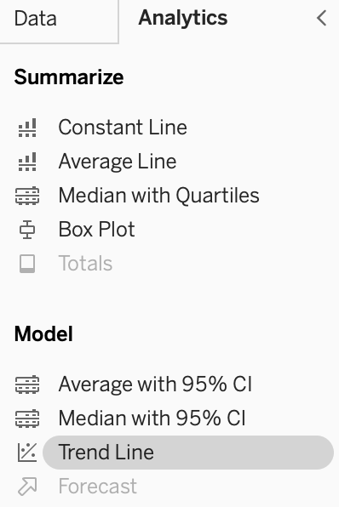
Trend Lines

Slide 12
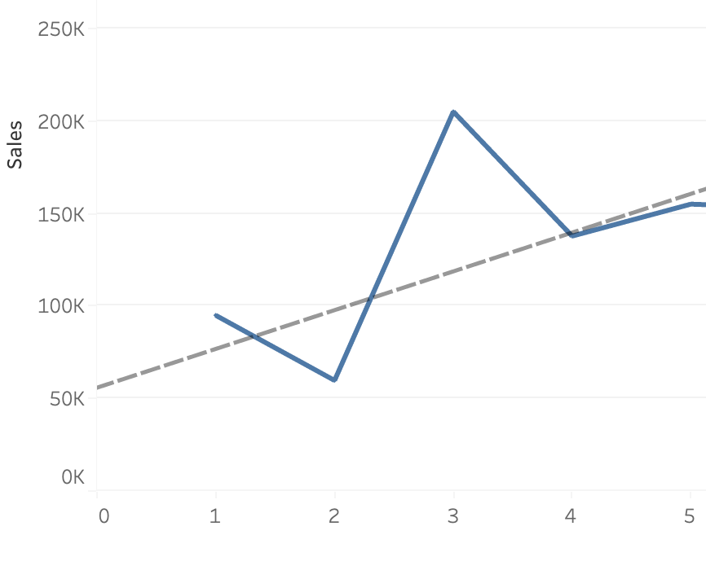
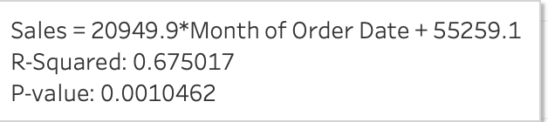
Trend Lines - Regression

Slide 13
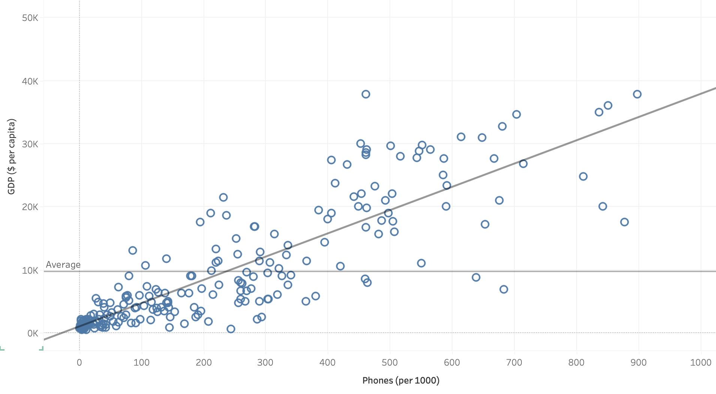
Trend Lines on Scatter Plots

Slide 14
Lunch

Slide 15
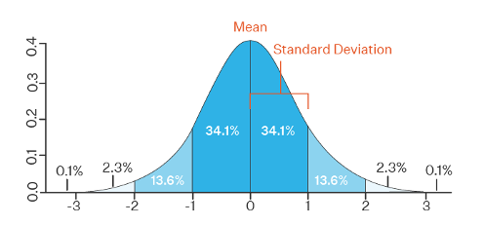
Distributions

Slide 16
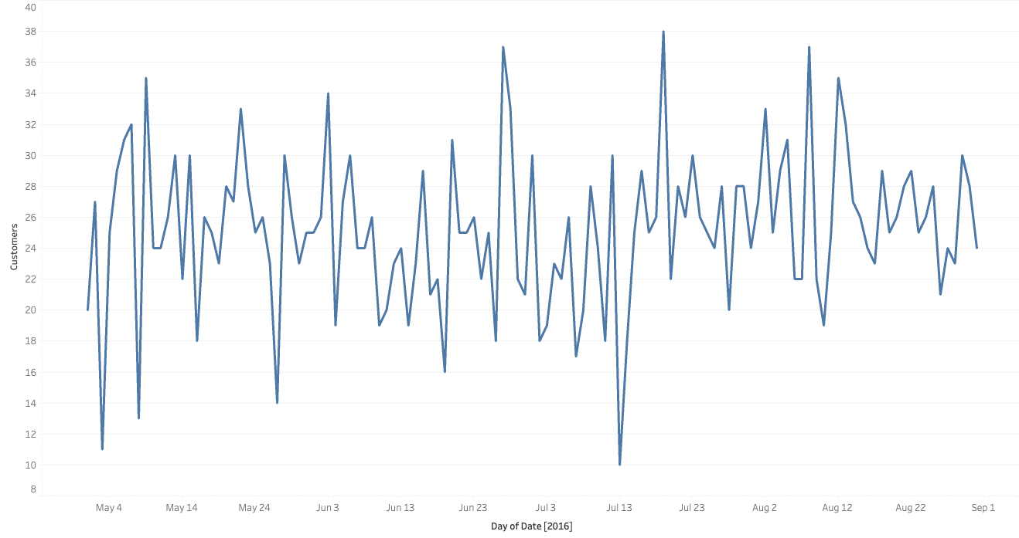
A Stable Process Over Time

Slide 17
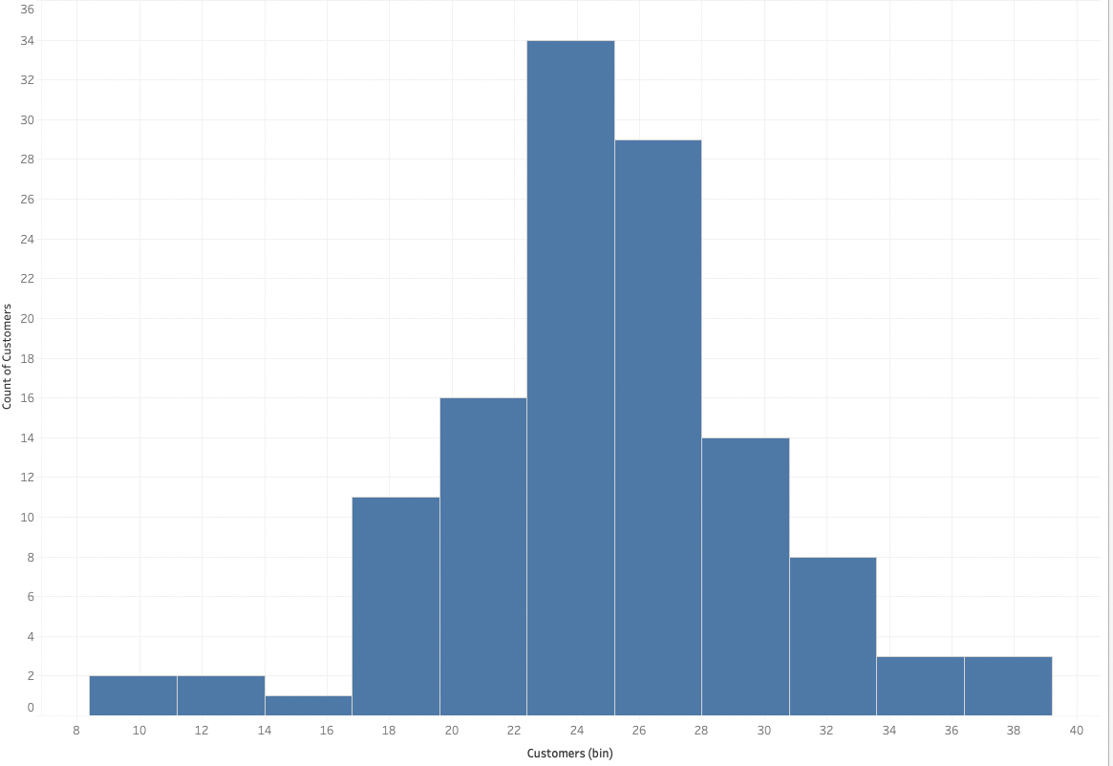
Histogram of Customers Per Day

Slide 18
Customers Per Day

Slide 19
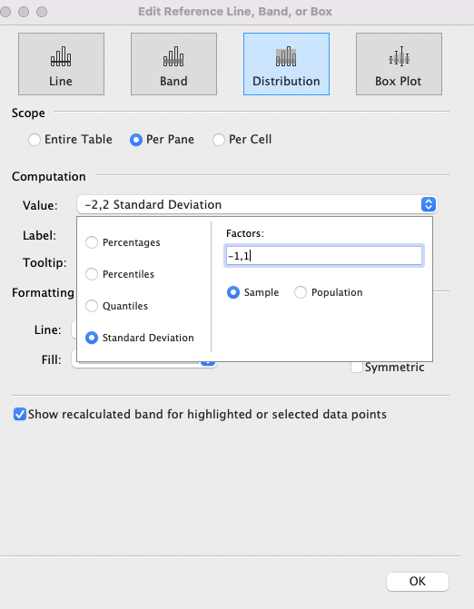
Reference Distributions

Slide 20
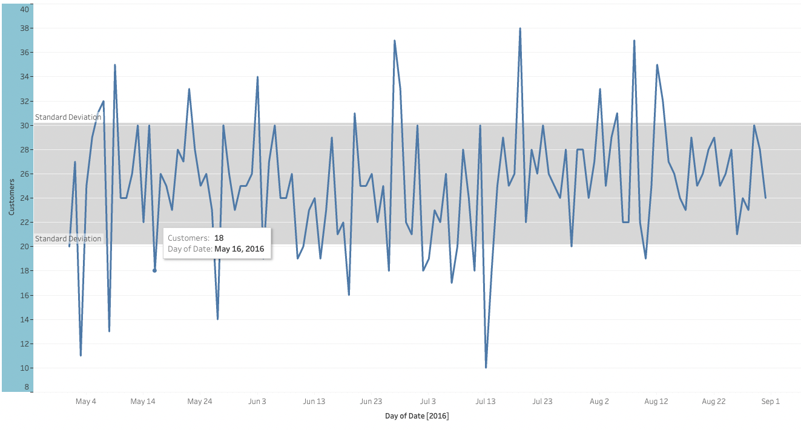

Slide 21
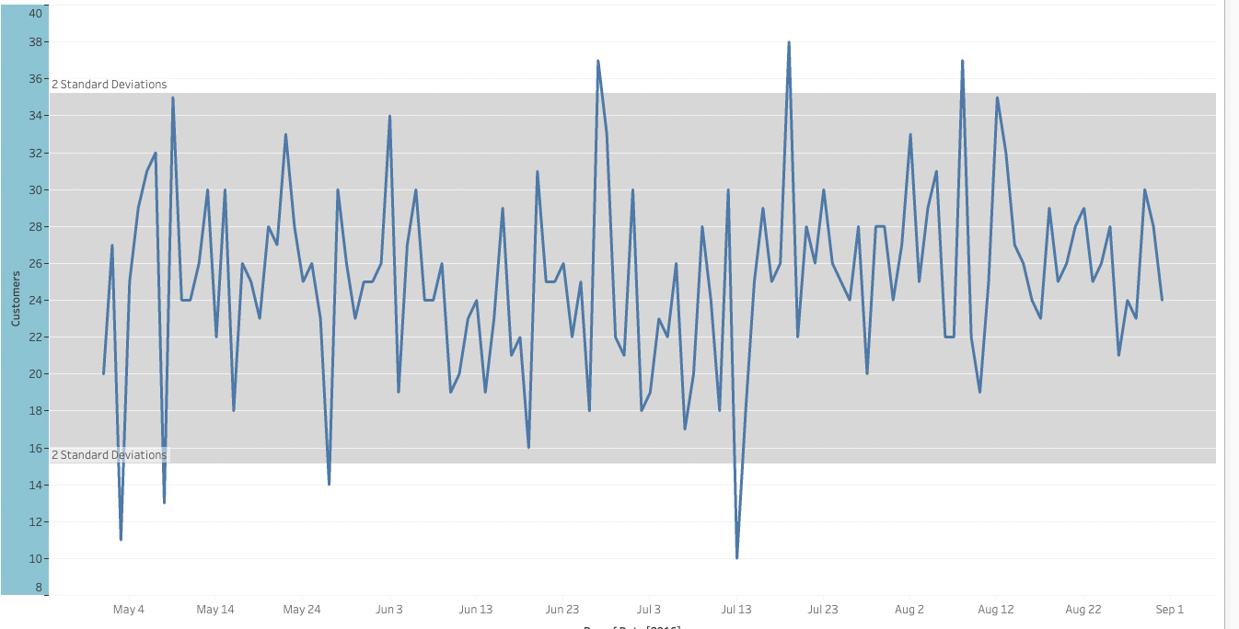

Slide 22
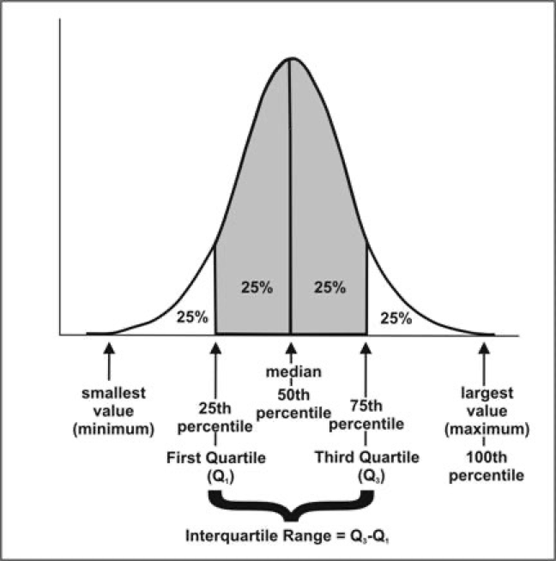
Reference Distributions (Quartiles)

Slide 23
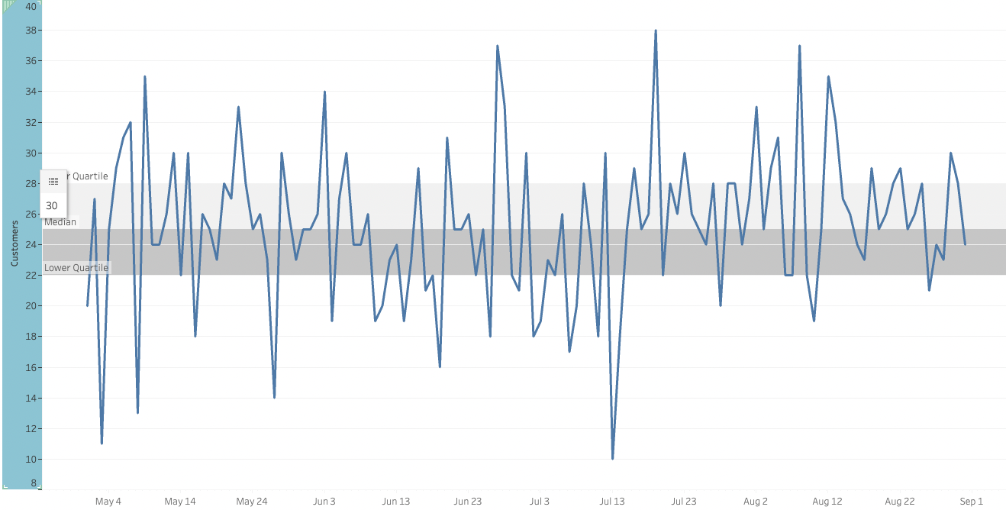

Slide 24
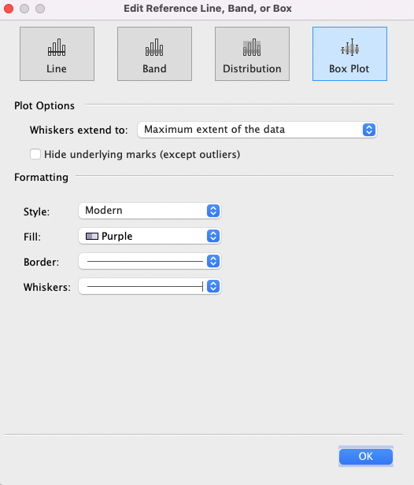
Reference Box Plot

Slide 25
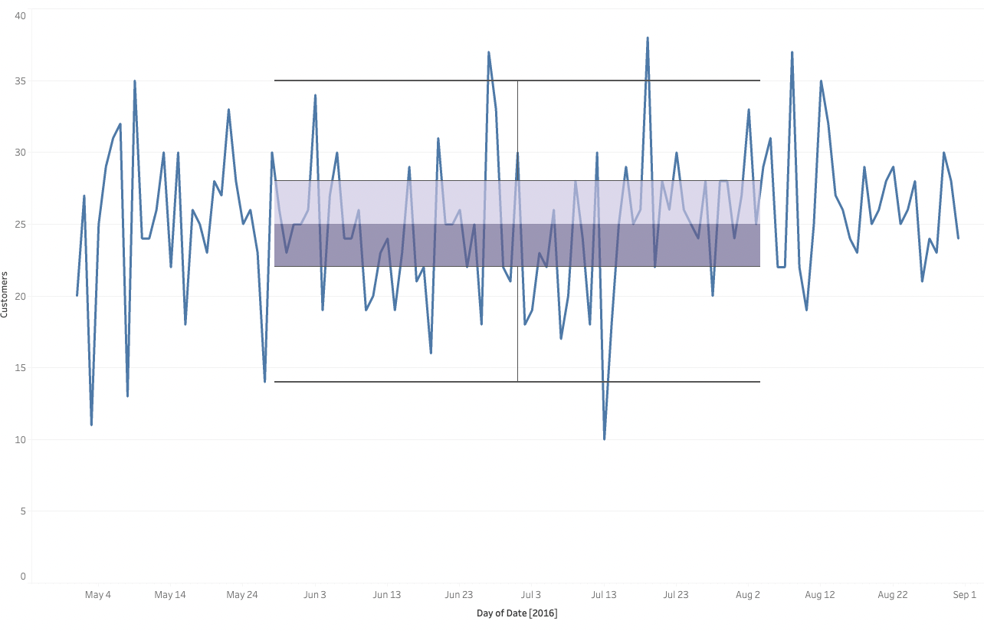

Slide 26
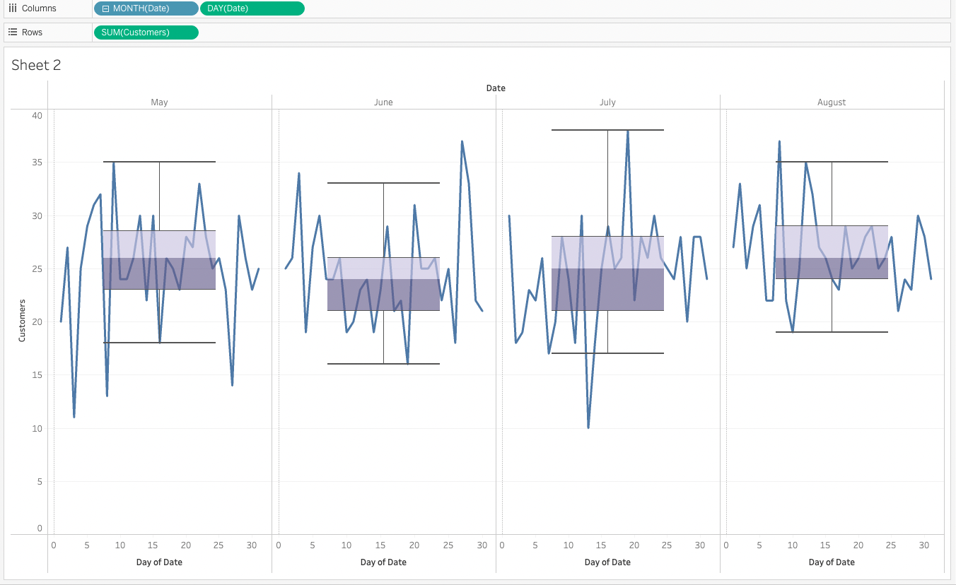

Slide 27
Module 9 (Mini) Challenge
use fake ice cream sales data
Create a line chart with sales by day (continuous)
Add a reference distribution for (-3, 3) standard deviations
Change the chart to discrete months, continuous days and add a reference box plot for each pane (month)
**Special Bilal challenge … create a histogram for sales with adjustable bin sizes

