Slide 1

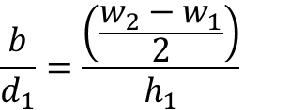









$$\left(x_{1},y_{1}\right)$$
$$\left(x_{2},y_{2}\right)$$
$x_{1},y_{1},w_{1}, w_{2}, h_{1}, d_{1}, d_{2}$が与えられたとき、
$x_{2}$を求めたい。
$$x_{2}=x_{1}+a$$
$$\frac{b}{d_{1}}=\frac{\left(\frac{w_{2}−w_{1}}{2}\right)}{h_{1}}$$
$$b=\frac{\left(w_{2}−w_{1}\right)d_{1}}{2h_{1}}$$
$$a=\sqrt{b^{2}+d_{1}^{2}}−b$$
$$b^{2}+d_{1}^{2}={\left(a+b\right)}^{2}$$
$$∴\left(ゆえに\right)$$
$$x_{2}=x_{1}+\sqrt{b^{2}+d_{1}^{2}}−b$$

