Slide 1
The Knowledge House Phase 2 Capstone Project
AUTOMOBILE PRICE ANALYSIS
What vehicle characteristics has the greatest impact on price?
Presented By:
Victor Martinez
Josie Joseph
Jenelle Downer
Oussama Fathi
Notes:
Imagine you're comparing two cars with very different specifications and prices. We wanted to understand which vehicle characteristics actually have the strongest relationship with price and whether those characteristics could be used to predict automobile prices. For our Phase 2 capstone, we combined exploratory analysis, clustering, regression modeling, and Tableau to turn raw vehicle specifications into actionable pricing insights.

Slide 2
OVERVIEW
OUR ANALYTICAL PROCESS
EDA
INPUT FEATURES
K- MEANS CLUSTERING
PREDICTING AUTOMOBILE PRICE
WHY THIS PROJECT MATTERS
Automobile Price Analysis
5
Notes:
Today we will be going over our analytical process, explain some the steps we took in our eda, why we chose using K-means clustering as our predictive model and lastly why this project matters from a business perspective.

Slide 3
OUR ANALYTICAL PROCESS
From raw data to decision-ready insights
01
02
03
04
05
06
UCI Data
Clean
Explore
Cluster
Predict
Communicate
→
→
→
→
Regression + model evaluation
→
Vehicle specifications + price
Missing values + preprocessing
Patterns + relationships
Natural vehicle segments
Interactive Tableau dashboard
Goal
Understand pricing patterns → segment vehicles → predict price
Dataset includes engine size, horsepower, fuel efficiency, body style, manufacturer and price.
Automobile Price Analysis
2
Notes:
We approached the project as an end-to-end analytics workflow. We started with the UCI Automobile dataset and cleaned and prepared it for analysis. From there, we used exploratory data analysis to understand distributions and relationships. We then used K-Means clustering to see whether vehicles naturally separated into market segments, and regression modeling to test how accurately vehicle characteristics could predict price. Finally, we used Tableau to communicate the results.

Slide 4
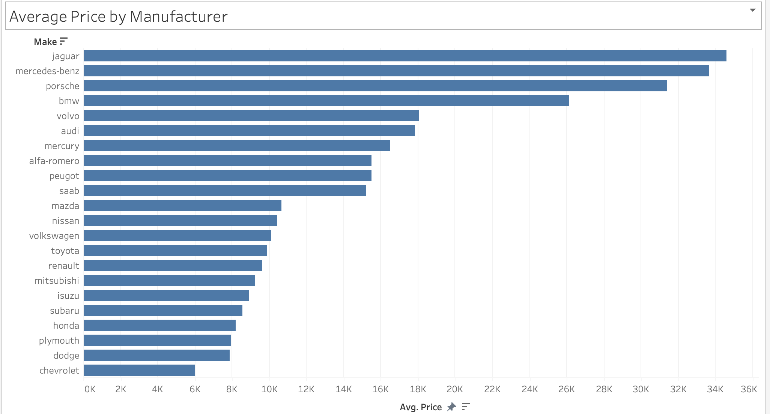
EXPLORATORY DATA ANALYSIS
What appears to drive automobile price?
EDA question
Which features are useful enough to carry forward into modeling?
Engine & power
Engine size and horsepower were key variables to investigate because performance-related specifications showed meaningful relationships with price.
Fuel efficiency
City and highway MPG offered a different view of the market and helped us compare efficiency against performance and price.
DROP YOUR BEST EDA CHART HERE
Vehicle profile
Body style, manufacturer and physical dimensions provided additional context for how vehicles are positioned and priced.
Automobile Price Analysis
3
Notes:
During EDA, we weren't just looking for interesting charts. We wanted to identify the variables that appeared most useful for explaining price. We explored factors such as horsepower, engine size, fuel efficiency, body style, and manufacturer. The goal was to understand which features contained meaningful pricing information and should be investigated further during modeling. Inserting Victor’s chart on price vs. manufacturing.

Slide 5
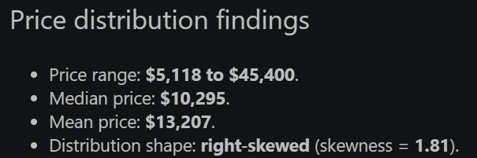
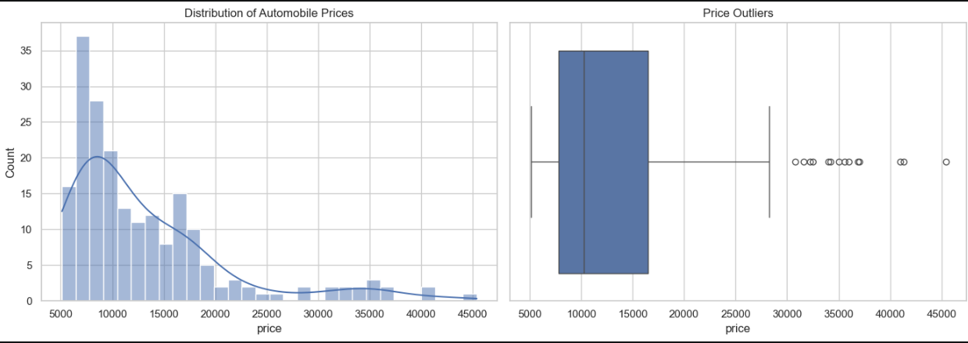
PRICE DISTRIBUTION
From raw data to decision-ready insights
Notes:
We approached the project as an end-to-end analytics workflow. We started with the UCI Automobile dataset and cleaned and prepared it for analysis. From there, we used exploratory data analysis to understand distributions and relationships. We then used K-Means clustering to see whether vehicles naturally separated into market segments, and regression modeling to test how accurately vehicle characteristics could predict price. Finally, we used Tableau to communicate the results.

Slide 6
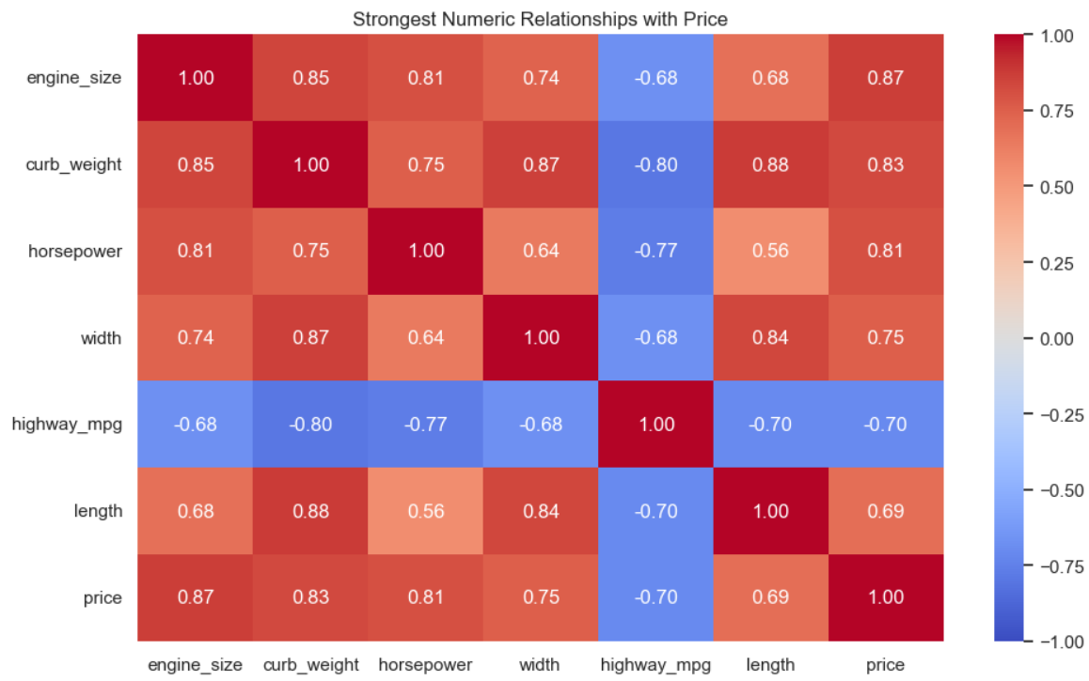
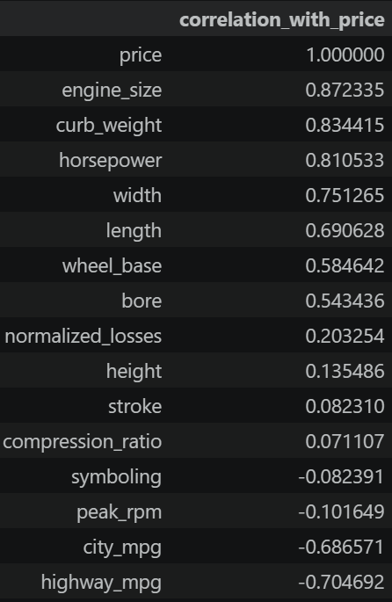
Correlation With Price
From raw data to decision-ready insights
Notes:
Numeric relationship findings
Top numeric relationships with price:
engine_size: correlation = 0.87
curb_weight: correlation = 0.83
horsepower: correlation = 0.81
width: correlation = 0.75
highway_mpg: correlation = -0.70
These variables are retained as candidates for later clustering and regression analysis.

Slide 7
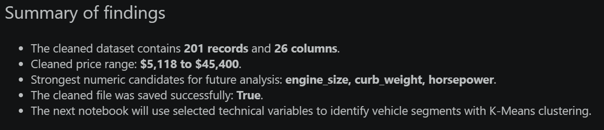
EDA Summary
From raw data to decision-ready insights
The exploratory analysis shows that automobile price is mainly associated with vehicle size, engine performance, and weight. Engine size, horsepower, and curb weight showed some of the strongest relationships with price, suggesting that larger and more powerful vehicles generally tend to have higher prices.
The price distribution is right-skewed, meaning that most vehicles fall in a lower-to-middle price range while a smaller number of high-priced vehicles extend the distribution upward. Price also varies across manufacturers and other vehicle characteristics, suggesting that both technical specifications and market positioning may be useful for price prediction.

Slide 8
K-MEANS CLUSTERING
Not every car competes in the same market
Cluster 2
Cluster 1
Mid-market profile
Cluster 3
Economy / value profile
Premium / performance profile
Why clustering?
It lets the data reveal groups of similar vehicles without assigning categories in advance.
Replace the example cluster labels above with the exact profiles from your final notebook.
Automobile Price Analysis
4
Notes:
We also wanted to go beyond individual relationships and ask whether vehicles naturally separated into different groups. For that, we used K-Means clustering, an unsupervised learning technique. Rather than telling the algorithm what type of car each observation represented, similarities within the features determined the groups. This gives us another way to think about pricing because a budget-oriented vehicle and a performance-oriented vehicle may belong in different competitive contexts. Replace the example cluster labels on this slide with your exact final cluster interpretation.

Slide 9
Segmentation with K-Means
From raw data to decision-ready insights
We used K-Means clustering to identify groups of automobiles with similar technical and physical characteristics. The resulting segments provide an unsupervised view of the data and can be evaluated as an optional input for later price-prediction models.
Do the automobiles in the dataset form distinct segments based on their technical characteristics?

Slide 10
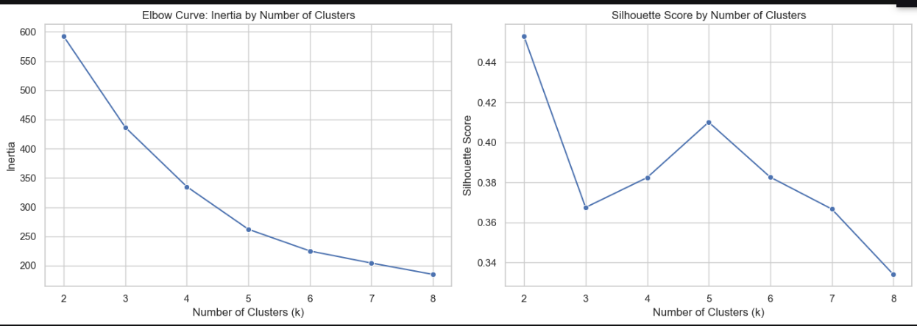
K-MEANS CLUSTERING
Not every car competes in the same market
K-Means requires the number of clusters, k, to be selected in advance. The elbow curve shows how compact the clusters become as k increases, while the silhouette score measures how well-separated and internally cohesive the groups are. The final choice balances these diagnostics with interpretability.
Notes:
We also wanted to go beyond individual relationships and ask whether vehicles naturally separated into different groups. For that, we used K-Means clustering, an unsupervised learning technique. Rather than telling the algorithm what type of car each observation represented, similarities within the features determined the groups. This gives us another way to think about pricing because a budget-oriented vehicle and a performance-oriented vehicle may belong in different competitive contexts. Replace the example cluster labels on this slide with your exact final cluster interpretation.

Slide 11
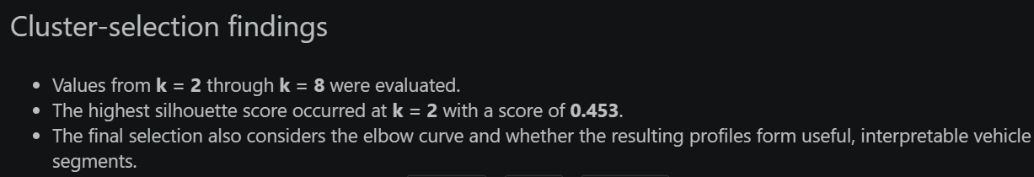
Cluster-selection findings
From raw data to decision-ready insights

Slide 12
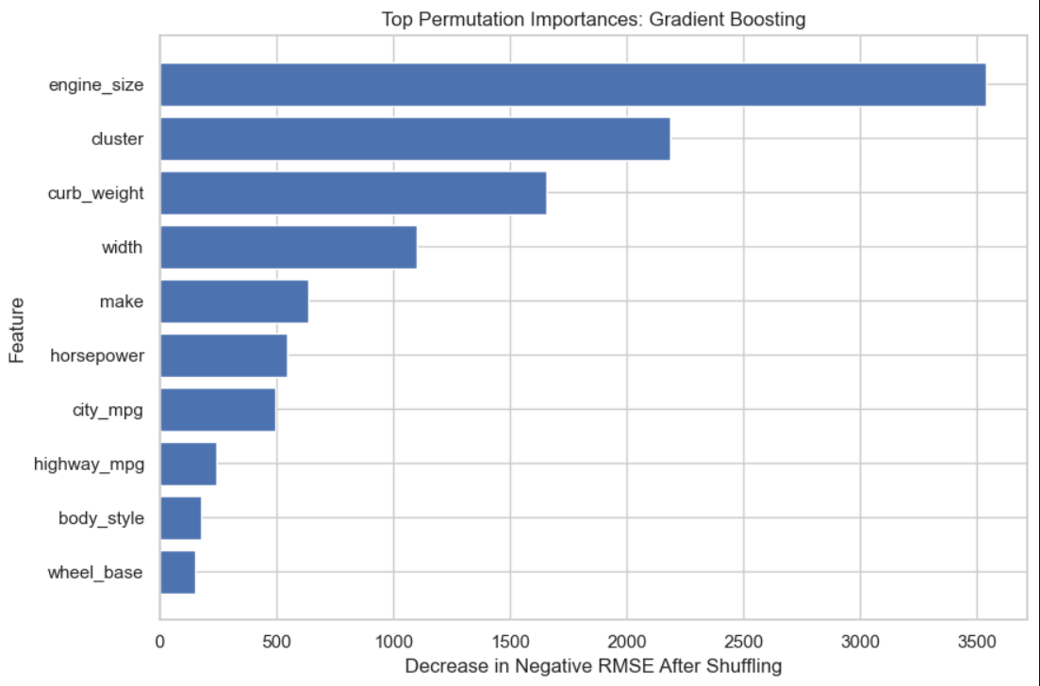
Top Permutation Importances
Notes:
Numeric relationship findings
Top numeric relationships with price:
engine_size: correlation = 0.87
curb_weight: correlation = 0.83
horsepower: correlation = 0.81
width: correlation = 0.75
highway_mpg: correlation = -0.70
These variables are retained as candidates for later clustering and regression analysis.

Slide 13
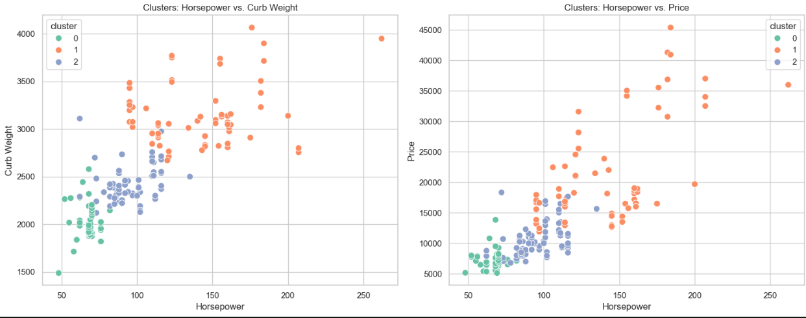
Cluster-selection visualization

Slide 14
Summary finding
K-Means was applied to 6 vehicle characteristics after median imputation and standardization.
The final model used k = 3 clusters and achieved a silhouette score of 0.368.
The clusters differ in their average engine size, horsepower, vehicle weight, and fuel efficiency.
Price was excluded from model fitting but varies across the resulting technical segments.
The clustered dataset was saved successfully: True.
Interpretation
The K-Means analysis identifies distinct groups of automobiles based on size, performance, weight, and fuel efficiency. The segments show that vehicles with larger engines, more horsepower, and greater curb weight generally appear in a different group from lighter, more fuel-efficient vehicles.

Slide 15
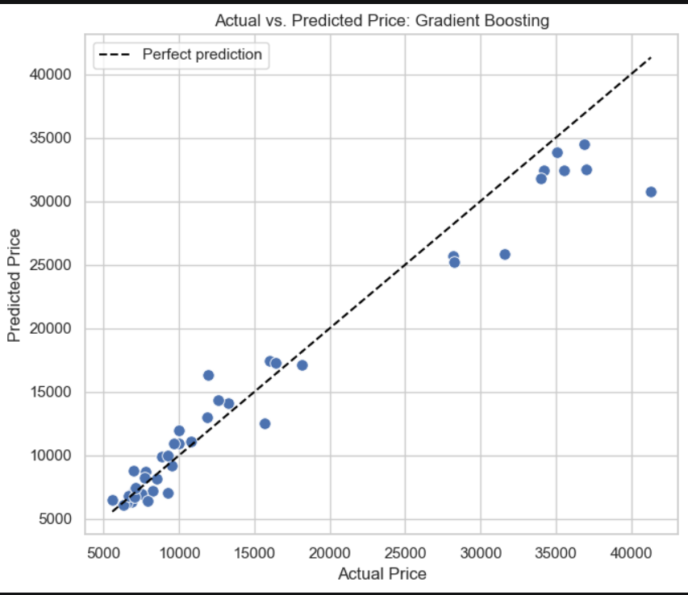
Actual vs Predicted price: Gradient boosting

Slide 16
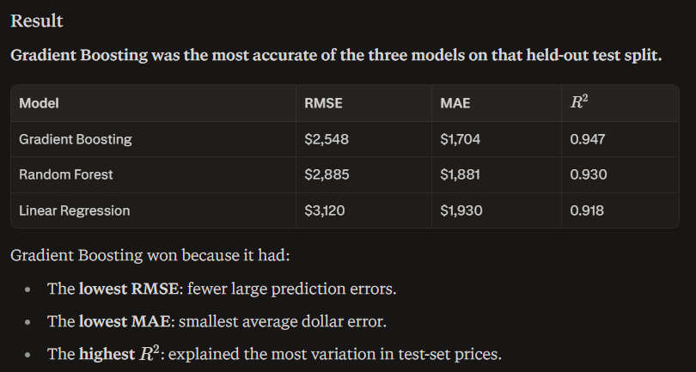
Summary of findings

Slide 17
Summary of findings
Automobile price was most strongly associated with engine size, followed by curb weight, horsepower, and overall vehicle size. Larger, heavier, more powerful vehicles generally had higher prices, while higher highway fuel efficiency was associated with lower prices. Vehicle segment also added useful context because it summarized combinations of performance, size, weight, and fuel efficiency.

Slide 18
WHY THE PROJECT MATTERS
From analysis to business value
Manufacturers
Dealerships
Consumers
Analysts
Understand which vehicle characteristics are associated with premium pricing and product positioning.
Compare vehicles within more appropriate market segments and support pricing conversations.
Evaluate whether a vehicle's price appears aligned with its observable specifications.
Use observable features to estimate price and communicate patterns through a dashboard.
DATA
→
INSIGHT
→
PREDICTION
→
DECISION
Automobile Price Analysis
6
Notes:
Ultimately, the value of this project isn't simply that we built a model. Manufacturers could use the analysis to understand which characteristics are associated with premium pricing. Dealerships could compare vehicles within more appropriate market segments. Consumers could better understand whether price aligns with a vehicle's specifications. And the Tableau dashboard makes those patterns accessible to people who don't need to work directly in Python.

Slide 19
KEY TAKEAWAYS/REVIEW
01
UNDERSTAND
EDA revealed relationships behind automobile pricing.
02
SEGMENT
Clustering explored natural groups of similar vehicles.
03
PREDICT
Regression translated vehicle characteristics into price estimates.
04
COMMUNICATE
Tableau turned the analysis into an accessible decision tool.
Automobile Price Analysis
7
Notes:
To summarize, this project took us through the complete analytical lifecycle. We started by understanding and cleaning the data, used exploratory analysis to uncover pricing relationships, applied clustering to understand different types of vehicles, built regression models to predict price, and communicated the findings through Tableau. The biggest takeaway is that a successful analytics project isn't just about producing a model. It's about explaining what the model tells us and how someone could actually use that information. Thank you.

