Slide 1
Underreporting of Domestic Violence during Lockdown
The Shadow Pandemic (Statistics Canada)
Team 9:
Vinamra Mathur and Zachary Zanussi

Slide 2
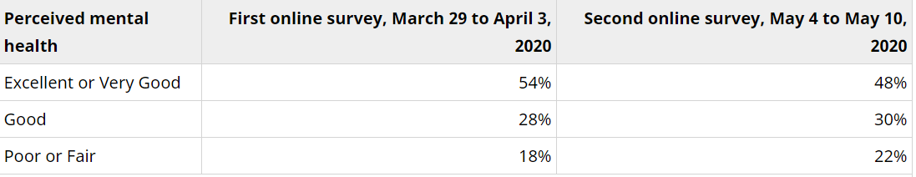
Common precursors to domestic violence are on the rise:
Mental health and stress: Alokan, Funmilola Bosede. "Domestic violence against women: A family menace." European Scientific Journal 9.19 (2013).
Fig: 1 Perceived Mental Health statistic Source: Canadian Perspectives Survey Series, May 2020 and March and April 2020
In May 2020, only 48% of Canadians reported having excellent or very good mental health, 6 percentage points lower than it was end of March.

Slide 3
Common precursors to domestic violence are on the rise:
Isolation and Control: Alokan, Funmilola Bosede. "Domestic violence against women: A family menace." European Scientific Journal 9.19 (2013).
Across Canada, NGOs have experienced a change of trend in the way violence is being reported.
Less time away from abusers makes it harder to report to police or hotlines
The common narrative has been how abusers are taking advantage of the conditions created by the pandemic:
Social isolation has been leveraged as a tool for engaging in violence
Misusing information about the pandemic is an additional control mechanism
Informal mechanisms of support and reporting (eg contact with neighbours, coworkers) have broken down
http://www.anovafuture.org/wp-content/uploads/2020/08/Full-Report.pdf (Pg-10),
Brief summary: Gender-based violence against non-status, refugee and immigrant women across Canada in the context of COVID19. OCASI. (2020). https://ocasi.org/gender-based-violence
WAVAW Rape Crisis Centre. Continuum of Sexual Harm During COVID-19. (2 April 2020) https://www.wavaw.ca/we-are-here-for-you-during-covid-19/.
Notes:
Source: - http://www.anovafuture.org/wp-content/uploads/2020/08/Full-Report.pdf (Pg-10), OCASI. (2020). Brief summary: Gender-based
violence against non-status, refugee and immigrant women across Canada in the context of COVID19. https://ocasi.org/gender-based-violence; WAVAW Rape Crisis Centre. (2 April 2020). Continuum of Sexual Harm During COVID-19. https://www.wavaw.ca/we-are-here-for-you-during-covid-19/.

Slide 4
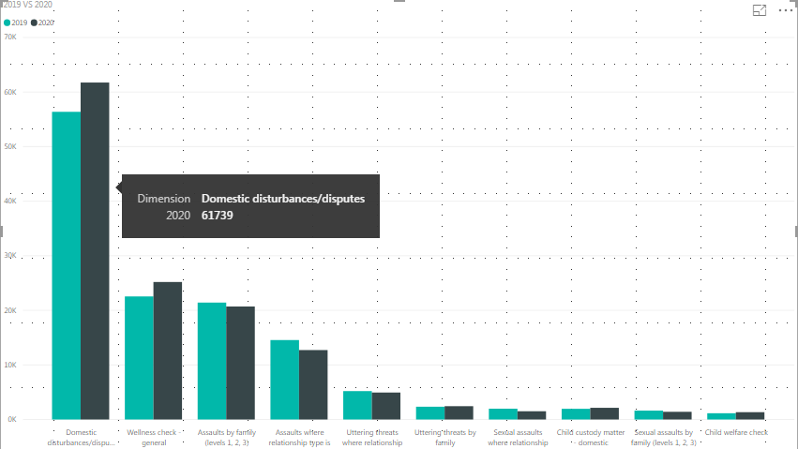
It is likely that underreporting of DV incidences is worse during the pandemic:
Reports of domestic violence in Canada have increased less than expected, given the increase in common precursors. In many cities, reporting rates have not changed or even decreased.
Police calls to respond to domestic disturbances have decreased or not increased in…
Ottawa
Calgary
Vancouver
York

Slide 5
Recommendations
Helplines should open new avenues for reporting and support: discrete apps, textlines, and email
Could partner with other essential services, such as banking or government offices
Eg, include information on support lines instead of hold music?
NGO’s and influencers should shift the focus of their messaging to encourage informal reporting and checking in
Statistical organizations should attempt to measure the change in degree of underreporting
If unemployment rate increases, how much should we expect incidences of domestic violence to increase? Does this match with the number of reported incidences?
Notes:
Many support lines are reporting that being unable to find time to be alone on the telephone was a barrier to receiving help
Not being exposed to friends, family, and coworkers has decreased the amount of informal reporting or support that victims used to receive. Information campaigns by NGO’s or influential people such as youtube or Instagram personalities could encourage people to check in on people close to them and potentially be an avenue for support.
Finally, statistical organizations should measure levels of domestic violence under the assumption that it is underreported. By identifying common visible precursors to domestic violence, these can be used as proxies for actual reported numbers.

Slide 6
Benefits beyond the pandemic…
Increased awareness of signs of domestic violence may help decrease its prevalence post-pandemic
Easier and more available reporting and support measures may reduce the degree of underreporting
Being aware of these trends and how to measure them may help us be better prepared for a future emergency

Slide 7
Thanks for listening!
Remember to check in with your neighbours and loved ones!

