Slide 1
Happiest Place in the World: Northern Europe or North America?
The Procrastinators: Sava Radovic, Vamsi Kurkal, josh ursua

Slide 2
Countries in Each Region
> SE.names <- c("Albania","Bosnia and Herzegovina","Croatia","Greece","Italy","Macedonia","Malta","Montenegro","Portugal","Serbia","Slovenia","Spain")
> NE.names <- c("Denmark","Estonia","Finland","Iceland","Ireland","Norway","Sweden","United Kingdom","Lithuania","Latvia")
> WE.names<-c("Austria","Belgium","France","Germany","Liechenstien","Luxemborg","Netherlands","Switzerland")
> EE.names<-c("Belarus","Bulgaria","Czech Republic","Hungary","Moldova","Poland","Romania","Russia","Slovakia","Ukraine")
> Afr.names <- c("Algeria","Cameroon","Chad","Egypt","Ethiopia","Guinea","Kenya","Mozambique","Niger","South Africa","Tanzania","Uganda")
> SEAsia.names<-c("Brunei","Cambodia","Indonesia","Laos","Malaysia","Myanmar","Philippines","Singapore","Thailand","Vietnam")
> EAsia.names<-c("China","Hong Kong","Japan","South Korea","Mongolia","Taiwan","India")
> MiddleEast.names<-c("Bahrain","Cyprus","Egypt","Iran","Iraq","Israel","Jordan","Kuwait","Lebanon","Oman","Qatar","Saudi Arabia","Syria","Turkey","United Arab Emirates","Yemen")
> NA.names<-c("Canada","United States","Mexico")
> CA.names<-c("Costa Rica","El Salvador","Guatemala","Honduras","Nicaragua","Panama")
> SA.names<-c("Brazil","Colombia","Argentina","Peru","Venezuela","Chile","Ecuador","Bolivia","Paraguay","Uruguay","Suriname")

Slide 3
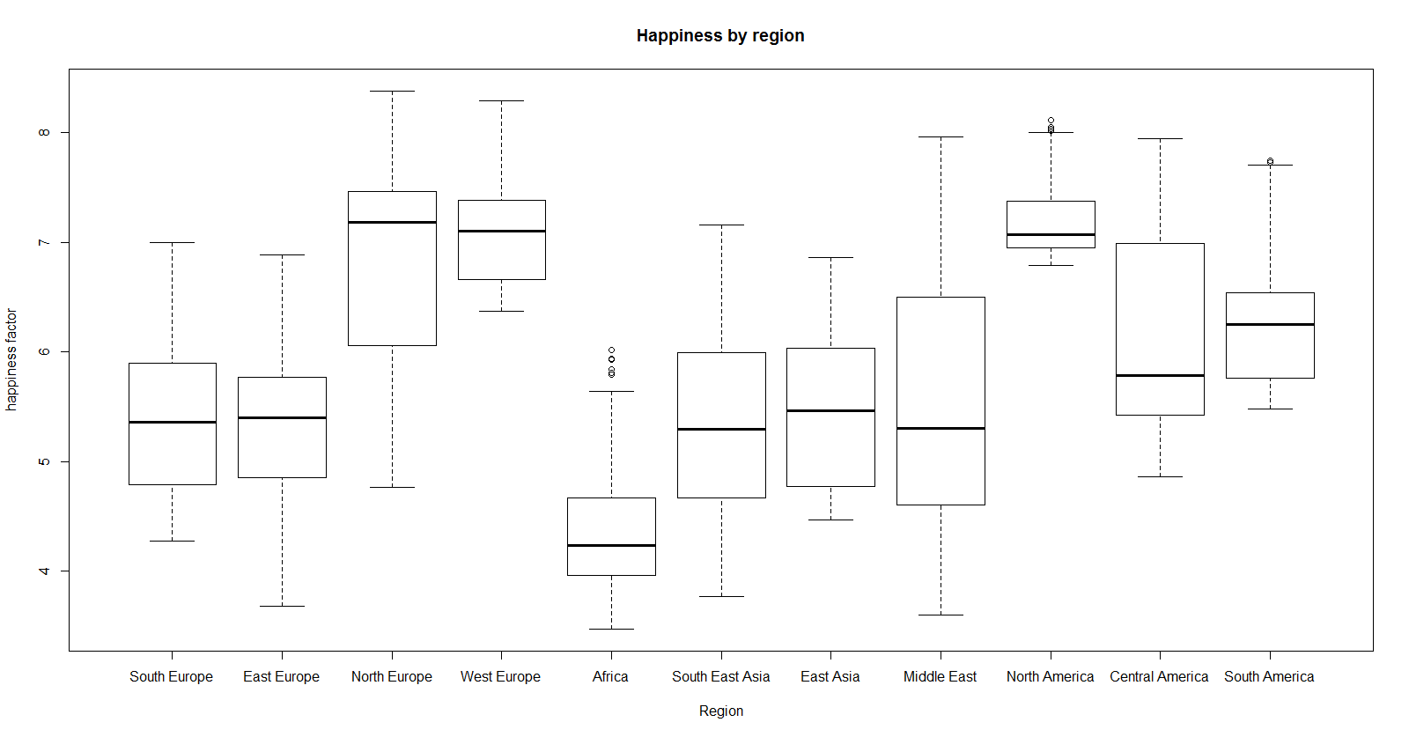

Slide 4
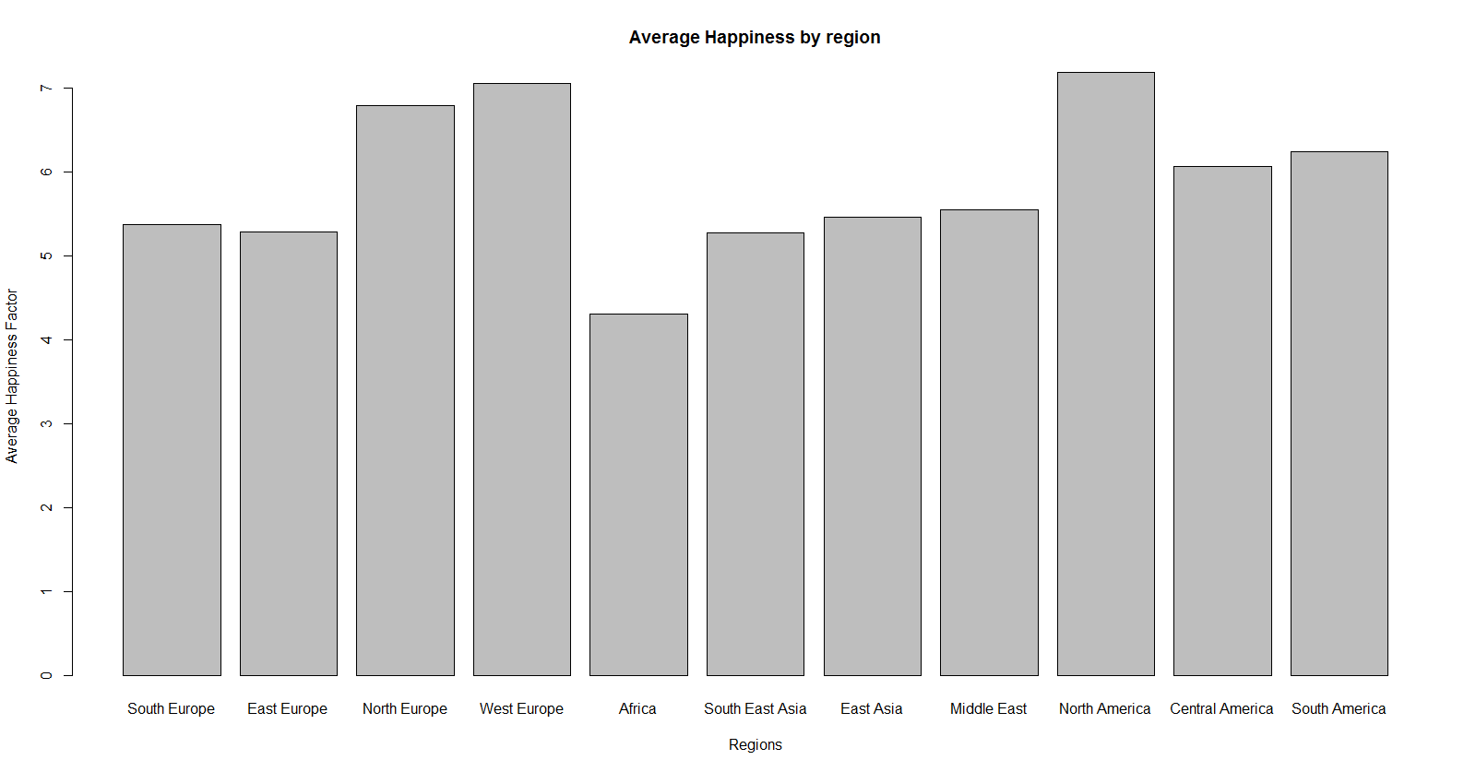

Slide 5
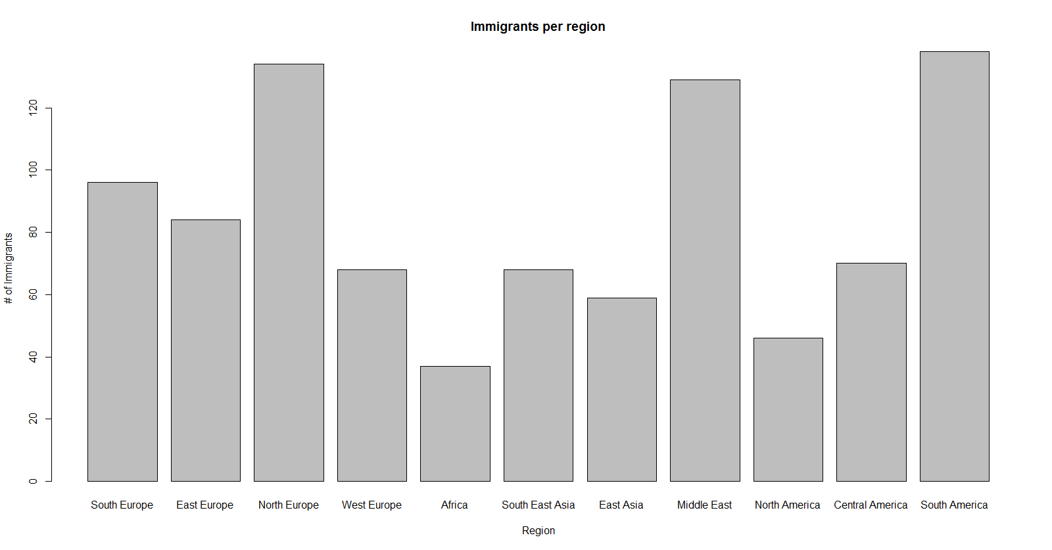

Slide 6
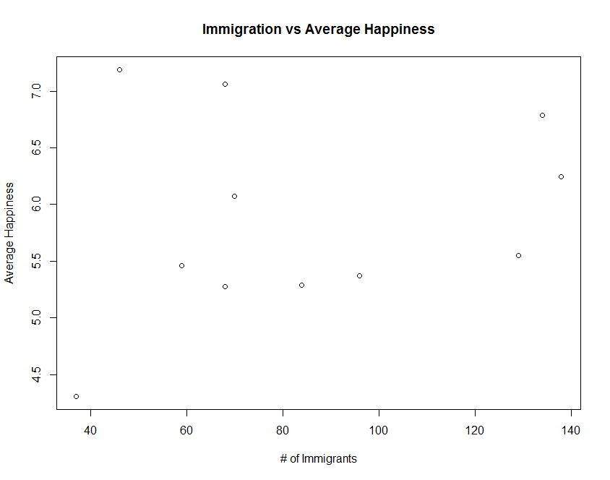

Slide 7
CONCLUSIONS
NORTHERN EUROPE HAD THE GREATEST MEDIAN HAPPINESS COMPARED TO OTHER REGIONS, BUT NORTH AMERICA HAD THE GREATEST MEAN HAPPINESS
SOUTH AMERICA HAD THE GREATEST NUMBER OF IMMIGRANTS
AFRICA HAD THE LOWEST MEAN AND MEDIAN HAPPINESS, AND THE LOWEST NUMBER OF IMMIGRANTS
THERE WAS NO CORRELATION BETWEEN THE NUMBER OF IMMIGRANTS IN EACH REGION AND THAT REGION’S AVERAGE HAPPINESS

Slide 8
CODE
> boxplot(SE$HAPPINESS,EE$HAPPINESS,NE$HAPPINESS,WE$HAPPINESS,Afr$HAPPINESS,SEAsia$HAPPINESS,EAsia$HAPPINESS,MiddleEast$HAPPINESS,NAmerica$HAPPINESS,CA$HAPPINESS,SA$HAPPINESS, names = Regions,xlab = "Region",ylab = "happiness factor", main = "Happiness by region")
>
> barplot(Averagehappiness, names = Regions, xlab= "Regions", ylab = "Average Happiness Factor", main = "Average Happiness by region")
>
> barplot(Immigrant,names = Regions, xlab = "Region", ylab = "# of Immigrants", main = "Immigrants per region")
>
> plot(Immigrant,Averagehappiness, xlab ="# of Immigrants", ylab = "Average Happiness", main = "Immigration vs Average Happiness")

