Slide 1
Zodiac Signs
Sava Radovic, Josh Ursua, Vamsi Kurkal
The Procrastinators

Slide 2
What the Zodiac Sign Dataset Contains
Years of education
Profession
Capital Gain
Capital Loss
Native Country
Profession
Data of 1,000 people was recorded

Slide 3
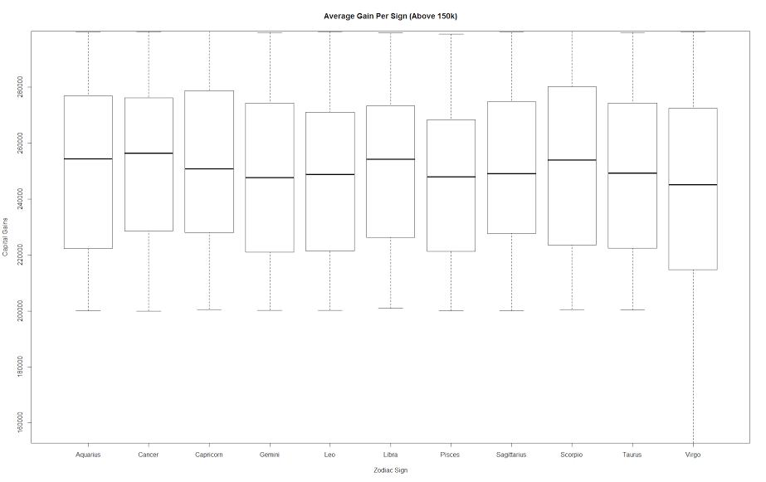
Capital Gain vs. Zodiac Sign

Slide 4
Conclusions from our Plots
People with the Cancer Zodiac Sign averaged the highest capital gain
People with Libra and Scorpia averaged the second highest capital gain
People with Virgo signs averaged the lowest

