Slide 1
Permutation Test: Score Vs. Texting
Sava Radovic, josh ursua, vamsi kurkal

Slide 2
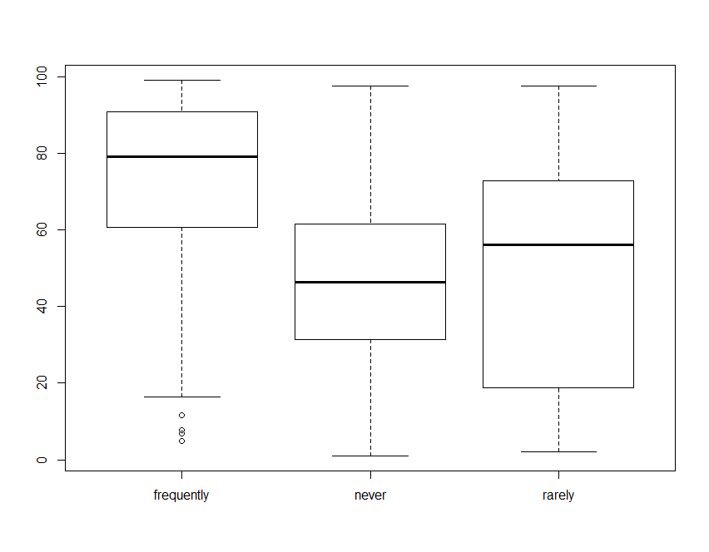
Score Vs. Texting

Slide 3
What these results tell us (In General)
Those who asked questions frequently received distinctly higher scores than those who did not
There was not much difference between the average scores of those who asked questions rarely and those who did not ask questions at all

Slide 4
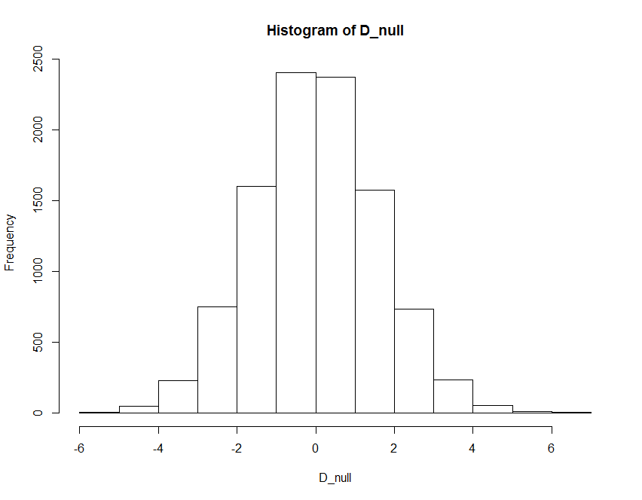
Permutation Test
P Value = 24.90905

Slide 5
Conclusions of Permutation Test
According to the Permutation Test, a significance level of -5 to 5 means that the null hypothesis is true
The data gives a significance value of 24.9095 (about 25)
Null hypothesis is rejected

Slide 6
Code
MOODY101_RANDOM <- read.csv("MOODY101_RANDOM.csv")
score <- MOODY101_RANDOM$SCORE
questions <- MOODY101_RANDOM$ASKSQUESTIONS
boxplot(score~questions)
nn<-mean(neverask_null)
fn<-mean(frequentlyask_null)
rn<-mean(rarelyask_null)
temp <- (nn+rn)/2
D_null <- c(D_null,(fn-temp))

