Slide 1
Wine Prices vs. Quality
The Data Crusaders: Eddie Lazar, Ryan Allison, Vamsi Kurkal

Slide 2
Punch Line
We found that on average, Kazakhstan’s and Montenegro's wine is by far the cheapest but their insanely low prices don’t make the wine any less good in terms of quality or rating. In fact, its usually better than that of France or Italy.
In particular, Montenegro has wine prices going down to one dollar or 50 cents, giving it a range of prices much larger than other countries.

Slide 3
Each Country’s Average Wine Prices
Argentina: 120.60300
Australia: 145.12171
California: 131.90437
France: 138.02150
Italy: 136.18953
Kazahkstan: 72.35150
Montenegro: 73.56176

Slide 4
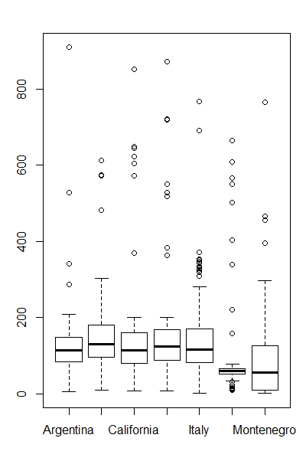
Kazakhstan vs. Montenegro
Notable that Montenegro’s median wine price is as low as Kazakhstan’s, but it’s upper quartile also goes much higher.

Slide 5
T-Test
We wanted to determine if a large random sample of Montenegro’s wine prices would yield the same results.
To do this, we compared different-sized samples of prices of France and Montenegro and see how they change.

Slide 6
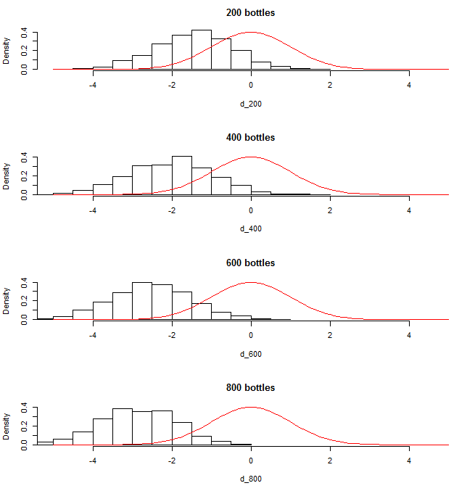
Standardized Mean Difference
The histogram moves to the right as the random sample size gets bigger and bigger. This means that the average prices for larger sample sizes are further apart from France’s prices than smaller sizes.

Slide 7
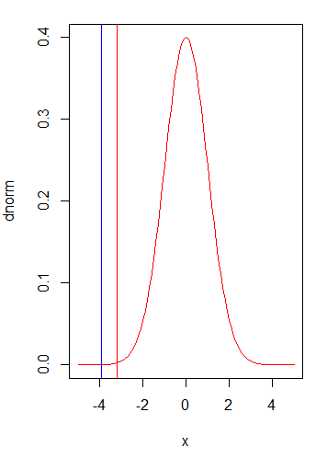
DNorm Graph
The red line is a data value from a smaller random sample, and the blue one is from a larger sample.

