Slide 1
Serious Games
Putting Games to Work

Slide 2
Agenda
What are games?
  Are virtual worlds games?
What do we learn from games?
What are serious games?
Why are they important?
Why do they work?

Slide 3
What do you think of when I say “games”?
Board games
Sports games
Social or political games
Computer games
  Addictive
  Online
  Multi-player
Adjectives?

Slide 4
What is a game?
Fun!
Rules-based
Defined goal
Can be played in a manner without real-world consequences
Accelerated experience
Allows risk-taking

Slide 5
MMORPGs and Virtual Worlds
Assets
Avatar Mediated
Communities
Immersive
Interactive
Persistent World
Real-Time Comm
Reputation
Social Interaction
Virtual Economy
MMORPGs
Virtual Worlds
Bound by a Narrative
Defined Roles
Non-Player Characters
Ranks and Levels
Rules
Business Opportunity
Unbounded Space
User Created Content
Kins, not Twins

Slide 6
Games have ALWAYS been used to teach
What kinds of games do young children play?
  Role modeling!
How do young animals learn skills?
  Playing!
What do you learn from Hide and Seek?
  Hunting, tracking, hiding, observation
Other examples?

Slide 7
What can we learn from video games?
Mental mapping: create a mental picture of what you have learned
Situational awareness: absorb what’s happening around you
Visual selective attention: focus on what’s important
Inductive discovery: learn by trial and error
Multitasking
Collaborating
Marc Prensky

Slide 8
Serious Games
Games with a serious purpose
  built for serious purpose
  used for serious purpose

Slide 9

What is a serious purpose?
Education
Training
Social change
Health education
Pain control
Rehabilitation

Slide 10
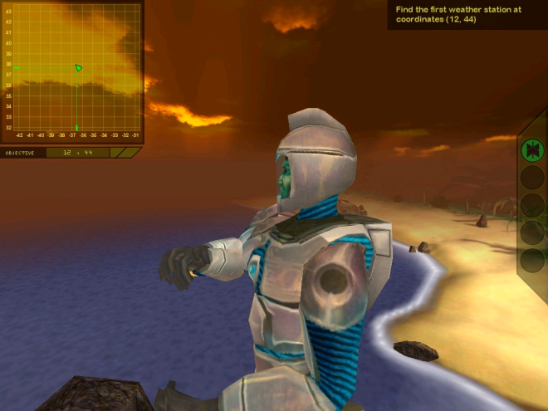


Education: Dimenxian
First person shooter teaches algebra
Average pre-test/post-test increase one grade level (75 students)
Underachieving students up to 3 grade levels.

Slide 11

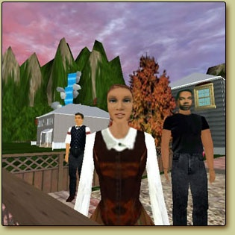
Education: River City
Middle school students
Scientific inquiry
19th century illness detectives
Improved success of lower achievers

Slide 12
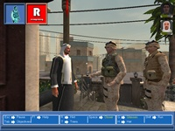
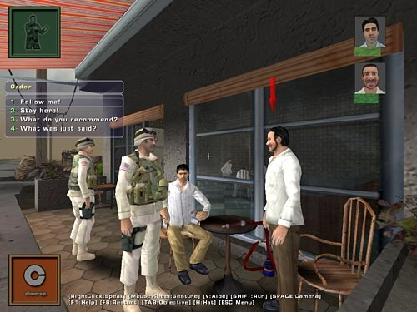
Training: Tactical Iraqi
Military
Teach language and culture
In use since August
Expanded to additional languages

Slide 13
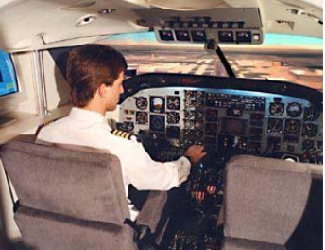
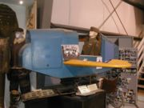
Training: Jet Simulators
Training done on simulators
First time a pilot flies a Boeing 777 is WITH PASSENGERS
Microsoft Flight Simulator effective

Slide 14

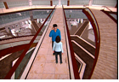
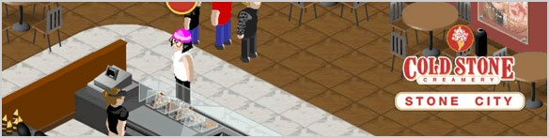
Training: Businesses
Cold Stone Creamery
Hilton Gardens
IBM

Slide 15
Social Change: Opinions
Letters to the editor
Articles
Books
Television shows
Documentaries
Movies
Web Sites
Blogs
Radio shows
Music
Paintings
Sculptures
Photographs
Signs

Slide 16
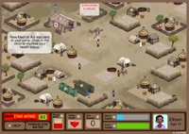
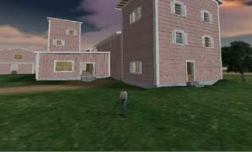
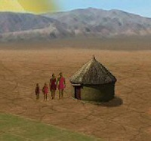

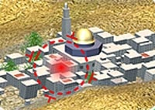
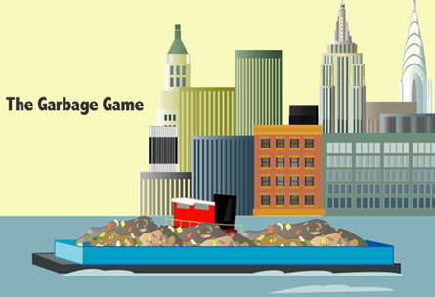
Social Change:
Transform
Awareness
Commentary
PeaceMaker
Garbage Glut
Eyewitness- Nanking Massacre
3rd World Farmer
Darfur is Dying
Waco Resurrection

Slide 17
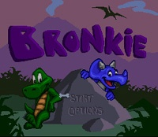
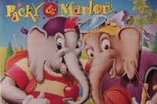
Health: Managing Illness
Asthma
Bronkie the Bronchosaurus
45% reduction in crises
Diabetes
Packy and Marlon
70% reduction in crises

Slide 18
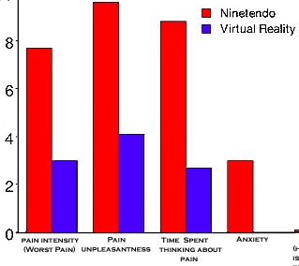
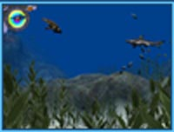
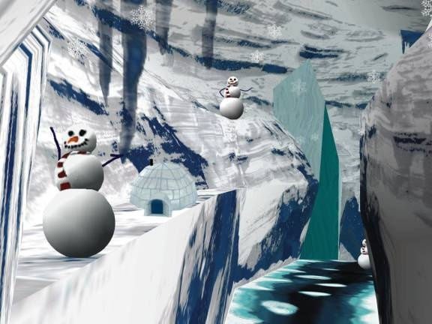
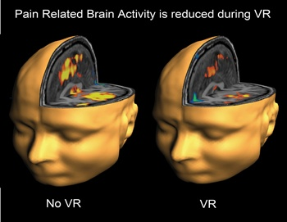
Pain: Alternative to Meds
Free Dive
SnowWorld

Slide 19
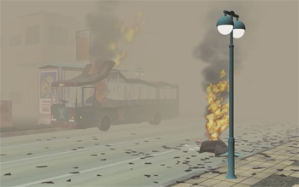
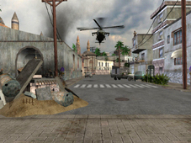
Rehabilitation: PTSD
Tailor environments to traumatic experience
Relive as much as can tolerate
Significant results
Full Spectrum Warrior

Slide 20
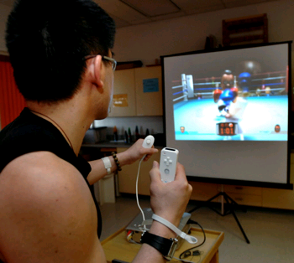
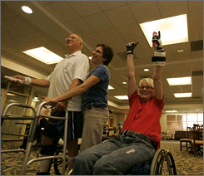
Rehabilitation: PT
Injury
Surgery
Stroke
Alzheimer
More fun = more time

Slide 21
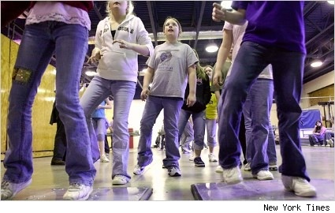
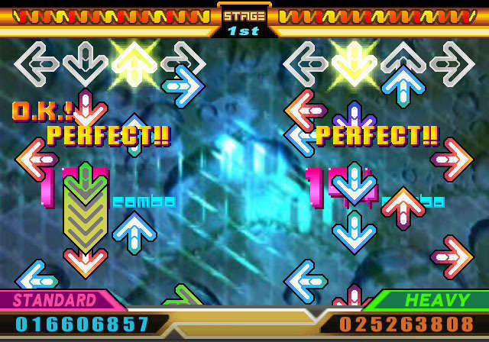
Rehabilitation: New Behaviors
Treatment for obesity
  West Virginia
Workout mode
  Track calories burned
Phys Ed classes
  Universities (Brandeis, Mt Holyoke, Caltech)
  High School in New York
Growing…

Slide 22
Studies Show Benefits
North Dakota State University
  Geology Explorer
  Virtual Cell
Lecture baseline
Web-based presentation
  No significant increase
Virtual world game
  15-40% increase
Lecture baseline
Web-based presentation
  13-30% increase
Virtual world game
  30-63% increase
New generation, New paradigms …

Slide 23
Digital Natives
(vs Digital Immigrants)
Receive information rapidly
Parallel process
Multi-task
Prefer graphics first
Prefer random access
Thrive on instant gratification and frequent rewards
Fundamentally think and process information differently

Slide 24
Why serious games?
Games engage people
  Engaged people work longer, learn better
Along with a learning curve, there is a forgetting curve
  People forget slower with games
  … because they learned it better?
But is there science behind this?

Slide 25
Learning Theory Support
Experiential learning
Inquiry-based learning
Authenticity
Self-efficacy
Goal-setting
Continual feedback
Cooperation

Slide 26
Biology Support
Brain retains only the important
  Important = emotionally significant
  Releases dopamine in amygdala
Game playing increases dopamine levels

