Slide 1
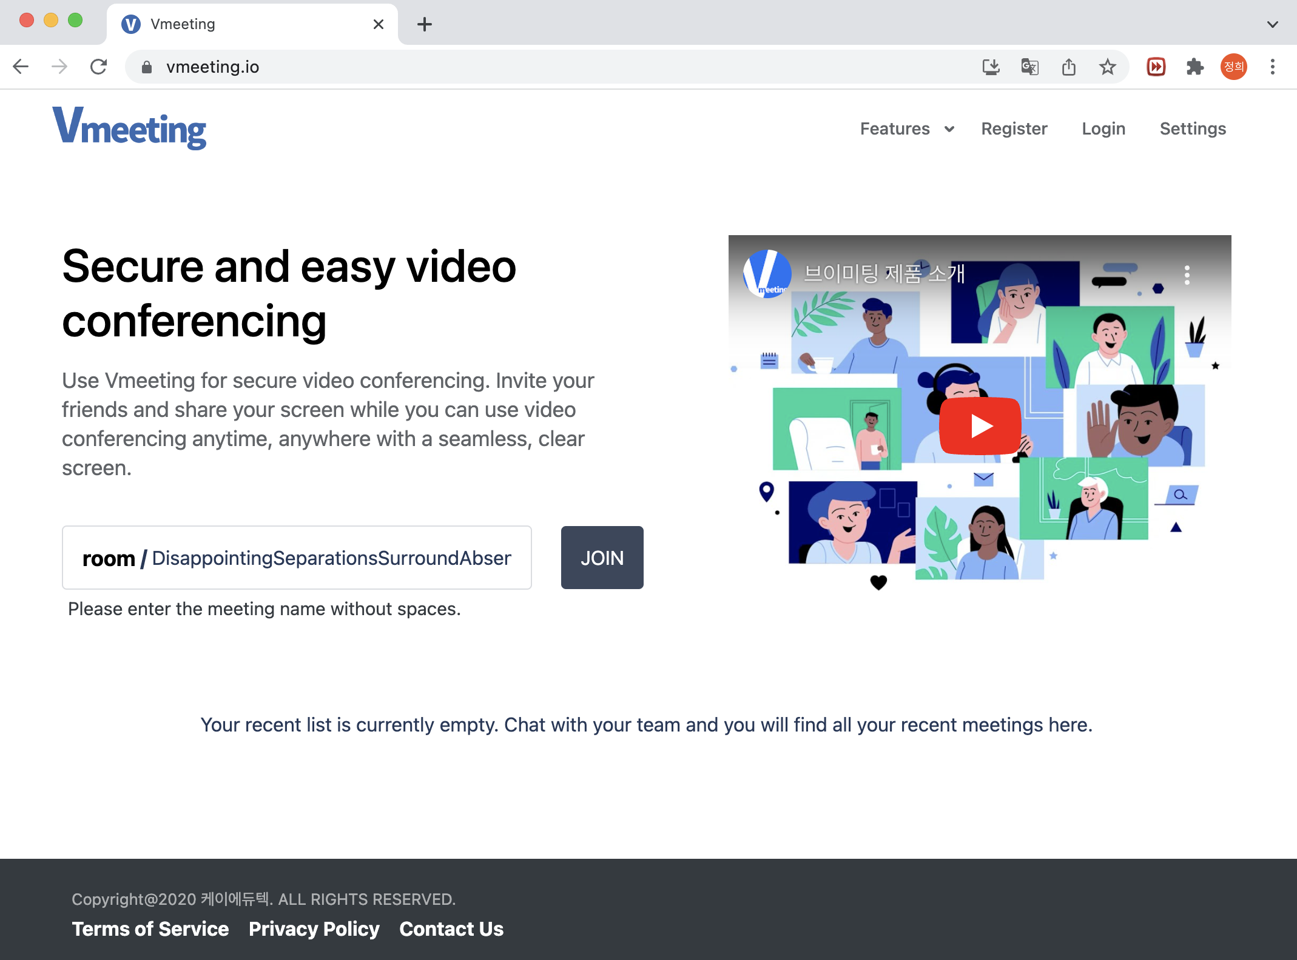
V
meeting
v2.2
User Guide
PC Guide
English

Slide 2
Contents
Start meetings
Start Vmeeting
4
Create New Account & Login
6
Settings & Controls
9
Host Meetings & Invite Users
11
Set Virtual Background
13
Utilities
Chat and Polls
16
Document Sharing
20
Screen Sharing
23
Video & Audio Settings
26
Participants
27
Statistics
29
Layouts
30
Video Quality
33
More
34
As a Host
Screen Recording
38
Live Streaming
40
Securities
43
Breakout Rooms
45
Tile view settings
47
Etc (Host Controls)
49
More
FAQ
58
Contacts
60

Slide 3
Start Meetings

Slide 4

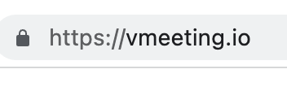
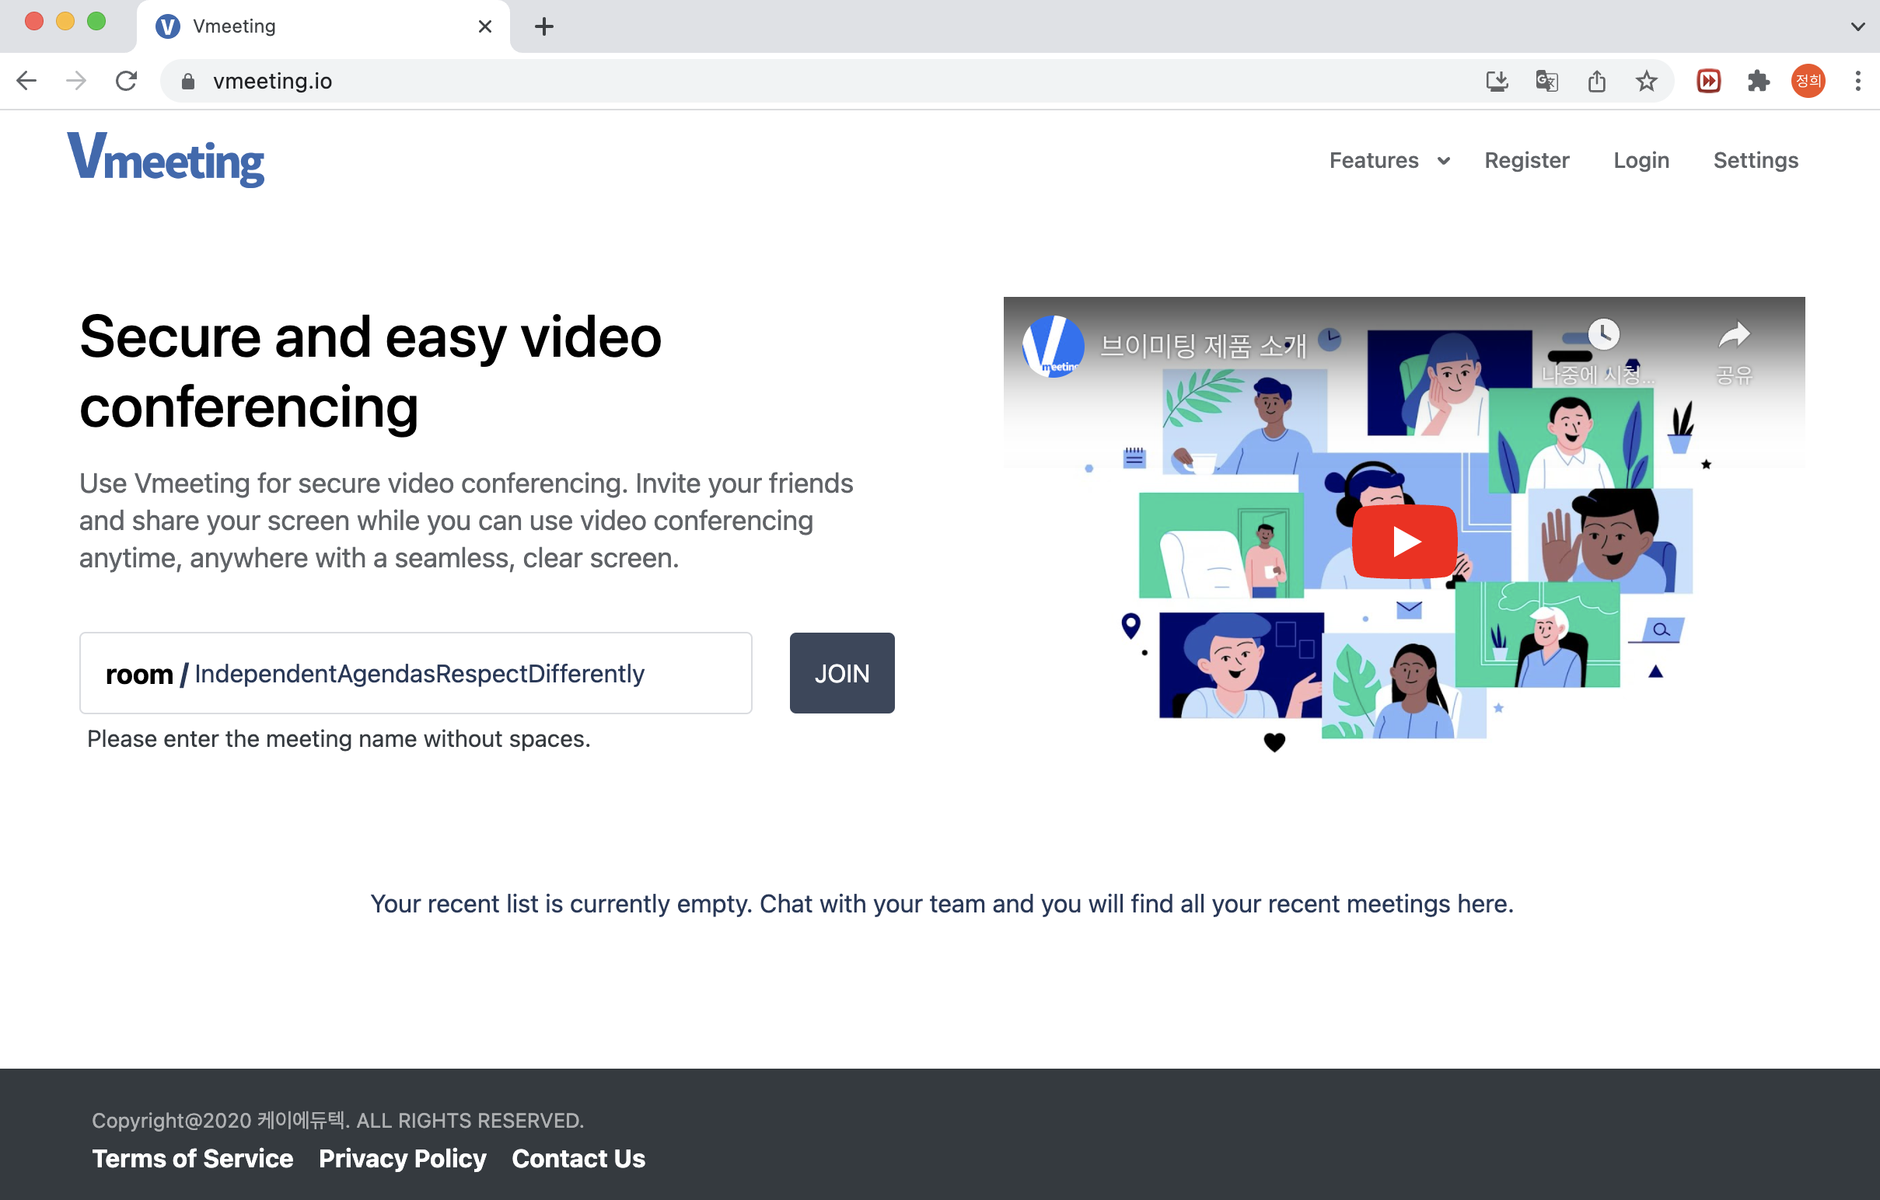
User Guide
English
v2.2
Start Vmeeting
PC Guide
Start Vmeeting and Introducing Vmeeting
Launch Vmeeting at vmeeting.io!
URL : https://vmeeting.io/
Vmeeting supports both Windows and MacOS.
We highly recommend using Chrome browser for Windows Users and MacOS Users.
Register or login to access meeting setting & controls and main features.
Users can also host meetings or view meeting history.

Slide 5
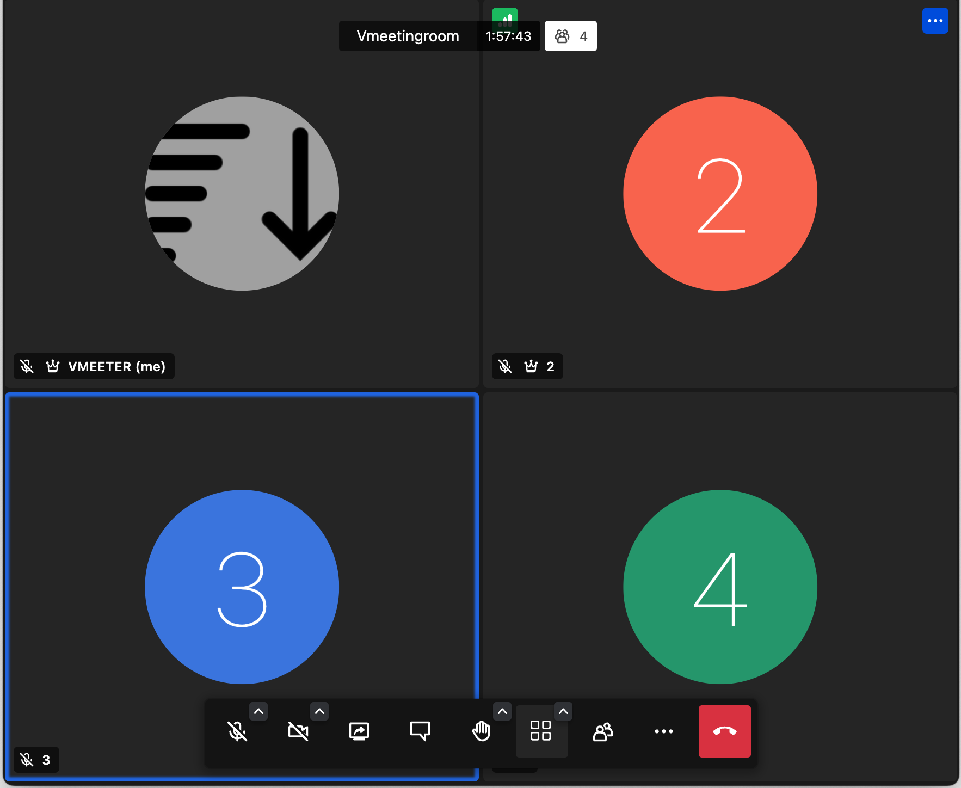

Meeting screens and features
Vmeeting is optimizing for user convenience and easier control.
Participant Network Info
Meeting name, meeting time
Participant control menu
Participant name, state
Statistics
Mute on/off, sound settings
Leave meeting
chat
Setting, Background, Recording, and more
Camera on/off, camera settings
Raise hand,
Reaction emoji
Participants (moderator control)
Share screen, presentations
Screen layout ,
Tile view settings

Slide 6
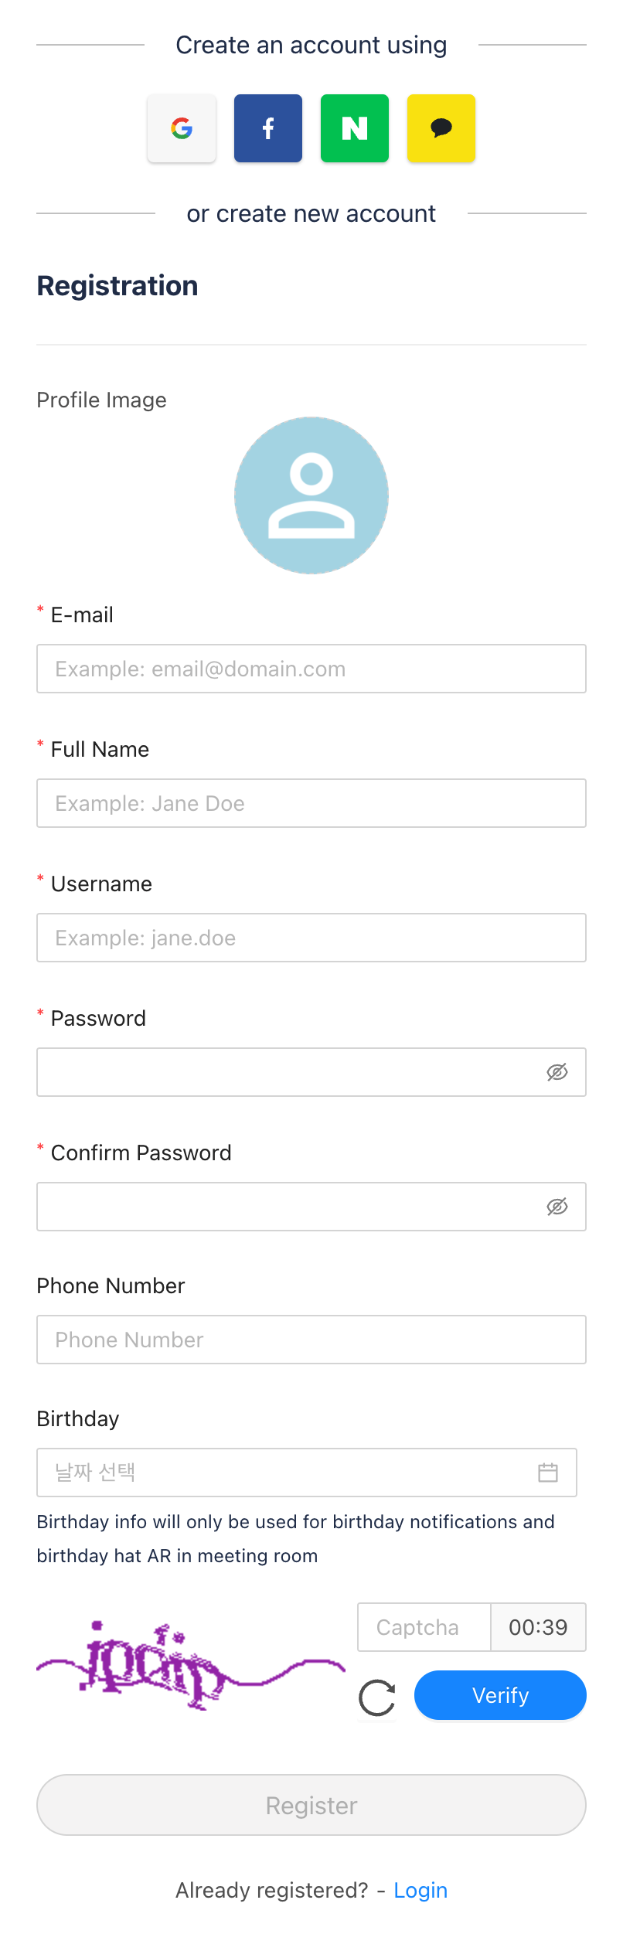

User Guide
English
v2.2
Create New Account & Login
PC Guide
Creating new account
You can either create an account with us or use Single Sign On (SSO) service to log in.
- Use Single Sign On (SSO)
1. Click [Register]
2. Select a service account you wish to sign in with
3. Enter email(ID) of the service and password
- Register with us
1. Click [Register]
2. Enter your name, e-mail, username, and password
3. Enter Capcha and click [Verify]
4. Click [Register]
Please make sure to use a valid e-mail address as:
URL for recorded meetings will be sent to this e-mail
URL for Password Reset Verification will be sent to this e-mail

Slide 7
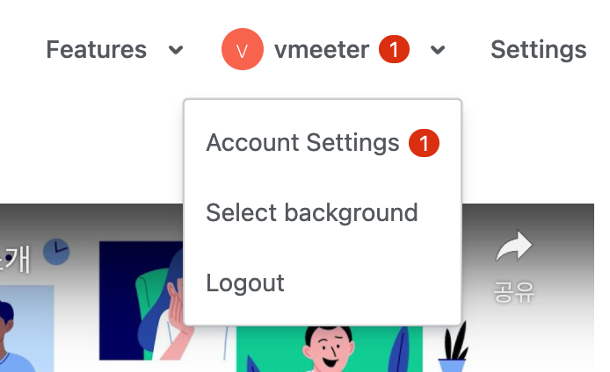
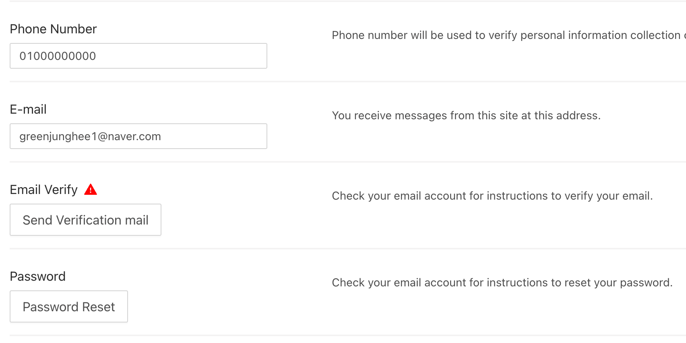
E-mail Verification
E-mail Verification is required after user registration.
Please proceed by clicking [Account] - [Account Settings] - [Send Verification mail].
- Red triangular icon will appear next to the username if the user’s e-mail is not verified.
- [Send Verification mail] will be deactivated after verification.
When using Single Sign On, email verification is completed automatically.
Account Settings & Membership Withdrawal
Click [Account] - [Account Setting] to update user Information.
Users may click [Membership Withdrawal] to permanently stop using Vmeeting.

Slide 8
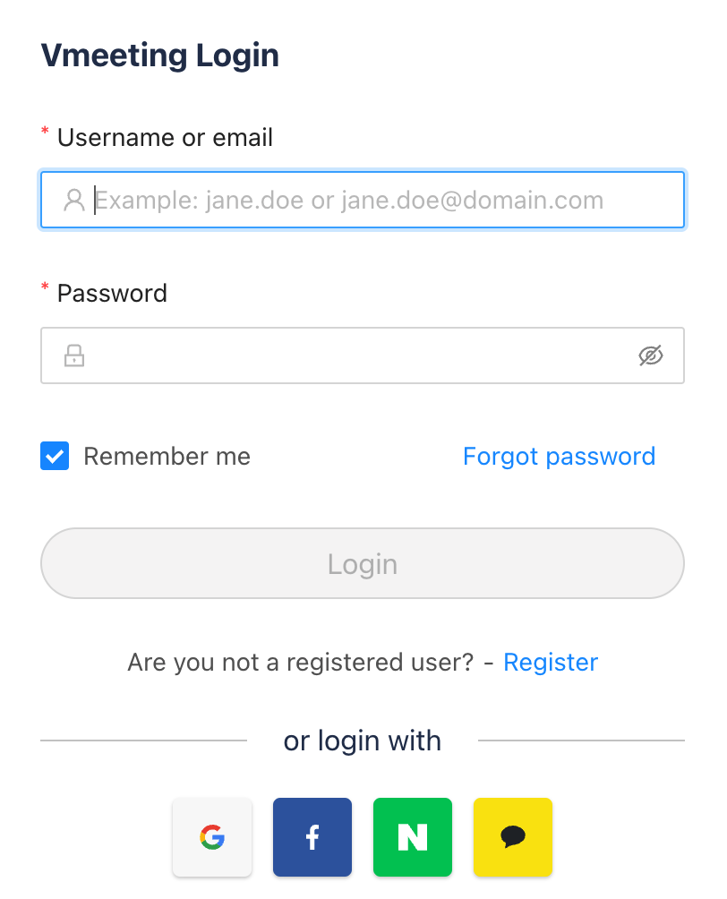
Log in (Single Sign On)
All users must login to host new meetings.
You can either log in with the account you have created with Vmeeting OR through other services via Single Sign On.
If you have forgotten your password, click
[Forgot password] to reset your password.
Users can participate meetings without logging in.
If you have forgotten your username and email, please create a new account.

Slide 9
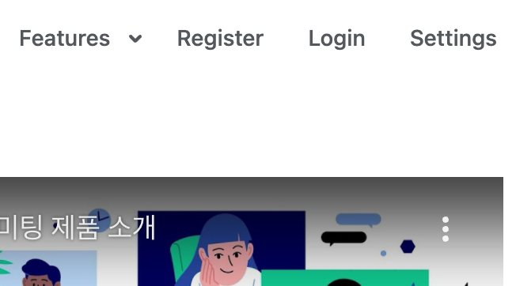
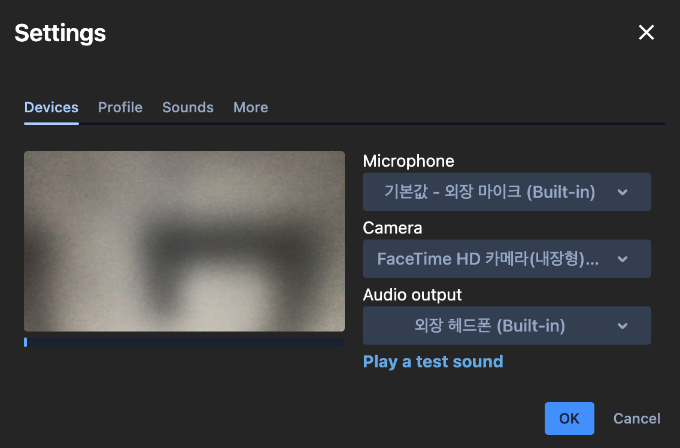
User Guide
English
v2.2
Settings
PC Guide
Settings
Users can select and change settings for the meetings.
Select [Settings] to adjust settings for devices (microphone, camera, speaker), profile, notifications, etc.
Users can also moderate settings during meetings by selecting [More] - [Settings] from the navigation panel.
Device
Select and set camera, microphone, and speaker devices for future meetings.
Includes:
Screen Preview to test camera
Audio Input to show audio gauge
[Play a Test Sound] to test speaker of the devices

Slide 10
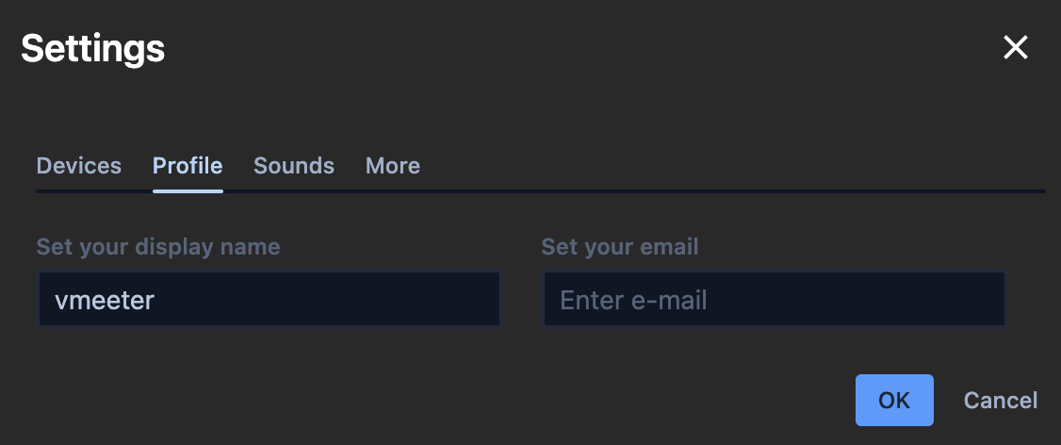
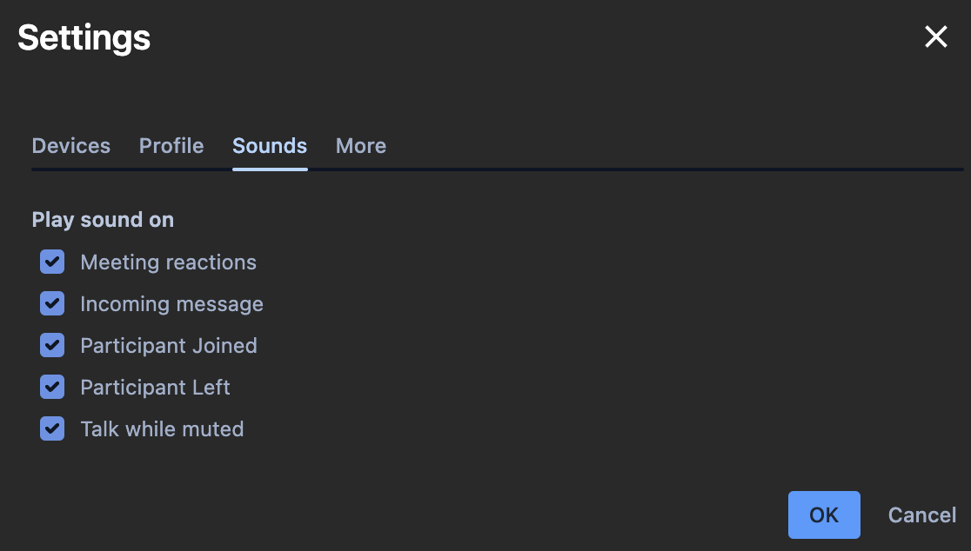
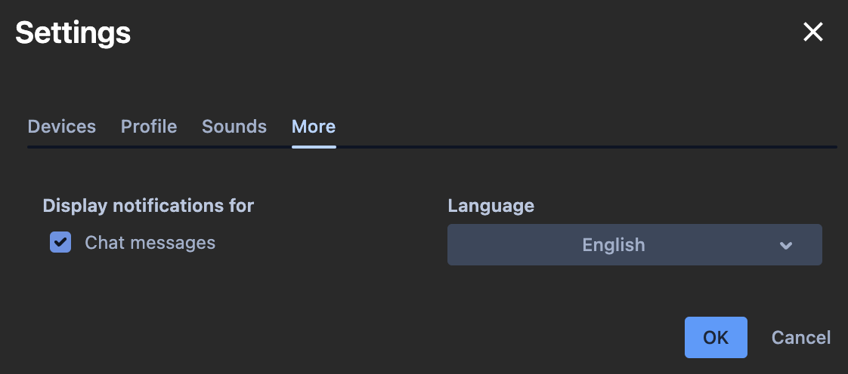
Profile
Users can edit display name and e-mail:
Display Name : Title to be used during meeting
Email : Contact information to be used during meeting
Sounds
Users can turn on notifications for various events including:
Meeting Reactions
Incoming Message
New Participant Arrival
Participant Exit
Talk while muted
More
Other setting options includes:
Chat Messages: Turn on/off notifications for chat messages
Languages : Select languages for Vmeeting

Slide 11
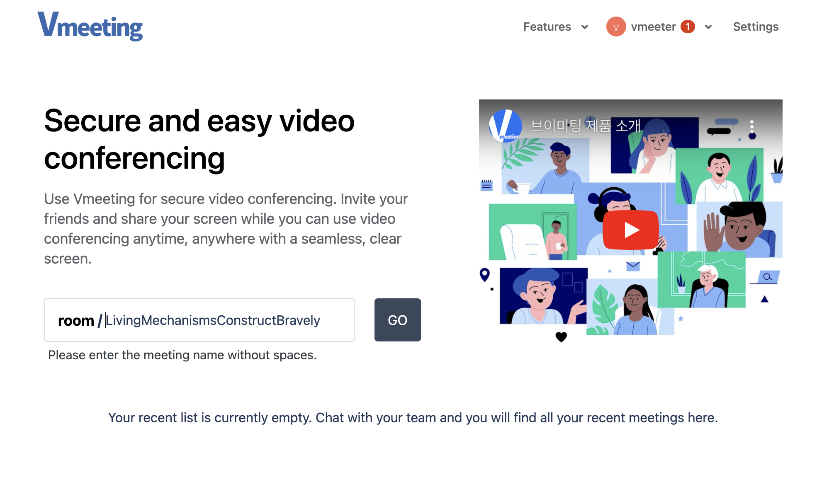
User Guide
English
v2.2
Host Meetings & Invite Users
PC Guide
Start Conference
Users can host meetings on web without any additional downloads.
Simply enter conference name and click [Go] to host a meeting.
※ Please note that if there has already been the same conference name previous created, an existing conference will automatically re-open.
※ Users must register or login to host a meeting.
All conference names must be combinations of numbers, Korean alphabet, alphabet, and ’_’ (underscore).
Random name will be assigned to meetings without names.

Slide 12
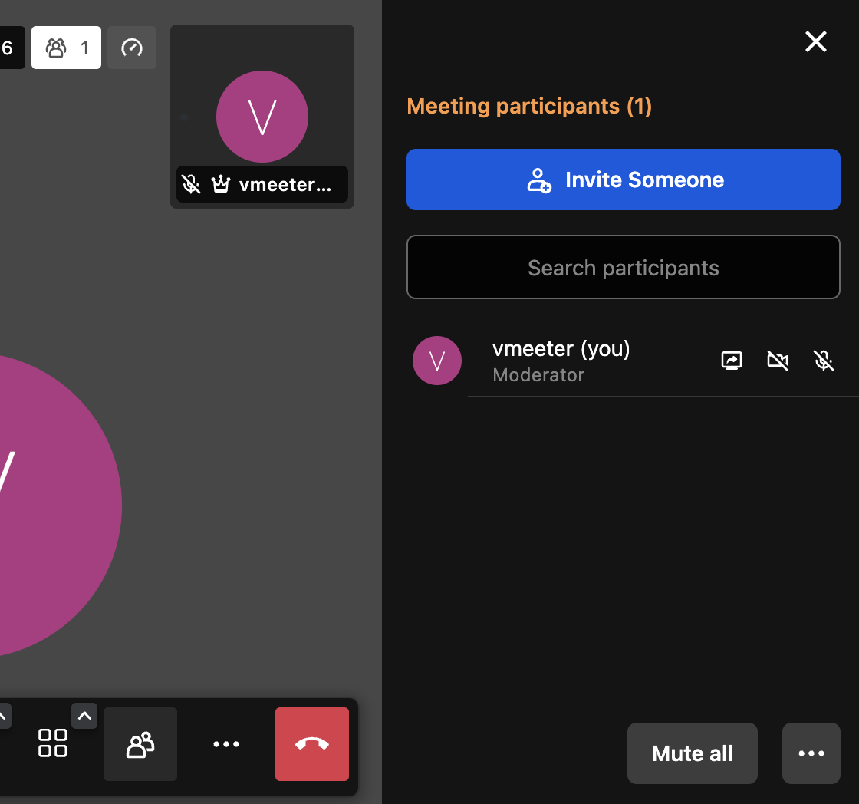
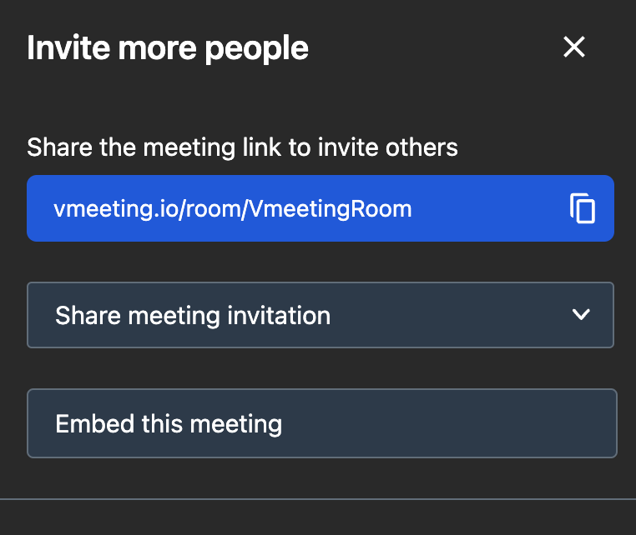
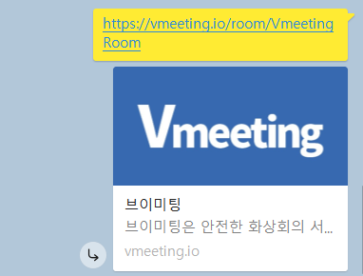
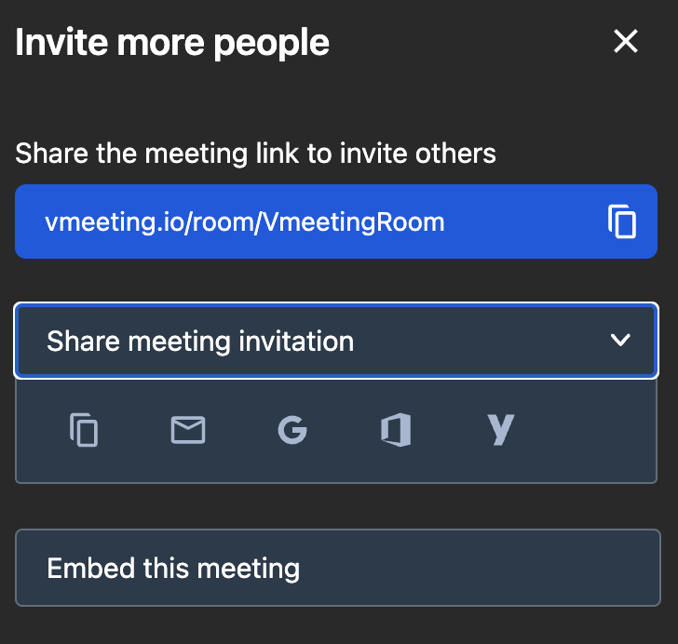
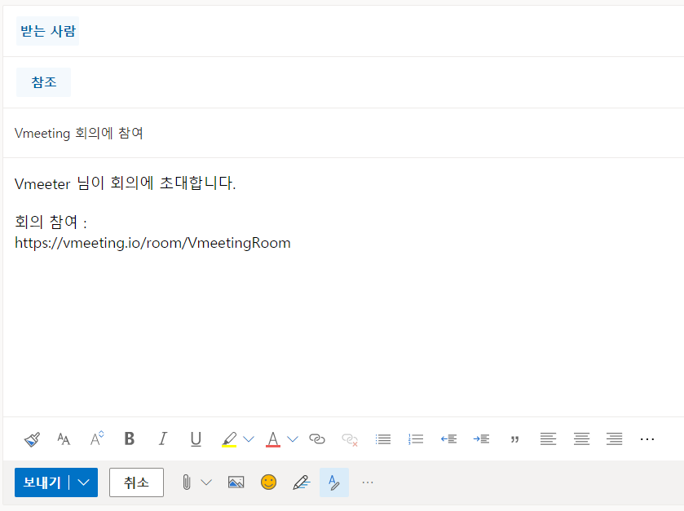
Invite Others
Select [Participants] from navigation panel and click [Invite Someone] to invite more participants.
Copy meeting link to share via KakaoTalk, LINE, etc. Participants can use link to directly join meeting.
Users can also share meeting invitation via email.
* For more information, refer to ‘More – Embed Meeting'

Slide 13
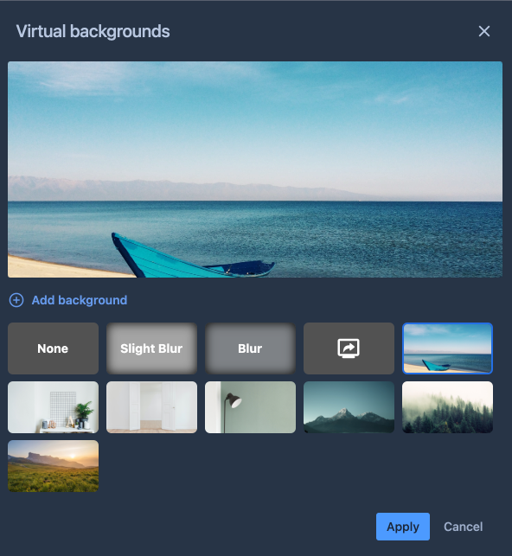
User Guide
English
v2.2
Set Virtual Background
PC Guide
Select Background
Vmeeting allows users to set virtual background for conferences.
Select [Account] - [Select Background] to set or upload more images for virtual backgrounds.
Users can also modify background image during meetings at [More Actions] - [Select Background] on the navigation panel.

Slide 14
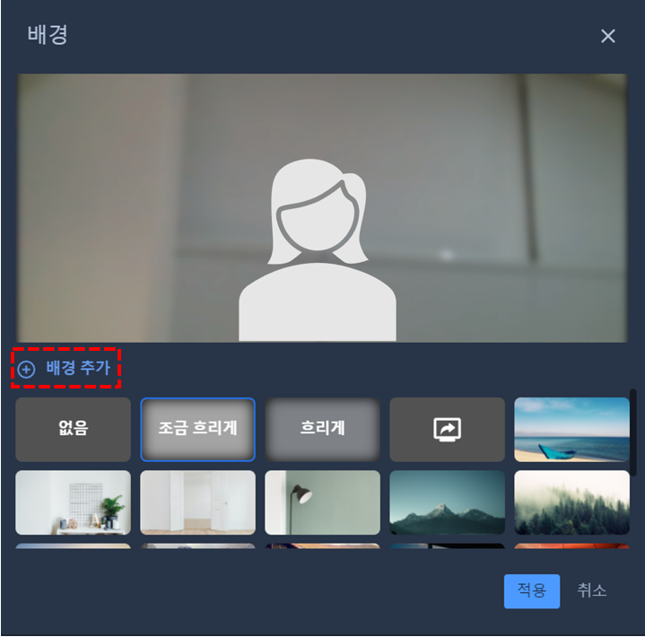
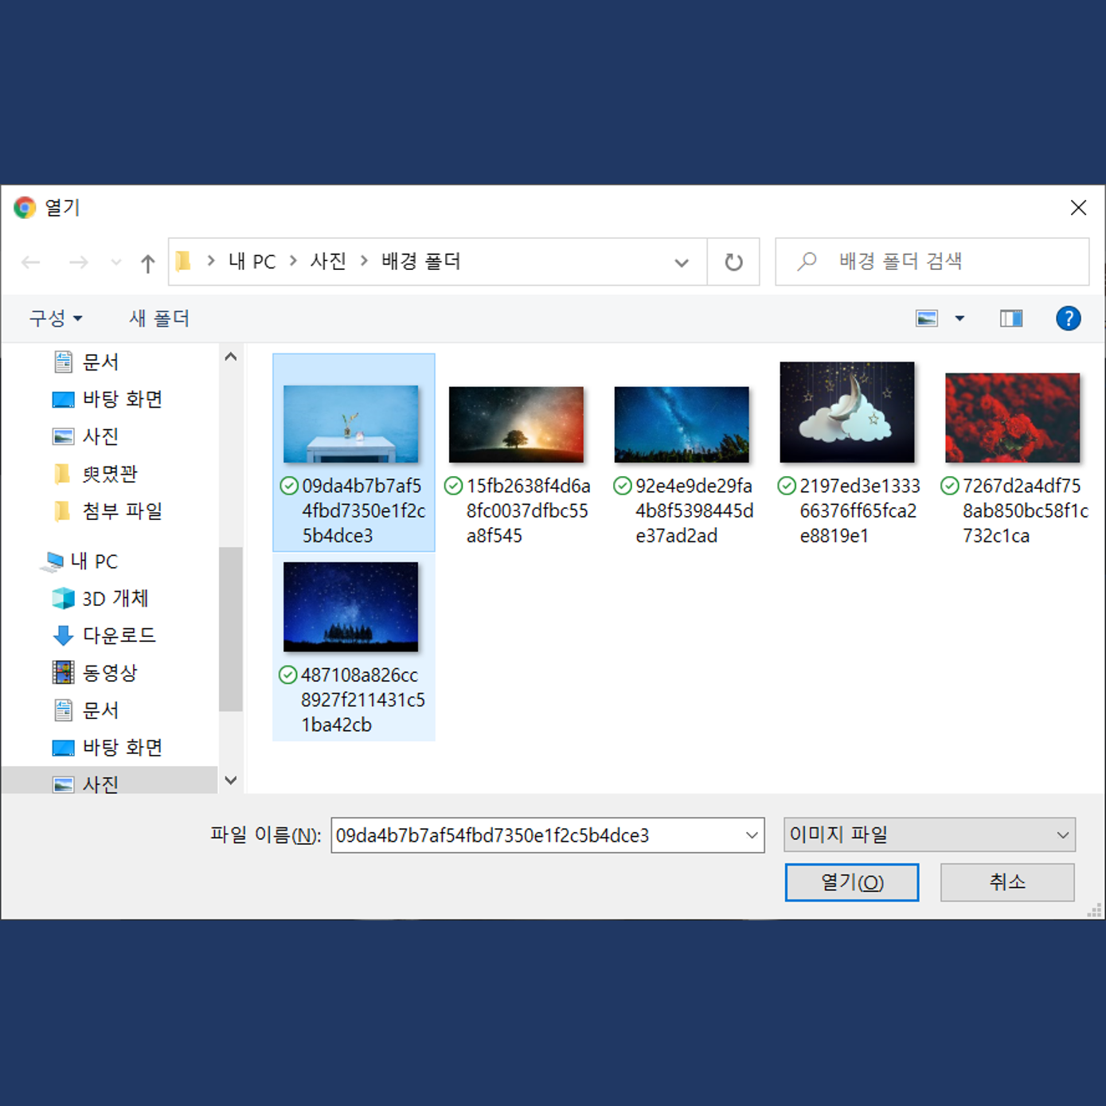
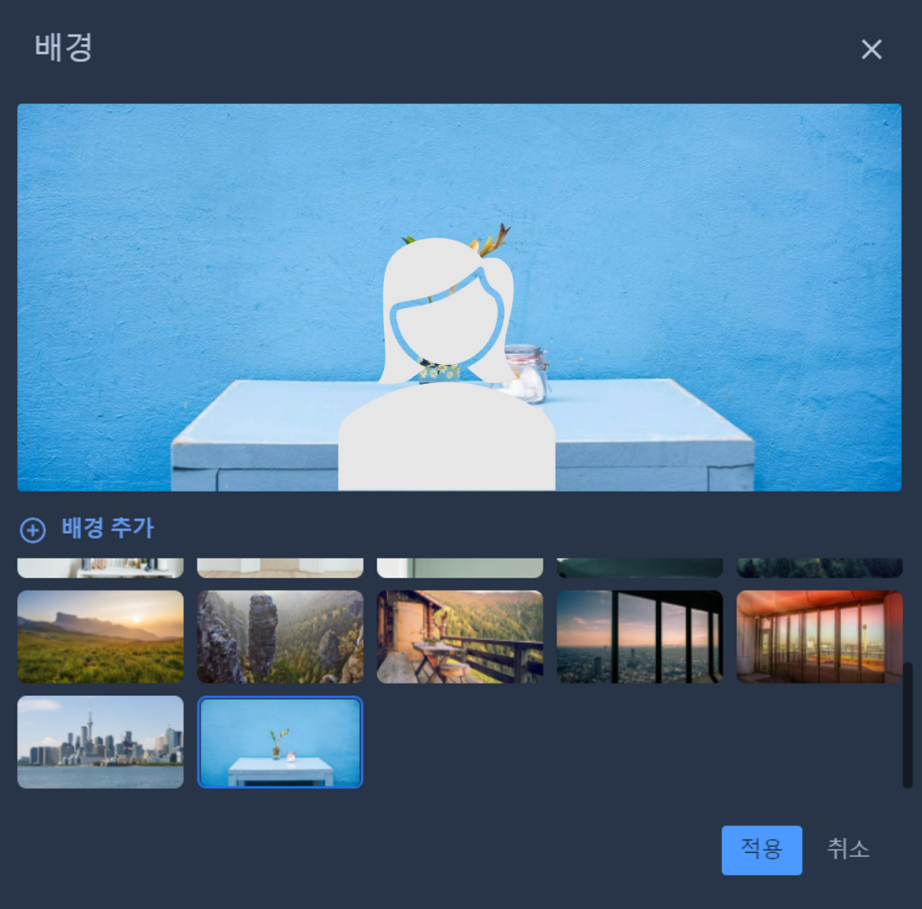
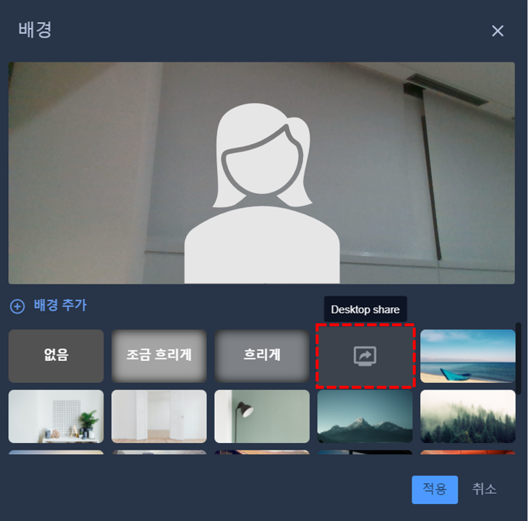
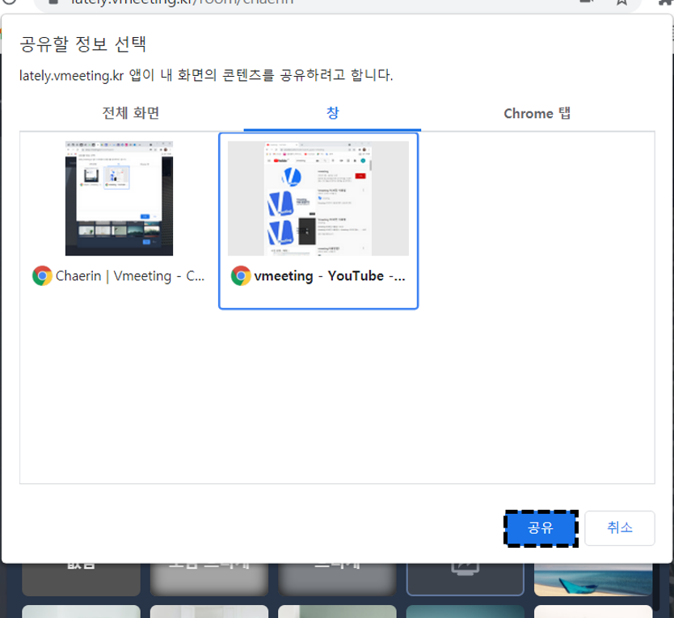
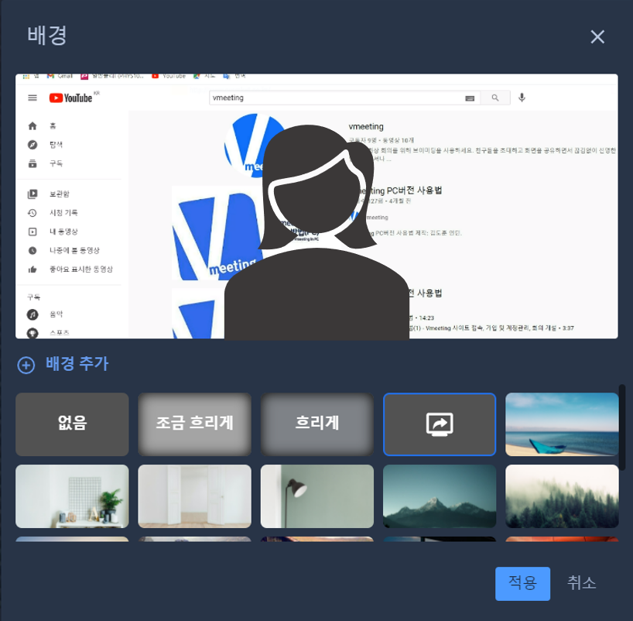
Add Background
Select [Add Background]
2. Choose Desktop Folder
3. Choose image to upload
4. Click [Open]
5. Confirm added image
6. Select image and click
[Apply]
Shared Screen as Background
1. Select [Desktop Share]
2. Choose what to share
among Entire screen,
Window or Chrome Tab
3. Click [Share]
4. Confirm that shared
content appears as
background
5. Click [Apply]

Slide 15
Utilities

Slide 16
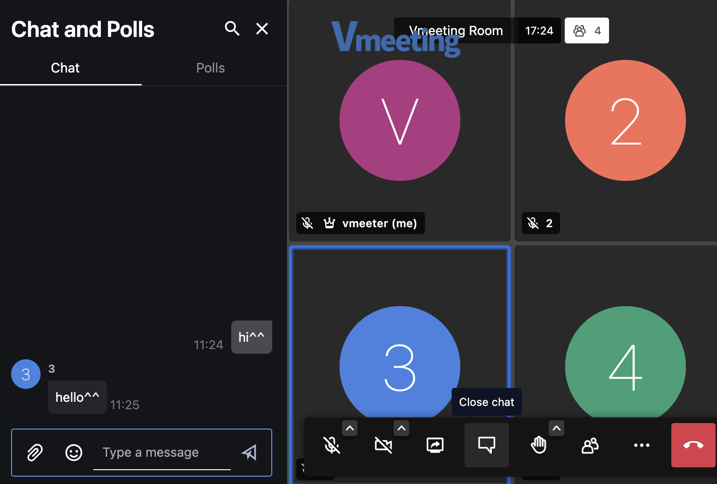
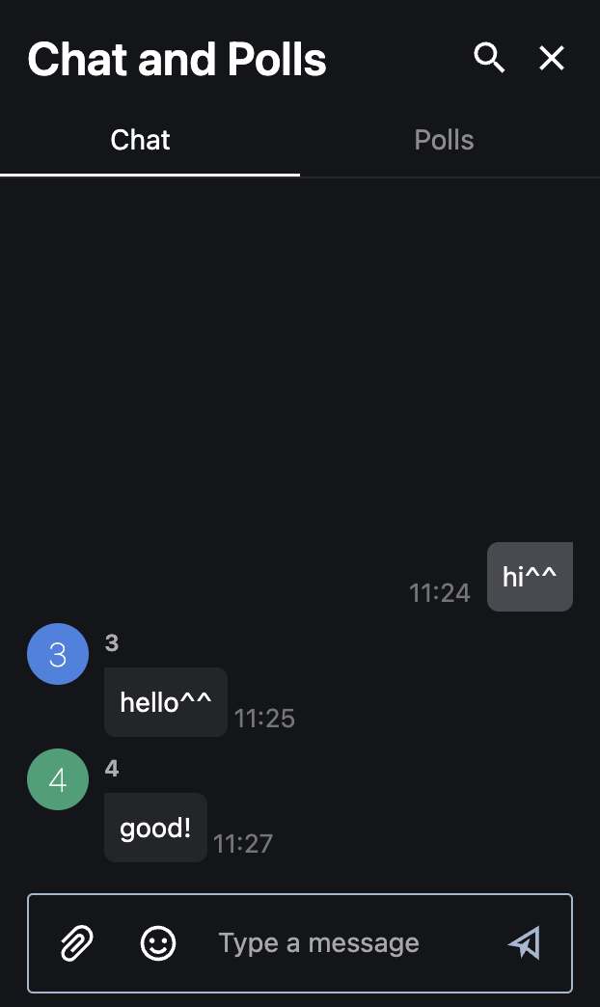
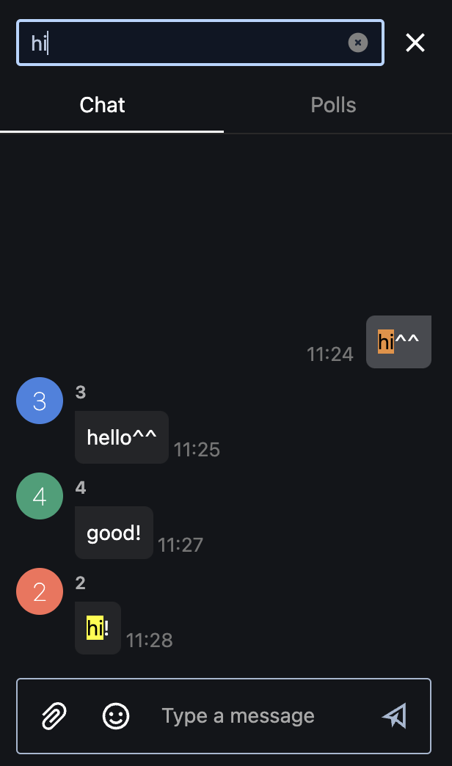
User Guide
English
v2.2
Chat and Polls
PC Guide
Send Messages
Users can send messages to all participants or send private messages to individuals.
Select [Open/Close Chat] from dock to toggle Chat panel.
Search Messages
Users can search keywords by clicking the search icon located on top of the Chat panel.
Search keywords will be highlighted in yellow.
-Orange indicates current
position.
-Press enter key to
continue searching.
16

Slide 17
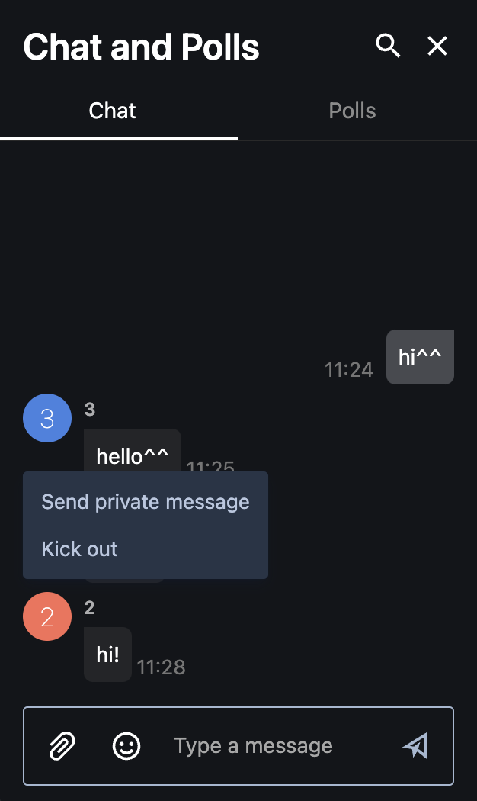
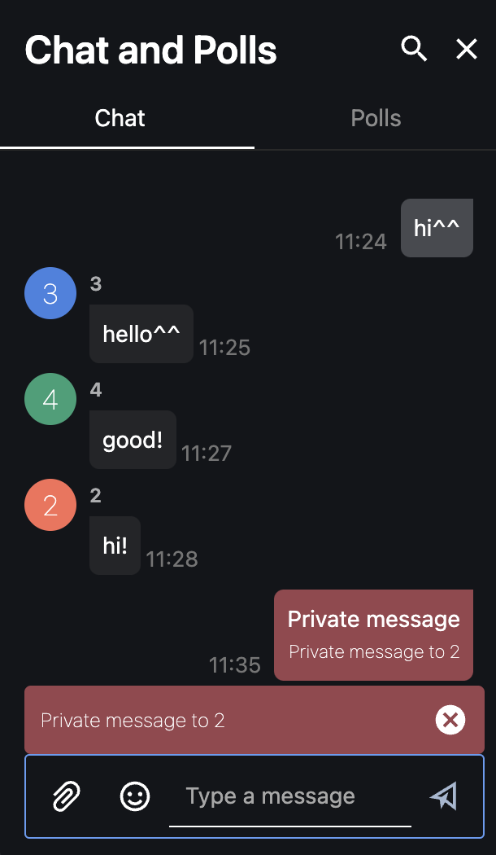
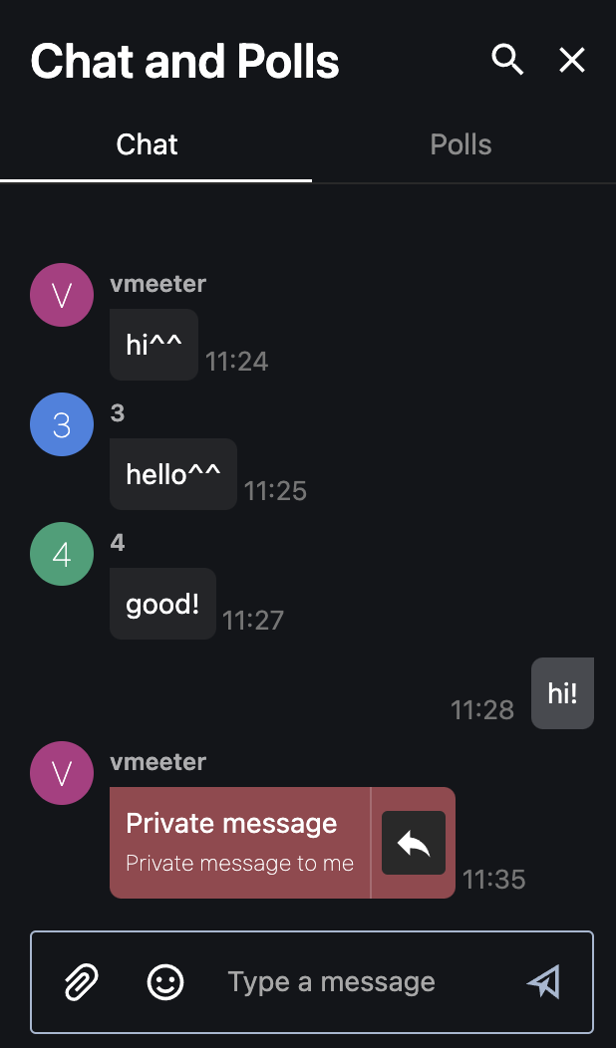
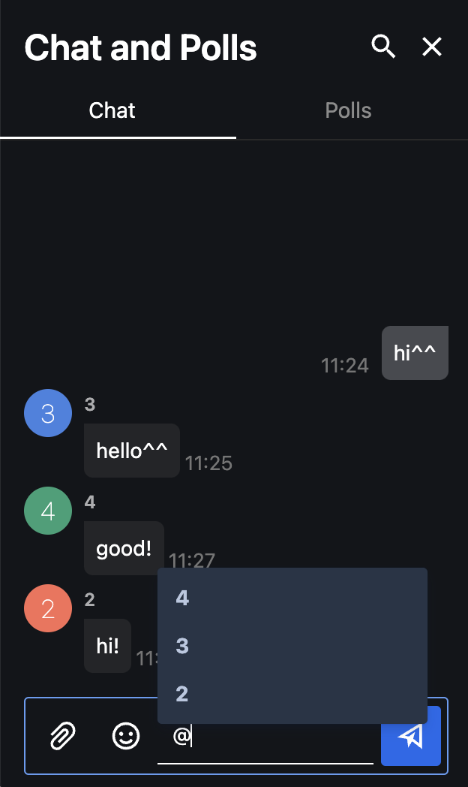
Send Private Messages
[Sending Private Messages]
[Receiving]
Users can send private messages by typing ‘@’ and either type in or select the user(s) they wish to send private messages to.
Users can also send private message through Participants - [Setting(...)] - [Send Private Messages].

Slide 18
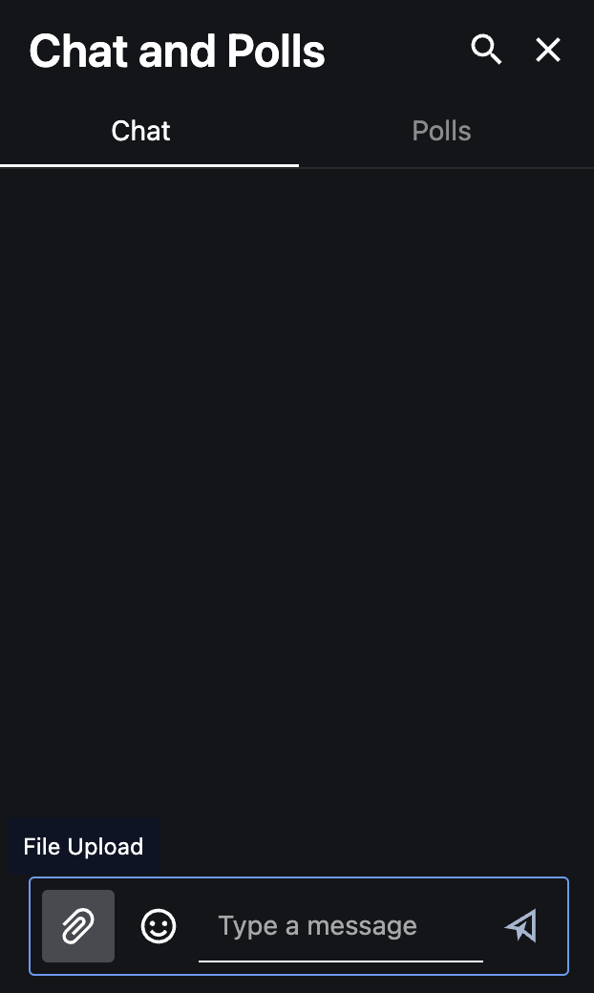
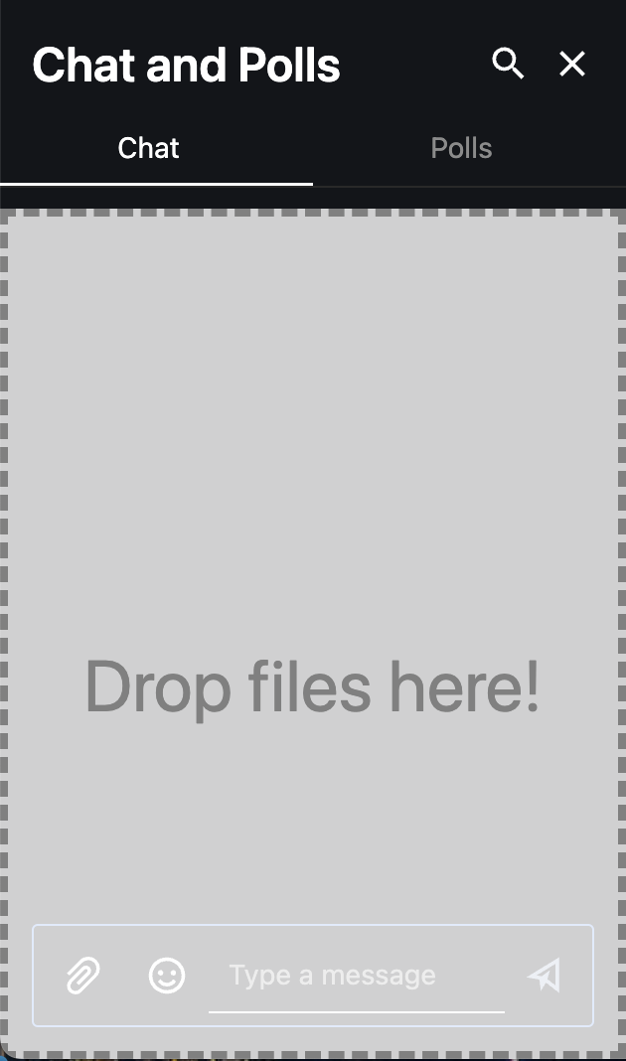
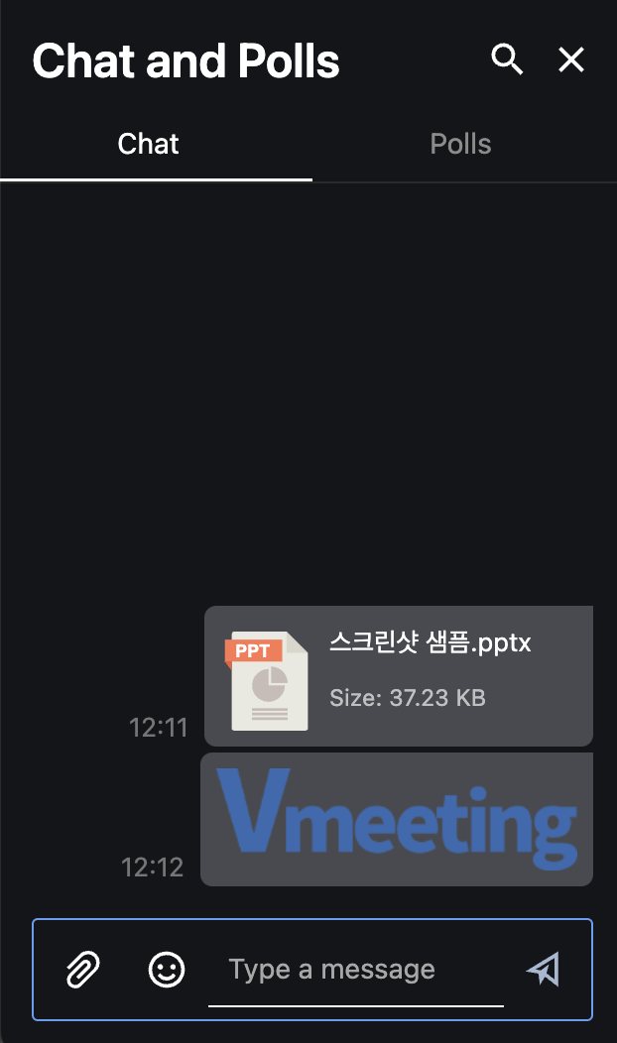
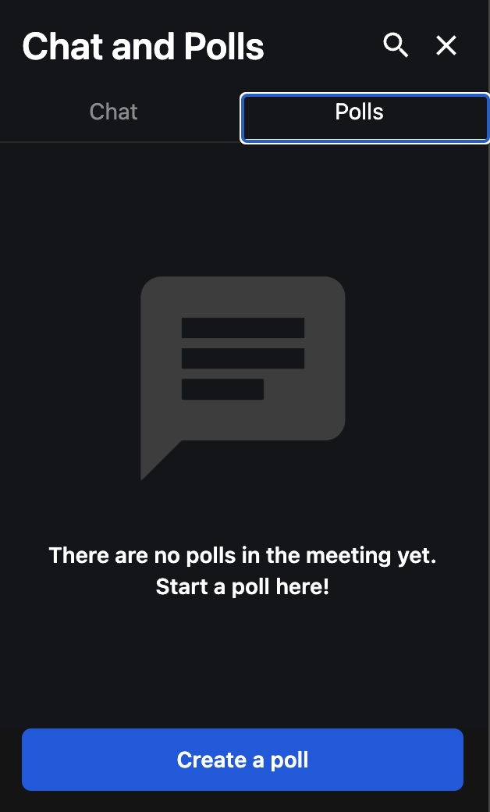
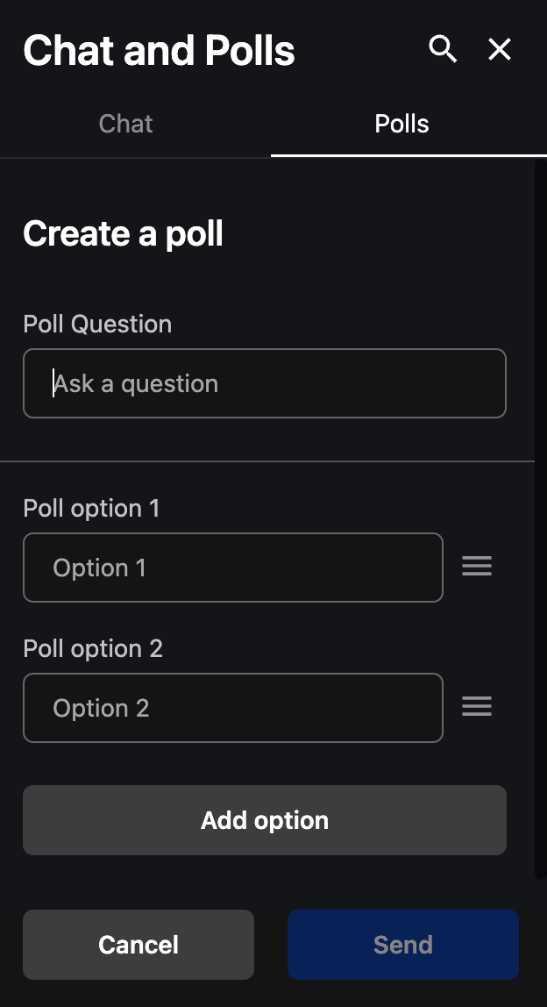
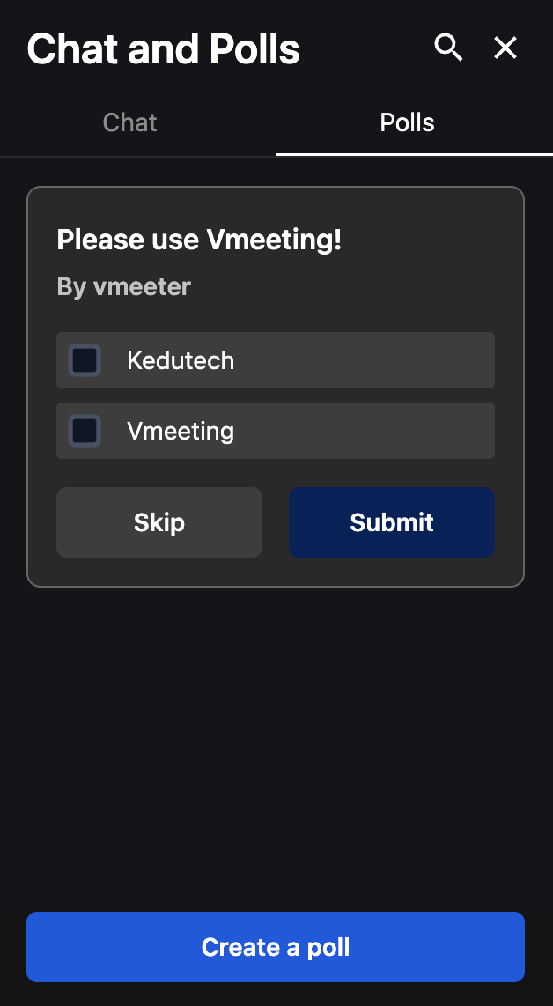
Send and Share Files (Documents, Pictures, Videos, etc..)
[Sharing Files]
[Downloading Files]
Users can share files to other participants by select [File Upload] Icon or Drag and Drop files to chat. Other participants can download the files by clicking the uploads.
Create a Poll
Users can create polls by [Open Chat] – [Polls]tab – [Create a poll] – Enter Poll Question and option(s)– [Send]

Slide 19
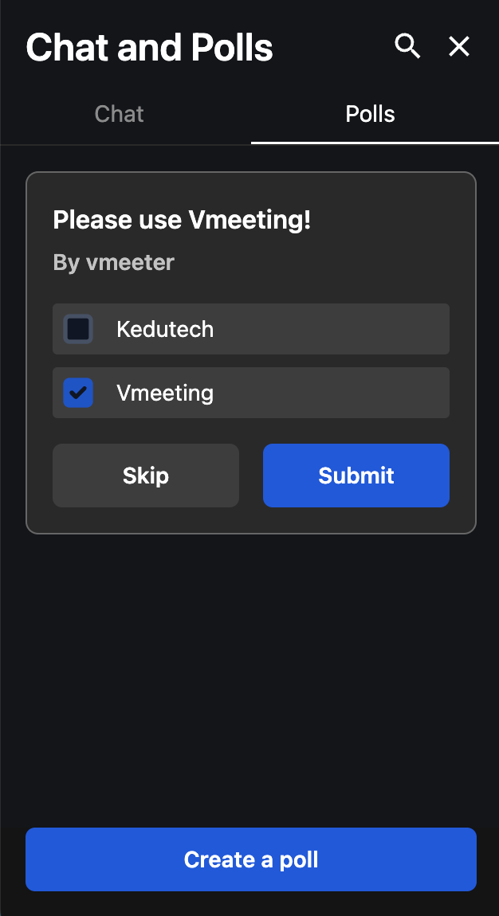
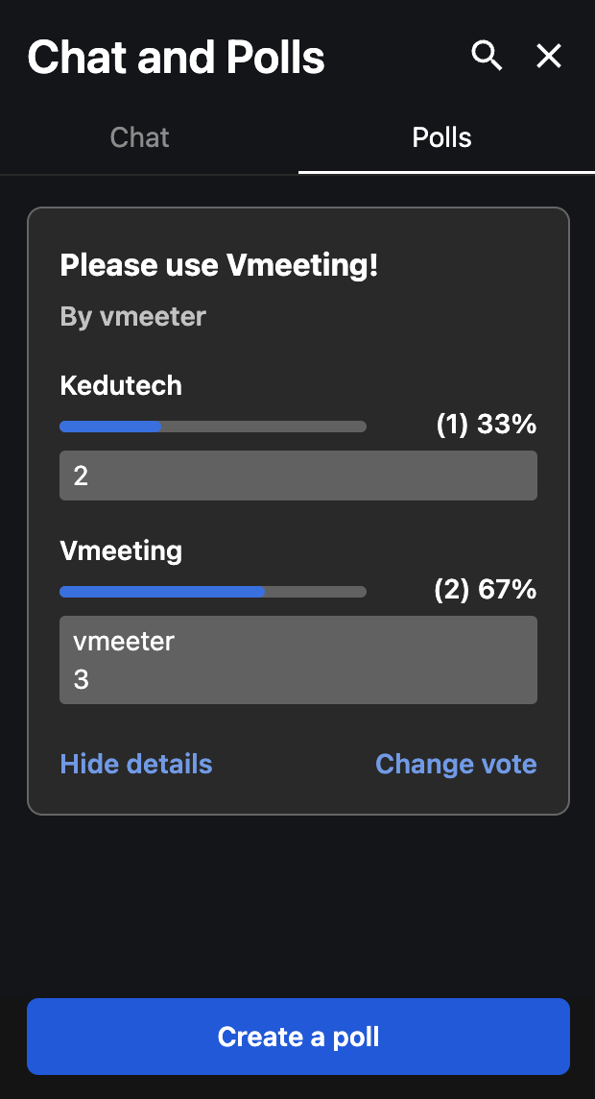
Vote/ Show Results
Voting will be completed once the user select options(s) and click [Submit]. Users can change vote by selecting [Change Vote].
Click [Show/Hide Details] to see results in more detail.

Slide 20
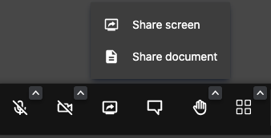
User Guide
English
v2.2
Document Sharing
PC Guide
Document Sharing
Users can share their documents and write or draw on them in real time.
All users can participate to write and draw simultaneously.
When a user starts/ends sharing document, this will be reflected on all other user’s screen.
The shared document, as well as overwritten contents, will be available to download during the meeting. Once the meeting ends, they will be deleted permanently.
- Document Sharing
1. Click [Toggle Document/Screen Sharing]
2. Click [Share Document]
End Document Sharing
1. Click [Toggle Document/Screen Sharing]
20

Slide 21
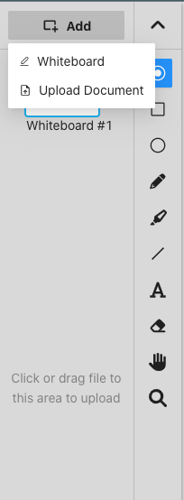
Upload Document
Users can upload documents by clicking [Add] - [Upload Document] or [Drag and Drop]. Users may also simply open a whiteboard without sharing documents.
All other participants can draw or write on the shared documents or on a whiteboard, which will be reflected on the screen in real time.
* Whiteboard will be restricted if the user is disabled for [Document Sharing] by host.
(See [Host Controls])
- Add
1. Click [Add]
2. Click [Upload Document]
3. Select a file from [Browse Files]
Or
Drag and Drop the document file you wish you to share in the Blue area
- Open Whiteboard
1. Click [Add]
2. Click [Whiteboard]
- Compatible document format and size limit
1. Document Size : Up to 100MB
2. Compatible File Formats:
PPT, PDF, XLS, DOC
PNG, JPG, BMP, GIF

Slide 22
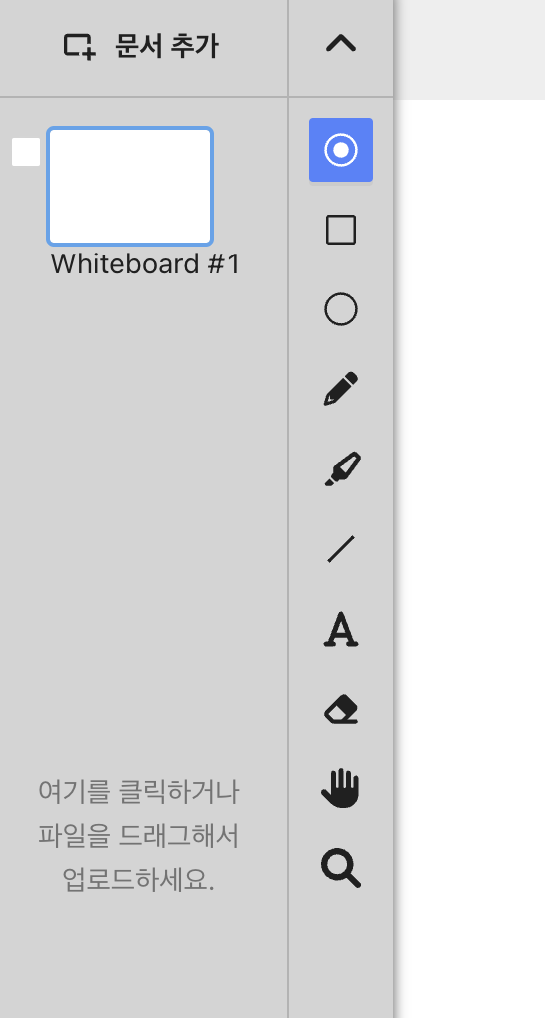
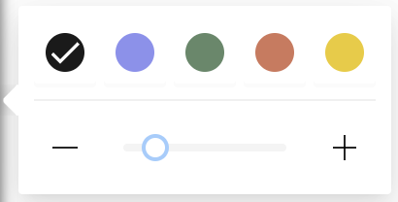
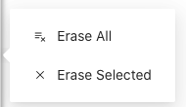
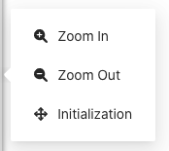
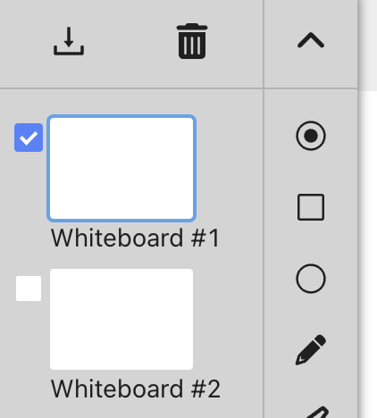
Tools
Tool Bar Open/Close
Color Options
Laser Pointer
Rectangle
Circle
Pen
Line Thickness
Highlighter
Line
Text
Eraser (All/Selected)
Hand
ZOOM IN/OUT
Download / Delete
Once you tick the checkbox next to the document, download or delete icons appear.
- Download
Download will start once you tick the checkbox and click [Download].
Documents with the overwritten components are converted into PDF to download.
- Delete
Document will be deleted once you tick the checkbox and click [Delete].

Slide 23
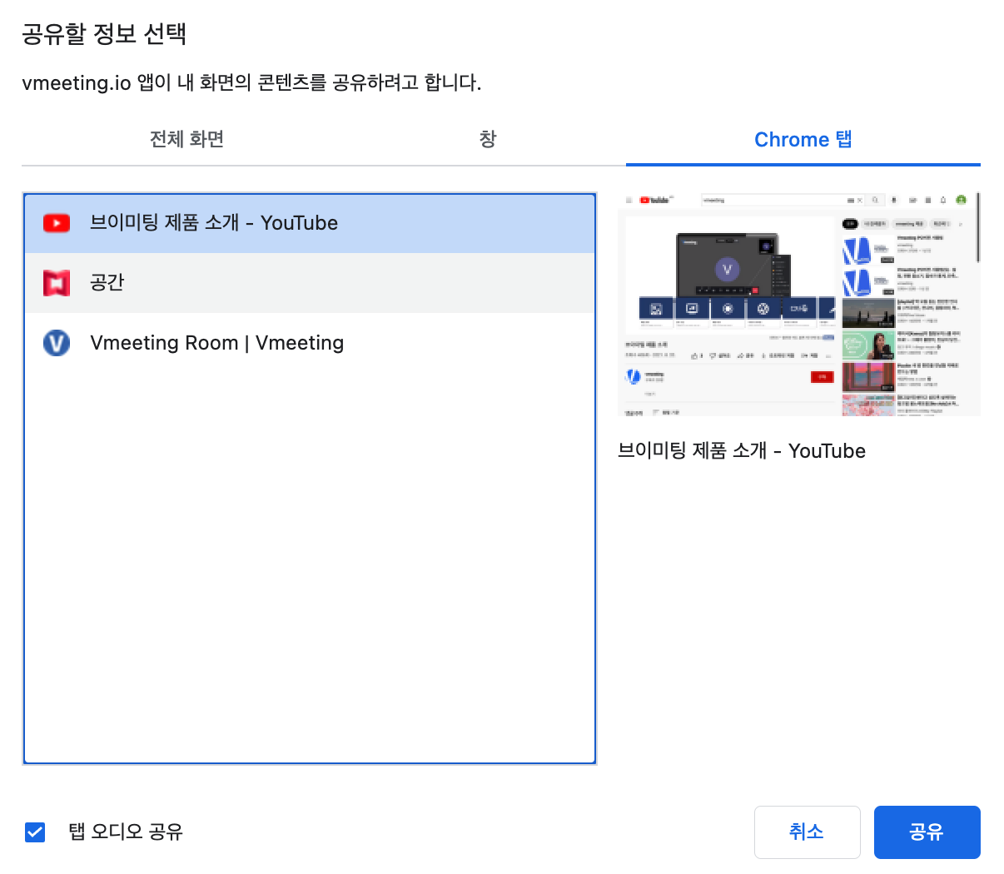
User Guide
English
V2.2
Screen Sharing
PC Guide
Screen Sharing
Users can share screen, documents, video, web browser, etc. with other participants during meeting.
- Enable Screen Sharing
1. Click [Toggle Document/Screen Sharing]
2. Click [Share screen]
3. A window will pop up to ask what to share
4. Select contents to share from the Share Tab
(Tick [Share Tab Audio] to share audio as well)
5. Click [Share]
- End Screen Sharing
1. Click [Toggle Document/Screen Sharing]
※ All sound, including shared audio, will be muted in case sharer toggles [mute].
23

Slide 24
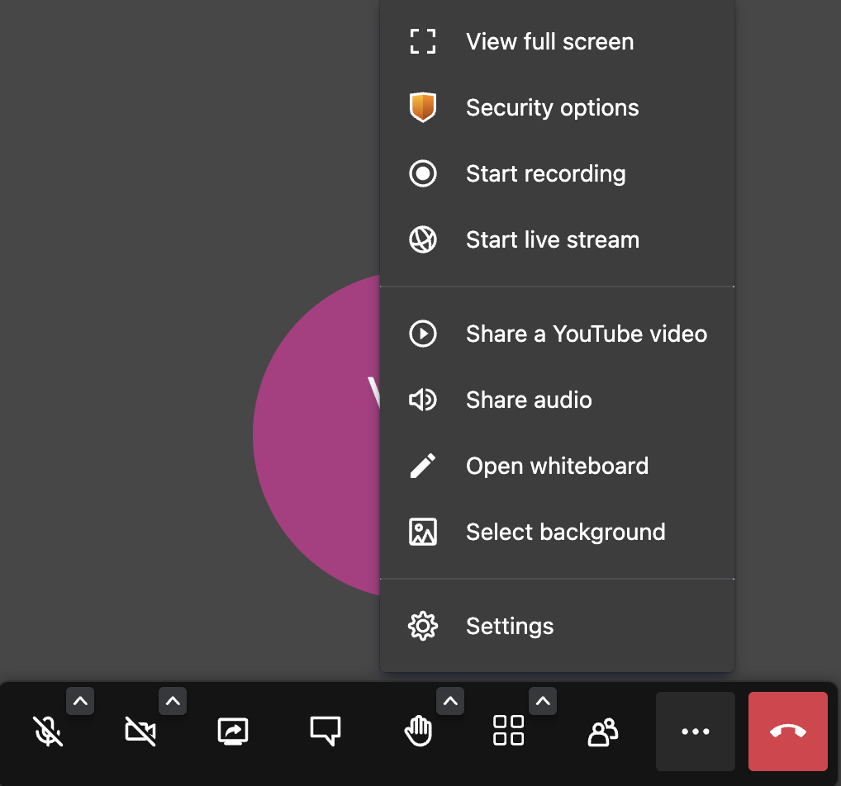

Sharing Youtube Video
Users can also share Youtube videos along with participants.
- Start Sharing YouTube Videos
1. Click [More Actions]
2. Select [Share a Youtube Video]
3. Enter Youtube link
4. Click [Share]
5. Share video with participants
Stop Sharing YouTube Videos
1. Click [More Actions]
2. Click [Stop Video] or
or click [Stop] from browser’s sharing notification
Sharer can manage audio, play/pause, video position, etc. for all participants.
Please note that there may be some delays between sharer and viewers.

Slide 25
Audio Sharing
Users may share audio with participants.
- Start Audio Sharing
1. Click [More Actions]
2. Click [Share Audio]
3. Select audio to share
4. Make sure to check the [Share Audio] option
5. Click [Share]
- Stop Audio Sharing
1. Click [More Actions]
2. Click [Stop Audio Sharing]
Or click [Stop] from sharing notification
※ ”Couldn’t share system audio!” message is displayed when user attempts audio sharing without checking the [Share tab audio] option.
※ All sound, including shared audio, will be muted in case user toggles [mute].

Slide 26


User Guide
English
v2.2
Video & Audio Setting
PC Guide
Microphone
Click [Mute/Unmute] to toggle microphone settings.
When [Mute], the icon changes accordingly and audio is not shared to other participants.
Click [^(audio setting)] to alter microphone and speaker settings.
Camera
Click [Start/Stop Camera] to toggle camera settings.
When [Stop Camera], the icon changes accordingly and video is not shared to other participants.
Click [^(camera setting)] to alter camera settings.
26

Slide 27


User Guide
English
v2.2
Participants
PC Guide
View Participants
Click [Participants] to open/close participant list.
Users can check participants status (mic, camera, screen share) and invite others from this panel.
27

Slide 28

Participants- Invite User
Click [Invite Someone] to copy meeting URL, send e-mail invitation or embed meeting using HTML.
For more information, see the "Creating and Inviting Meetings" page.
Participants- Utilities
Users can send private messages to other participants at Participants - [Setting(…)].
Hosts can access additional features. Further information is available at ‘Host Authorities’.
* More information on ‘Messaging’, ‘Host Authorities’.
28

Slide 29


User Guide
English
v2.2
Statistics
PC Guide
Speaker Stats
Users can access participation statistics for each user.
This can be viewed by clicking the people icon on top.
※ People icon is displayed only when more than 2 users have participated the meeting.
29

Slide 30




User Guide
English
v2.2
Layouts
PC Guide
Toggle Tile-View
Users can adjust screen layouts according to the type and size of meeting.
Tile-View : Can view all participants at once
Change to tile view by clicking [Toggle Tile View] from the bottom menu bar.
Lock Mode : Can lock specific participant by selecting their screen or selecting the person from participant list ( A pin icon will be shown on the participant list)
Speaker Mode : automatically shows the current speaker
(This mode only works when neither Tile-View mode or Lock mode is enabled)
30

Slide 31



Mirror Screen
Click [Settings(...)] - [Flip] on mini-view tile to mirror your screen.
Please note that flip does not mirror other participant’s view.
Thumbnail Settings
Click [Settings(...)] to access [Send Private Message] and [Sound level] for specific users.
Using [Sound level], users can adjust audio for specific users.
Hosts can access additional features. Further information is available at ‘As a Host’.
* More information on ‘chat and polls’ and ‘As a Host’.

Slide 32

Participant Information
Additional participant information is displayed as icons on Thumbnail:
- Display Name
- Audio levels (in blue margin)
- Crown icon : Host
- Microphone icon : Muted
- Network icon : Network Status (tap to access specific information)

Slide 33


User Guide
English
V2.2
Video Quality
PC Guide
Manage Video Quality
Users can optimize their video quality for meetings.
Users can set their video quality by clicking the performance icon on top. Other participants view videos of according quality.
Users may select among:
- Audio-Only (AUD, Camera is OFF)
- Low Definition (LD, 180p)
- Standard Definition (SD, 360p)
- High Definition (HD, 720p)
Please note that system may automatically downgrade video quality according to network connection.
33

Slide 34




User Guide
English
v2.2
More
PC Guide
Edit Meeting Subject
Select Edit icon on top of screen to edit meeting subjects.
※ Editing the Meeting Subject does not change the meeting URL.
Raise/Lower Hand
Users can raise hand in order to request to speak.
Toggle [Raise/Lower your hand] to request/withdraw permission to speak. Once requested, yellow hand icon and outline will appear on the participant’s tile, with total number of requests shown on top.
34

Slide 35

Invite – Embed Meeting (HTML)
Users can embed meetings on web using HTML.
This can be done by copying HTML code from [Participants] – [Invite Someone] – [Embed this meeting] and pasting it on web. Users can participate meetings on web where it is embedded.

Slide 36
As a Host

Slide 37
User Guide
English
v2.2
As a Host
PC Guide
Host Controls
Vmeeting offers various features for hosts to efficiently manage meetings and participants.
Users are automatically assigned as hosts when they start a new meeting. Users can also receive host controls from another host.
1. Screen Recording
2. Live Streaming
3. Security Options (Lobby Mode/ Password)
4. Breakout Rooms
5. Tile View Settings (Layouts, Pin Participants)
6. Set Participants Default Audio/Camera Settings
7. Toggle [Everyone follows me]
8. Remove Participant (Kick-Out)
9. Assign Participant as host
10. End Meeting for all
- Leave after assigning new host
11. Moderation Controls
- Screen share, Mute, Camera, Chat, Polls, Rename, Assign to Breakout Rooms
12. Others
- Random selection, Timer
37

Slide 38



User Guide
English
v2.2
Screen Recording
PC Guide
Screen Recording
Hosts can record and download meetings.
When recording begins, a notification and REC icon is displayed. When host stops recording, the download URL is sent to the host’s e-mail.
Start Recording
1. Click [More Actions] - [Start recording]
2. Select [Start recording]
3. When recording begins, REC icon is displayed on top. All participants receive notification that host started screen recording.
38

Slide 39



End Recording
1. Click [More Action] - [Stop Recording]
2. Select [Confirm]
3. Participants are notified that recording is stopped. REC icon is no longer displayed.
4. Host receives download URL via mail.
(Recording is automatically stopped when meeting is closed.)
※ Only YouTube Video, Audio, Screen Sharing are recorded. Chat records are not recorded.

Slide 40

User Guide
English
V2.2
LIVE Streaming
PC Guide
LIVE Streaming
Vmeeting offers live steaming on various platforms including YouTube, NaverTV, AfricaTV, and Twitch via RTMP.
Click [More Actions]-[Start live stream] to start streaming.
YouTube Streaming
Meetings can be streamed live on Youtube.
40

Slide 41






1
1. Enter YouTube (https://www.youtube.com) from separate tab
2. Click [Create (Camera icon)]
3. Select [Go live]
- User must create a YouTube Creator Studio Account and finish user verification before streaming. If this is your first streaming on YouTube, all streaming activities are limited for the first 24 hours.
4. Select [Stream] on the left panel to start streaming.
5. Edit necessary information including Title, Privacy, Category, etc.
2

Slide 42

8. Click (Default stream key) - [Copy] to retrieve stream key
9. Paste on ‘Start live streaming’ pop-up
10. Click [Start live stream] to begin streaming
3
11. Vmeeting meeting video is live streaming on YouTube
Live Streaming in other platforms
Users can easily follow similar procedures to stream Vmeeting live on other platforms.

Slide 43



User Guide
English
v2.2
Securities
PC Guide
Securities
Users can toggle lobby mode or lock meeting rooms for security purposes.
- Lobby Mode : Only participants that the host approves can participate meetings.
- Set Password: Participants can only join after password verification
Lobby Mode
- Lobby Mode Setting
Click [More Actions]
Click [Security Options]
Security Options window
Enable Lobby – Switch on/off
- Green(v) : Lobby Mode activated
- Gray(x) : Lobby Mode deactivated
- Request to join the participant meeting
Once lobby mode is activated, participants must [Ask to Join], and can only join after host approval.
If host disapproves participation, user is automatically sent back to lobby and notified.
43

Slide 44


Set Password
- Set Password
1. Click [More Actions] -
[Security Options]
2. Select ‘Password' - [Add Password]
3. Enter password
4. Click [Add]
- Remove Password
1. Click [More Actions] - [Security Options]
2. Select ‘Password' - [Remove]
- Request to join the participant meeting
Once password is activated, users must enter a password to join meeting.

Slide 45


User Guide
English
v2.2
v2.0
Breakout Rooms
Breakout Rooms
PC Guide
PC 가이드
Breakout Rooms
Users can split the main meeting into separate sessions.
Host can assign participants into sessions either manually or automatically. Participants can also choose to join sessions themselves. (Please refer to Moderation Controls)
Add Breakout Rooms
Add breakout rooms from [Participants] – [Add breakout room].
Add Breakout room is a function that only the moderator can create.
45

Slide 46




Join Breakout Room
Join breakout room by clicking [Join], over the room.
moderator can enter all Breakout rooms, and participants can enter according to the permission of the moderator.
Breakout Room Options
- Auto assign to breakout rooms
Assign participants automatically by clicking [Auto assign to breakout rooms].
- Rename breakout room
Rename breakout room from [More(…)] – [Change Name].
- Remove breakout room
Remove breakout room from [More(…)] – [Remove].

Slide 47




User Guide
English
v2.2
Tile view settings
PC 가이드
Tile view settings
Users can set tile layouts and lock certain participant(s) from [Tile view settings].
- Tile Layout
Tile layout can be set from ’2 x 2’ to ‘7 x 7’.
Example)
[2x2]
[7x7]
47

Slide 48


- Pin participants
Users can select participants to lock from the participant list by ticking their name box. Once chosen, users can drag them to reorder.
- Lock method
1. Select a participant to pin from the participant list (check the checkbox)
2. Selected participants change the order by dragging
(Deselect with [X], [Reset] button)
3. Select the [Apply] button
2
1
3
Example)
[before]
[after]
※ The number of participants to be locked will automatically change accordingly.
※ Pinning is reflected to all other participants’ screen in the meeting room.
48

Slide 49

User Guide
English
v2.2
More
PC Guide
Settings – Moderator
Hosts can set and change default audio/camera settings for participants at [More Actions] - [Setting] - [Moderator]tab.
- Everyone starts muted: Everyone starts muted on joining the meeting.
- Everyone starts hidden: Everyone starts with camera turned off on joining the meeting.
- Everyone follow me: Everyone’s screen follows that of the host.
ex) If a host toggles to tile view mode, it is reflected on everyone’s screen accordingly.
Mute reaction sounds for everyone: Reactions sounds are muted for everyone
Show user name of pointer in document sharing : Host can choose to display all user’s mouse pointer with each user’s name tagged along on a shared document. To enable/disable this option

Slide 50


Mute/Disable Video for Everyone Else but a Specific User
Hosts can use [Participants] - Individual Settings(…) – [Mute everyone else] to turn OFF all audios except for that of a selected participant.
This can be also done on [Settings(…)] on user tile-view.
Mute/Stop Video for Specific User
Hosts can use [Participants] - Individual Settings(…) – [Mute] to mute, or [Stop Video] to disable video for specific users.
This can be also done on [Settings(…)] on user tile-view.
Mute All/Stop everyone’s video
Hosts can select [Participants] - [Mute all] to mute all participants or select [Participants] – [Settings(…)] - [Stop everyone’s video] to turn all cameras off.

Slide 51



Ask to unmute
Host can ask to unmute selected participants from [Ask to unmute] button/ [Participants] - Individual Settings(…) - [Ask to unmute].
Selected participants will receive an alert to unmute and will be unmuted on clicking [Unmute].
Allow Video
Host can ask to unmute video for selected participants from [Participants] - Individual Settings(…) - [Allow video].
Selected participants will receive an alert to unmute video. Video will be turned on if the participants click on [Unmute video].

Slide 52



Kick-out User
Host can remove participants from meeting. This can be done from Chat, Participants or User Tile-View.
- Chat
Select Open Chat - Setting(…) - [Kick-out] to remove user from meeting.
- Participants
Select Participants - Setting(…) -[Kick out] to remove user from meeting.
- User Tile-View
Select Setting(…) -[Kick out] from user tile-view to remove user from meeting.

Slide 53


Assign new host
Hosts can assign new host for current meeting.
- Participants
Select Participants- Setting(…) - [Grant Moderator] to assign user as new host.
- User Tile-view
Select Setting(…) - [Grant Moderator] from user tile-view to assign user as new host.

Slide 54


End Meeting for All
Hosts can select [End for All] to end meeting at exit. All participants are automatically dismissed from meeting.
Select and Leave
Hosts can also select [Leave] to assign a new host before exiting the meeting room. Remaining participants may continue the meeting with the newly assigned host.

Slide 55

Moderation Controls
Host can allow certain rights to attendees for meetings.
Moderation controls can be set from Participants – More(…).
Screen share : allows attendees to share their screens.
Unmute themselves : allows attendees to unmute without host’s approval.
Start their video : allows attendees to turn their video on without host’s approval.
Chatting : allows attendees to chat.
Create poll : allows attendees to create polls.
Change name : allows attendees to rename themselves.
Join breakout rooms : allows attendees to join breakout rooms themselves.
Document share : allow participants to share documents.
Once disabled, all other participants will
only be able to view the document and
will not be able to start and end
document sharing.
(Disable Upload Document, Download,
Delete, Whiteboard)

Slide 56


Random Selection
Users can randomly select one participant. On completion, the selected participant’s screen will be pinned. This can be used to assign a presenter, play games, etc. and is only active and when 3 or more users are present.
Use random selection from Participants – More(…) – Random Selection.
Timer
Users can set a timer. A notification is displayed when it ends.
This can be used to set a presentation duration, self study times etc.
Use timer from Participants – More (…) – Timer.

Slide 57
Etc.

Slide 58
User Guide
English
v2.2
FAQ
PC Guide
Do you need an account to use Vmeeting?
A Vmeeting account is not required for those who only participate in a meeting. However, an account is necessary to host or start a new meeting.
How do you purchase a license for Vmeeting?
Contact vmeeting-info@kedutech.kr for support.
How do you join a meeting?
You can simply join by clicking on a meeting URL or entering a meeting name at vmeeting.io.
Do you need a webcam to join a meeting?
Vmeeting does not require users to connect webcam device to participate in a meeting.
How many participants can join the meeting?
Vmeeting supports up to 10 participants for free. To host larger meetings, you must purchase a license for Vmeeting which can support up to 500 participants. Please contact vmeeting-info@kedutech.kr for more information.
How do I reset my password?
You can reset your password at [Login] – [Reset Password].
Why can’t I use some features?
Some features may not be available depending on your OS or web browser. Features may also vary between web and application.

Slide 59
My camera/microphone is not working.
Make sure that your device is connected to your PC and selected as the main video/audio input. If device is still not working, please check if it is already being used. Devices cannot be used in multiple applications concurrently. If it is not being used, please check the device accessibility at settings as instructed as below:
◼︎ Windows
Enter [Start Menu > Setting > Privacy> Camera/Microphone]
Turn on [Allow Camera/Microphone Access for this device].
3. Turn on [Allow apps to access your camera/microphone].
4. Allow access for browser under [Choose which apps can access your camera/microphone].
◼︎ macOS
Enter [Menu> System Preferences…> Security & Privacy> Privacy].
Allow camera/microphone access for browser.
How can I prevent echo during meeting?
Echo can occur when users connect meeting audio with multiple devices or when multiple users join meeting at the same location. To prevent this, make sure to leave only microphone and speaker on per meeting.
You can also minimize additional noise by turning microphone off when not speaking.
I can’t share my screen. (macOS)
If screen sharing results in an error message or black screen, please check the screen recording accessibility for browser as instructed below. Screen sharing cannot be performed without screen recording access.
◼︎ macOS
Enter [Menu> Systems Preferences… > Security & Privacy > Privacy].
Allow Screen Recording access for browser.

Slide 60

User Guide
English
v2.2
Contact
PC Guide
Customer Service
E-mail : vmeeting-info@kedutech.kr
About us
[head office]
(37673) 87 Cheongam-Ro. CHANGeUP GROUND Office No. 536, Nam-Gu, Pohang, Gyeongbuk. Republic of Korea
[laboratory]
(06233) 1214, 23, Gangnam-daero 84-gil, Gangnam-gu, Seoul, Republic of Korea
[Site]
https://vmeeting.io

