Slide 1
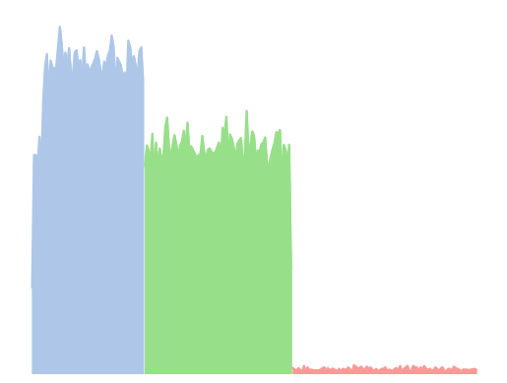
Definition of PRICE RANGES by
Price Distribution of 50,000 Products
$1
$7
$15
$25
$1
$7
$15
$25
LOW PRICE
MID PRICE
HIGH PRICE

Slide 2
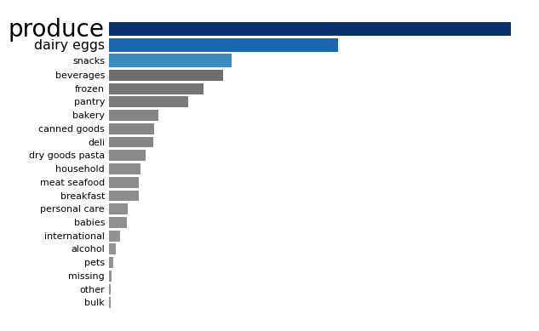
Departments with Highest Item Sales
9.5 Million products sold
5.4 Million
2.9 Million

Slide 3
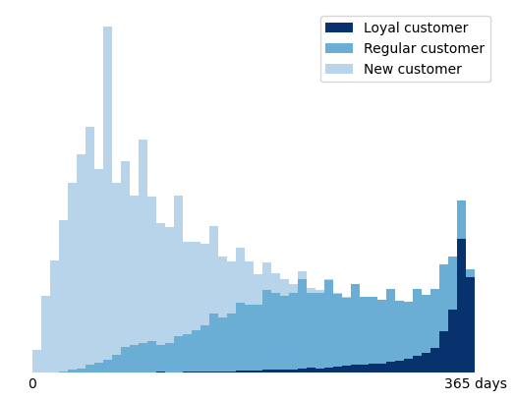
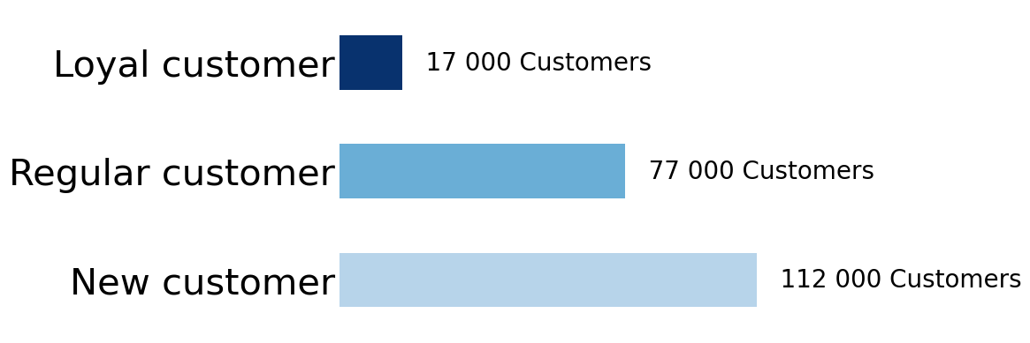
Maximum
CUSTOMER LOYALTY
spans 1 year
17K Loyal
Customers
(40+ orders)
77K Regular
Customers
(up to 40 orders)
112K New
Customers
(up to 10 orders)

Slide 4
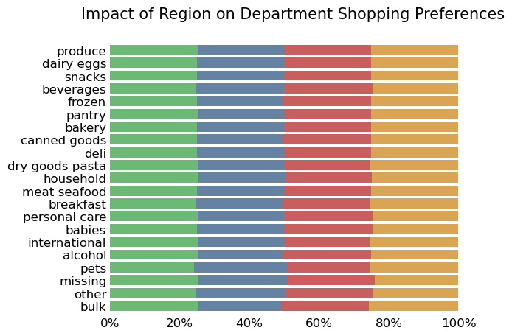
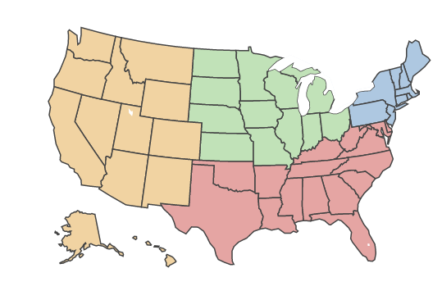
West
Midwest
Northeast
South

