Slide 1
Mongo DB and Python
Introduction. Essentials and Concepts.
Valentin Mihai
Iulie 2020

Slide 2
Agenda
NoSQL – aspecte generale, diferente SQL
MongoDB. Notiuni teoretice.
MongoDB. Creare, operare local DB. Exemple.
Mongo DB in Pycharm. Exemple.
Mongo DB in Pycharm si ISStar.
Tools:
  Mongo DB – Robo3T
  Convertor sintaxa MySQL->MongoDB
Bibliografie

Slide 3
NoSQL
Diferente MySQL
NoSQL: No SQL sau Not Only SQL – generatie/categorie noua de DB in care datele nu sunt stocate sub forma clasica RDBMS (Relational Data base Management System): table, column,schema vs. document.
Sistemele RDBMS au un design care permite crearea de relatii intre tabele diferite din aceeasi DB, in functie de anumiti parametri comuni. Pentru sistemele NoSQL nu se utilizeaza acest concept.
Bazele de date de tip NoSQL folosesc modele de date mai flexibile de cat SQL, fiind caracterizate de o scalabilitate mai mare si o viteza de raspuns mult mai mare.
Una din principalele diferente de concept intre SQL si NoSQL: principiul scalabilitatii verticale sau orizontale:
  MySQL – scalabilitate verticala: cresterea in dimensiune/capacitate/viteza prin adaugarea de resurse (RAM, CPU) masinilor deja existente;
  Pretul achizitiei acestora poate deveni ridicat, HW mai performant = Costuri crescute.
  NoSQL – scalabilitate orizontala: cresterea in dimensiune/capacitate/viteza prin adaugarea de resurse in plan orizontal – cresterea numarului de noduri intr –un pool de resurse HW. Acestea de multe ori sunt echipamente mai ieftin de achizionat. Costuri reduse.
Aplicatiile de tip BigData se axeaza pe sisteme NoSQL, datorita volumului urias de date a caror procesare, stocare, manipulare devin extrem de dificile in SQL.

Slide 4
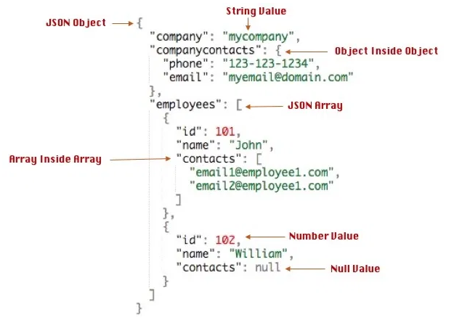
MongoDB. Introducere
Notiuni teoretice
RDBMS (MySQL) | MongoDB
Database | Database
Table | Collection
Entry/Tuple/Row | Document
Column | Field
MongoDB este o tehnologie DB de tip NoSQL, folosita in multe tipuri de aplicatii, inclusiv BigData. Exemple https://www.mongodb.com/who-uses-mongodb
Notiuni fundamentale in MongoDB: colectie, document. Pastrand simetria fata de RDBMS, o colectie este corespondenta unei tabele, iar un document este corespondentul unui entry/obiect/rand in tabela.
Un DB de tip MongoDB poate contine colectii multiple, neexistand necesitatea de a pastra caracteristici de tip ‘schema’ (RDBMS) intre ele, adica o structura similara.
O colectie contine unul sau mai multe documente. Documentul este un set de perechi de tip <key:value> a carui structura va fi mereu cea de tip .json (JavaScript Object Notation).
Documentele din aceeasi colectie au o libertate a structurii foarte mare, ele respectand asa numita ‘dynamic schema’.
Nu este necesar sa aiba aceleasi ‘keys’ adica Fields/Campuri. De exemplu un camp pentru key name ul poate fi acelasi in documente diferite, poate fi usor asociat cu un tip de ‘value’ diferit.
Se observa asemanarea cu structura de date de tip dictionary.
Exemplu document in format .json

Slide 5
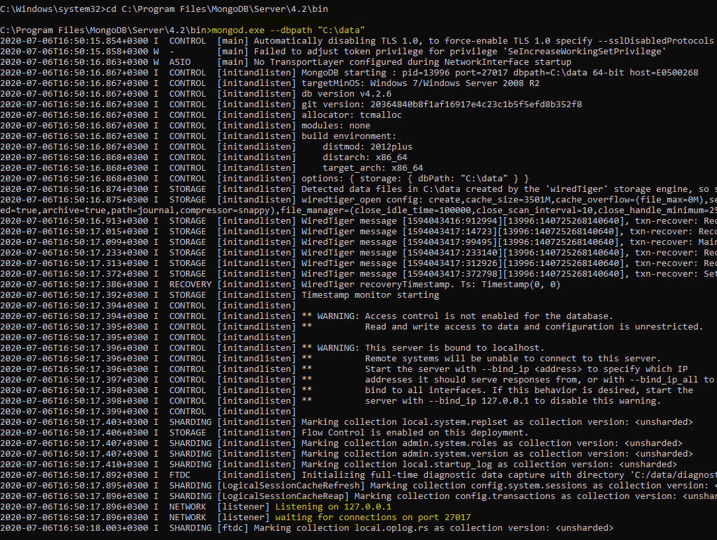
MongoDB. Introducere
Instalare MongoDB
Step1 . Download MongoDB Community Server versiunea 4.2
https://www.mongodb.com/try/download/community
MongoDB se va instala in urmatorul path:
C:\Program Files\MongoDB\Server\4.2\bin
Step2. Configurare environment pe PC local
Creare director in C: ‘\data\db’ cu rolul de a pastra fisierele de system necesare
b. Maparea dbpath ului cu folderul local creat
-dupa executia in cmd se poate vedea ca procesul mongod.exe se executa,iar statusul este cel de asteptare a conexiunilor active
C:\>md data
C:\md data\db
C:\Users\XYZ>cd C:\Program Files\MongoDB\Server\4.2\bin
C:\Program Files\MongoDB\Server\4.2\bin>mongod.exe --dbpath "C:\data"

Slide 6
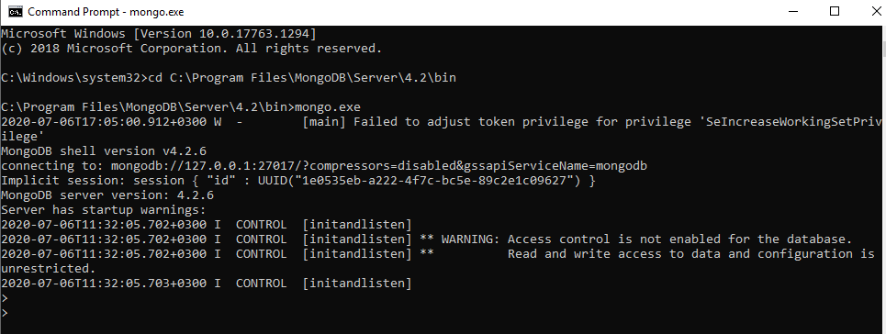
MongoDB. Introducere
Conectare la procesul MongoDB
Dupa ce s-a realizat instalarea Mongo, pentru a deschide ulterior conexiunea avem nevoie doar de rularea urmatoarelor comenzi
>cd C:\Program Files\MongoDB\Server\4.2\bin
C:\Program Files\MongoDB\Server\4.2\bin>mongo.exe
In acest moment avem control in linia de comanda a MongoDB.
Sintaxa de baza a majoritatii comenzilor utilizate respecta urmatorul format:
>db.function_name()
  >db.serverStatus()
  >db.help(), >db.stats()
>db.collection_name.function_name1()
  >db.collection_name.insert({})
>db.collection_name.function_name1().function_name2()
  >db.collection_name.find({},{}).pretty()
IMPORTANT: este disponibil auto-complete, in scrierea sintaxei!

Slide 7
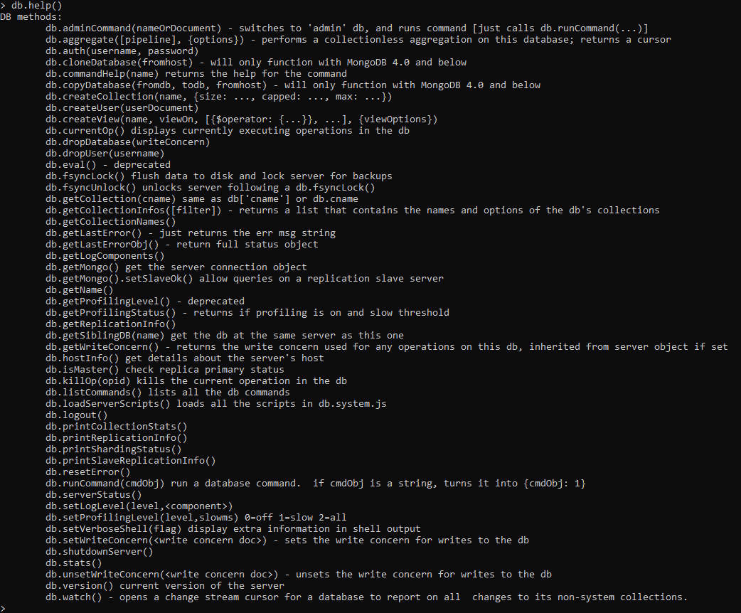
MongoDB
Comenzi initiale –exemplu functia help()

Slide 8
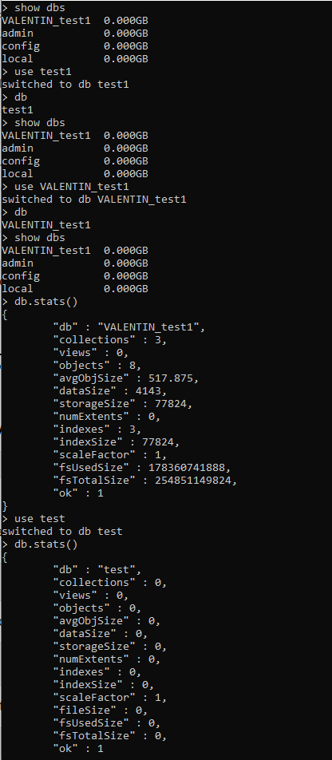
MongoDB
Comenzi initiale
Crearea unei DB in Mongo.
Crearea sau simpla initiere a unei baze de bate in mongo se face prin comanda
>use database_name
Daca baza de date nu exista, se va crea automat o baza de date cu acest nume.
Pentru verificarea unei eventuale liste de DB uri deja create
>show dbs
Pentru a lista DB ul pe care suntem conectati
>db
In exemplul alaturat se poate urmari crearea unei baze de date ‘test1’
Baza de date ‘VALENTIN_test1’ este creata anterior acestui pas si contine un numar de 3 colectii.
Baza de date ‘test1’ care tocmai a fost create nu contine nicio colectie momentan, fiind goala.
Se poate observa prin executarea unei comenzi de tip >db ca practic baza de date ‘test1’ nu este vizibila, atat timp cat ea nu contine nicio colectie.
Pentru a salva practic baza de date test1, este necesara inserarea macar a unei colectii.
>Continuare in slide urmator.

Slide 9
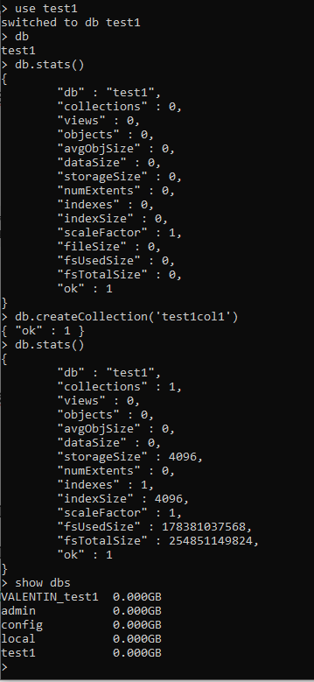
MongoDB
Crearea unei colectii intr-un DB existent
Pentru a introduce o colectie intr-un DB existent (parametrul options este optional)
Am creat in DB ‘test1’ colectia ‘test1col1’, am primit raspunsul {“ok”:1}
Daca executam db.stats() putem vedea ca numarul de colectii a crescut de la 0 la1
>show dbs , de aceasta data ne indica existenta ‘test1’ in lista de db uri
In acest moment practic, am creat o colectie goala, care nu contine niciun document.
Urmatorul pas: inserarea unui prim document in colectia creata.
Odata ce suntem conectati la DB ul corect, si cunoastem colectia in care dorim sa introducem date, putem sa folosim ca exemplu basic inserarea continutului unui fisier in format json.
>db.collection_name.insert({"name":"John", "age":31, "city":"New York"})
>db.createCollection(name, options)

Slide 10
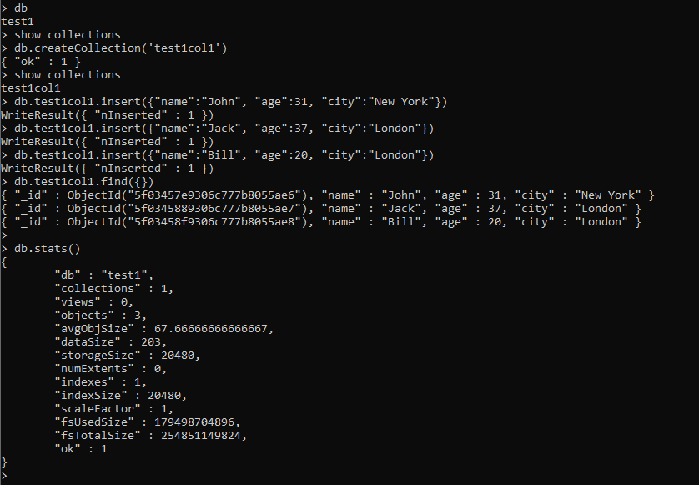
MongoDB
Crearea unei colectii intr-un DB existent
Inserarea documentelor in colectii
Putem observa ca am introdus in DB ul ‘test1’, in colectia ‘test1col1’, 3 documente in format json folosind functia insert()
Un Query in aceasta tabela care returneaza toate elementele/documentele inserate se poate face folosinf functia find(), aplicata colectiei.
Este important de retinut ca orice document in orice colectie, o data creat sau introdus va primi un ID unic, dat de functia
ObjectId(“…….”)
Aceasta functie este folosita in bazele de date pentru a crea un identificator pe 12 bytes aproape unic, caracterizat astfel
  Primii 4 bytes – valoarea timestamp (momentul cand ObjectID ul as fost creat, masurat in secunde since Unix Epoch time)
  5 bytes – random value
  3 bytes – un contor care se incrementeaza mereu, initialiat random
ObjectID ul trebuie sa ofere unicitate documentului inserat, acesta pastrand astfel o referinta in baza de date.
Pentru mai multe info:
https://docs.mongodb.com/manual/reference/method/ObjectId/
Notes:
> db
test1
> show collections
> db.createCollection('test1col1')
{ "ok" : 1 }
> show collections
test1col1
> db.test1col1.insert({"name":"John", "age":31, "city":"New York"})
WriteResult({ "nInserted" : 1 })
> db.test1col1.insert({"name":"Jack", "age":37, "city":"London"})
WriteResult({ "nInserted" : 1 })
> db.test1col1.insert({"name":"Bill", "age":20, "city":"London"})
WriteResult({ "nInserted" : 1 })
> db.test1col1.find({})
{ "_id" : ObjectId("5f03457e9306c777b8055ae6"), "name" : "John", "age" : 31, "city" : "New York" }
{ "_id" : ObjectId("5f0345889306c777b8055ae7"), "name" : "Jack", "age" : 37, "city" : "London" }
{ "_id" : ObjectId("5f03458f9306c777b8055ae8"), "name" : "Bill", "age" : 20, "city" : "London" }
>
> db.stats()
{
"db" : "test1",
"collections" : 1,
"views" : 0,
"objects" : 3,
"avgObjSize" : 67.66666666666667,
"dataSize" : 203,
"storageSize" : 20480,
"numExtents" : 0,
"indexes" : 1,
"indexSize" : 20480,
"scaleFactor" : 1,
"fsUsedSize" : 179498704896,
"fsTotalSize" : 254851149824,
"ok" : 1
}
>

Slide 11
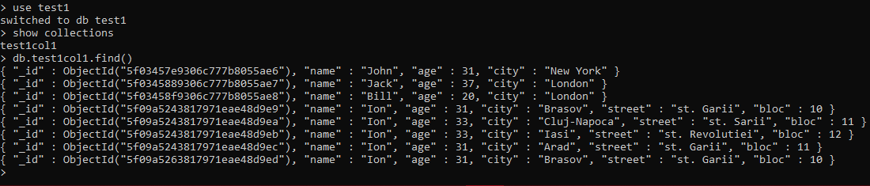
MongoDB
Query –uri
Putem observa ca in aceeasi colectie putem avea documente cu un numar diferit de campuri (fields)
Prin comparatie, in MySQL o tabela va avea un numar fix de coloane. Pentru fiecare row, va exista o valoare coresponzatoare fiecarei coloane, inclusiv valoarea Null.
In MySQL pentru a putea face un Query (SELECT) asupra unor obiecte din 2 sau mai multe tabele diferite, care au ca punct comun una sau mai multe coloane este necesara o sintaxa mai complicata – folosirea operatorului (JOIN) https://www.w3schools.com/sql/sql_join.asp
In exemplul de mai jos, in aceeasi colectie ‘test1col1’ avem acces la documente de dimensiuni diferite care au campuri comune, dar anumite campuri lipsesc din unele documente:

Slide 12
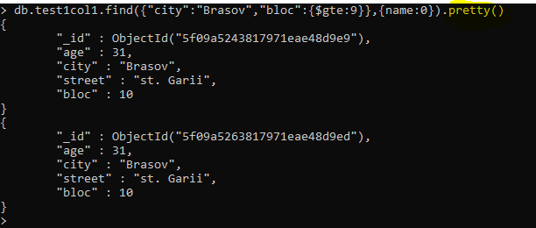
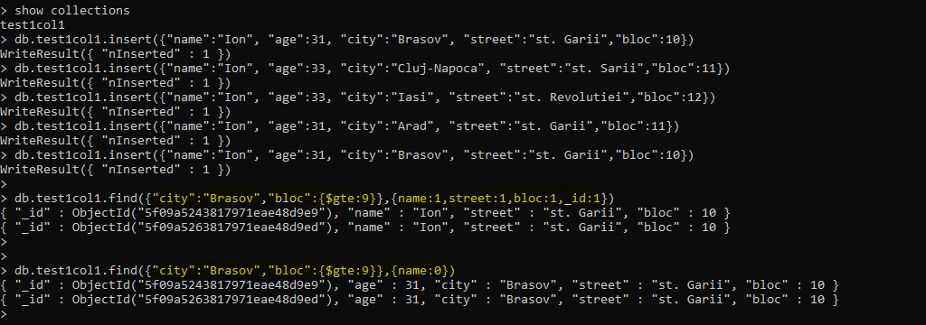
MongoDB
Query –uri folosind conditii
Corespondenta cu MySQL:
SELECT column1, column2,.. FROM table1 WHERE condition1.. condition_n
db.collection_name.find({field1:value1,field2:value2,…},{field1:1,field2:1,field3:1..})
db.collection_name.find({field1:value1,field2:value2,…},{field1:0,field2:0})
db.collection_name.find({field1:value1,field2:value2,…},{field1:0,field2:0}).pretty()
Notes:
> show collections
test1col1
> db.test1col1.insert({"name":"Ion", "age":31, "city":"Brasov", "street":"st. Garii","bloc":10})
WriteResult({ "nInserted" : 1 })
> db.test1col1.insert({"name":"Ion", "age":33, "city":"Cluj-Napoca", "street":"st. Sarii","bloc":11})
WriteResult({ "nInserted" : 1 })
> db.test1col1.insert({"name":"Ion", "age":33, "city":"Iasi", "street":"st. Revolutiei","bloc":12})
WriteResult({ "nInserted" : 1 })
> db.test1col1.insert({"name":"Ion", "age":31, "city":"Arad", "street":"st. Garii","bloc":11})
WriteResult({ "nInserted" : 1 })
> db.test1col1.insert({"name":"Ion", "age":31, "city":"Brasov", "street":"st. Garii","bloc":10})
WriteResult({ "nInserted" : 1 })
>
> db.test1col1.find({"city":"Brasov","bloc":{$gte:9}},{name:1,street:1,bloc:1,_id:1})
{ "_id" : ObjectId("5f09a5243817971eae48d9e9"), "name" : "Ion", "street" : "st. Garii", "bloc" : 10 }
{ "_id" : ObjectId("5f09a5263817971eae48d9ed"), "name" : "Ion", "street" : "st. Garii", "bloc" : 10 }
>
>
> db.test1col1.find({"city":"Brasov","bloc":{$gte:9}},{name:0})
{ "_id" : ObjectId("5f09a5243817971eae48d9e9"), "age" : 31, "city" : "Brasov", "street" : "st. Garii", "bloc" : 10 }
{ "_id" : ObjectId("5f09a5263817971eae48d9ed"), "age" : 31, "city" : "Brasov", "street" : "st. Garii", "bloc" : 10 }
>
> db.test1col1.find({"city":"Brasov","bloc":{$gte:9}},{name:0}).pretty()
{
"_id" : ObjectId("5f09a5243817971eae48d9e9"),
"age" : 31,
"city" : "Brasov",
"street" : "st. Garii",
"bloc" : 10
}
{
"_id" : ObjectId("5f09a5263817971eae48d9ed"),
"age" : 31,
"city" : "Brasov",
"street" : "st. Garii",
"bloc" : 10
}
>

Slide 13
MongoDB
Query –uri folosind conditii
Corespondenta cu RDBMS (Relational DataBase Management System –ex. MySQL)
Operation | Syntax | Example | RDBMS Equivalent
Equality | {<key>:{$eg:<value>}} | db.mycol.find({"by":"tutorials point"}).pretty() | where by = 'tutorials point'
Less Than | {<key>:{$lt:<value>}} | db.mycol.find({"likes":{$lt:50}}).pretty() | where likes < 50
Less Than Equals | {<key>:{$lte:<value>}} | db.mycol.find({"likes":{$lte:50}}).pretty() | where likes <= 50
Greater Than | {<key>:{$gt:<value>}} | db.mycol.find({"likes":{$gt:50}}).pretty() | where likes > 50
Greater Than Equals | {<key>:{$gte:<value>}} | db.mycol.find({"likes":{$gte:50}}).pretty() | where likes >= 50
Not Equals | {<key>:{$ne:<value>}} | db.mycol.find({"likes":{$ne:50}}).pretty() | where likes != 50
Values in an array | {<key>:{$in:[<value1>, <value2>,……<valueN>]}} | db.mycol.find({"name":{$in:["Raj", "Ram", "Raghu"]}}).pretty() | Where name matches any of the value in :["Raj", "Ram", "Raghu"]
Values not in an array | {<key>:{$nin:<value>}} | db.mycol.find({"name":{$nin:["Ramu", "Raghav"]}}).pretty() | Where name values is not in the array :["Ramu", "Raghav"] or, doesn’t exist at all
https://www.tutorialspoint.com/mongodb/mongodb_query_document.htm

Slide 14
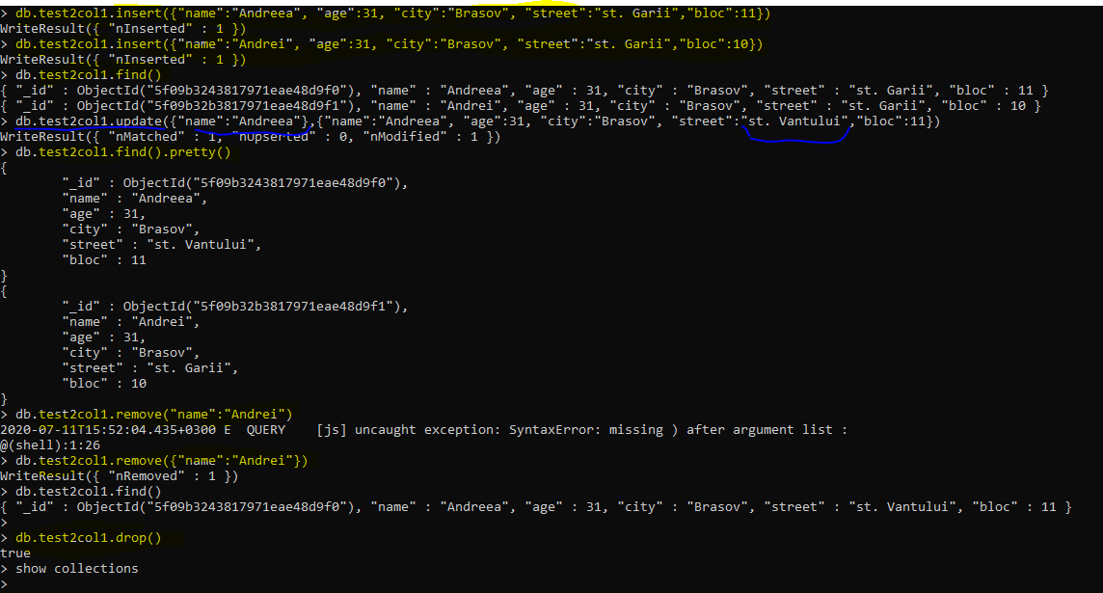
MongoDB
Update Document
Delete Document
Delete Collection
Drop DB
>db.COLLECTION_NAME.update(SELECTION_CRITERIA, UPDATED_DATA)
>db.COLLECTION_NAME.remove(DELLETION_CRITERIA)
>db.COLLECTION_NAME.drop()
>db.dropDatabase()
Notes:
> db.test2col1.insert({"name":"Andreea", "age":31, "city":"Brasov", "street":"st. Garii","bloc":11})
WriteResult({ "nInserted" : 1 })
> db.test2col1.insert({"name":"Andrei", "age":31, "city":"Brasov", "street":"st. Garii","bloc":10})
WriteResult({ "nInserted" : 1 })
> db.test2col1.find()
{ "_id" : ObjectId("5f09b3243817971eae48d9f0"), "name" : "Andreea", "age" : 31, "city" : "Brasov", "street" : "st. Garii", "bloc" : 11 }
{ "_id" : ObjectId("5f09b32b3817971eae48d9f1"), "name" : "Andrei", "age" : 31, "city" : "Brasov", "street" : "st. Garii", "bloc" : 10 }
> db.test2col1.update({"name":"Andreea"},{"name":"Andreea", "age":31, "city":"Brasov", "street":"st. Vantului","bloc":11})
WriteResult({ "nMatched" : 1, "nUpserted" : 0, "nModified" : 1 })
> db.test2col1.find().pretty()
{
"_id" : ObjectId("5f09b3243817971eae48d9f0"),
"name" : "Andreea",
"age" : 31,
"city" : "Brasov",
"street" : "st. Vantului",
"bloc" : 11
}
{
"_id" : ObjectId("5f09b32b3817971eae48d9f1"),
"name" : "Andrei",
"age" : 31,
"city" : "Brasov",
"street" : "st. Garii",
"bloc" : 10
}
> db.test2col1.remove("name":"Andrei")
2020-07-11T15:52:04.435+0300 E QUERY [js] uncaught exception: SyntaxError: missing ) after argument list :
@(shell):1:26
> db.test2col1.remove({"name":"Andrei"})
WriteResult({ "nRemoved" : 1 })
> db.test2col1.find()
{ "_id" : ObjectId("5f09b3243817971eae48d9f0"), "name" : "Andreea", "age" : 31, "city" : "Brasov", "street" : "st. Vantului", "bloc" : 11 }
>
> db.test2col1.drop()
true
> show collections
>

Slide 15
Mongo DB in Pycharm
Conectare si creare DB
import pymongo
my_dict1_PHBMAP={'BE':'0','AF11':'10','AF12':'12', 'AF13':'14',\
'AF21':'18', 'AF22':'20', 'AF23':'22','AF31':'26',\
'AF32':'28','AF33':'30', 'AF41':'34', 'AF42':'40', 'AF43':'46',\
'EF':'48','CS1':'8', 'CS2':'16', 'CS3':'24', 'CS4':'32','CS5':'41', 'CS6':'49', 'CS7':'56'}
#connect to local Mongo Client
myclient = pymongo.MongoClient("mongodb://localhost:27017/")
# create mongo data base "RAN1"
mydb = myclient["RAN1"]
mycollection1=mydb["RAN1_collection1"]
#insert one document
#mycollection1.insert_one(my_dict1_PHBMAP)
print(myclient.list_database_names())
# mycollection1.drop()
Este necesara instalarea unui Mongo driver pentru Python. Vom instala in Pycharm driverul pymongo, care trebuie apoi importat.
In exemplul urmator putem vedea :
  cum se face conectarea catre serverul Mongo ( in cazul nostru clientul instalat local)
  Crearea DB, crearea unei colectii.
  Insert in DB, Query in DB
(Cazul 1) – se creaza DB ‘RAN1’, se creaza prima colectie ‘RAN1_collection1’ dar cand listam DB urile deja existente se vede lipsa DB ului ‘RAN1’
(Cazul2) - atat crearea DB ului cat si crearea unei colectii sunt dependente de introducerea unui document – decomentarea liniei
#mycollection1.insert_one(my_dict1_PHBMAP)
La fiecare executie a programului se va introduce un nou document cu continutul dictionarului my_dict1_PHBMAP
C:\1_valentin\py\venv\Scripts\python.exe "C:/1_valentin/py/PYTHON PROJECTS/python/Mongo_project_1/mongo_db_python_0.py"
['VALENTIN_test1', 'admin', 'config', 'local', 'test1']
Process finished with exit code 0
C:\1_valentin\py\venv\Scripts\python.exe "C:/1_valentin/py/PYTHON PROJECTS/python/Mongo_project_1/mongo_db_python_0.py"
['RAN1', 'VALENTIN_test1', 'admin', 'config', 'local', 'test1']
Process finished with exit code 0

Slide 16
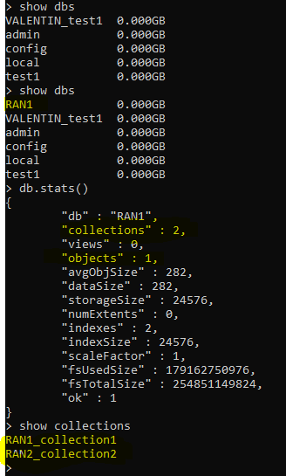
Mongo DB in Pycharm
Conectare si creare DB
import pymongo
my_dict1_PHBMAP={'BE':'0','AF11':'10','AF12':'12', 'AF13':'14',\
'AF21':'18', 'AF22':'20', 'AF23':'22','AF31':'26',\
'AF32':'28','AF33':'30', 'AF41':'34', 'AF42':'40', 'AF43':'46',\
'EF':'48','CS1':'8', 'CS2':'16', 'CS3':'24', 'CS4':'32','CS5':'41', 'CS6':'49', 'CS7':'56'}
#connect to local Mongo Client
myclient = pymongo.MongoClient("mongodb://localhost:27017/")
# create mongo data base "RAN1"
mydb = myclient["RAN1"]
mycollection1=mydb["RAN1_collection1"]
mycollection1.insert_one(my_dict1_PHBMAP)
print(myclient.list_database_names())
mycollection2=mydb.create_collection("RAN2_collection2")
print(mydb.list_collection_names())
# mycollection1.drop()
# mycollection2.drop()
Verificare lista DB in CMD, dupa executarea codului py
In acelasi exemplu – crearea a doua colectii in DB ‘RAN1’ prin metode diferite:
mycollection1=mydb["RAN1_collection1"]
//initializarea si apelarea "RAN1_collection1“ ori de cate ori este nevoie
mycollection2=mydb.create_collection("RAN2_collection2")
//folosirea metodei .create_collection() - permite crearea colectiei, dar la repetarea executiei –error!
C:\1_valentin\py\venv\Scripts\python.exe "C:/1_valentin/py/PYTHON PROJECTS/python/Mongo_project_1/mongo_db_python_0.py"
['RAN1', 'VALENTIN_test1', 'admin', 'config', 'local', 'test1']
['RAN1_collection1', 'RAN2_collection2']
Process finished with exit code 0
1st
2nd
Cmd line:
Se observa 2 colectii create, dar un singur document/object in DB ‘RAN1’ – obiect creat prin mycollection1.insert_one(my_dict1_PHBMAP)
mycollection2=mydb.create_collection("RAN2_collection2")
File "C:\1_valentin\py\venv\lib\site-packages\pymongo\database.py", line 407, in create_collection
raise CollectionInvalid("collection %s already exists" % name)
pymongo.errors.CollectionInvalid: collection RAN2_collection2 already exists
Process finished with exit code 1

Slide 17
Mongo DB in Pycharm
Query folosind python
import pymongo, random
from random import shuffle
my_dict2_TRMMAP={'Common channel primary path':'EF','IMS SRB primary path':'AF42','SRB primary path':'EF',\
'AMR voice primary path':'AF43','R99 CS conversational primary path':'AF43',\
'R99 CS streaming primary path':'AF41','R99 PS conversational primary path':'AF43',\
'R99 PS streaming primary path':'AF41','R99 PS high PRI interactive primary path':'AF41',\
'R99 PS middle PRI interactive primary path':'AF31','R99 PS low PRI interactive primary path':'BE',\
'R99 PS background primary path':'BE','HSDPA Signal primary path':'EF','HSDPA IMS Signal primary path':'AF42',\
'HSDPA Voice primary path':'AF43','HSDPA conversational primary path':'AF43','HSDPA streaming primary path':'AF41',\
'HSDPA high PRI interactive primary path':'AF41','HSDPA middle PRI interactive primary path':'AF31',\
'HSDPA low PRI interactive primary path':'BE','HSDPA background primary path':'BE','HSUPA Signal primary path':'EF',\
'HSUPA IMS Signal primary path':'AF42','HSUPA Voice primary path':'AF43','HSUPA conversational primary path':'AF43',\
'HSUPA streaming primary path':'AF41','HSUPA high PRI interactive primary path':'AF41',\
'HSUPA middle PRI interactive primary path':'AF31','HSUPA low PRI interactive primary path':'BE',\
'HSUPA background primary path':'BE'}
R=random.randint(0,100) #generate random integer
i=0
while i<R:
keys=list(my_dict2_TRMMAP.keys())
values=list(my_dict2_TRMMAP.values())
shuffle(values)
my_dict2_TRMMAP_random=dict(zip(keys,values)) #create shuffled dictionary(mixed values)
#connect to local Mongo Client
myclient = pymongo.MongoClient("mongodb://localhost:27017/")
# create mongo data base "RAN100"
mydb = myclient["RAN100"]
mycollection1=mydb["RAN100_collection1"]
mycollection1.insert_one(my_dict2_TRMMAP_random)
for document in mycollection1.find(): #query in collection
print(document)
i=i+1
print(mycollection1.count_documents({}))
print(mycollection1.count_documents({'Common channel primary path': 'EF'}))
Se declara un dictionar care reda continutul unui managed object de tip TRMMAP: my_dict2_TRMMAP.
Folosind functia random.shuffle() se ‘mixeaza’ valorile, generandu-se mereu un dictionary nou cu valorile amestecate.
Se creaza DB ‘RAN100’ si colectia ‘RAN100_collection1’
Se foloseste metoda .insert_one() pentru a face insert in colectie cu continutul nou, la fiecare iteratie.
La final, se face un query pentru a vedea cate documente au fost introduce in total si se printeaza documentele avand conditia
'Common channel primary path': 'EF’

Slide 18
Mongo DB in Pycharm
Conversie .csv in .json
Import date csv in MongoDB. Update.
Creare/update DB cu datele din json: lista dictionare in format json
Librarii necesare: csv, json, pymongo
def create_DB_collection(dbName,collectionName,data_to_import):
myclient = pymongo.MongoClient("mongodb://localhost:27017/")
# create mongo data base
mydb = myclient[dbName]
print(myclient.list_database_names())
mycollection=mydb[collectionName]
print(mydb.list_collection_names())
i=0
while i<len(data_to_import):
mycollection.insert_one(data_to_import[i]) #insert_one() method to insert each object
del data_to_import[i]['_id']
i=i+1
return mydb,mycollection
def update_DB(myDB,mycol,myquery,mynewvalues):
newvalues = {"$set": mynewvalues}
mycol.update_many(myquery, newvalues) # update_many() method for updating all objects
#main
DATA=csv_to_json("Dresden - Copy.csv") #covert csv file to json format
(MYDB,MYCOL)=create_DB_collection("RAN2","RAN2_license_items",DATA) #import json to DB/collection
myquery_x={"Cab_type": "BTS3900 WCDMA"}
mynewvalues_x=
{"Cab_type": {"CAB1":"BTS3900","CAB2":"BTS3900","CAB3":"BTS3000","new_CAB":{"1":"Nokia","2":"Ericsson"}}}
update_DB(MYDB,MYCOL,myquery_x,mynewvalues_x)
Conversie csv to json
import csv,json,pymongo
def csv_to_json(csv_file_name): #convert csv to json
csvfile = open(csv_file_name,'r')
jsonfile = open('file.json', 'w')
fieldnames=("Site Name","Cab_type","UL CE","DL CE","Local Cell","HSDPA","HSDPA RRM","HS-PDSCH Code","MBMS","HSUPA") #csv column headers
reader = csv.DictReader( csvfile, fieldnames)
reader_list_format=[ row for row in reader ]
out = json.dumps( reader_list_format[1::] )
jsonfile.write(out)
jsonfile.close()
json1_file = open('file.json')
json1_str = json1_file.read()
json1_data = json.loads(json1_str)
return json1_data

Slide 19
Mongo DB in Pycharm si ISStar
Secventa automata RET Data Import
Exemplu de conexiune ‘Almost Zero Touch’ ☺
Scopul este de a importa intr-o baza de date de tip NoSQL MongoDB, datele din reteaua live : RET Device Number si RET Device Name pentru o lista data de statii 4G.
Vom folosi:
  Isstar: mongo_test.hsl3
  Isstar: transfer_to_email.hsl3
  Pycharm: outlook_export.py
  Pycharm: mongo_db_python_3_RET_import.py
Se va obtine o baza de date RET_DB, cuprinzand o colectie ‘RET_collection’ in care au fost importate datele in urma unei conversii csv->json

Slide 20
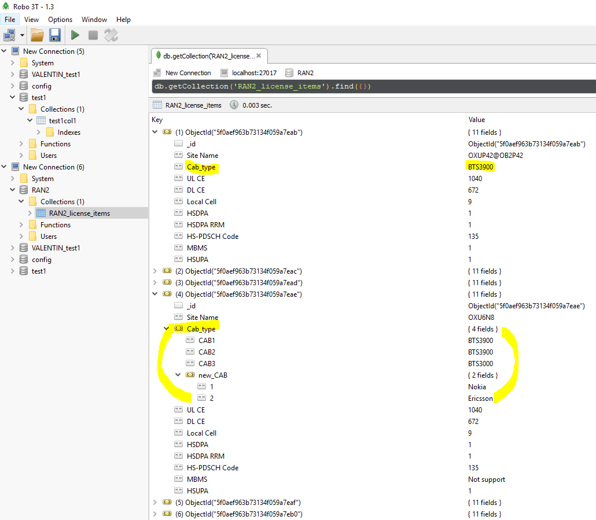
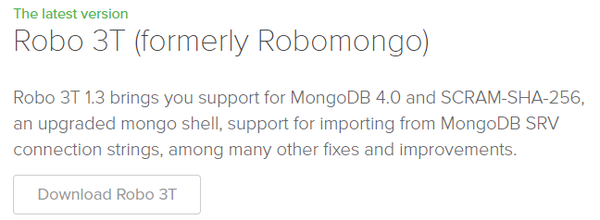
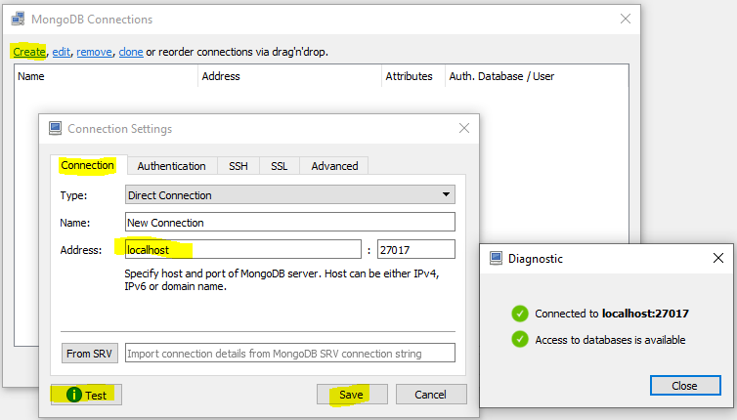
Tools: MongoDB GUI client
Robo3T 1.3.1
In urma executiei programului anterior, putem face query in Robo3T:
Pentru a opera orice baza de date NoSQL, avem nevoie de un tool de tip client/browser care sa ne permita accesul in DB prin GUI.
Robo3T - https://robomongo.org/download
Command line interface
Configurare DB din localhost

Slide 21
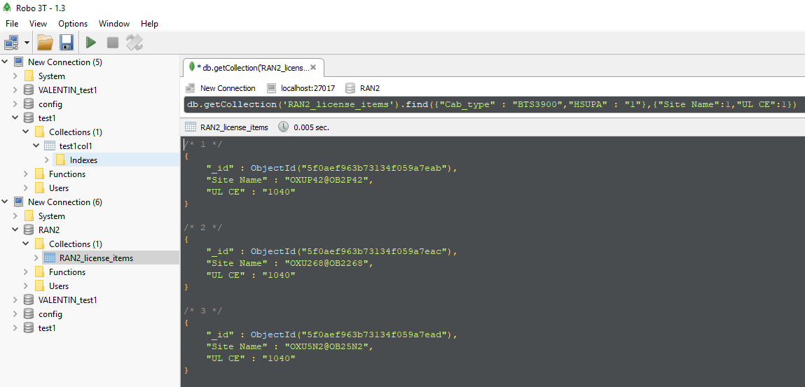
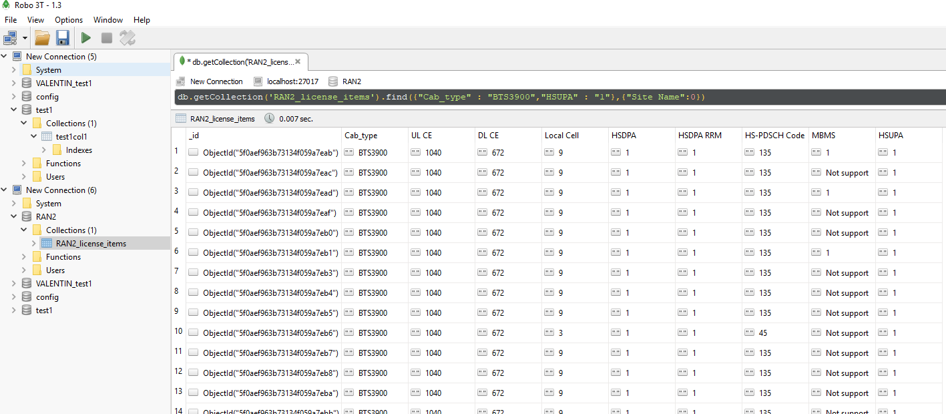
Tools: MongoDB GUI client
Robo3T 1.3.1
Query conditionat
Json format display
Table format display

Slide 22
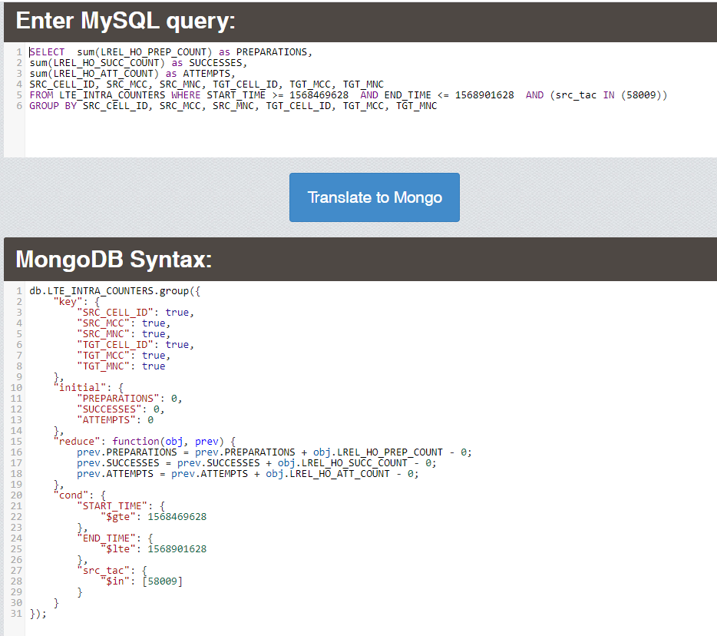
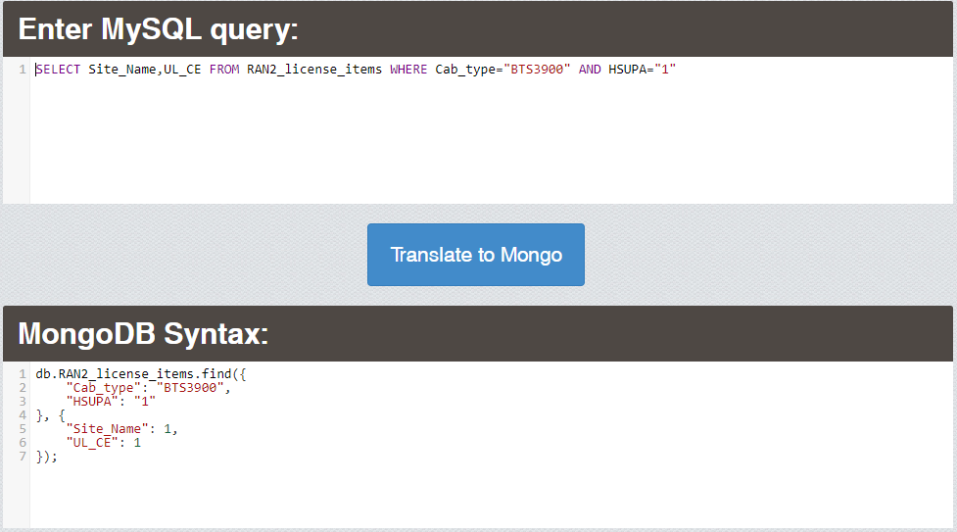
Tools: Convertor MySQL ->MongoDB
http://www.querymongo.com/
In cazul in care sintaxa MongoDB devine complexa, se poate recurge la analogia sintaxei din MySQL, folosind un convertor online.
Sintaxa obtinuta poate fi folosita in cod py, Robo3T, etc.

Slide 23
Bibliografie
https://docs.mongodb.com/manual/
https://www.w3schools.com/js/js_json_intro.asp
https://www.tutorialspoint.com/mongodb/mongodb_environment.htm
https://www.tutorialspoint.com/mongodb/mongodb_data_modeling.htm
https://www.w3schools.com/python/python_mongodb_getstarted.asp
http://www.querymongo.com/

Slide 24
Thank you!

