Slide 1
Multi-Resolution Image Store – A Case of Size-Tiered Storage Systems
Ming Chen (mchen@cs.stonybrook.edu)

Slide 2
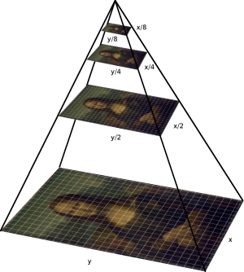
Introduction

Slide 3
Small Objects: Hot
What
Metadata, Thumbnails
How
Random: Searching, Indexing, Preview
Where
Top tiers: RAM, FLASH
Why
Throughput: op/sec
Inherent fit: Performance++;
Intuitive: peek before embark; size proportional

Slide 4
Large Objects: Not So Hot
What
Large Images, Multimedia, Logs, Backup
How
Sequential: Streaming, Scan, Mapping
Where
Bottom tiers: SATA, TAPE
Why
Throughput: mb/sec
Inherent fit: Capacity--; Cost--;
Slow seeks amortized by fast sequential I/Os

Slide 5
Implementation
Schema Based on KV Store
Log-structured Merge Tree
Compaction (Temporal Locality)
Multi-Tier Tablet Server Storage Layer (GTSSL)
Deal with opposite extremes

Slide 6
Contributions
Size-Tiered Property of Workloads
Metadata Management
Fast Prototyping of Specialized Storage Systems
Take Advantage of Standards (JPEG 2000)

Slide 7
Feasibility
Hardware
SSD, SAS, SATA drives
Servers
Software
Berkeley DB, Level DB, KVDB
GTSSL
Filebench
Intelligence
CSE602
FSL

Slide 8
Benchmark
Synthetic Workloads
Access Model Presented in Haystack
Filebench
Real Workloads
IIPImage deployments
TODO

Slide 9
References
GTSSL, An Efficient Multi-Tier Tablet Server Storage Architecture
Finding a needle in Haystack: Facebook's photo storage
IIPImage, http://iipimage.sourceforge.net/documentation/images/
A study of irregularities in file-size distribution
hFS: a hybrid file system prototype for improving small file and metadata performance
A Pseudo-Infinite Multimedia Storage System, http://www.fsl.cs.sunysb.edu/project-multimediafs.html
Unifying biological image formats with HDF5
In-Kernel Berkeley DB Databases and Transactional Storage, http://www.fsl.cs.sunysb.edu/project-kbdb.html

