Slide 1
Multi-Resolution Image Store
– A Case of Size-Tiered Storage Systems
Ming Chen (mchen@cs.stonybrook.edu)

Slide 2
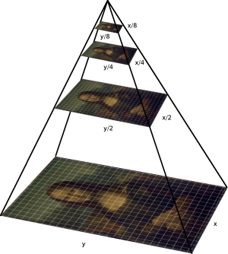
Introduction

Slide 3
Concerns
1. Use-cases that will be benefited?
Web server, e.g., Wikipedia
2. Which layers that will be involved?
Image Resolutions: thumbnail, large
Storage Layers: ram, SSD, HDD

Slide 4
User Case: Wikipedia

Slide 5
Storage Layers: SSD, HDD

Slide 6
Q&A
Thanks!

